Slide 1
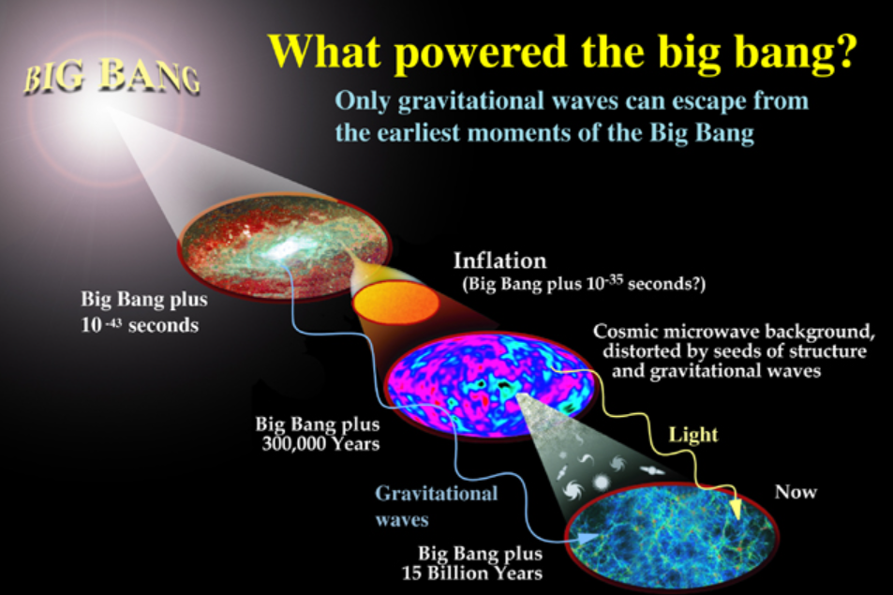
Primordial (Relic) Gravitational Waves (PGWs) and Cosmology
Wen Zhao
Department of Astronomy, University of Science and Technology of China

Slide 2
OUTLINE
History of the Universe: From Inflation to Acceleration
Primordial (Relic) Gravitational Wave: Generation and Evolution
Detection methods: Status and Future
Conclusions

Slide 3
OUTLINE
History of the Universe: From Inflation to Acceleration
Primordial (Relic) Gravitational Wave: Generation and Evolution
Detection methods: Status and Future
Conclusions

Slide 4
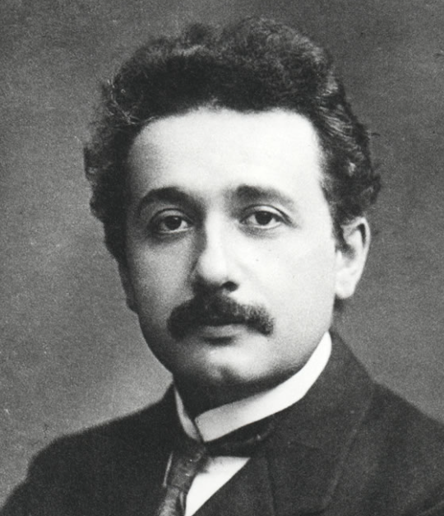

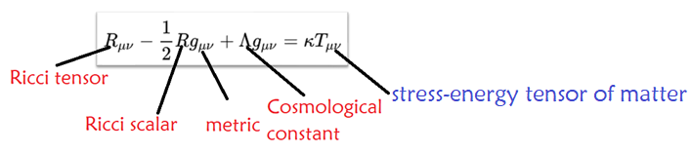
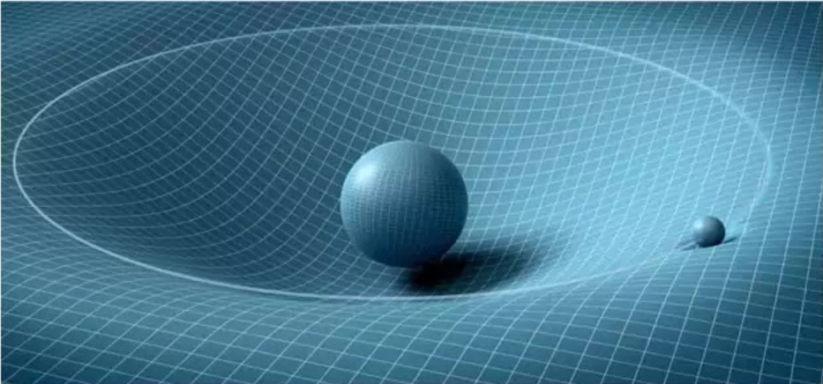
General Relativity
In 1915, Albert Einstein constructed the General Relativity (GR) to describe the gravitational phenomena.
Geodesic equation: spacetime tells matter how to move
Einstein equation: matter tells spacetime how to curve

Slide 5
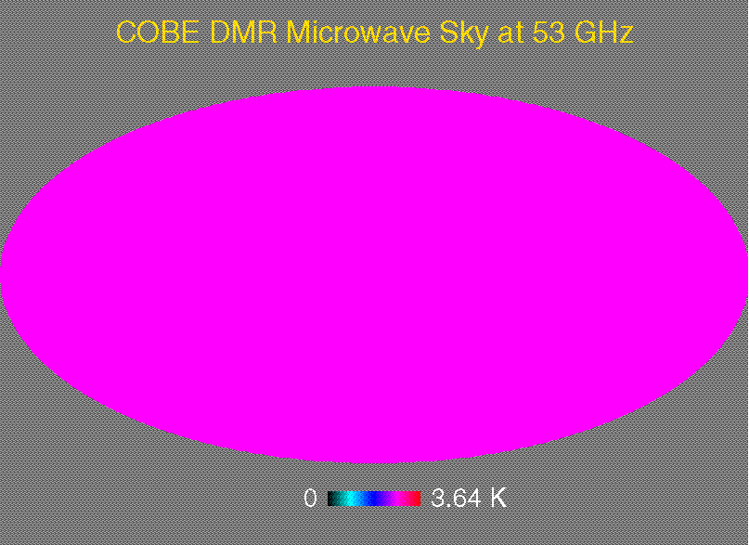
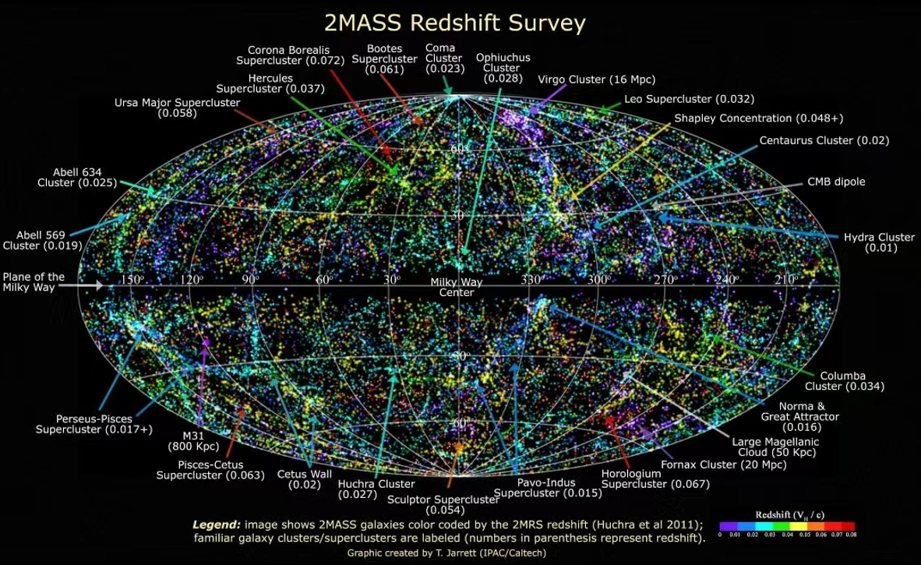
Cosmological Principle
The spatial distribution of matter in the universe is uniformly isotropic and homogeneous when viewed on a large enough scale.
It is proved by a number of observations, including the distributions of Cosmic Microwave Background (CMB), galaxies in large-scale structure (LSS) and so on.

Slide 6
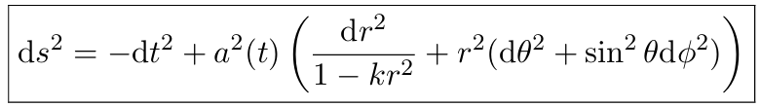
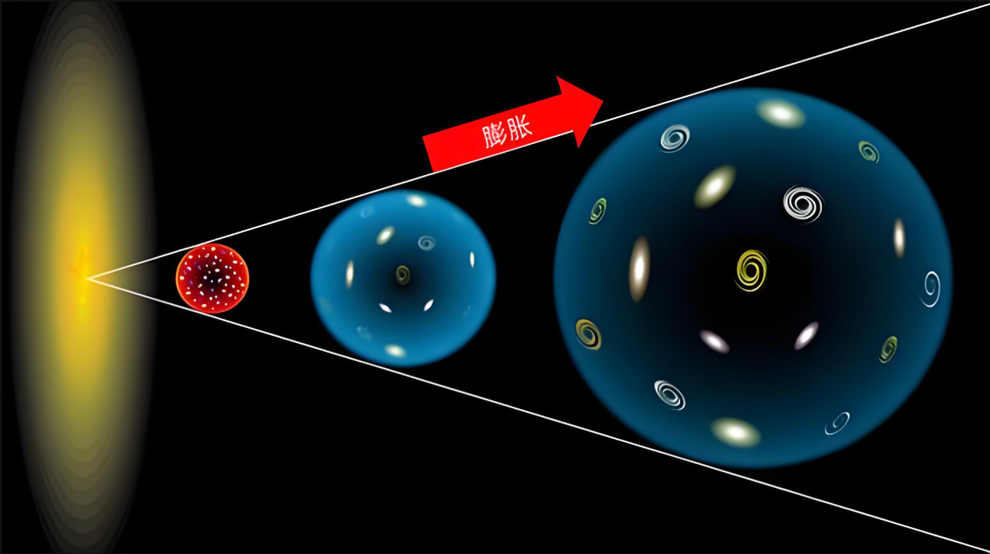
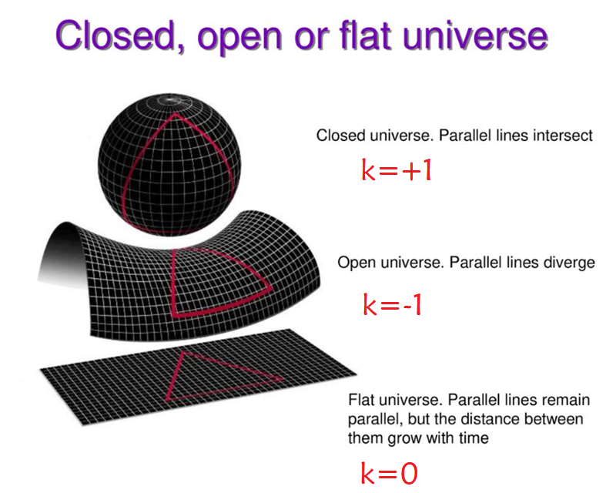
Friedmann–Lemaître–Robertson–Walker (FLRW) metric
The general form of the metric, which describes the a homogeneous and isotropic universe is the FLRW metric, given by:

Slide 7

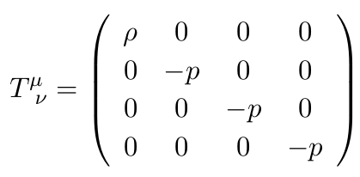
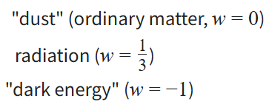
Matters in the Universe
The matter in Universe is always assumed as the Prefect Fluid: radiation (i.e. photon, neutrino, gravitational wave), dust or matter (i.e. baryon, dark matter, etc), dark energy, inflation field, etc.
In the frame that is comoving with the fluid, the energy-momentum of stress-energy tensor of the prefect fluid is given by:

Slide 8
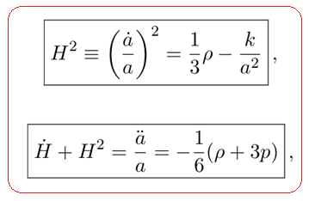
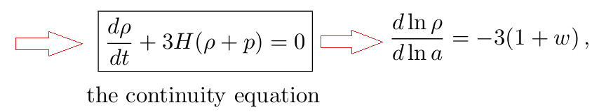
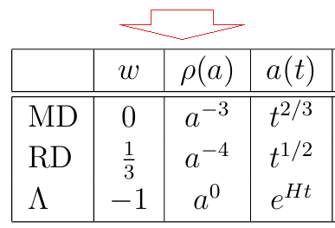
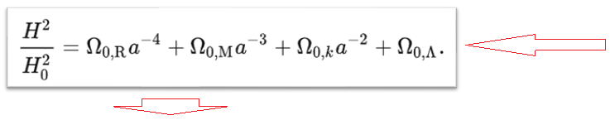
Friedmann Equations
With FLRW metric, Einstein field equation reduces to the Friedmann equations as:

Slide 9
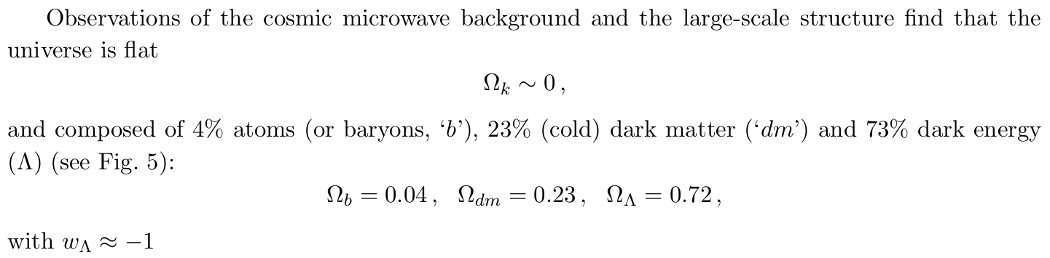
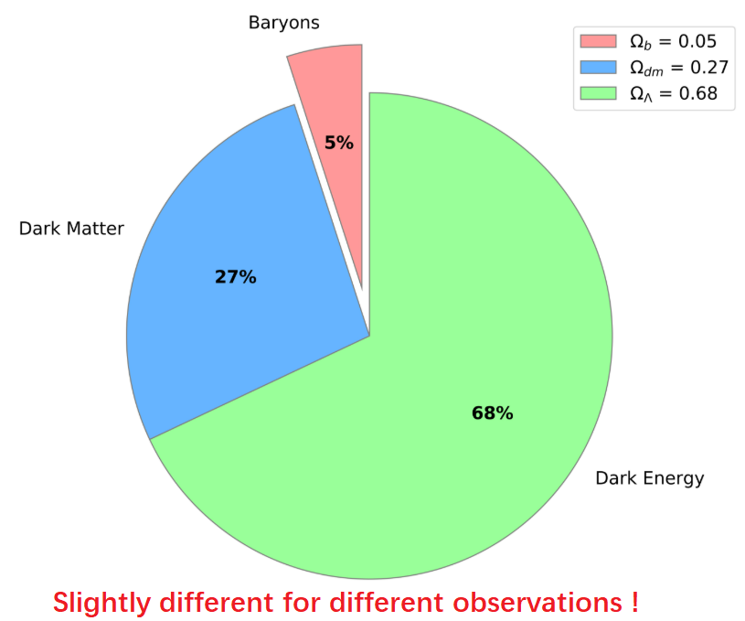
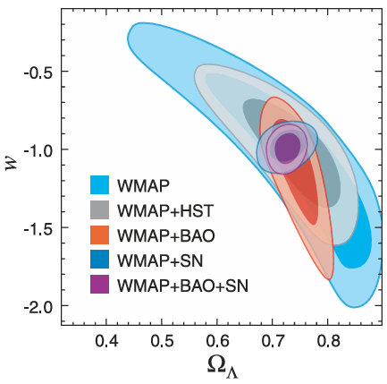
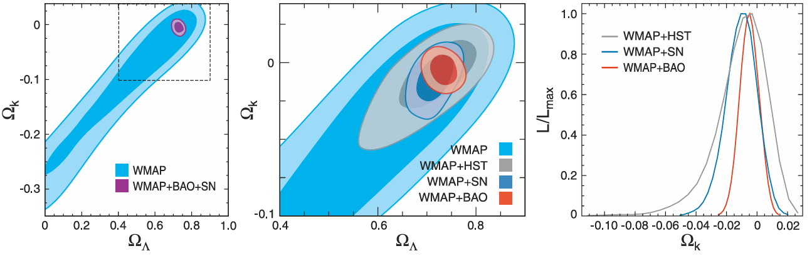
The Concordance Model

Slide 10
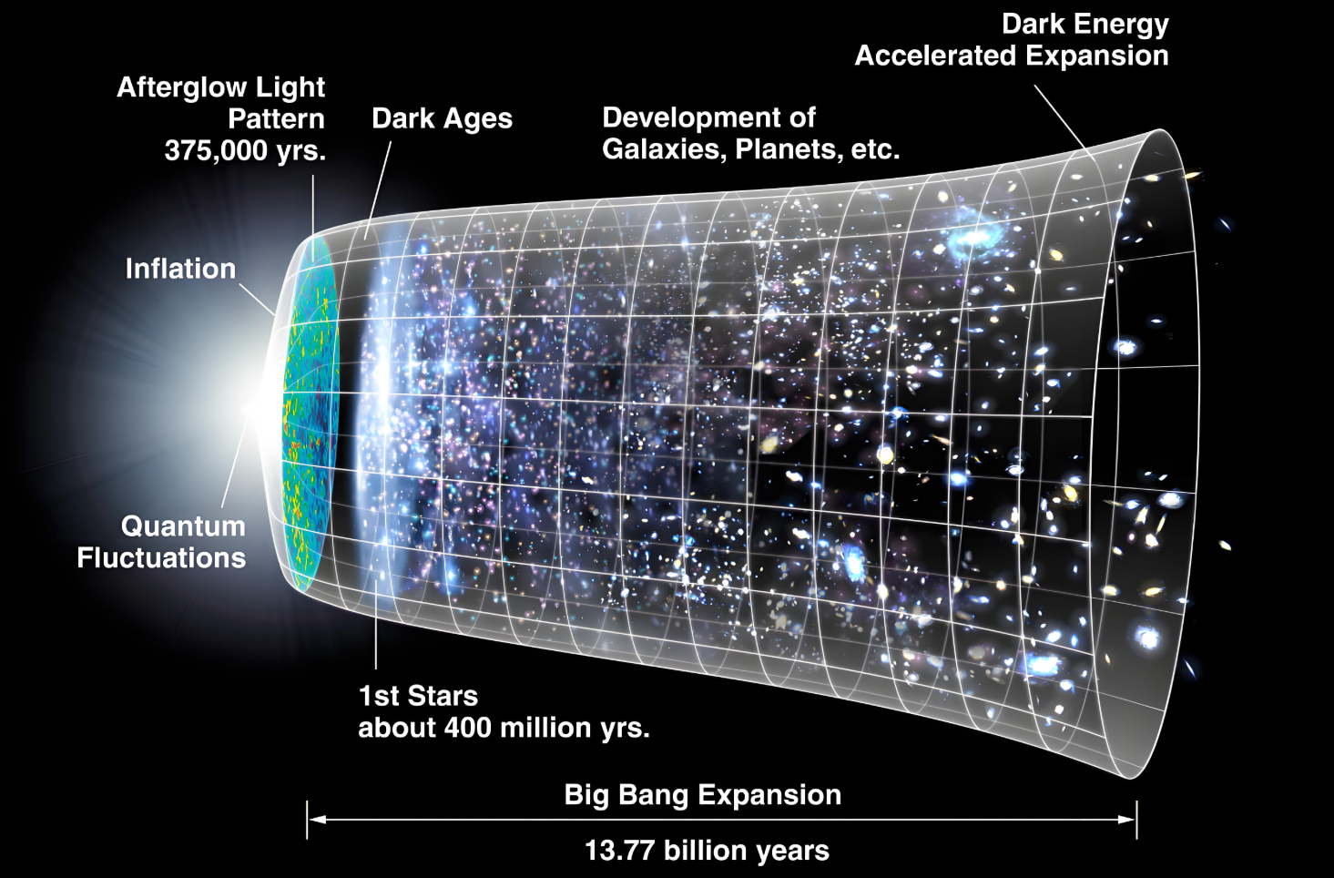

Slide 11
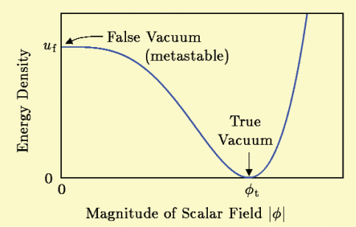
1. Mysterious inflation of very early Universe
Inflation tries to resolve several problems in traditional Big Bang cosmology, including: the magnetic-monopole problem, flatness problem, horizon problem and so on (details can be found in textbooks).
Cosmic inflation is the hypothesis that the very early universe expanded exponentially fast. Distances between points doubled every 10⁻³⁷ seconds; the expansion of the universe lasted at least 10⁻³⁵ seconds, i.e., the space scale expanded at least e⁻⁶⁰ times (e-folding number N>60) during inflation stage, but its full duration is not certain.
The underlying physics of inflation is not well understood. In the standard model, the dominant component is the so-called inflaton, a kind of scalar field, which is potential dominant during inflation stage.
Although there are numerous indirect evidences (flatness of the universe, nearly scale-invariant primordial scalar perturbations, Gaussianity of primordial perturbations and so on) support this scenario, the smoking-gun evidence, i.e. the PGWs, is not yet detected.
Cosmic inflation is an excellent bridge to link the high-energy physics (e.g. quantum gravity) and cosmology!

Slide 12
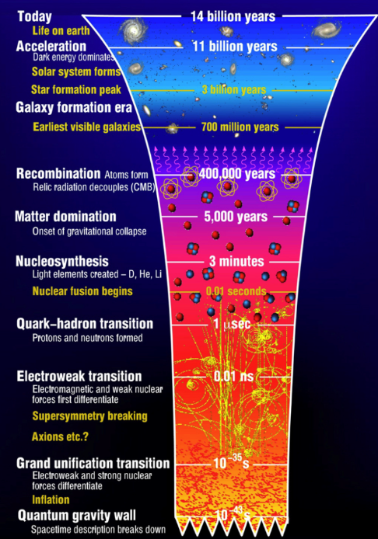
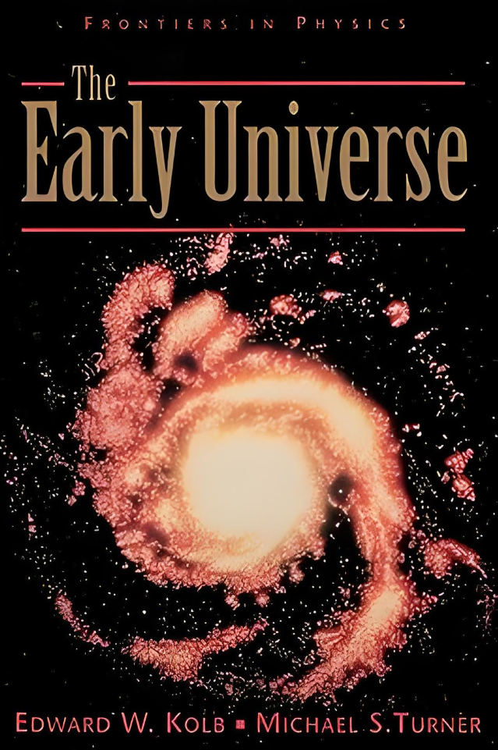

2. Fruitful physics in the early Universe

Slide 13
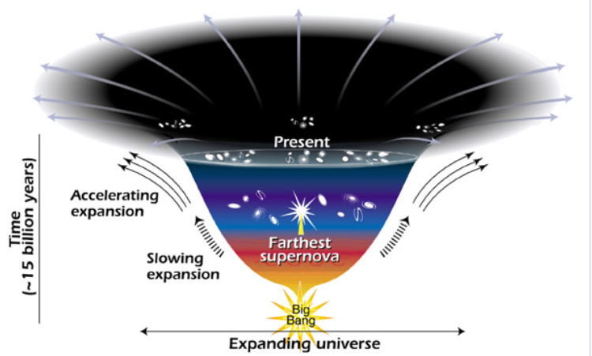
Cosmic acceleration and the fate of the Universe
In the classical model with normal matter dominant, the expansion of the universe should be decelerating, due to the attractive force of gravity.
However, all observations show that the expansion of the universe is accelerating (similar to inflation) at least in the recent stage, such that the velocity at which a distant galaxy recedes from the observer is continuously increasing with time.
In the frame of General Relativity, we need a kind of strange matter (dark energy) with EoS w~-1 to account for the observations.
There are three kinds of solutions:
(1) cosmological constant with effective w=-1;
(2) dark energy component with w~-1;
(3) modified gravitational theory, i.e. beyond GR.
The cosmic acceleration also leave imprints in PGWs.

Slide 14
OUTLINE
History of the Universe: From Inflation to Acceleration
Primordial (Relic) Gravitational Wave: Generation and Evolution
Detection methods: Status and Future
Conclusions

Slide 15
Generation of PGWs
15
In the curved space-time, the vacuum state at the stage 1 naturally corresponds to the multi-particle state at a different stage 2.
If considering the Universe, we can assume the universe had a vacuum state of graviton at the initial stage. With the expansion of the Universe, but the radiation-dominant stage, the gravitons were naturally generated. Therefore, the origin of PGW is a kind of primordial quantum fluctuation, and it naturally encoded the information of quantum gravity. (Grishchuk, 1974)
If the Universe had an exact de-Sitter expansion (exactly exponential expansion of scale factor a(t)) in the inflationary stage, the generated primordial power spectrum of RGWs is scale-invariance, i.e. the amplitude at all the frequency is a constant.

Slide 16
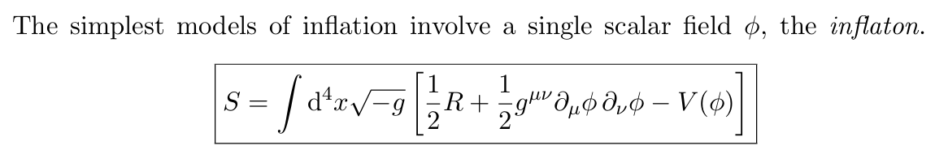
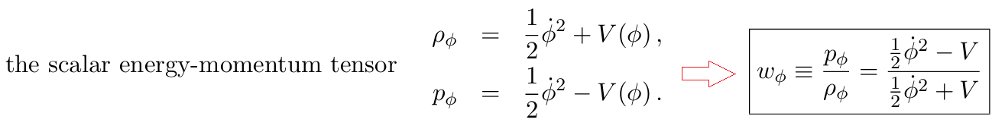
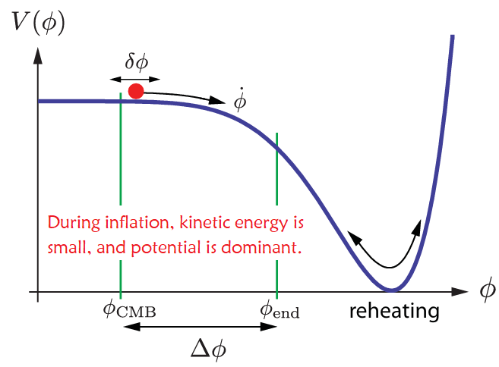
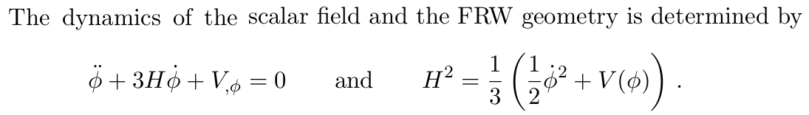
Inflation: Scalar Field Dynamics
------ arXiv:0907.5242 (TASI Lectures on Inflation)

Slide 17
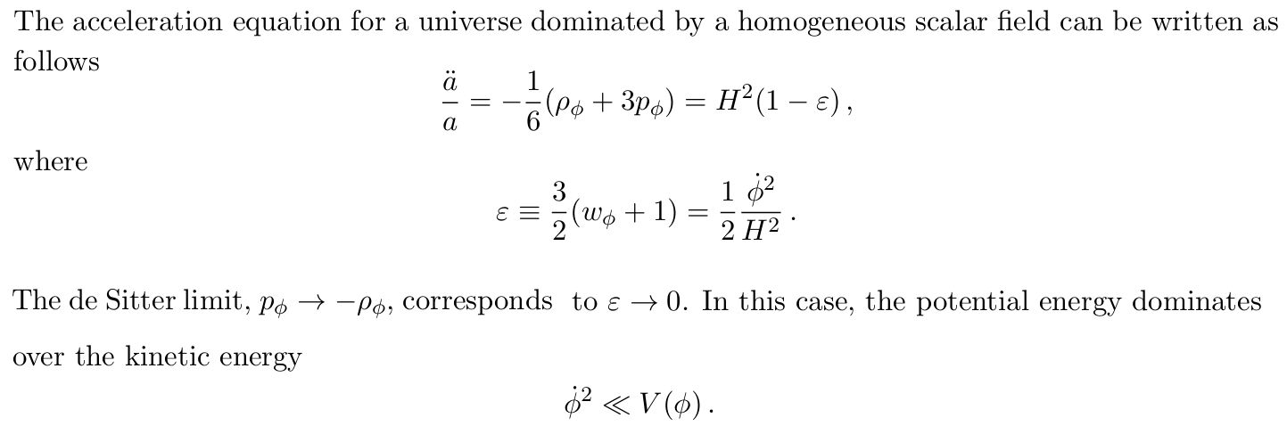
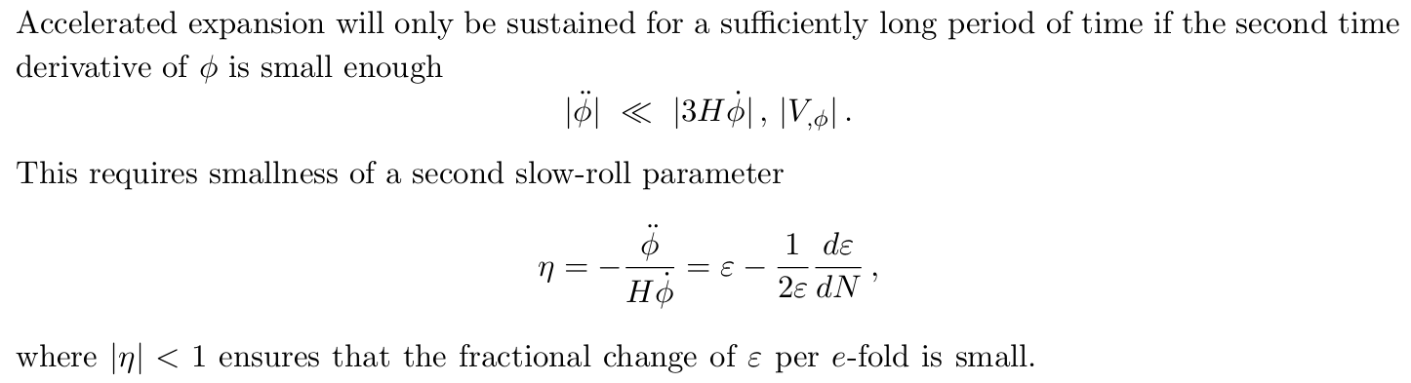
Single-field Slow-roll Inflation

Slide 18
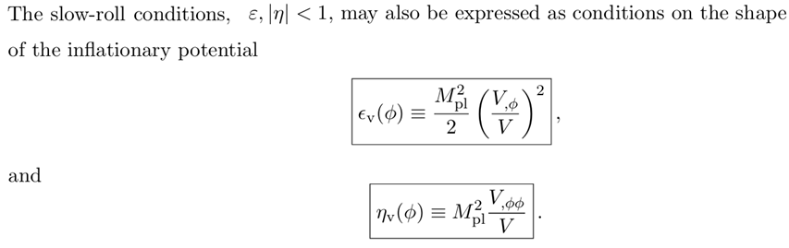
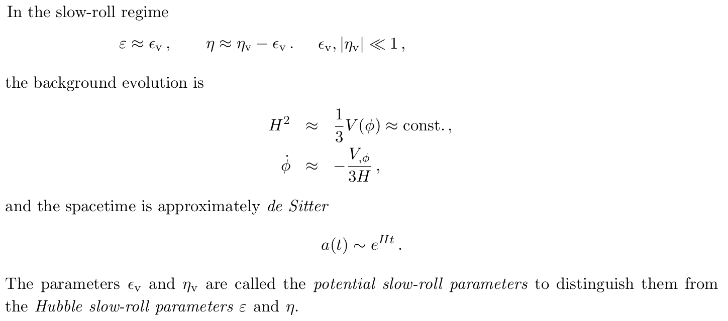

Slide 19
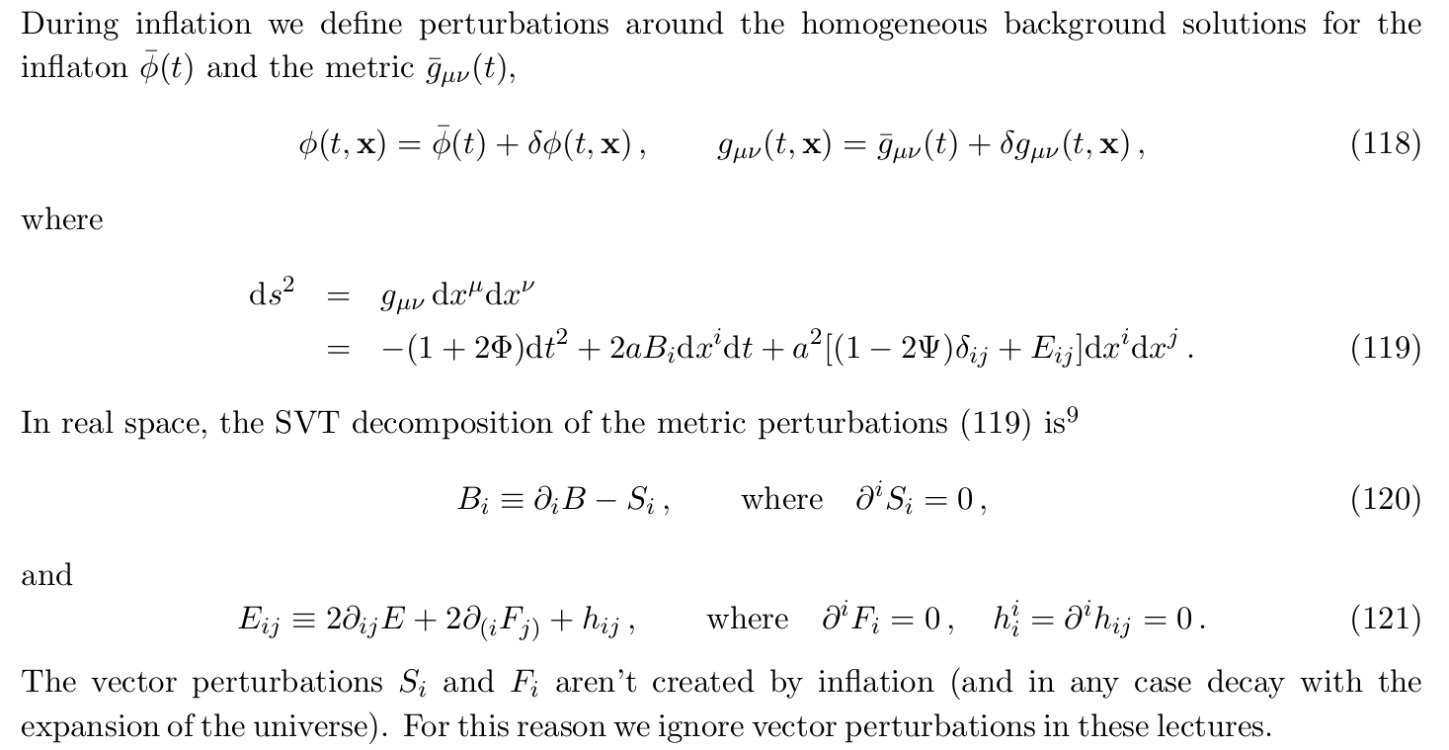
Quantum Fluctuations during Inflation

Slide 20
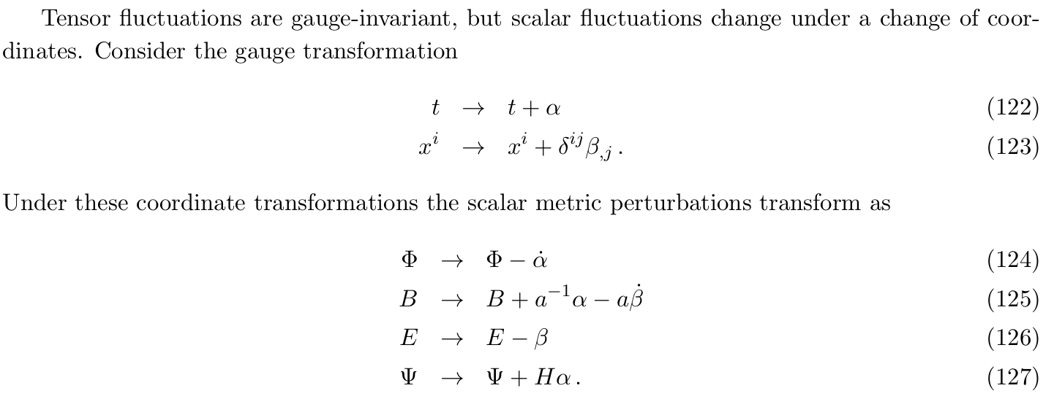
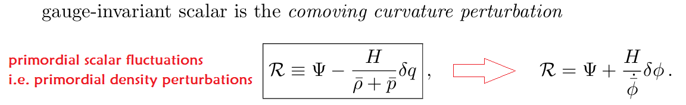

Slide 21
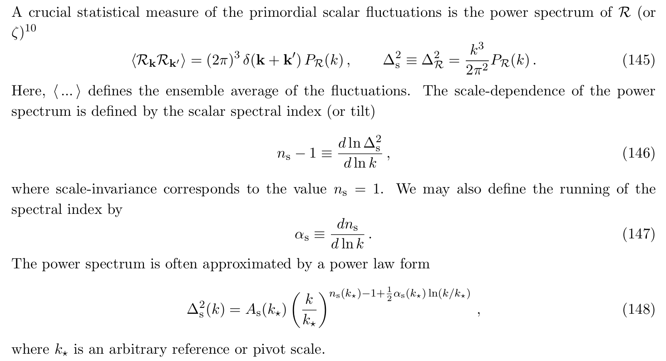
Statistics of Scalar Perturbations

Slide 22
The Quantum Origin of Structure:
------Quantum Zero-Point Fluctuations
Quantum fluctuations during inflation induce a non-zero variance for fluctuations in all light elds (like the inflaton or the metric perturbations).
Cosmologically relevant fluctuations start their lives inside the horizon (Hubble radius 1/aH). So, they origin from the quantum fluctuation in subhorizon scale (k>> aH).
During inflation, the comoving wavenumber is constant, but the comoving Hubble radius shrinks during in inflation, so eventually all fluctuations exit the horizon, become the classical fluctuation at superhorizon (k<aH) and freeze.

Slide 23
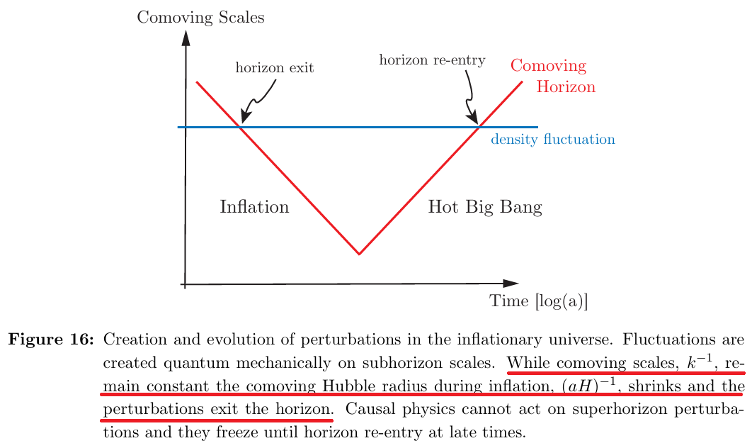
The transition occurred at k/a=H, so the amplitude of physical perturbations depends only on ‘H’.
‘H’ is nearly constant, so the amplitude of all perturbation modes are nearly constant (i.e. nearly scale-invariant).

Slide 24
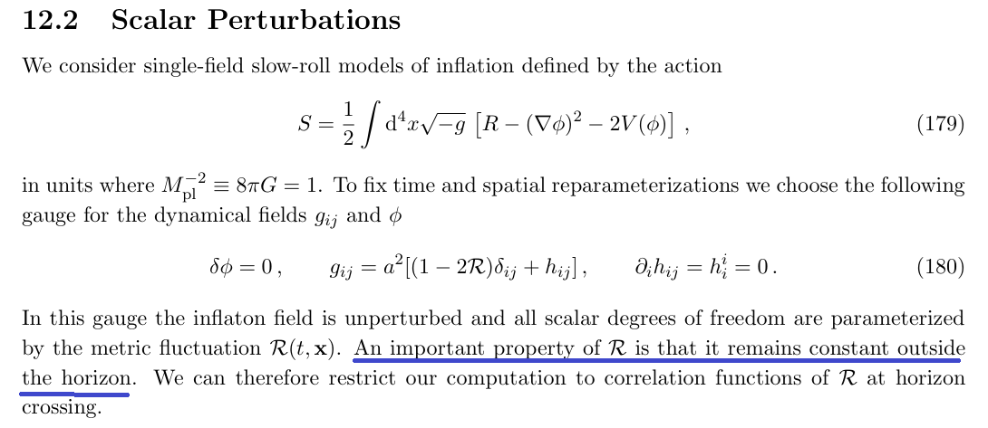
Example: Quantum Fluctuations in de Sitter Space

Slide 25
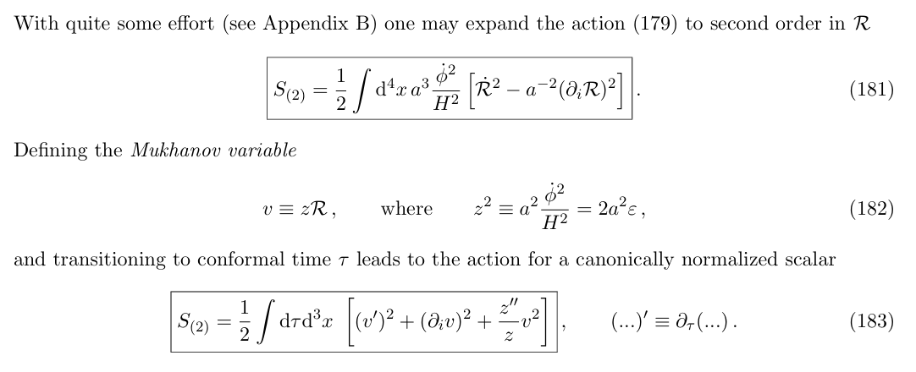
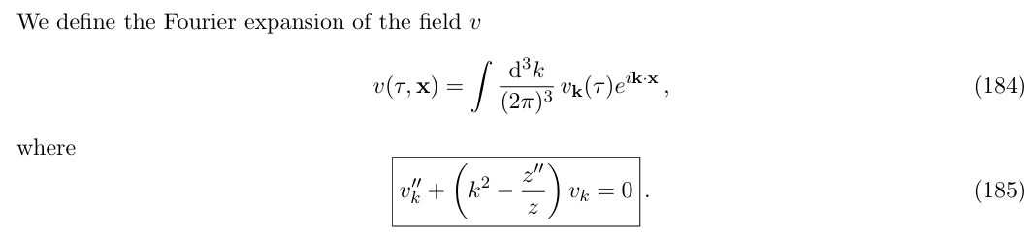
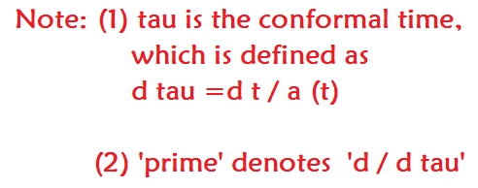

Slide 26
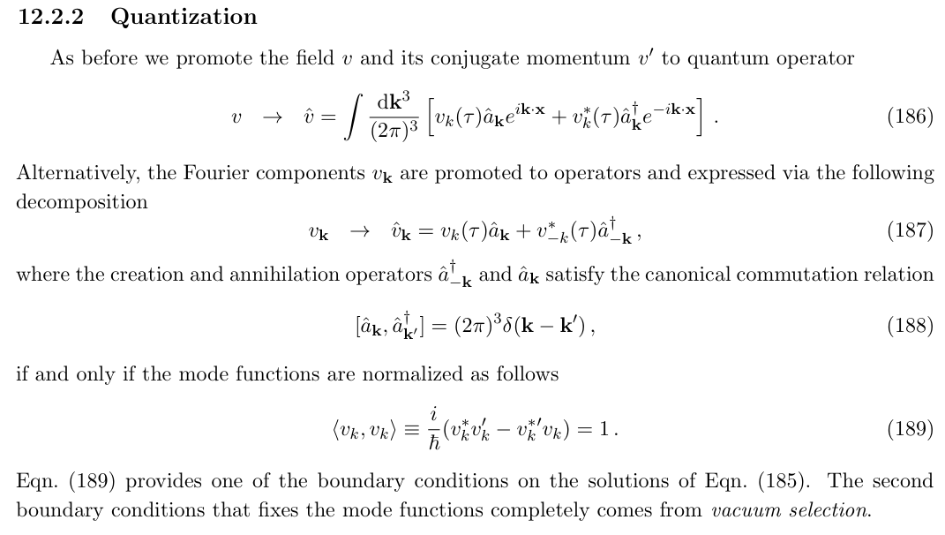

Slide 27
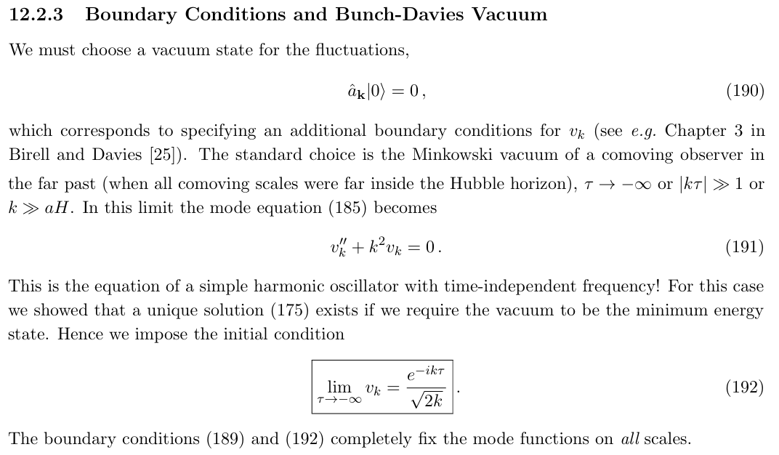

Slide 28
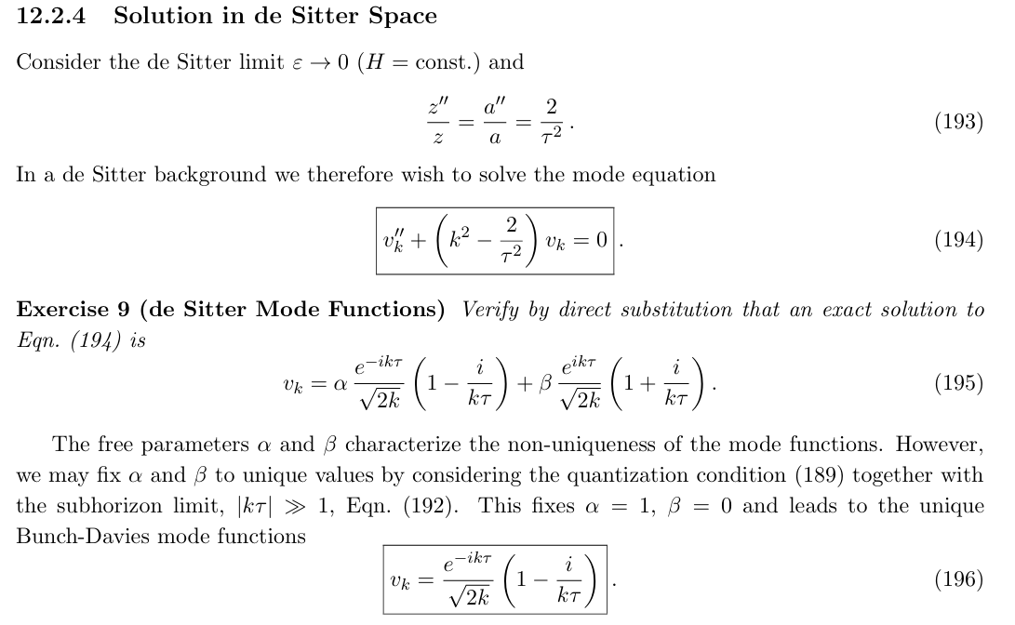

Slide 29
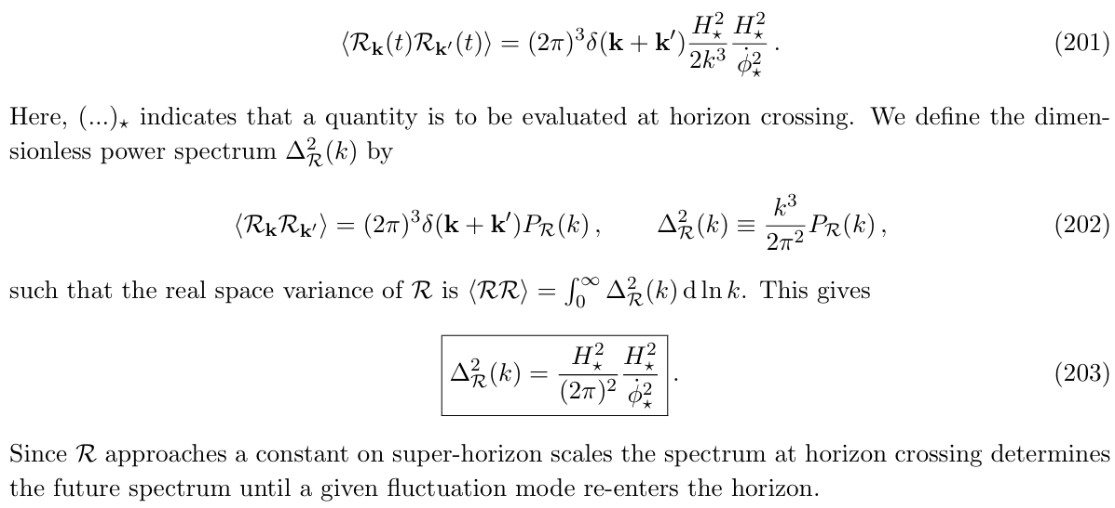

Slide 30
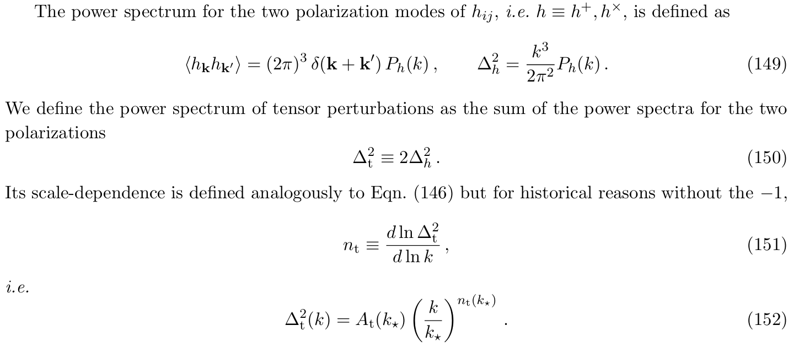
Statistics of Tensor Perturbations

Slide 31
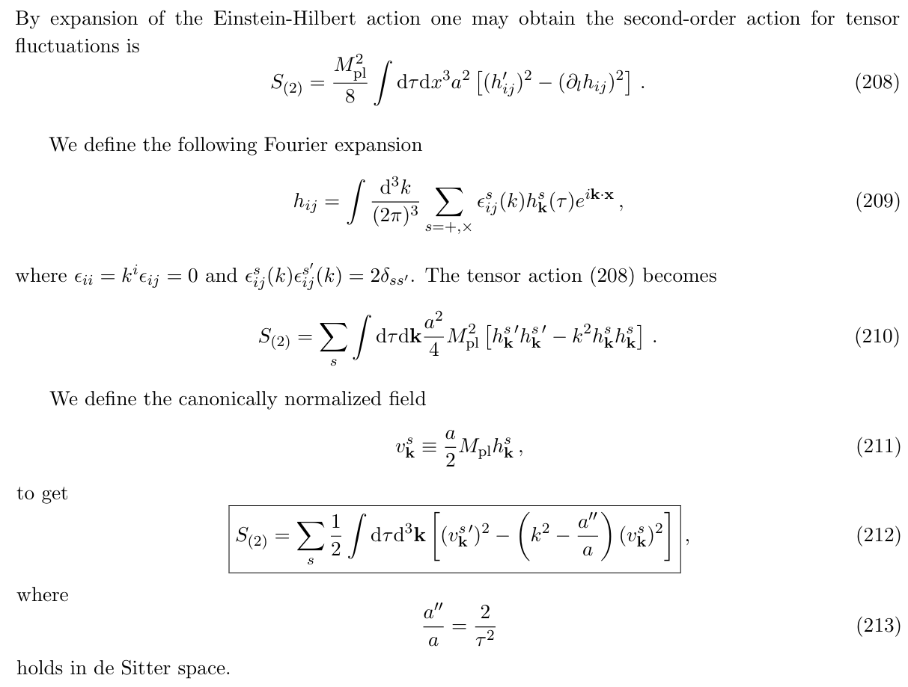

Slide 32
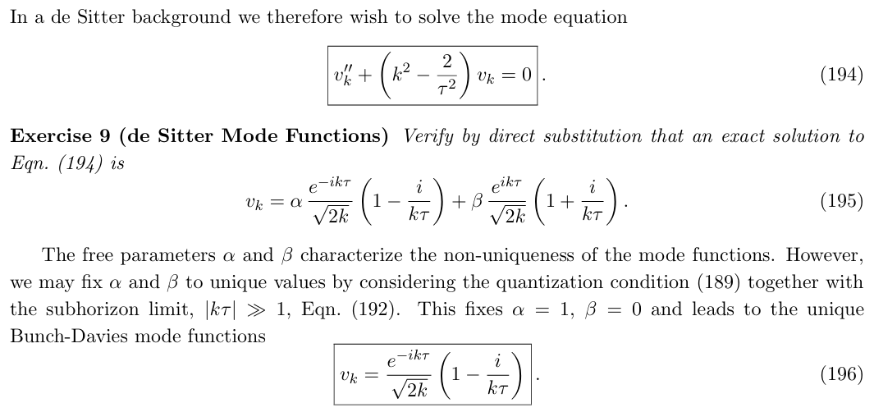

Slide 33
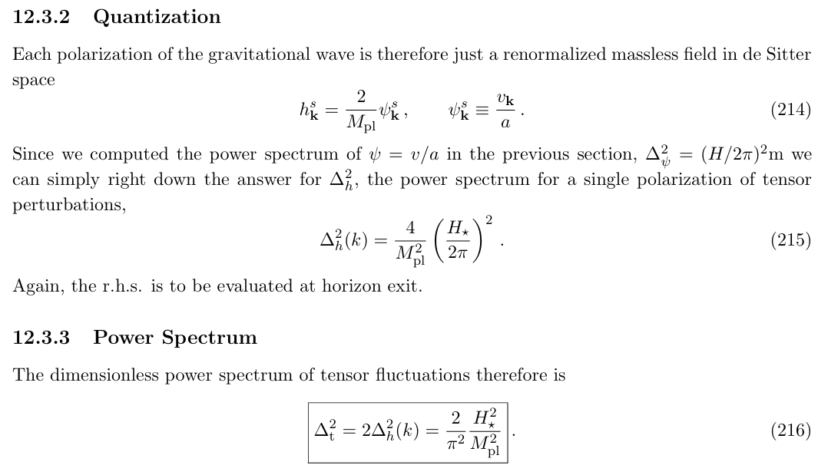

Slide 34
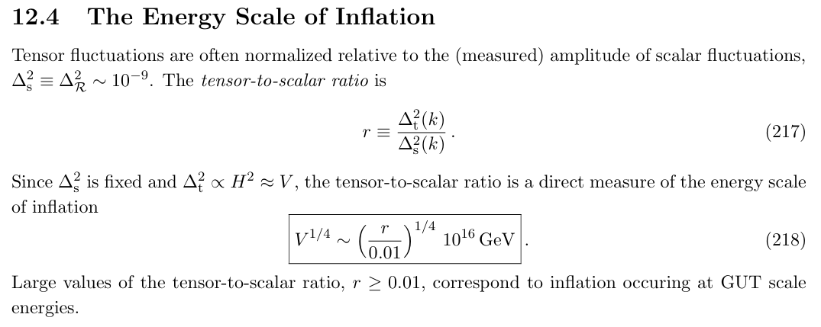

Slide 35






Summary
Primordial scalar perturbations (density fluctuations):
Primordial tensor perturbations (PGWs):
Consistency relation:

Slide 36


Observations
Amplitude:
Spectral index: ns ~ 0.97
Tensor-to-scalar ratio: r<0.03
Others are all close to zero.

Slide 37

Evolution of PGWs
In the expanding Universe, and the evolution equation of PGW is given by:
Ignoring the source term, the evolution depends only on the function of a(t). Therefore, the spectrum of PGWs encodes the clean information of the total history of the Universe.
For a wavenumber k, it crosses the horizon if k=aH.
If k<<aH, i.e. the wavelength is much larger than the horizon scale, we have h=constant;
If k>>aH, i.e. the wavelength is much smaller than the horizon scale, we have h=constant/a.

Slide 38


38

Slide 39


Transfer Function
------ Liu et al., PRD 93, 024031 (2016)
Dimensionless spectrum of energy density of PGW:
Transfer function:
Present spectrum of energy density of PGW:
39

Slide 40

40

Slide 41


Slide 42

Transfer Function:
------ RGWs in the accelerating universe
Evolution of the Universe:
Radiation dominant → matter dominant → Lambda dominant
Numerically fit formula (redshift-suppression effect)
42

Slide 43


Slide 44

Transfer Function:
------ Effects of cosmic phase transitions
When the hot universe gradually cooled down in the radiation-dominant era, massive particles became less relativistic and contributed less to the energy density of radiation.
Typical cases are the breaking of supersymmetry (SUSY) and the combination of quarks into hadrons (phase transition of quantum chromodynamics, i.e., QCD phase transition). Besides that, the annihilation of electrons and positrons also induced big change in the energy density of radiation.
The cosmic phase transitions change the energy density of radiation, and affect evolution history of scale factor a(t), which influences the amplitude of PGW by a new transfer function:
44

Slide 45



Slide 46


Transfer Function:
------ Effects of relativistic free-streaming gases
When the cosmic neutrinos (and the possible dark fluids) decouple from the rest of radiation, the free streaming of neutrinos contributes to the anisotropic stress of PGW as follows:
The transfer function:
46

Slide 47



Slide 48

48

Slide 49


Slide 50
Properties of PGWs
Stochastic signal – something random, Gaussian, noisy, unpredictable
Background signal – something happening almost everywhere, in all directions, at all times
All frequency – from 10⁻¹⁸ to 10¹⁰ Hz
50

Slide 51

51

Slide 52
OUTLINE
History of the Universe: From Inflation to Acceleration
Primordial (Relic) Gravitational Wave: Generation and Evolution
Detection methods: Status and Future
Conclusions

Slide 53


Slide 54


Slide 55



Slide 57

Main GW sources
Megers of compact binaries
(BNS, NS-BH, BBH)
Rotating neutron stars
Supernovae in Galaxy
GW backgrounds
(Astrophysical and cosmological)

Slide 58

58

Slide 59


Slide 61


Main GW sources
Megers of SMBBH
Extreme mass ratio inspirals (EMRIs)
GW background at mHz frequency
(Astrophysical and cosmological)

Slide 62




Slide 63


Slide 64


Slide 65





Slide 66

Main GW sources
SMBBH binaries
GW from cosmic string
GW background at nHz frequency
(Astrophysical and cosmological)

Slide 67


Slide 68


Slide 69


Slide 70


Slide 71


Slide 72


Slide 73


Slide 74


Slide 75
OUTLINE
History of the Universe: From Inflation to Acceleration
Primordial (Relic) Gravitational Wave: Generation and Evolution
Detection methods: Status and Future
Conclusions

Slide 76
Conclusions
The PGW origin from the tensor modes of quantum fluctuations during inflation, so it naturally encodes the information of quantum gravity.
The primordial amplitude of PGW directly the energy scale of inflation, so it always treated as the smoking-gun evidence of inflation.
The evolving of PGW after inflation depends only on a(t). Therefore, the observed spectrum faithfully recorded the overall evolutionary history of the universe.
The amplitude of PGWs are different for different frequency range: the higher frequency, the smaller amplitude.
In the near future, the most hopeful detection method is by the CMB observation, which can detect the PGW at very low frequency range.

Slide 77



Slide 81


Friedmann–Lemaître–Robertson–Walker (FLRW) metric
The general form of the metric, which describes the a homogeneous and isotropic universe is the FLRW metric, given by:
Thus, the Einstein field equation turns to the Friedmann equations as:

Slide 82


Slide 83
Friedmann–Lemaître–Robertson–Walker (FLRW) metric
The general form of the metric, which describes the a homogeneous and isotropic universe is the FLRW metric, given by:
Thus, the Einstein field equation turns to the Friedmann equations as:

Slide 84

Standard Cosmological Model
The matter in Universe is always assumed as the Prefect Fluid: radiation (i.e. photon, neutrino, gravitational wave), dust or matter (i.e. baryon, dark matter, etc), dark energy, inflation field, etc.
From Friedmann Equations, we derive the evolution equation of the universe:

Slide 85


Slide 86




PGW during Inflation
PGW (tensor mode) in the FLRW metric:
Power spectrum:
Bunch-Davies Vacuum:
Stewart-Lyth formula:
86

Slide 87


Transfer Function:
------ Effects of cosmic phase transitions
When the hot universe gradually cooled down in the radiation-dominant era, massive particles became less relativistic and contributed less to the energy density of radiation.
The cosmic phase transitions change the energy density of radiation, and affect the amplitude by the transfer function:
87

Slide 88


Slide 89

Thermodynamics in Expanding Universe

Slide 90



Transfer Function:
------ Effects of general equation of state
After inflation, the Universe should experience a period of reheating to create the matter and dark matter we see today.
It is suspected that this epoch before BBN can be quantified as follows:
The modified transfer function:
90

Slide 91


