Slide 1
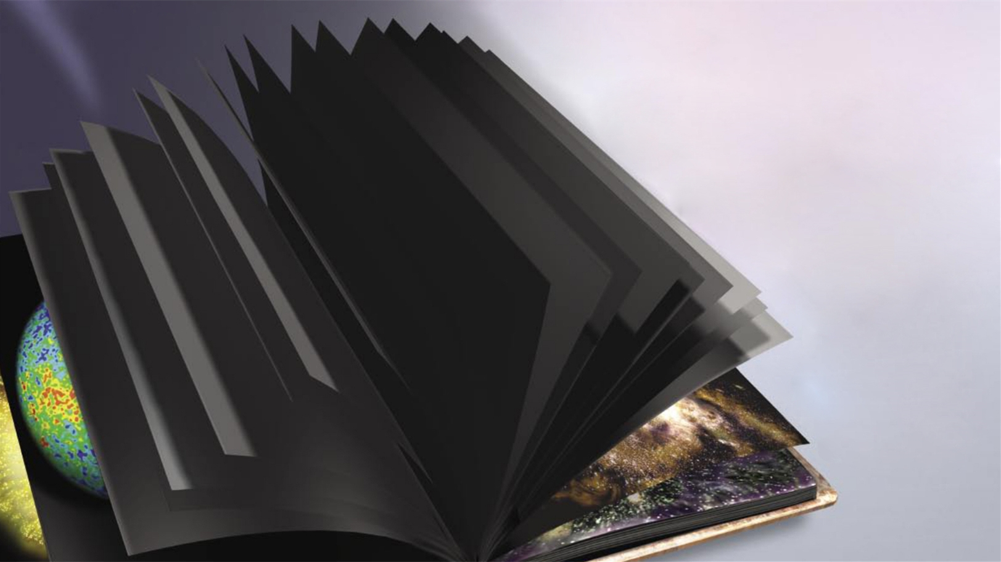


Cosmic Dawn and Epoch of Reionization: 宇宙黎明和再电离 Lecture 2: Observations 第二讲：观测
茅奕｜清华大学天文系
图：Avi Loeb

Slide 2
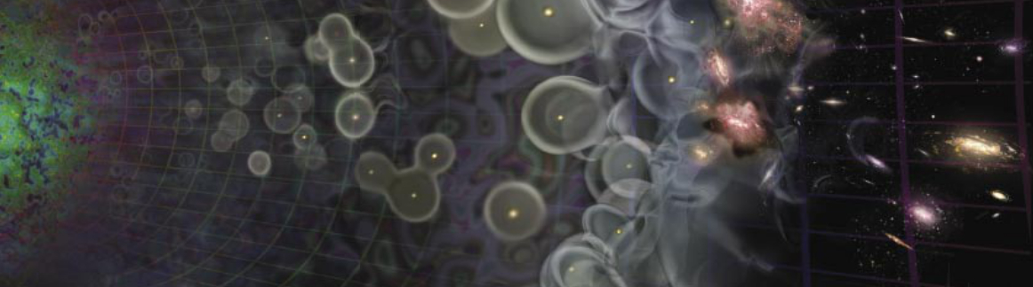
21厘米谱线的基本物理
21厘米现有的观测结果
21厘米数据处理：RFI、前景去除、科学分析
再电离的其他宇宙学探针
Notes:
加一个过渡也，您强调下我们为什么要研究宇宙再电离

Slide 3
21厘米谱线的基本物理
Notes:
加一个过渡也，您强调下我们为什么要研究宇宙再电离

Slide 4
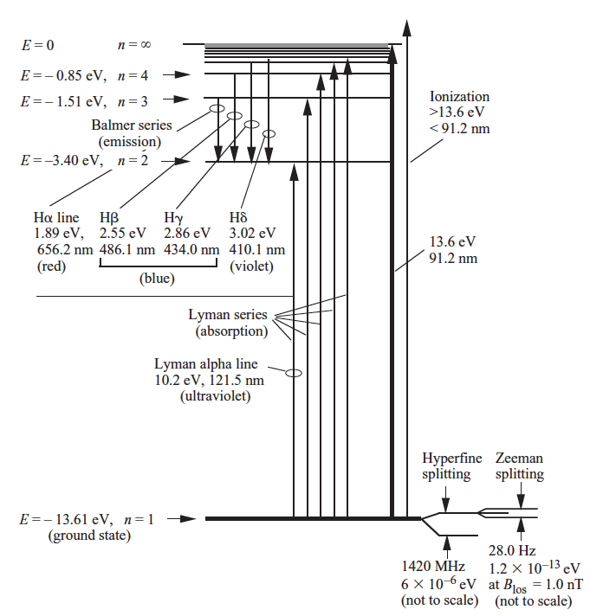
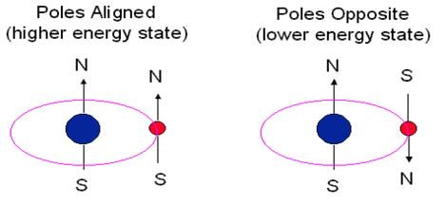
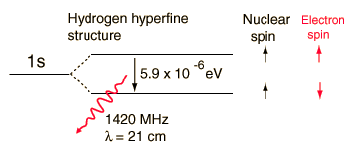
21-cm Line of Atomic Hydrogen
The 21cm line comes from the transition between two hyperfine states of the hydrogen atom 1s state.
Notes:
Oort assigned his student, H.C. Van de Hulst, the job of figuring out what radio spectral lines might exist and what their frequencies would be.
After 1952 the first maps of the neutral hydrogen in the Galaxy were made and revealed, for the first time, the spiral structure of the Milky Way.

Slide 5
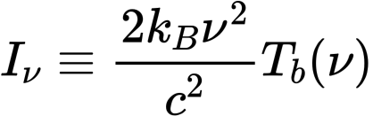
The 21cm brightness temperature
Rayleigh-Jeans limit
The 21cm brightness temperature
Notes:
-- neutral fraction is the ratio of atomic hydrogen and total hydrogen including those ionized.

Slide 6
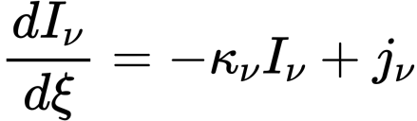
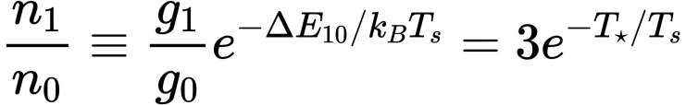


The 21cm brightness temperature
Radiative transfer equation
The formal solution of radiative transfer equation:
Spin temperature:
Notes:
-- neutral fraction is the ratio of atomic hydrogen and total hydrogen including those ionized.

Slide 7
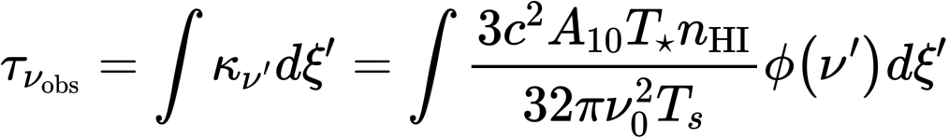
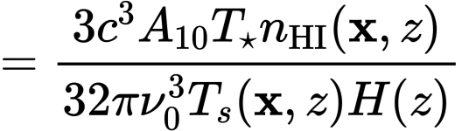
The 21cm brightness temperature
Optical depth
(对应于32Myrs才会自发跃迁一次！）
So 21 cm optical depth is usually very small!
Notes:
-- neutral fraction is the ratio of atomic hydrogen and total hydrogen including those ionized.

Slide 8
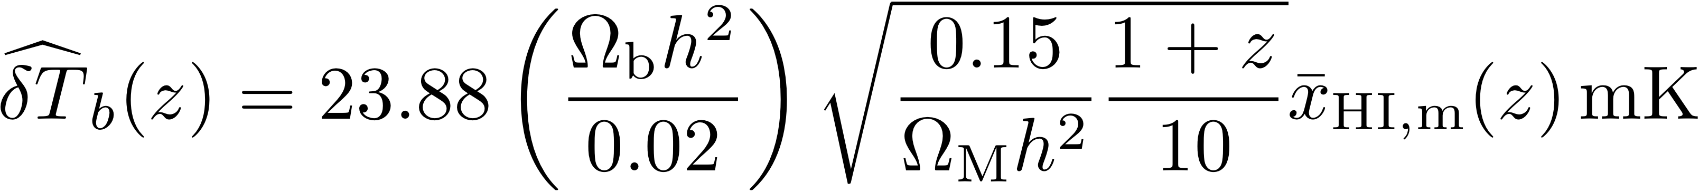
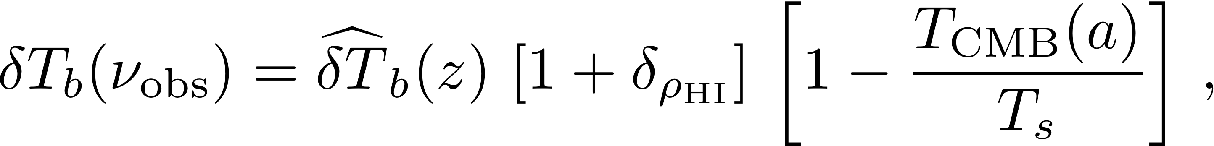

The 21cm brightness temperature
neutral fraction
HI over-density
Total hydrogen over-density
(of interest to cosmology)
Hydrogen neutral
fraction fluctuation
(of interest to astrophysics)
Notes:
-- neutral fraction is the ratio of atomic hydrogen and total hydrogen including those ionized.

Slide 9
The 21cm brightness temperature
neutral fraction
Spin temperature
Emission (positive signal against CMB): if Τ_{s} > Τ_{CMB}
Absorption (negative signal against CMB): if Τ_{s} < Τ_{CMB}
Transparent (no signal against CMB): if Τ_{s} = Τ_{CMB}.
Notes:
-- neutral fraction is the ratio of atomic hydrogen and total hydrogen including those ionized.

Slide 10



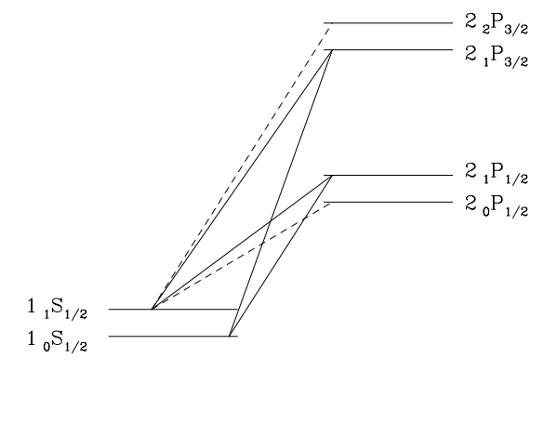
Spin temperature couplings
Absorption of CMB photons and stimulated emission
Collisional excitation: collisions with neutral H atoms, residual electrons and protons (thru Compton scattering)
Wouthuysen-Field (WF) Effect/ Lyα pumping: Scattering off Lyα photons

Slide 11
The CMB, cosmic gas temperature, and 21 cm spin temperature
in the dark ages, cosmic dawn and the epoch of reionization
Collisional excitation
Adiabatically cooling
Lyα
pumping
X-ray
heating
Τ_{s} → Τ_{gas}
Τ_{s} → Τ_{gas}

Slide 12
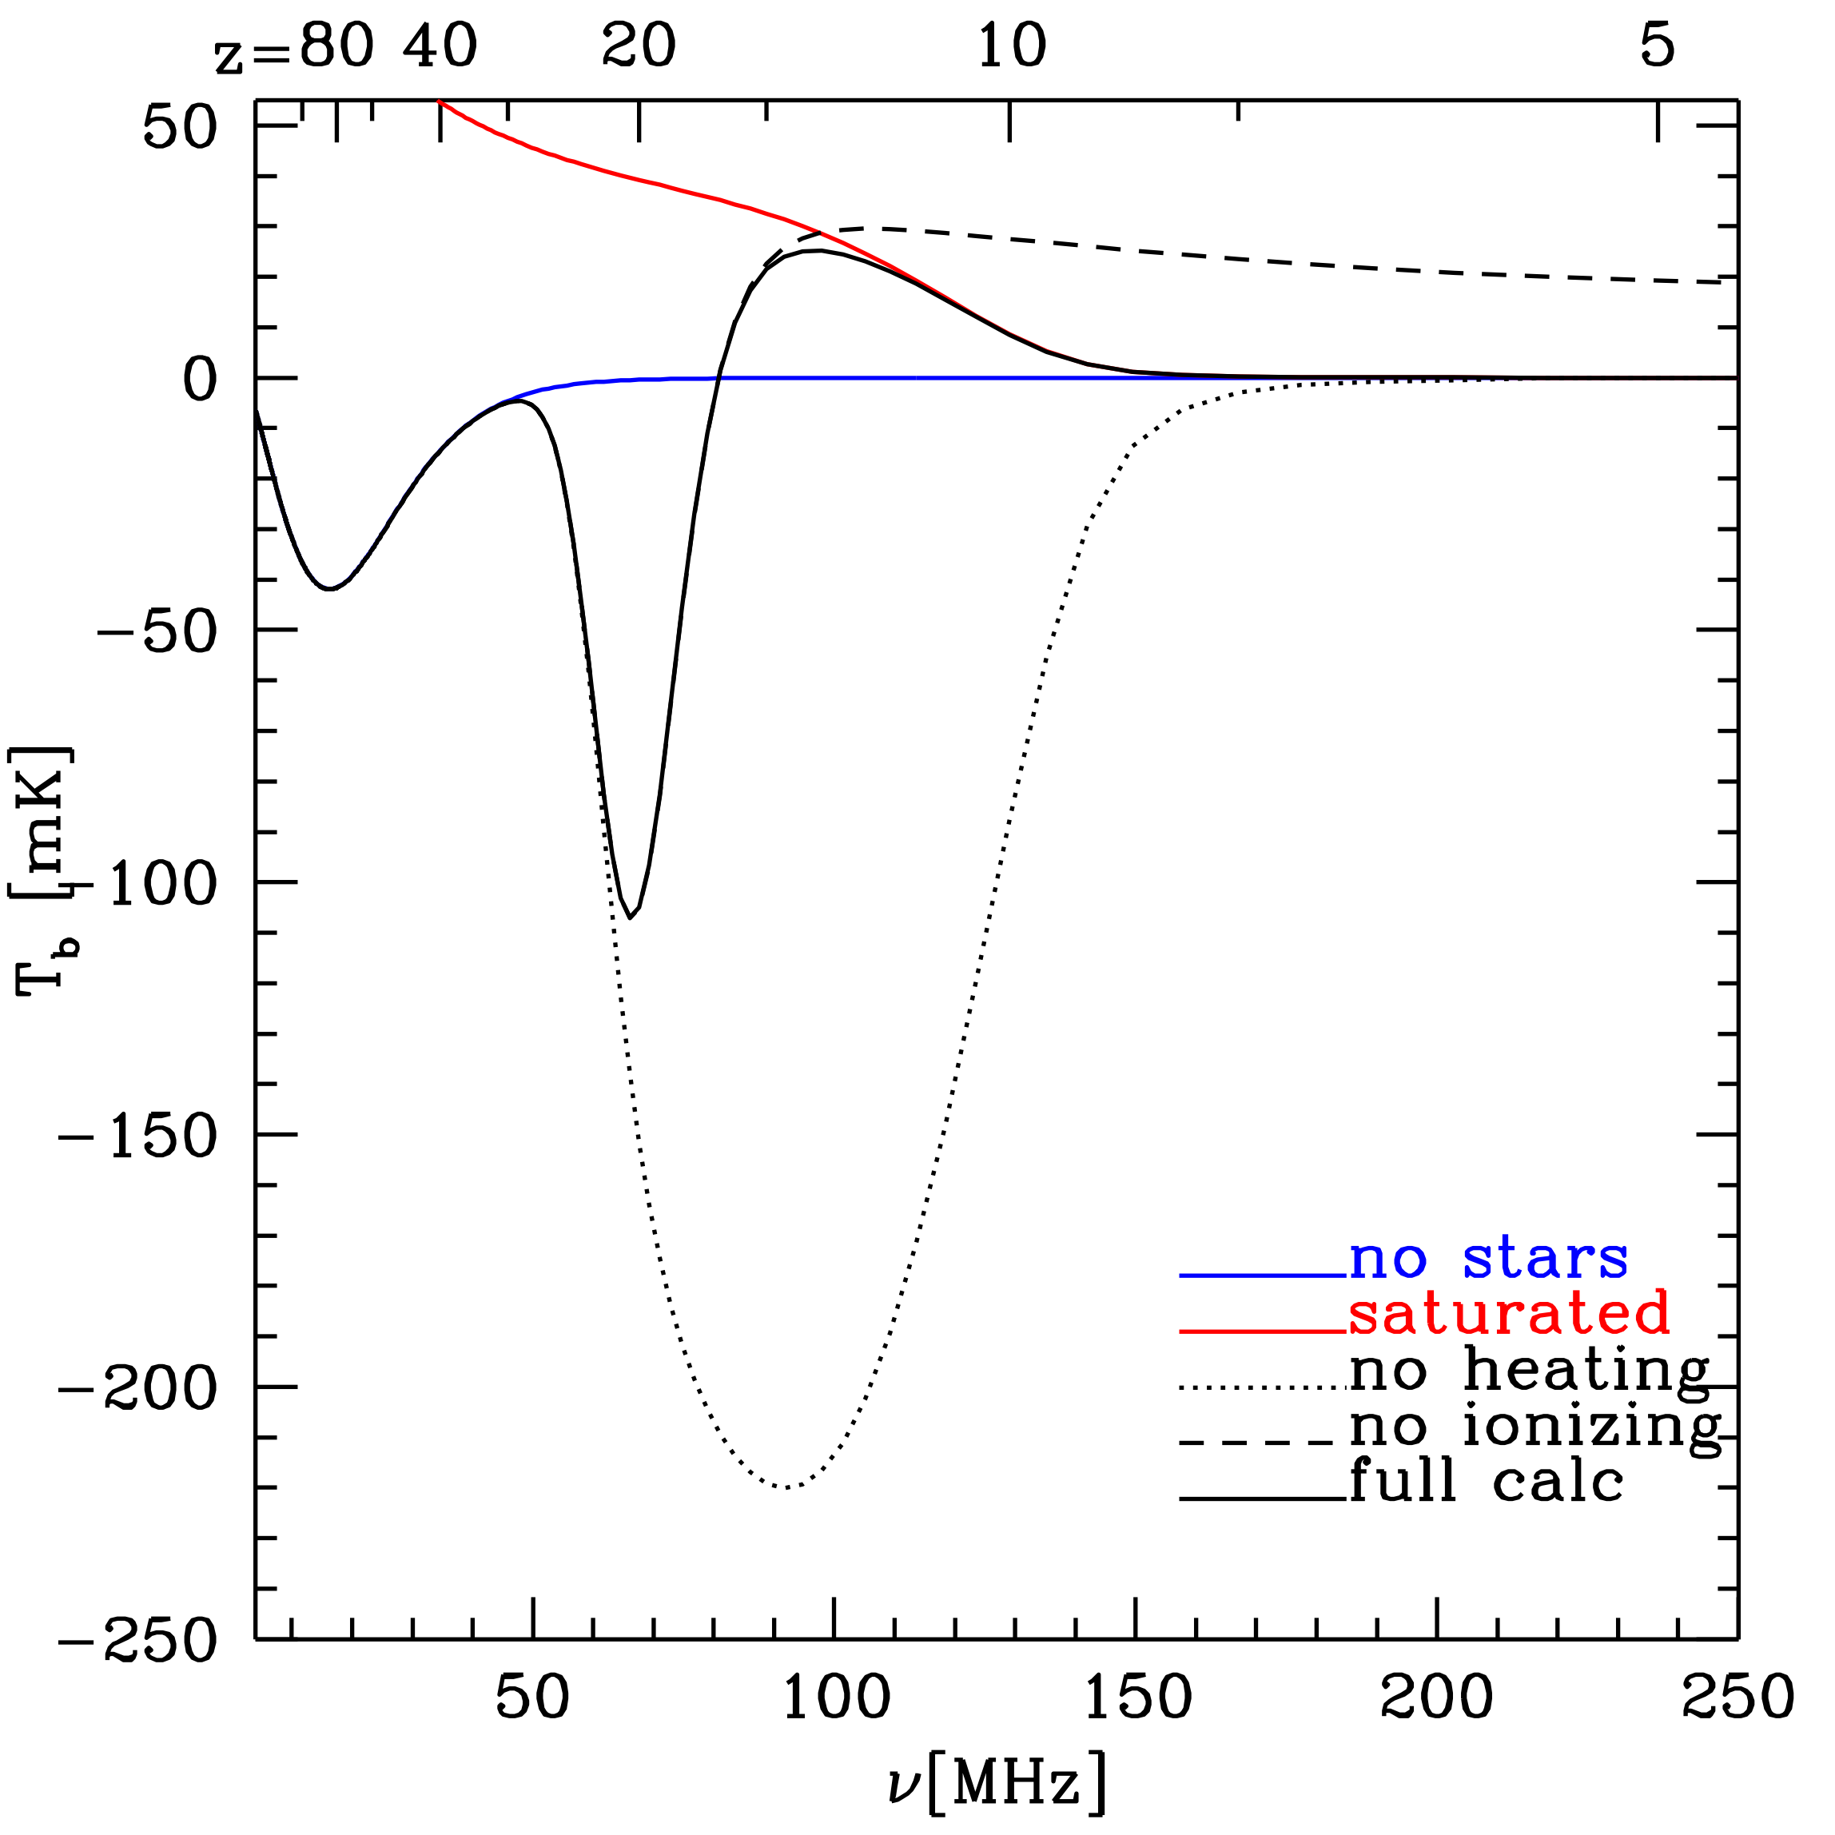
The (Global) Cosmic 21 cm Background 21厘米平均信号
in the dark ages, cosmic dawn and the epoch of reionization
Collisional excitation
Reionization
First galaxies form
再电离
Post-reionization
加热宇宙
第一代星系形成
X-ray
heating
Lyα
pumping
Pritchard & Loeb, PRD ‘10

Slide 13
图像信号
再电离
第一代星系形成
平均信号
加热宇宙
统计起伏信号
图：A. Liu & R. Shaw

Slide 14
21厘米现有的观测结果
Notes:
加一个过渡也，您强调下我们为什么要研究宇宙再电离

Slide 15
图像信号
再电离
第一代星系形成
平均信号
加热宇宙
统计起伏信号
图：A. Liu & R. Shaw

Slide 16
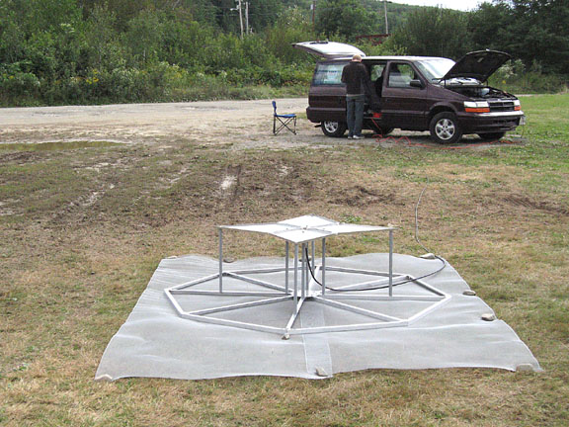
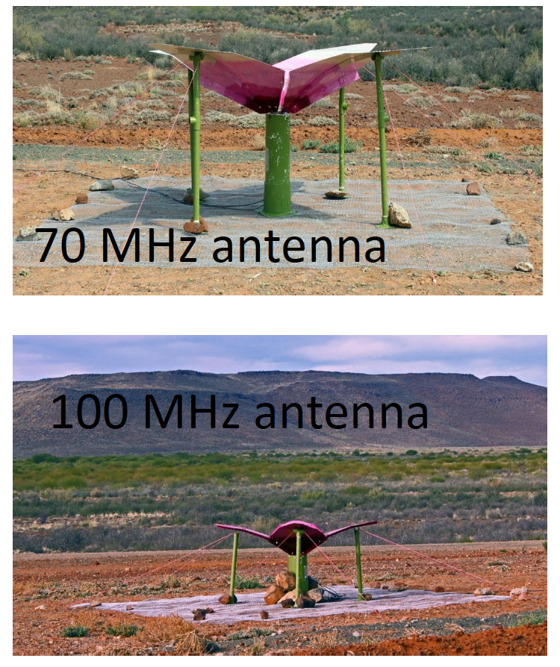
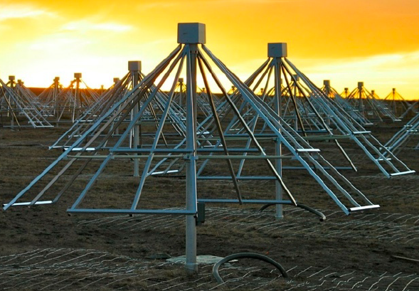
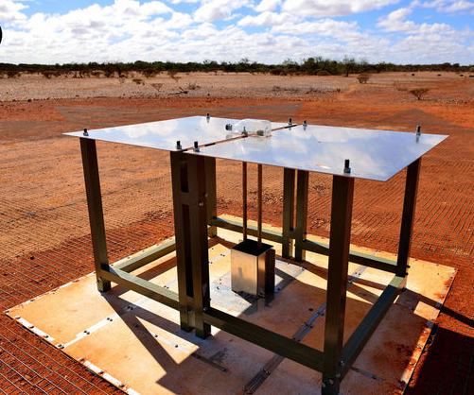
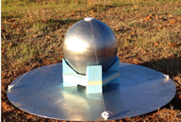
单个天线测量平均信号
EDGES
高频天线
美国/澳洲
PRIZM
低频天线
南非
LEDA
美国
PRIZM
高频天线
南非
SARAS-2
印度
EDGES
低频天线
美国/澳洲

Slide 17
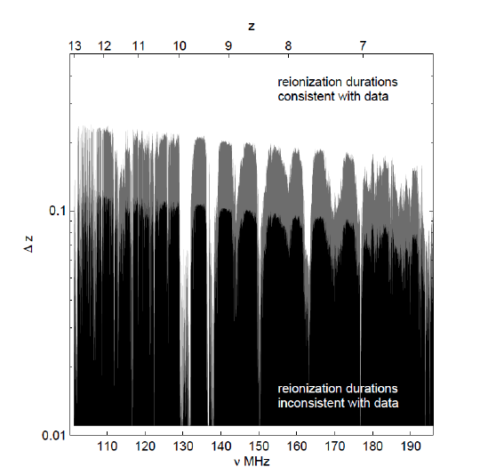
Direct Constraints on Reionization: 21-cm
EDGES measures the sky-averaged (global mean) 21-cm brightness temperature. Excluding the duration of reionization Δz<0.06 (2σ).
EDGES
高频天线
美国/澳洲
Bowman & Rogers (2010)

Slide 18
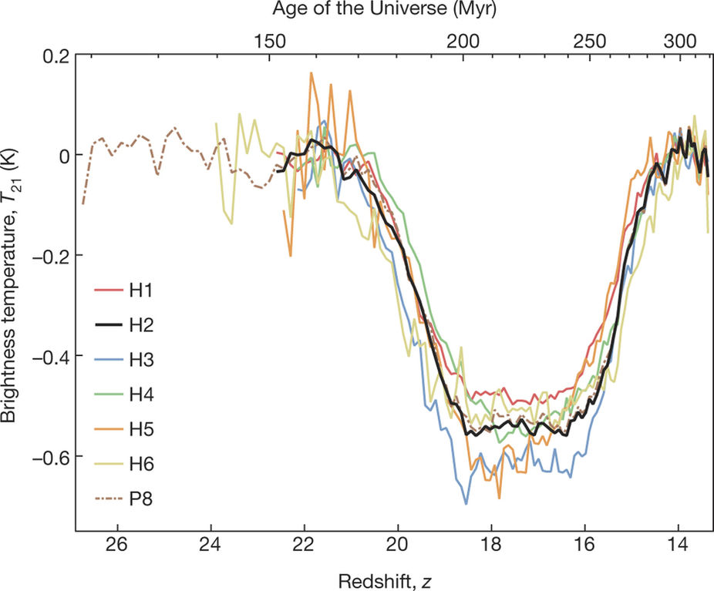
First Detection of 21-cm Signal from Cosmic Dawn?
Discovery: the detection of a flattened absorption profile in the sky-averaged radio spectrum, which is centered at 78 MHz and has a best-fitting FWHM of 19 MHz and an amplitude of 0.5K. 😀
EDGES
低频天线
美国/澳洲
J D Bowman et al. Nature 555, 67–70 (2018)

Slide 19
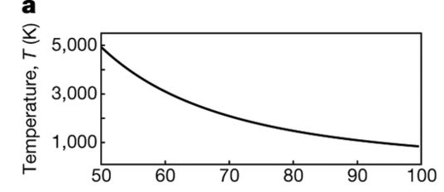
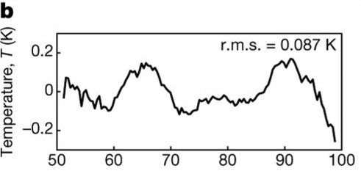
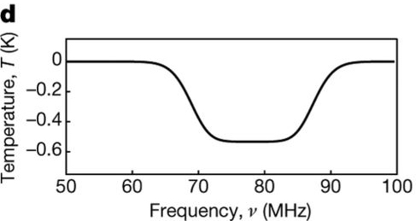
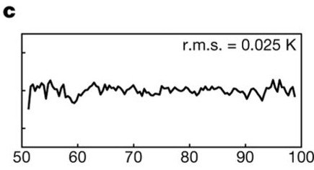
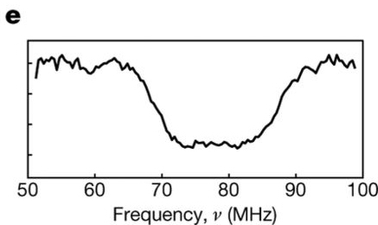
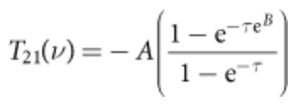
First Detection of 21-cm Signal from Cosmic Dawn?
J D Bowman et al. Nature 555, 67–70 (2018)
a. Measured spectrum
b. Residuals after fitting and removing only the foreground model based on the known spectral properties of the Galactic synchrotron spectrum and Earth’s ionosphere.
c. Residuals after fitting and removing the foreground model and the 21 cm model simultaneously.
d. The 21-cm absorption profile is modelled as a flattened Gaussian:
e. Sum of the residuals (c) and the 21-cm model (d)

Slide 20

First Detection of 21-cm Signal from Cosmic Dawn?
Discovery: the detection of a flattened absorption profile in the sky-averaged radio spectrum, which is centered at 78 MHz and has a best-fitting FWHM of 19 MHz and an amplitude of 0.5K. 😀
Interpretation: This detection is consistent with expectations for the 21-cm signal induced by the first stars. The observed profile is centered at z=17, and spans approximately 20>z>15. 😀
Problem: The best-fitting amplitude 500mK is more than a factor of two greater than, or 3.8$σ$ above, the strongest possible absorption of 209mK at this frequency under standard expectations. 😱 Solution:
Gas is further cooled by new physics, e.g. scattering of baryons and dark matter particles (Barkana 2018)
Stronger radiation background than CMB
EDGES
低频天线
美国/澳洲
J D Bowman et al. Nature 555, 67–70 (2018)

Slide 21
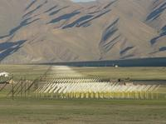
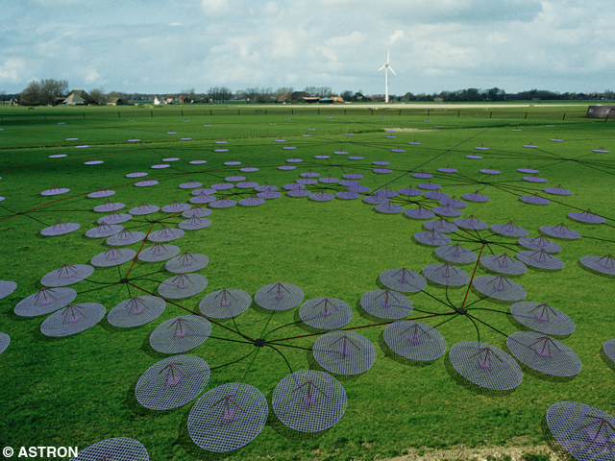
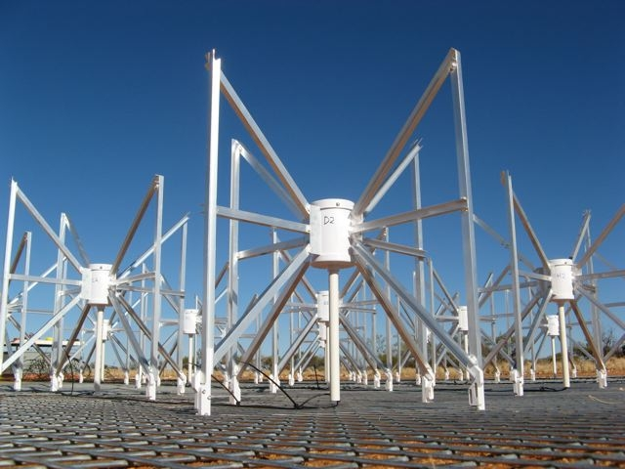
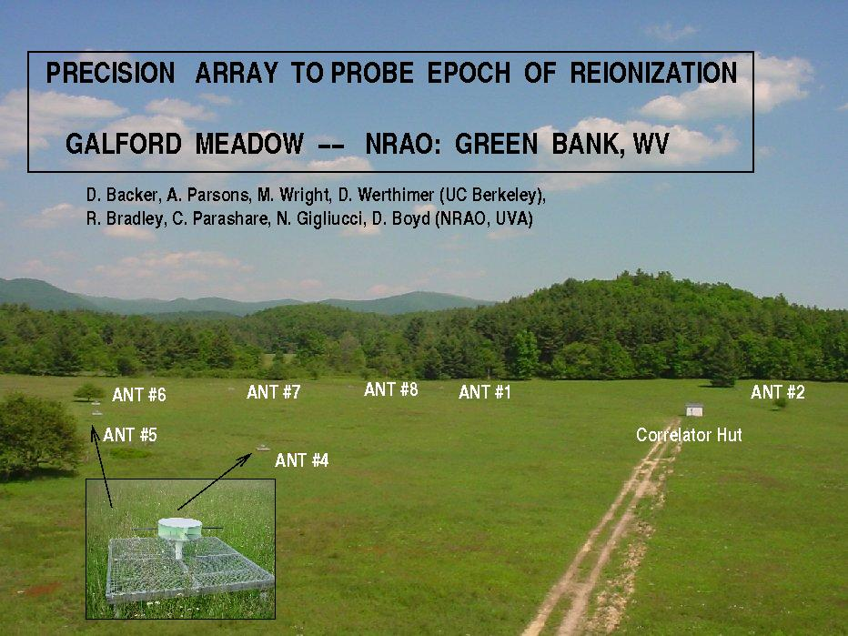
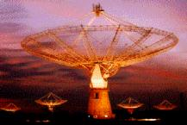
第一代射电干涉阵列（试图）测量信号的统计起伏
21CMA 中国·新疆
LOFAR 荷兰/欧洲
MWA 澳大利亚
PAPER 美国、南非
GMRT 印度

Slide 22
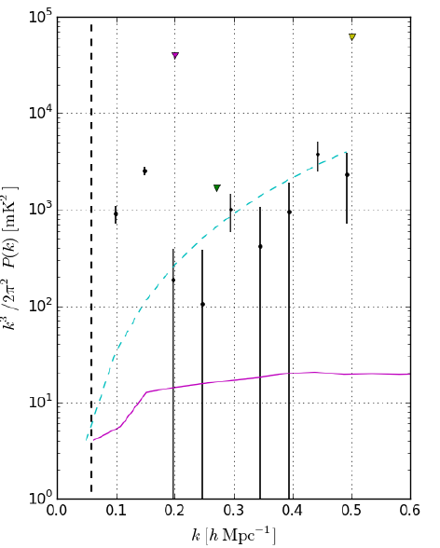
Direct Constraints on Reionization: 21-cm
PAPER, MWA, LOFAR and GMRT measure the power spectrum of 21-cm brightness temperature fluctuations.
LOFAR
(Patil+’17)
GMRT
(Paciga+’11)
MWA
(Dillon+’14)
PAPER
(Parsons+’14)
Predicted noise 2σ level
HERA Phase I
(Abdurashidova+’21)
PAPER 2015 observation (black dots with 2σ error bars)
Ali et al. (2015)
Predicted signal from a theoretical model at 50% ionization

Slide 23
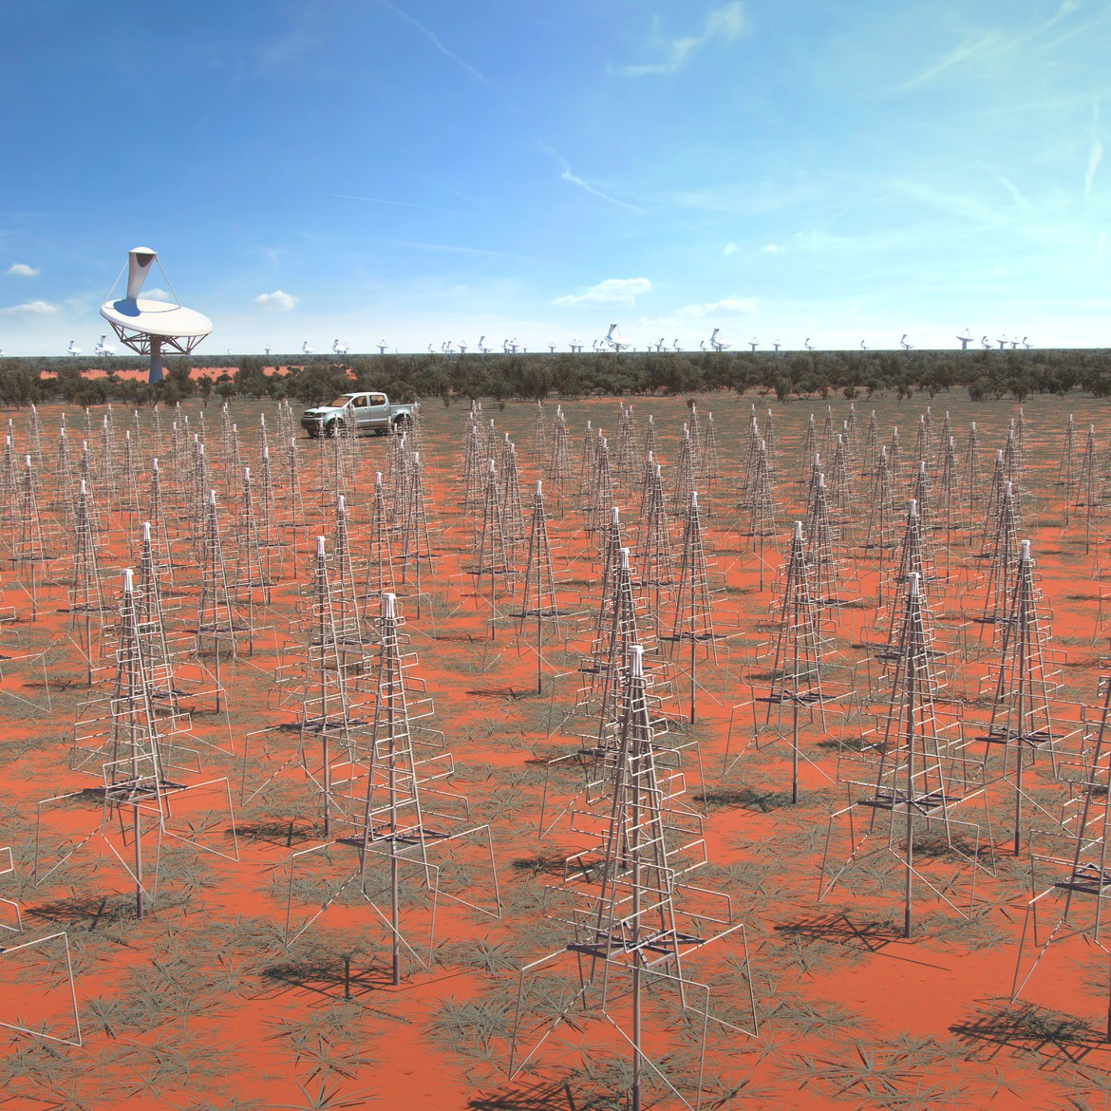
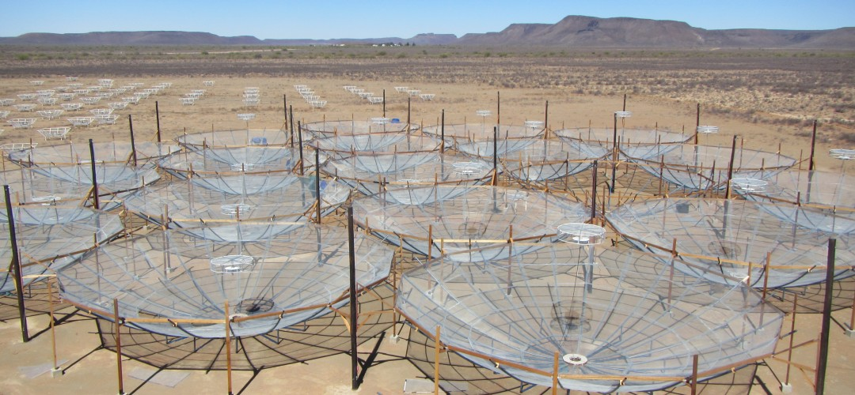
第二代射电干涉阵列将测量信号的统计起伏和图像
SKA（平方公里阵列望远镜）
一期工程～10亿欧元
14国国际合作
（澳/加/中/法/德/印/意/荷/新/南非/西/瑞典/瑞士/英）
HERA
美国
（+加/英/南非/意）

Slide 24
21厘米数据处理：
RFI、前景去除、科学分析
Data Analysis in 21 cm observations
Calibration
RFI flagging (in visibility measurement)
Image making
Foreground subtraction
Scientific interpretation (parameter inference)

Slide 25
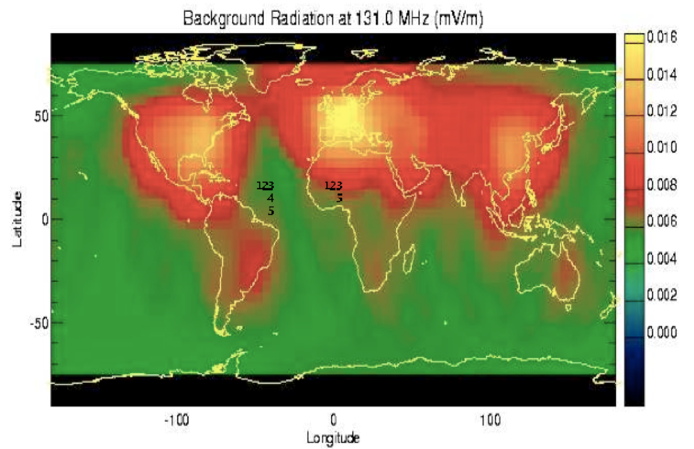
Radio Frequency Inference (RFI)
LOFAR
21CMA
GMRT
SARAS-3
PRIZM
PAPER
HERA
SKA-mid
EDGES
MWA
SKA-low

Slide 26
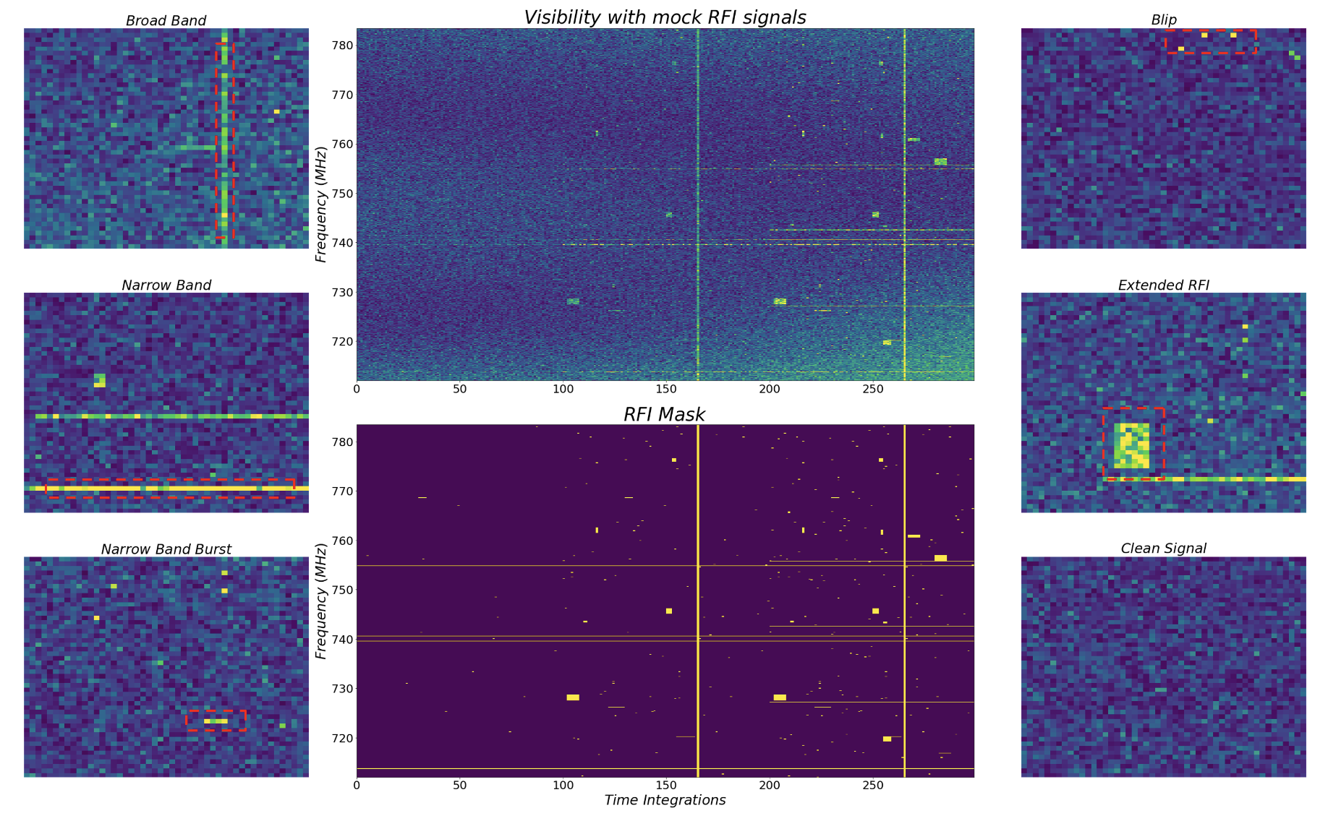
RFI Flagging with U-Net
Characteristic RFI Classification
Visibility with mock RFI signals
Blip
Broad band
Narrow band
Extended
Frequency
Flagged RFI
Narrow band burst
Cleaned Signal
Time
Sui, YM, Zuo, Chen et al., in prep.

Slide 27
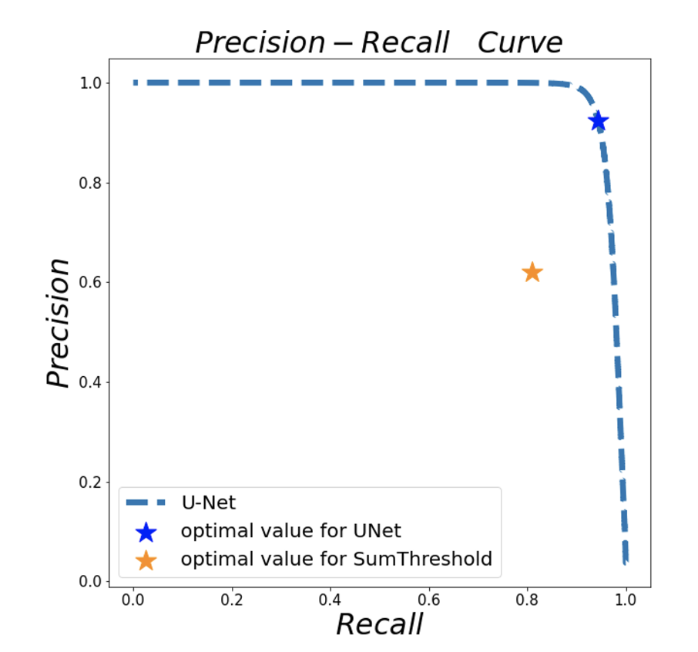
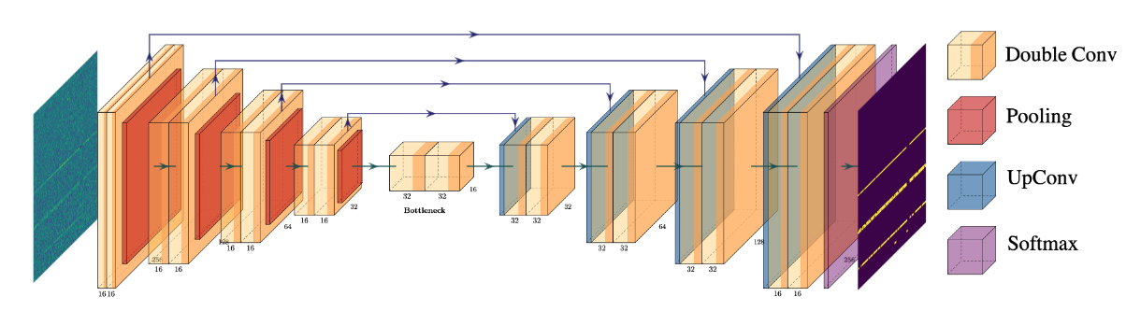
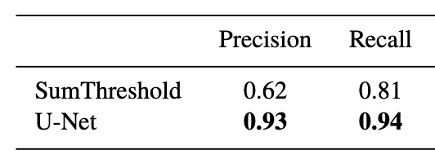
RFI Flagging with U-Net
U-Net
优化结果
(Optimized
U-Net)
传统方法优化结果
(Optimized SumThreshold)
精确率(Precision)
召回率(Recall)
See also Sun, Deng, Wang, et al., MNRAS, 2022
Sui, YM, Zuo, Chen et al., in prep.

Slide 28
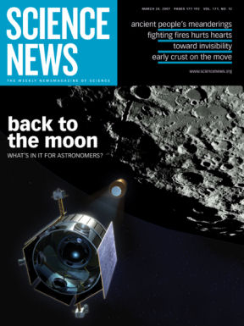
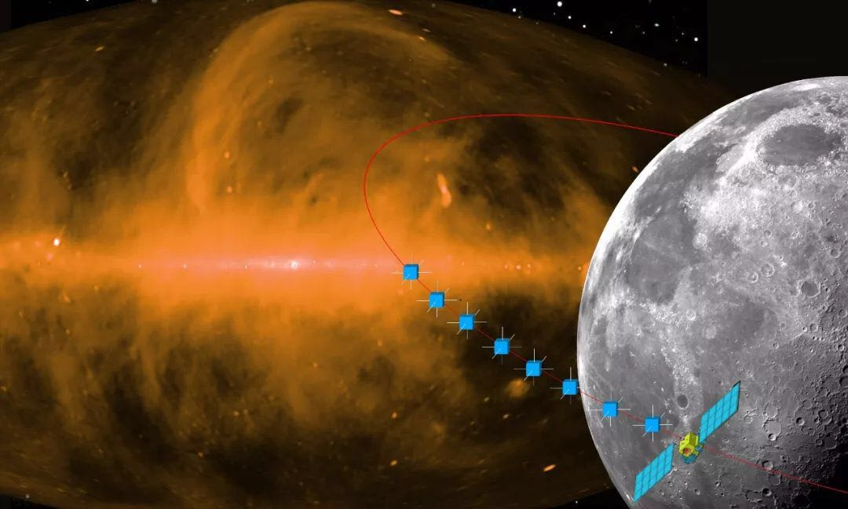
远离地面无线电干扰——到月球背面去
DAPPAR
鸿蒙计划
（超长波天文观测阵列，DSL)

Slide 29
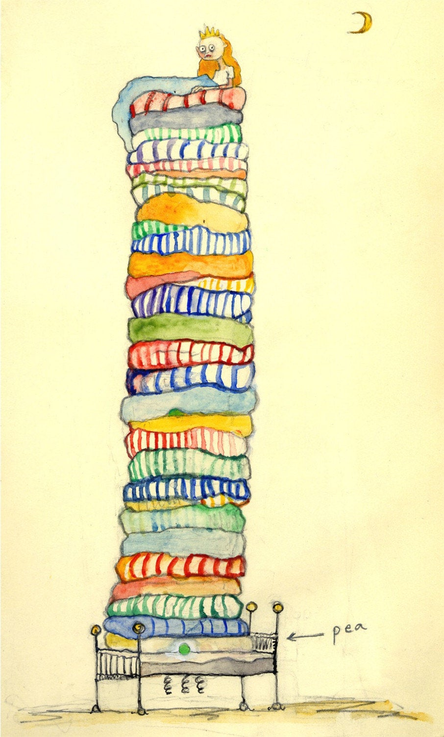
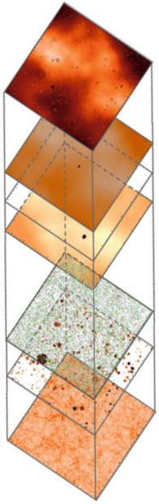
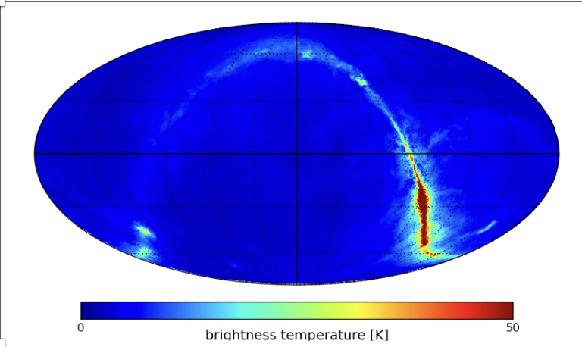
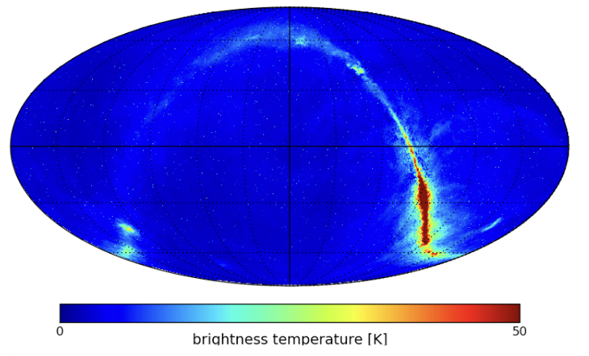
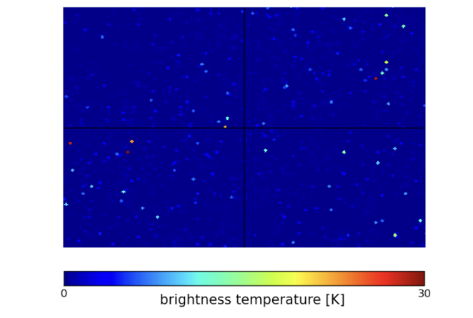
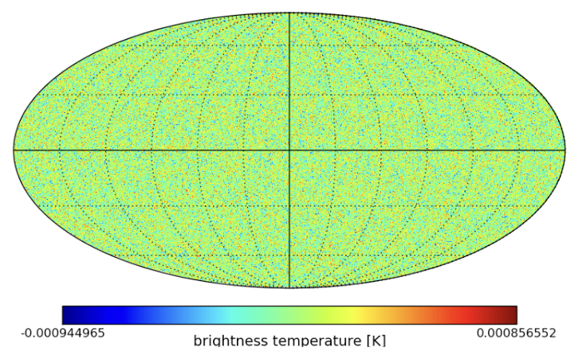
Foreground Contamination in 21 cm Observations
银河系前景Galactic synchrotron
emission
(~2000 mK)
河外前景Extragalactic point sources
(~800 mK)
Sum of all components
宇宙再电离的21厘米信号Cosmic 21 cm signal from the EoR (~10 mK)
Zuo, Chen & YM, 2023, ApJ (arXiv:2208.14675)

Slide 30
21厘米前景污染去除办法
Non-blind method (model dependent)
polynomial fitting
Blind method (model independent)
Principal Component Analysis (PCA)
Gaussian Process Regression (GPR)

Slide 31
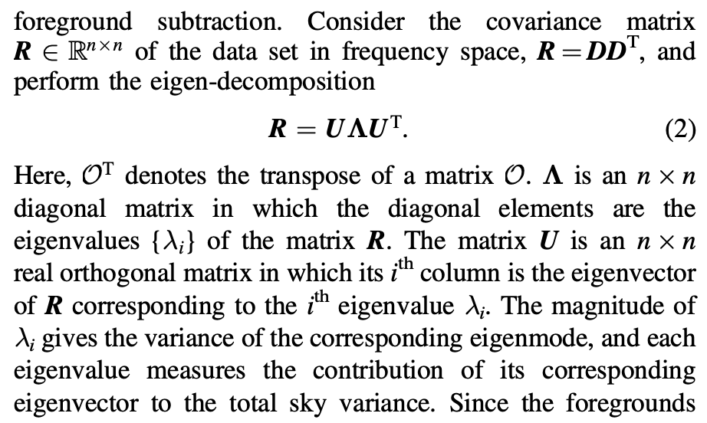


Principal Component Analysis (PCA)
For covariance matrix
PCA/SVD

Slide 32
Extract astrophysical information from cleaned data
21厘米数据的科学分析
图像信号
再电离
第一代星系形成
平均信号
加热宇宙
统计起伏信号
（功率谱）
图：A. Liu & R. Shaw

Slide 33



Parameter Estimation using 21 cm Power Spectrum
21cm Power Spectrum
Reionization Parameters
Bayesian inference of reionization model parameters with conventional MCMC method (21CMMC code)
ζ
the ionizing efficiency
$T_{vir}$
the minimum virial temperature of halos that host ionizing sources
Greig & Mesinger, 2015, MNRAS

Slide 34


Parameter Estimation using 21 cm Power Spectrum
Estimation of reionization model parameters with artificial neural networks
(note: point estimate, not posterior inference)
Shimabukuro & Semelin, 2017, MNRAS

Slide 35


Statistical Inference in Cosmology
Observation
Summary Statistics
Likelihood
Sampling
Statistical Inference
Parameter Posterior

Slide 36







$$P\left(θ | t\right)$$
Posterior
Simulation-Based Inference (SBI)
1. Generative Way (density estimation likelihood-free inference, DELFI):
Density Estimator
Prior
Zhao, YM, et al
2022a,2022b, 2023
$$\{θ,t\}$$
$$P\left(t | θ\right)$$
$$P\left(θ | t\right)∝P\left(t | θ\right)P(θ)$$
Bayes’ Theorem
2. Discriminative Way (Neural Ration Estimation, NRE):
Ce, YM, et al
In prep
Ratio estimation
Prior
$$r\left(θ,t\right)=\frac{P(t|θ) }{P(t)}$$
$$P\left(θ | t\right)=r\left(θ,t\right)P(θ)$$
$$\{θ,t\}$$

Slide 37

$$P\left(θ | t\right)$$
Posterior
Simulation-Based Inference (SBI)
1. Generative Way (density estimation likelihood-free inference, DELFI):
Zhao, YM, et al
2022a,2022b, 2023
Density Estimator
Prior
$$\{θ,t\}$$
$$P\left(t | θ\right)$$
$$P\left(θ | t\right)∝P\left(t | θ\right)P(θ)$$
Bayes’ Theorem
An example of Neural Density Estimators (NDEs)
Zhao, YM, Cheng & Wandelt, 2022a, ApJ (arXiv:arXiv:2105.03344)

Slide 38

Inference of reionization model parameters
from 21 cm power spectrum
MCMC
21cmDELFI-PS
Faint galaxies dominated reionization
Bright galaxies dominated reionization
Zhao, YM & Wandelt, 2022b, ApJ (arXiv:2203.15734)

Slide 39
Extract astrophysical information from cleaned data
Images
Global Signal
Power Spectrum
A. Liu & R. Shaw

Slide 40



Likelihood-free Bayesian inference
Xiaosheng
Zhao
(now postdoc
at JHU)
Structure of Convolutional Neural Networks (CNN)
Zhao, YM, Cheng & Wandelt, 2022a, ApJ (arXiv:arXiv:2105.03344)
$T_{vir}$
Minimum virial temperature of haloes that host star-forming galaxies
$ζ$
UV Ionizing efficiency of galaxies.

Slide 41
Likelihood-free Bayesian inference
Xiaosheng
Zhao
(now postdoc
at JHU)
Compression
Solid harmonic wavelet scattering transform (SHWST)
Zhao, YM, Zuo & Wandelt, ApJ 2024 (arXiv: 2310.17602)

Slide 42
Likelihood-free Bayesian inference
Xiaosheng
Zhao
(now postdoc
at JHU)
Compression
Solid harmonic wavelet scattering transform (SHWST)
Zhao, YM, Zuo & Wandelt, ApJ 2024 (arXiv: 2310.17602)

Slide 43

Inference of reionization model parameters
from 21 cm lightcone 3D images
MCMC
Xiaosheng
Zhao
(now postdoc
at JHU)
21cmDELFI-PS
3D ScatterNet
Faint galaxies dominated reionization
Bright galaxies dominated reionization
大质量星系主导再电离的模型
Zhao, YM, Zuo & Wandelt, ApJ 2024 (arXiv: 2310.17602)

Slide 44










$$P\left(θ | t\right)$$
Posterior
Simulation-Based Inference (SBI)
2. Discriminative Way (Neural Ration Estimation, NRE):
Ce, YM, et al
In prep
Ratio estimation
Prior
$$r\left(θ,t\right)=\frac{P(t|θ) }{P(t)}$$
$$P\left(θ | t\right)=r\left(θ,t\right)P(θ)$$
$$\{θ,t\}$$
$$P\left(θ,t\right)=P\left(t | θ\right)P(θ)$$
$$\{θ,t\}$$
Classifier
$$\max_{D}{E_{p\left(θ,t\right)}[\log\left(D\left(t,θ\right)\right]+E_{p\left(θ)p(t\right)}[log(1−D\left(t,θ\right))]}$$
$$D(t,θ)$$
$$r\left(θ,t\right)=\frac{P(x|t) }{P(t)}$$
$$P\left(θ\right)P(t)$$
$$D^{∗}\left(t,θ\right)=\frac{r\left(θ,t\right)}{r\left(θ,t\right)+1}$$

Slide 45




Comparison between two SBI methods
Pure Signal
+ Thermal Noise
+Residual Foreground
Ce Sui
Bright Galaxy
Model
Ce, YM, et al. in prep

Slide 46
除了21厘米谱线，宇宙再电离还有新的探针吗？
Notes:
加一个过渡也，您强调下我们为什么要研究宇宙再电离

Slide 47
宇宙再电离新的探针（一）
研究21厘米与CO线的协同观测
What else can we learn about the EoR than just constraining reionization model parameters?

Slide 48

We can reconstruct the initial density fields
Local Universe:
ELUCID (Wang et al 2013)
BORG (Jasche & Wandelt 2013)
….
+ Hamiltonian Monte Carlo
“observed”
“resimulated”
Wang et al 2013

Slide 49

We can reconstruct the initial density fields from high-redshift observations

Slide 50


We can reconstruct the initial density fields from high-redshift observations
☑ H I 21 cm intensity mapping

Slide 51


We can reconstruct the initial density fields from high-redshift observations
☑ H I 21 cm intensity mapping
☑ Molecular line intensity mapping

Slide 52







We can use line intensity mappings
Minimize Cost Function ~ Maximize Likelihood
Meng
Zhou
(now postdoc
at NAOC)
Resimulated LIM
Mock (input) LIM
Weight
j: 21cm and CO
$α$: pixels
Uncertainty
21cm:
neutral region
CO (1→0):
ionized region
Zhou and YM, ApJ 2024 (arXiv:2311.14940)

Slide 53


We employ the conjugate gradient to minimize the cost function.
Meng
Zhou
(now postdoc
at NAOC)
Zhou and YM, ApJ 2024 (arXiv:2311.14940)

Slide 54

Analytical gradients agree with numerical results.
Excursion Set model of reionization (ESMR):
Meng
Zhou
Empirical L~SFR model:
analytical evaluations
ESMR
Zel’dovich
approximation
numerical evaluations
Zhou and YM, ApJ 2024 (arXiv:2311.14940)

Slide 55


We can reconstruct the initial density fields from high-redshift observations
H I 21 cm intensity mapping
z=7.56, x_{HI} = 0.25
z=8.20, x_{HI} = 0.50
z=9.54, x_{HI} = 0.75
Meng
Zhou
(now postdoc
at NAOC)
Input maps
Resimulated maps
L = 4.95%
L = 6.73%
L = 4.55%
Zhou and YM, ApJ 2024 (arXiv:2311.14940 )

Slide 56

We can reconstruct the initial density fields from high-redshift observations
CO line intensity mapping
z=7.56, x_{HI} = 0.25
z=8.20, x_{HI} = 0.50
z=9.54, x_{HI} = 0.75
Meng
Zhou
(now postdoc
at NAOC)
Input maps
Resimulated maps
L = 4.95%
L = 6.73%
L = 4.55%
Zhou and YM, ApJ 2024 (arXiv:2311.14940 )

Slide 57
We can reconstruct the initial density fields from high-redshift observations
Relative error of 21cm power spectrum
Relative error of CO power spectrum
Zhou and YM, ApJ 2024 (arXiv:2311.14940 )
The reconstructed power spectrum is <4% error in most cases.

Slide 58

We can reconstruct the initial density fields from high-redshift observations
Zhou and YM, ApJ 2024
(arXiv:2311.14940 )
True initial overdensity field
Meng
Zhou
(now postdoc
at NAOC)
Reconstructed initial overdensity field
From observations at:
z=7.56, x_{HI} = 0.25
z=8.20, x_{HI} = 0.50
z=9.54, x_{HI} = 0.75

Slide 59

We can reconstruct the initial density fields from high-redshift observations
From observations at:
z=7.56, x_{HI} = 0.25
z=8.20, x_{HI} = 0.50
z=9.54, x_{HI} = 0.75
Reconstructed
True initial overdensity
PDF
Zhou and YM, ApJ 2024 (arXiv:2311.14940 )
Residuals

Slide 60


We can reconstruct the initial density fields from high-redshift observations
Relative error of initial overdensity power spectrum
Power spectrum of initial overdensity
Zhou and YM, ApJ submitted (arXiv:2311.14940 )
The reconstructed power spectrum is <4% error in most cases.
Zhou and YM, ApJ 2024 (arXiv:2311.14940)

Slide 61
宇宙再电离新的探针（二）
Lyα森林功率谱作为宇宙再电离的新探针
Post-reionization Lyα forest power spectrum as a new probe of cosmic reionization
P. Montero-Camacho & YM, MNRAS, 2020
P. Montero-Camacho & YM, MNRAS, 2021
P. Montero-Camacho, Y. Liu & YM, MNRAS, 2023
P. Montero-Camacho, Y. Zhang & YM, 2023, submitted

Slide 62

Effect of cosmic reionization on the post-reionization IGM
Slide from P. Montero-Camacho

Slide 63

Effect of cosmic reionization on the post-reionization IGM
Hirata (2018)
Slide from P. Montero-Camacho

Slide 64

Effect of cosmic reionization on the post-reionization IGM
P. Montero-Camacho et al. (2019)
Slide from P. Montero-Camacho

Slide 65



Effect of cosmic reionization on the post-reionization IGM
P. Montero-Camacho & YM, MNRAS, 2020
Slide from P. Montero-Camacho

Slide 66







Forecast for DESI using 3D Lya power spectrum: constraints on reionization parameters
P. Montero-Camacho & YM, 2021, MNRAS

Slide 67


Forecast for DESI using 3D Lya power spectrum: implications on global reionization history
P. Montero-Camacho & YM, 2021, MNRAS

Slide 68



Slide 69
宇宙再电离时代的观测证据
已有探针：
Lyα 森林光深测量：再电离结束于红移6
宇宙微波背景辐射：再电离渐变
Lyα 发射体：再电离非均匀
未来探针：
☑ 中性氢21厘米谱线强度映射
☑ 分子谱线强度映射，及其与21厘米交叉关联
☑ 中性氢21厘米森林
☑ 低红移Lyα 森林功率谱

