Slide 1
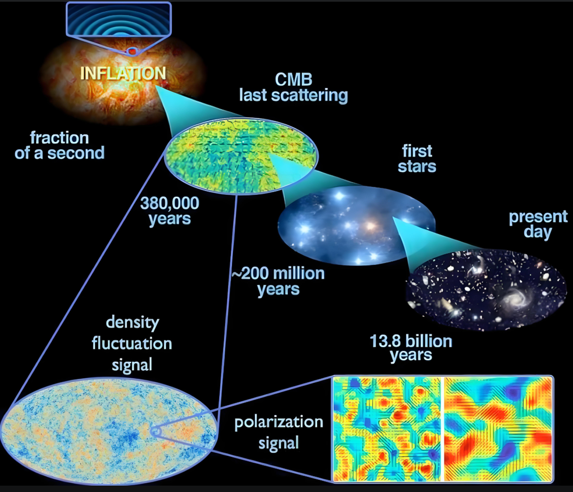
Cosmic Microwave Background (CMB) radiation and the detection of PGWs
Wen Zhao
Department of Astronomy, University of Science and Technology of China

Slide 2
OUTLINE
CMB and cosmology
Statistical properties of CMB
Physics of CMB
Detecting PGWs in CMB
Conclusions

Slide 3
OUTLINE
CMB and cosmology
Statistical properties of CMB
Physics of CMB
Detecting PGWs in CMB
Conclusions

Slide 4
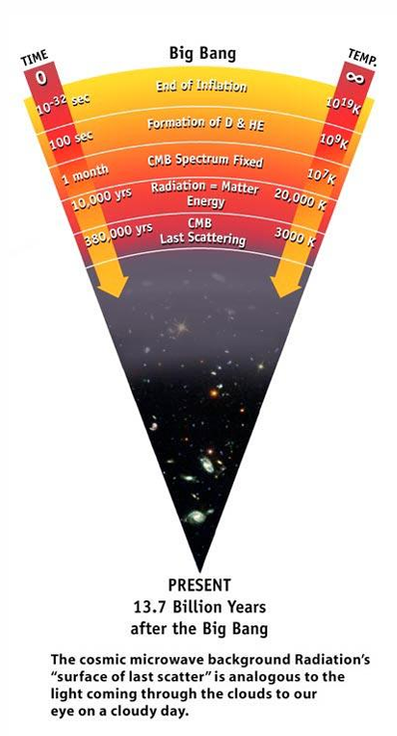
CMB and cosmology
In the Big Bang cosmological model, during the earliest periods, the universe was filled with an opaque fog of dense, hot plasma of sub-atomic particles.
As the universe expanded, this plasma cooled to the point where protons and electrons combined to form neutral atoms of mostly hydrogen.
These atoms could not scatter thermal radiation by Thomson scattering, and so the universe became transparent. Known as the recombination epoch, this decoupling event released photons to travel freely through space, which formed the CMB radiation.
The recombination epoch occurred at z~1100, where the age of the Universe is about 380,000 years old, and the temperature is about 3000K.
The CMB radiation continued to cool, with the expansion of the Universe, and today the peak should be at the microwave band.

Slide 5
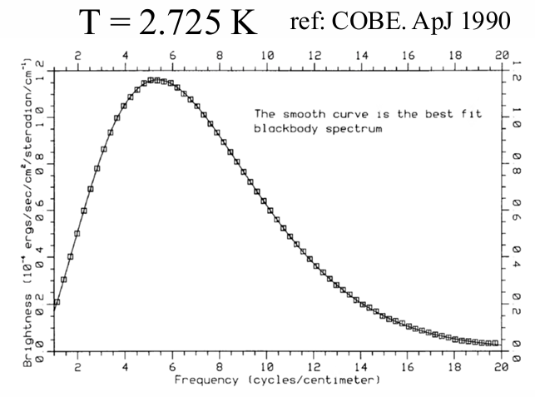
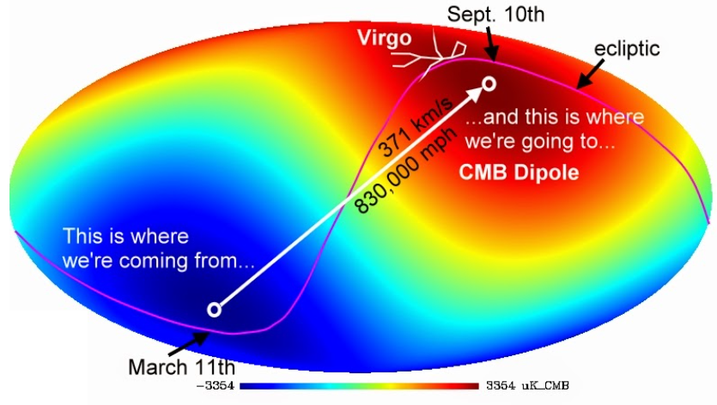
Perfect Planck Thermal Spectrum
The CMB is an emission of uniform black body thermal energy coming from all directions with a temperature of 2.72548±0.00057 K (from COEB observations).
Subtracting the prefect thermal spectrum, we find a dipole anisotropy from the Doppler shift of the background radiation with amplitude ~ 3.35mK.
This dipole is caused by the peculiar velocity of the Sun relative to the comoving cosmic rest frame as it moves at 369.82 ± 0.11 km/s towards the constellation Crater near its boundary with the constellation Leo.

Slide 6
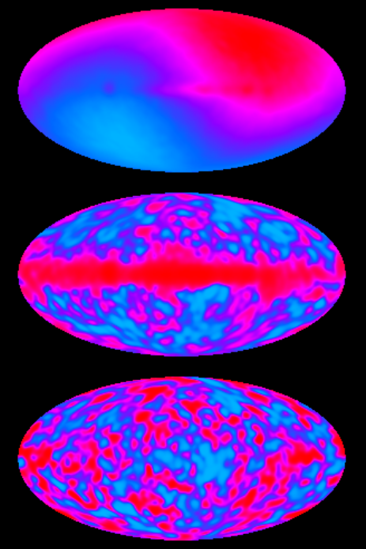
Temperature Anisotropy
What we can find, if subtracting the Black Body spectrum and the dipole structure?
Surprised, we find a temperature anisotropy map with amplitude of 10⁻⁵ of background.
This anisotropy reflects the non-uniformity of the early universe, and seeds the large-scale structure.
But, what is the origin of this anisotropy?

Slide 7
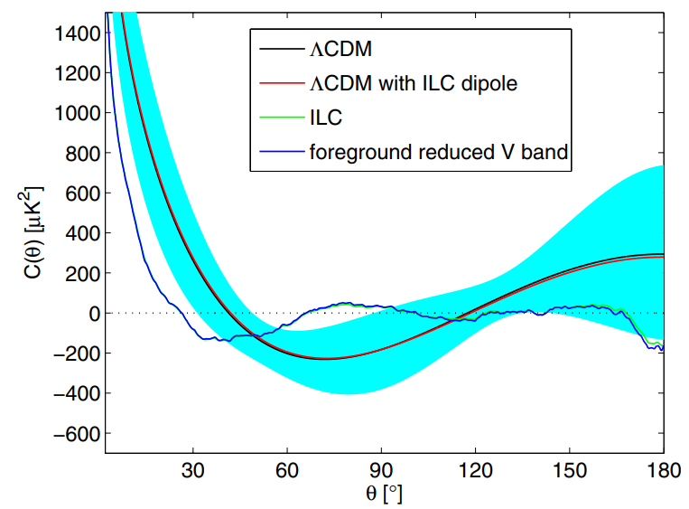
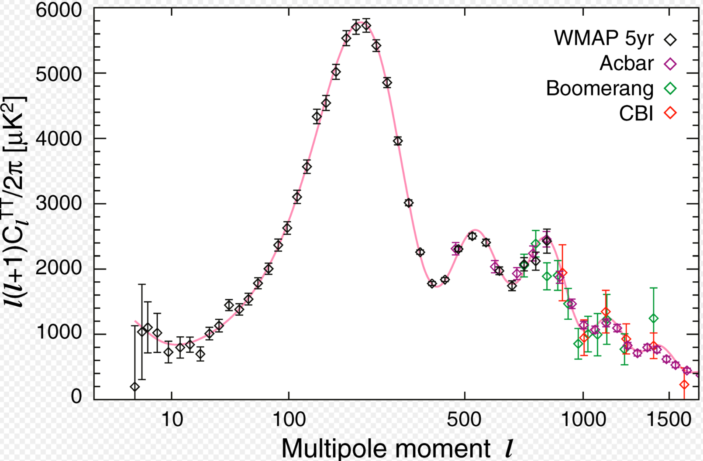
Super-horizon Fluctuations
Statistical analysis shows that these anisotropies are not random distributed. Different points have the significant correlations.
COBE satellite found that, the non-zero correlation exists even if the angle is larger than the horizon scale ( ~ 2 deg) of recombination scale.
These super-horizon fluctuations strongly support the inflationary model: Primordial Scalar and Tensor Perturbations → CMB Temperature Perturbations

Slide 8
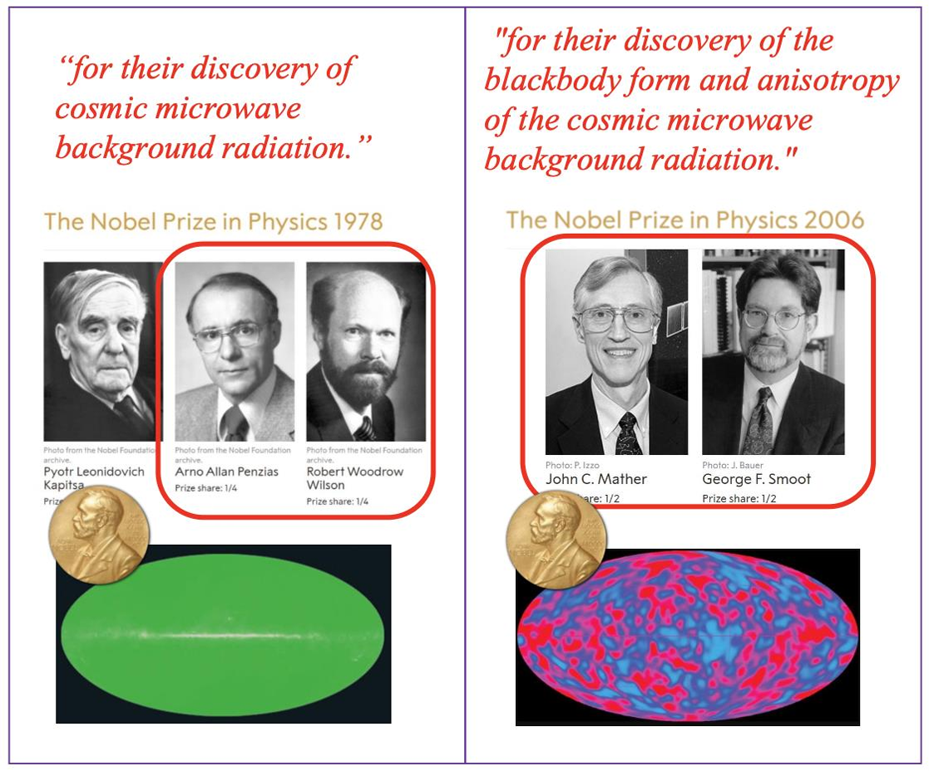

Slide 9
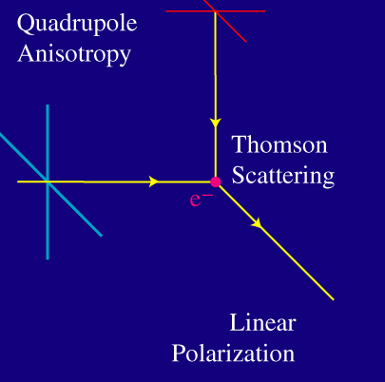
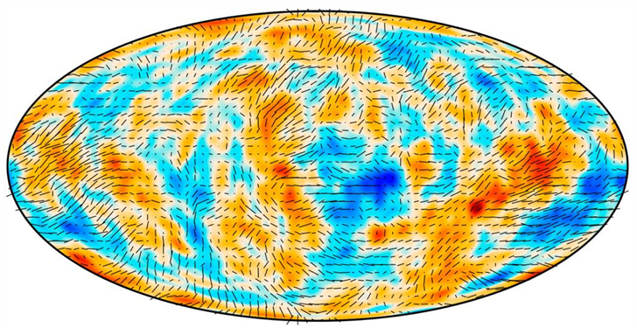
Linear Polarization of CMB
The CMB is polarized at the level of a few microkelvin.
The linear polarization can be generated by the Thomson scattering of CMB photons (right).
Two factors are needed: (1) Temperature anisotropies; (2) Free electrons, which can be satisfied only in two stages of the Universe: @ recombination stage (z~1100), and @ reionization stage (z~10).
In the standard model, no reason to generate the circular polarization.

Slide 10
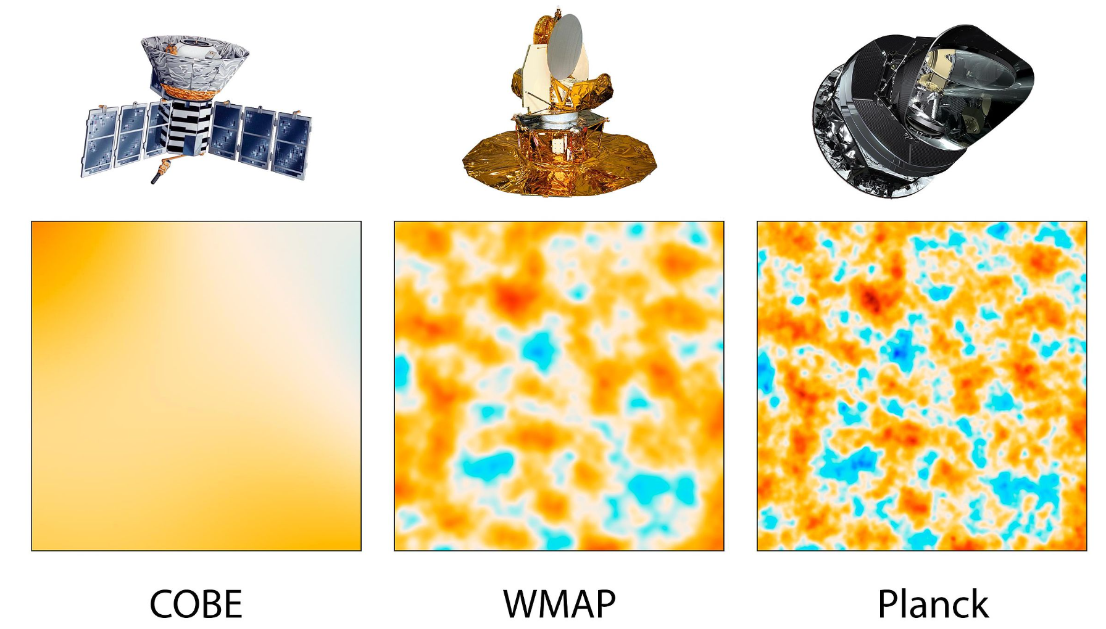
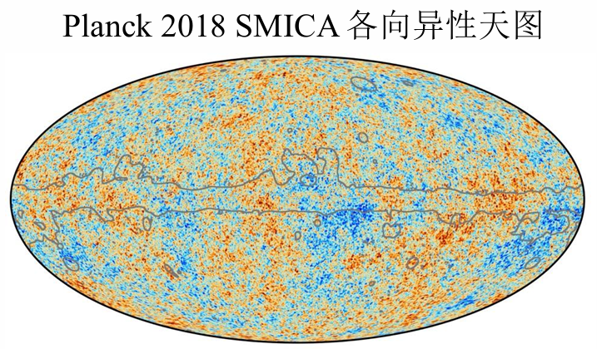
Observations: From COBE to Planck
The COBE satellite (1989–1996) detected and quantified the large-scale anisotropies for the first time.
The ground-based DASI experiment made the first detection of the polarization of the CMB.
The WMAP satellite (2001-2010) make much more precise measurements of the large-scale anisotropies over the full sky, and open the new era of precise cosmology.
A third space mission, the Planck mission, was launched in May 2009 and performed an even more detailed investigation on both CMB temperature and polarization anisotropies.
The ground-based PolarBear experiment detected the lensed B-mode polarization for the first time.

Slide 11
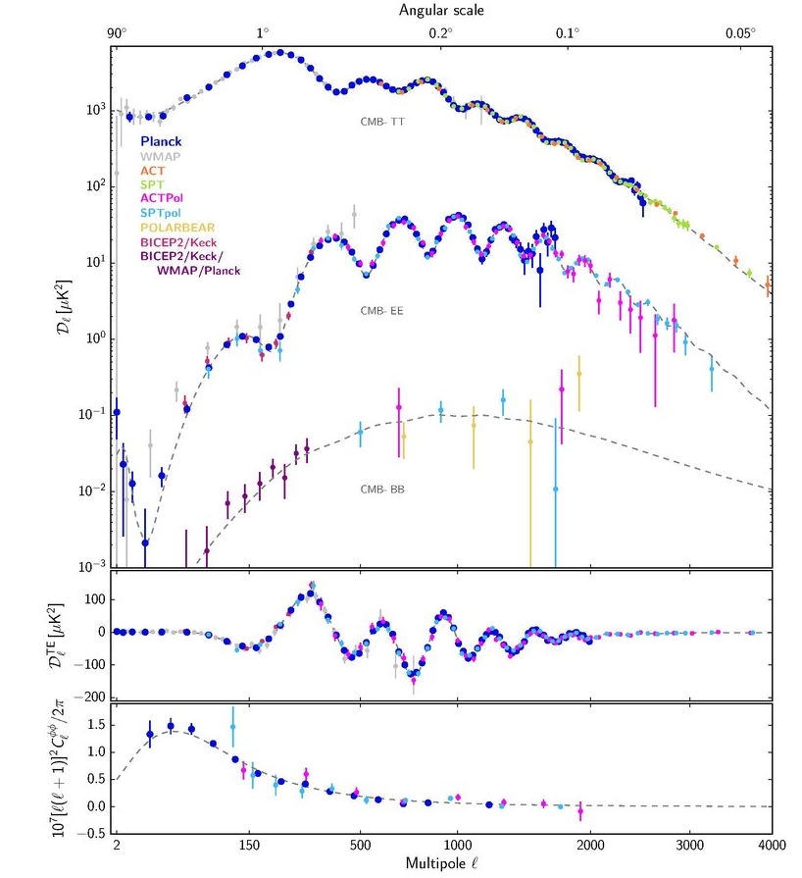
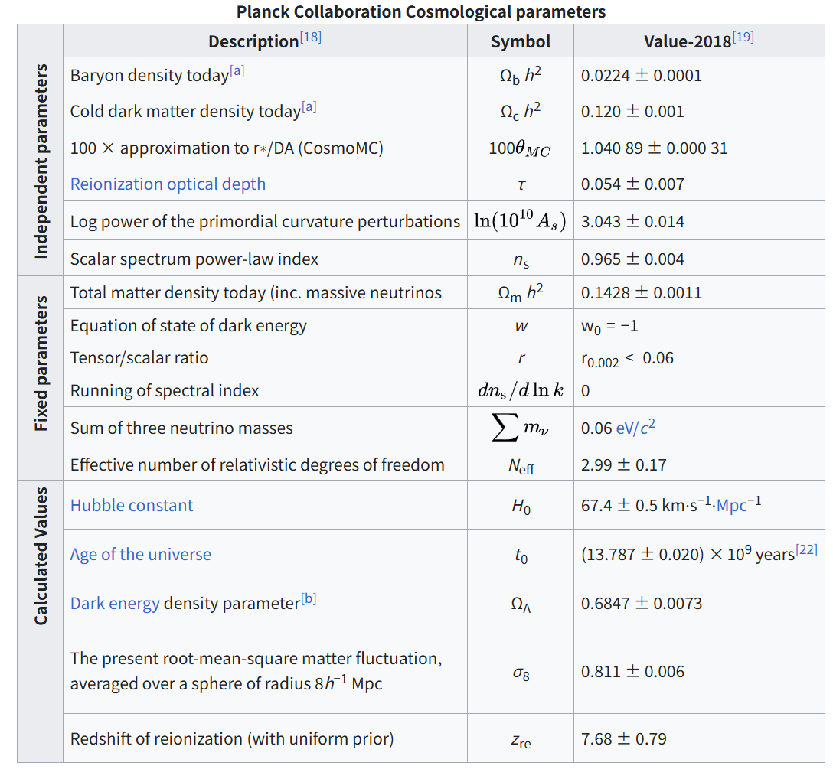
CMB and Precise Cosmology

Slide 12
OUTLINE
CMB and cosmology
Statistical properties of CMB (W.Zhao et al., Phys.Rev.D 79, 023002, 2009)
Physics of CMB
Detecting PGWs in CMB
Conclusions

Slide 13
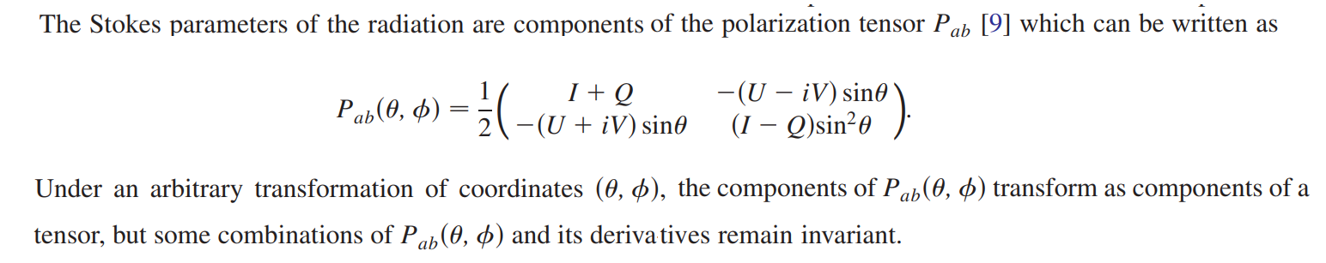
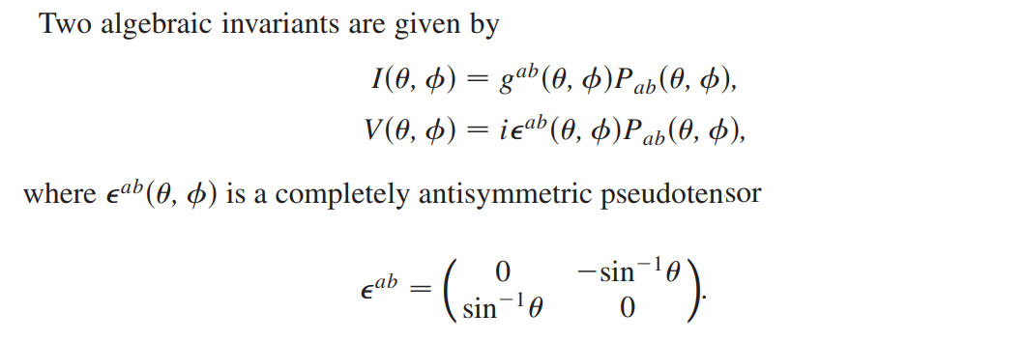
Statistical properties of CMB

Slide 14
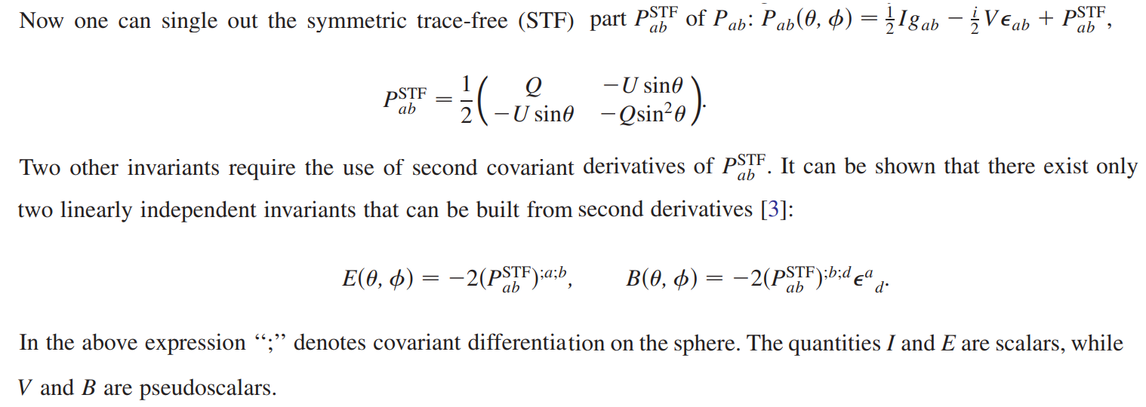
E and B types of polarization of the CMB field
14

Slide 15
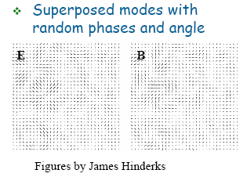
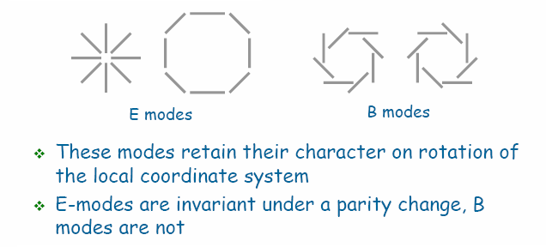

Slide 16
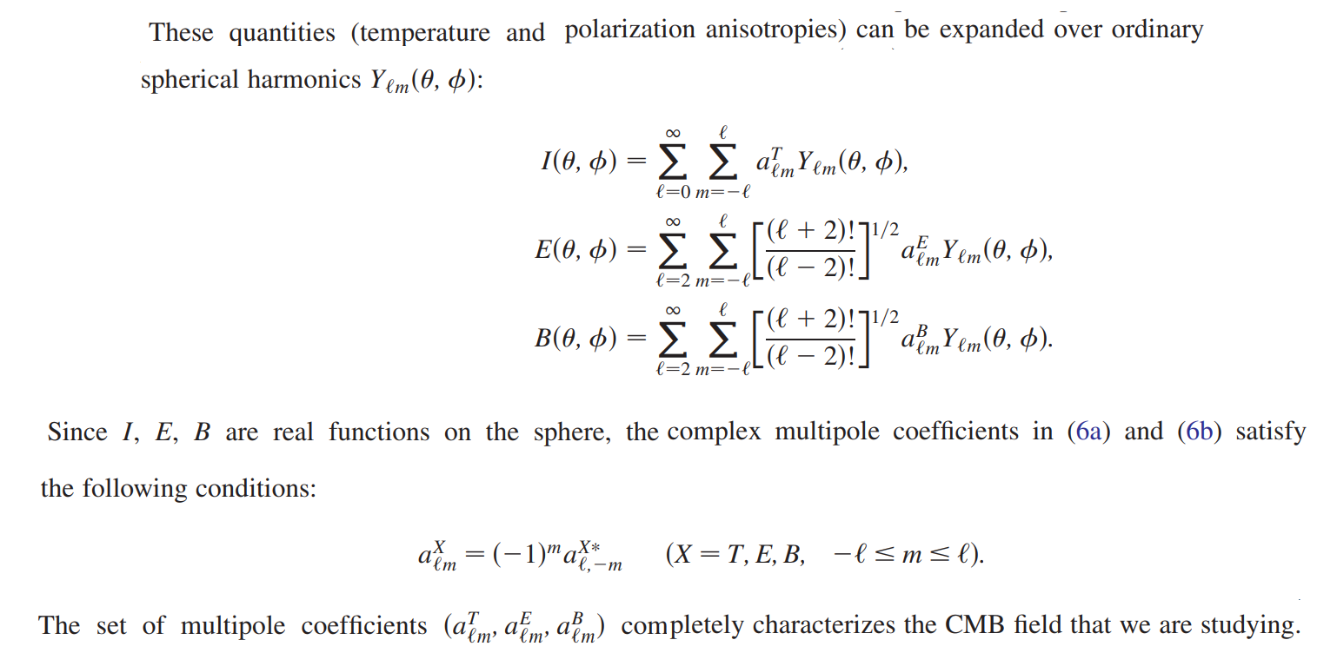

Slide 17
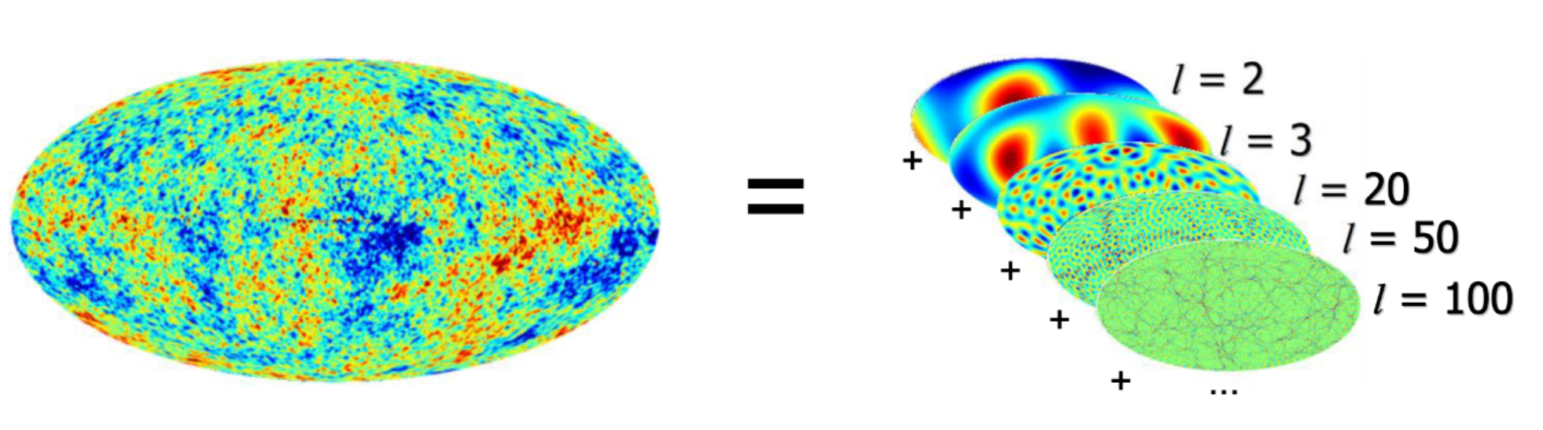
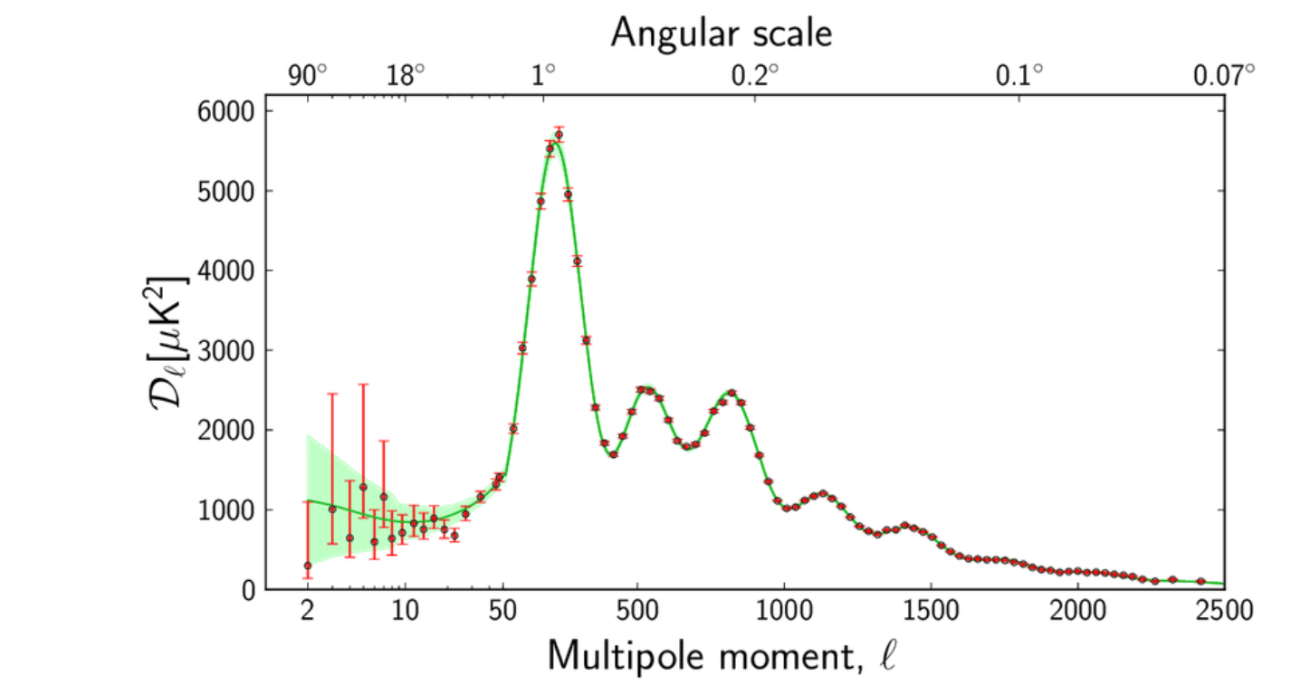

Slide 18
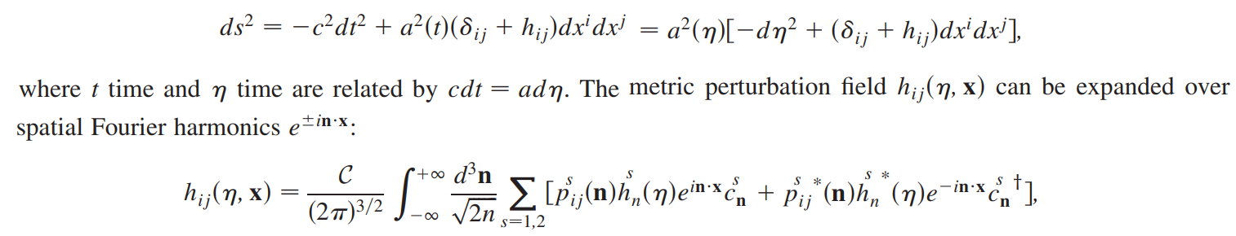
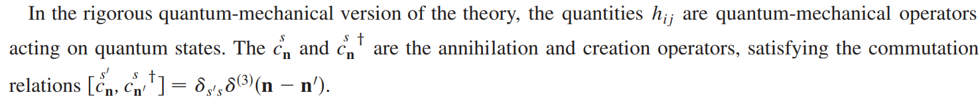
Statistics of Primordial Perturbations
Let’s consider the tensor perturbation as an example:

Slide 19
Since the Schrodinger evolution of the initial vacuum state into a squeezed vacuum state retains the Gaussianity of the state, we are justified in assuming that each individual complex coefficient is described by a complex Gaussian pdf with a zero mean and unit variance.
The first and second moments calculated with the joint pdf amount to:
Since the coefficients obey a joint multivariate Gaussian (normal) distribution, the higher order averages are expressible in terms of the second moments. In other words, the second moments are sufficient to describe all the statistical properties of perturbation fields.

Slide 20
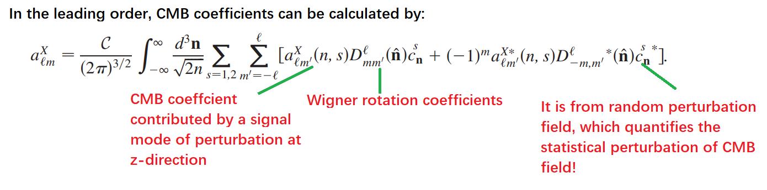
From Primordial Perturbations to CMB Anisotropies

Slide 21
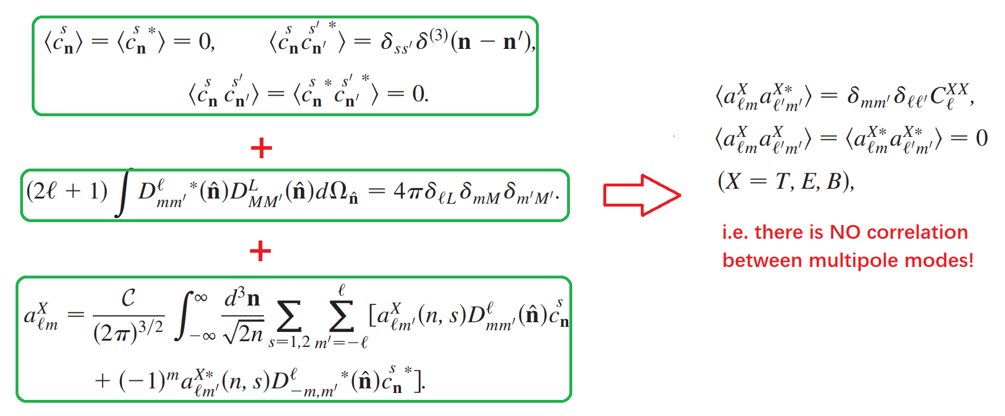
Since CMB fields linearly depends on the primordial fluctuations, all the CMB multipoles coefficients satisfy the multivariate Gaussian distribution.

Slide 22
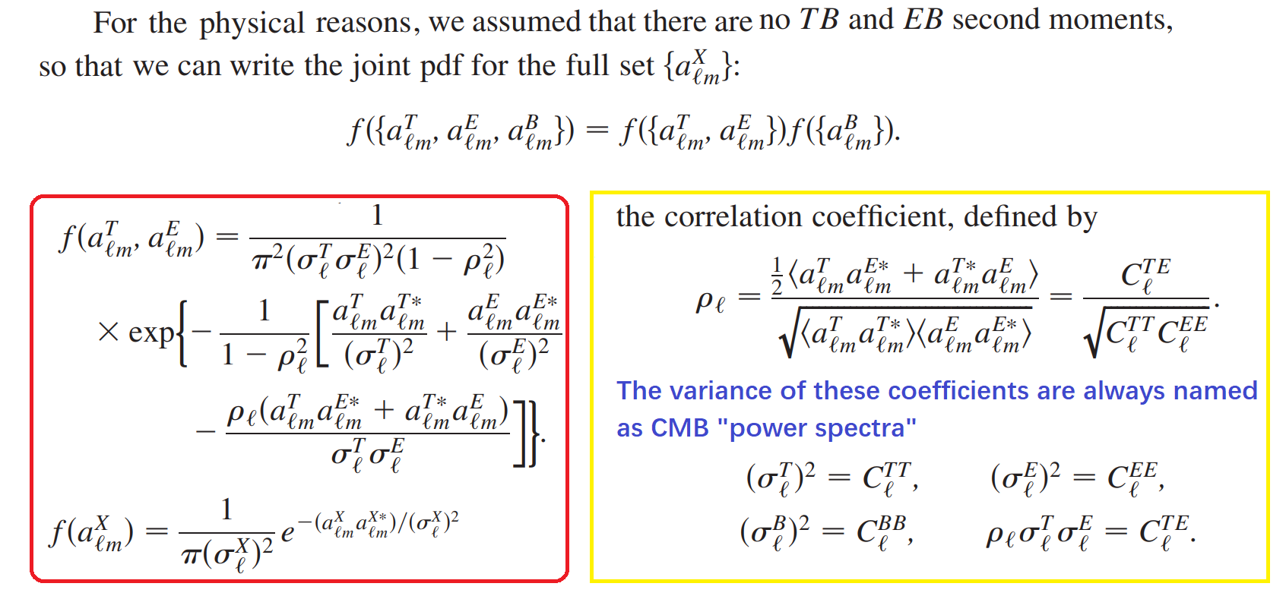

Slide 23
Estimators of CMB Power Spectra
As mentioned above, the second momentum describes all the statistics of all the CMB field.
CMB power spectra are defined as the ensemble average of all possible universe.
However, we have only one Universe, and have no chance to measure these average values. Therefore, CMB power spectra are not measurable!
The unique way is to define their estimators (observable data), which can be calculated from real CMB observations.

Slide 24
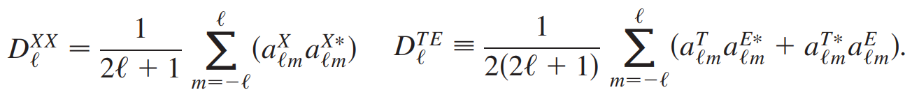
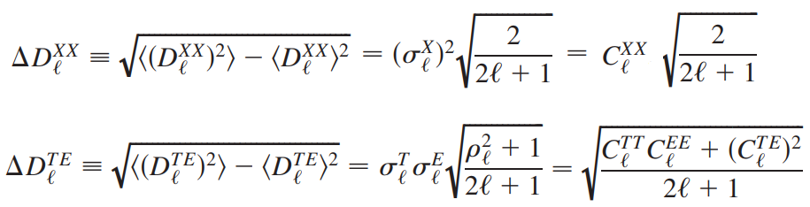
The best-unbiased estimators are given by:
Unbiased: Their expectation values equal to the spectra:
Best: They have the minimal standard deviations:
Note that, these non-zero values indicate the minimal uncertainties of estimators, which also called as “cosmic variance”!

Slide 25
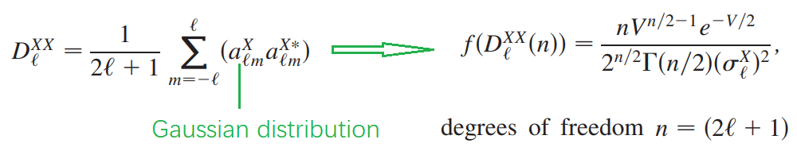
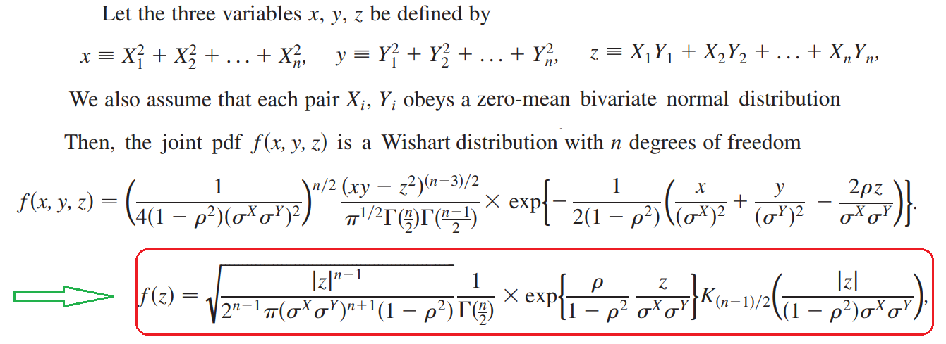
Probability Density Functions (PDFs) of estimators
For the estimators of auto-correlation spectra :
For the estimators of cross-correlation spectra:

Slide 26
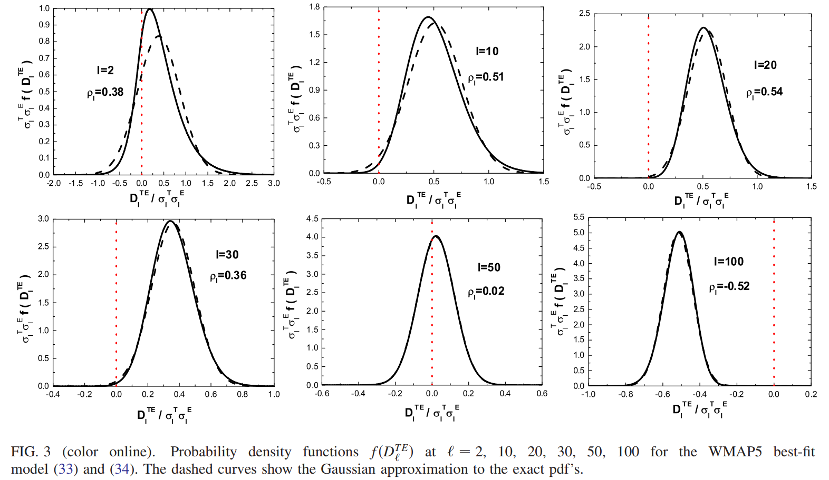

Slide 27
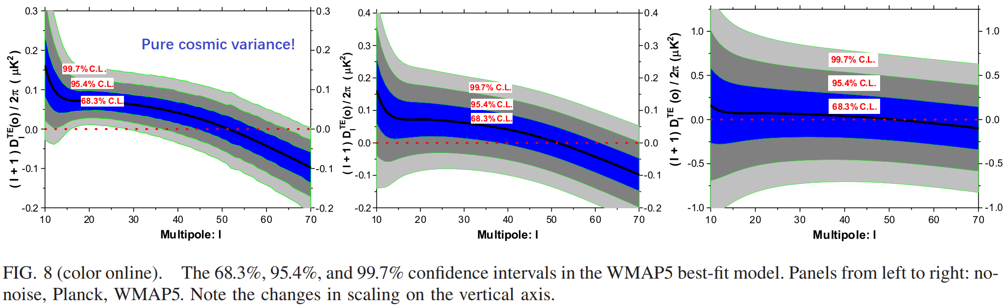
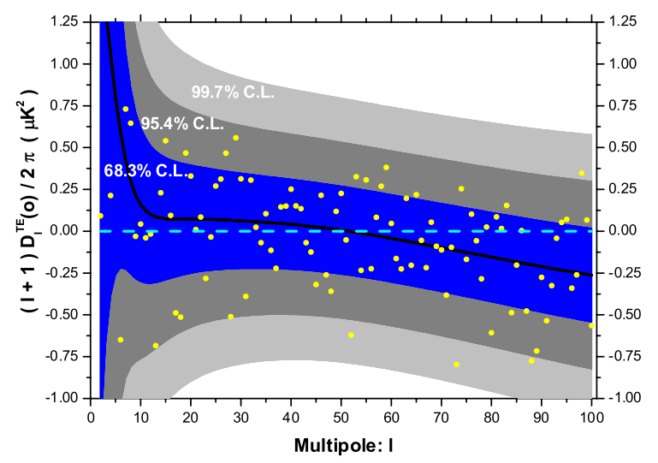
In real observation, these distributions affected by:
Instrumental noises
Partial-sky surveys
Foregrounds
Systematics
………

Slide 28
OUTLINE
CMB and cosmology
Statistical properties of CMB
Physics of CMB
Detecting PGWs in CMB
Conclusions

Slide 29
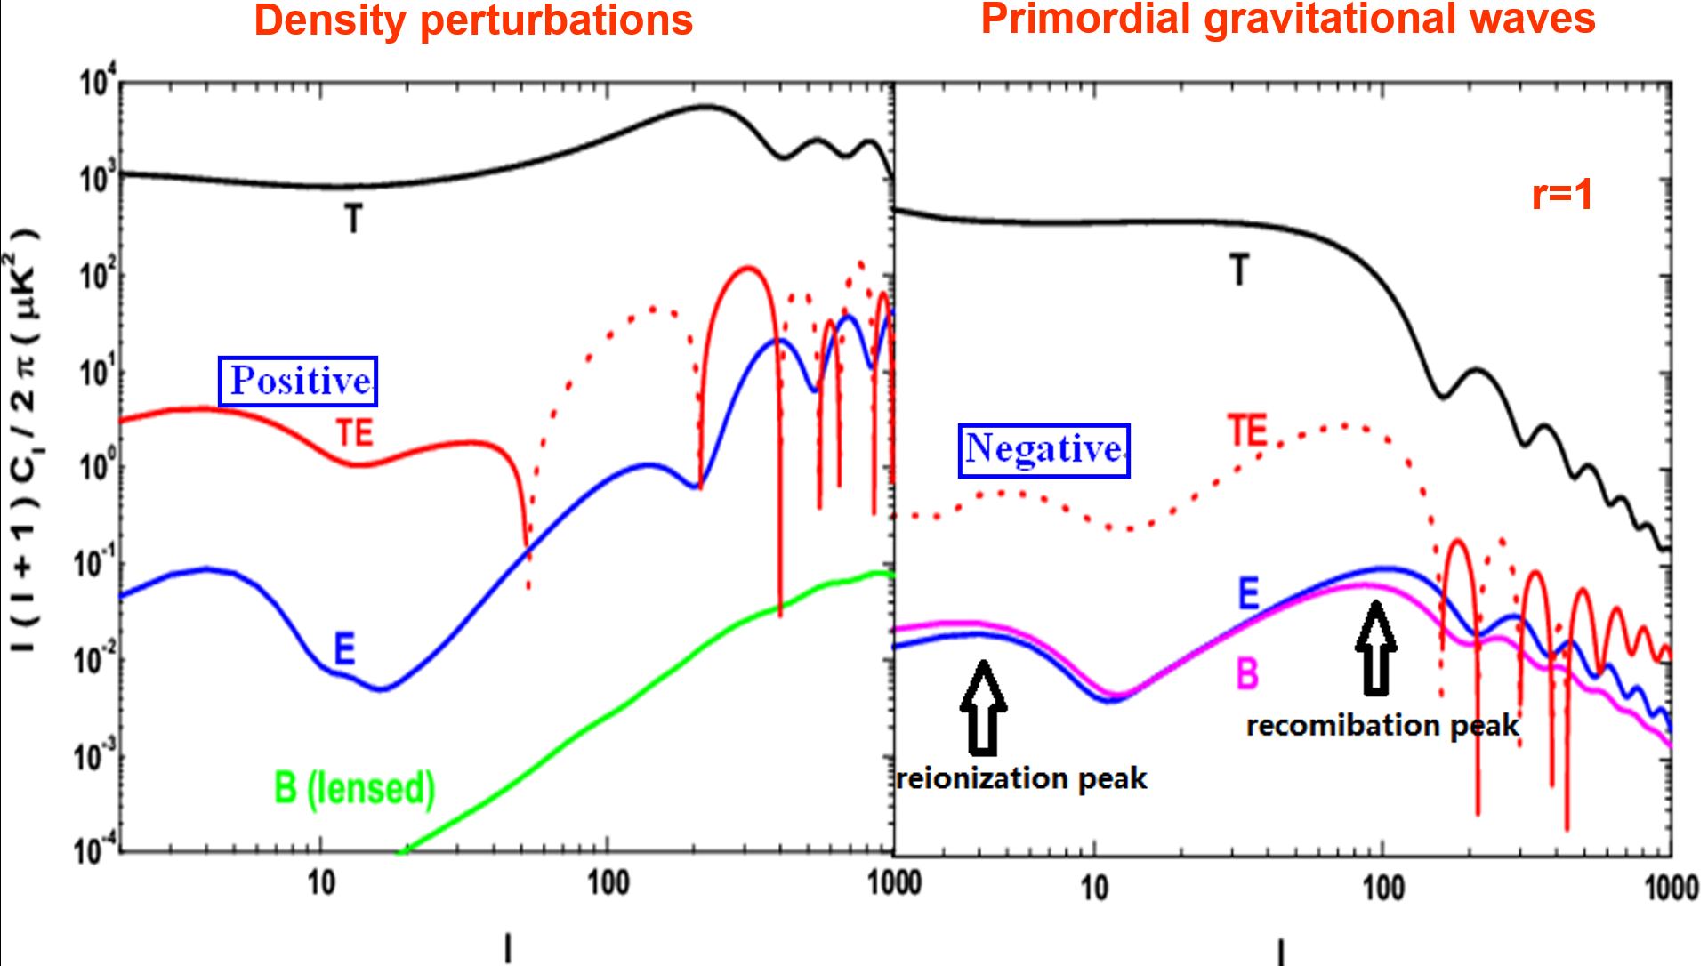
Public package: http://CAMB.info

Slide 30
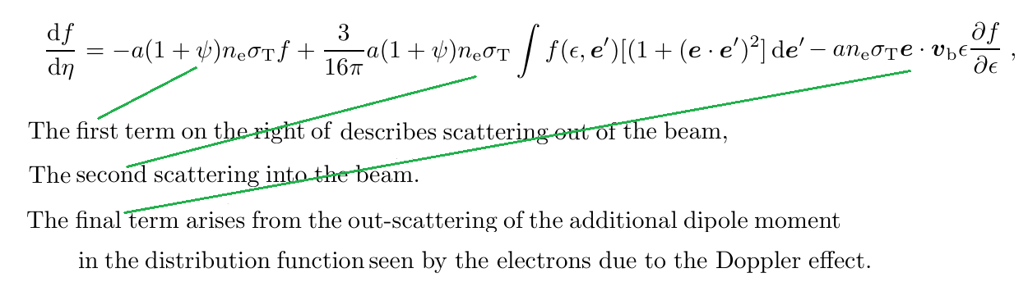
Temperature Anisotropy Spectrum sourced by Scalar Fluctuations
The dominant scattering mechanism to affect CMB anisotropies is classical Thomson scattering off free electrons.
For scalar fluctuations, the metric perturbations strongly coupled with the matters (electrons, baryons, dark matters etc.) in the Universe.
The evolution of the photon distribution function in the presence of Thomson scattering is:

Slide 31
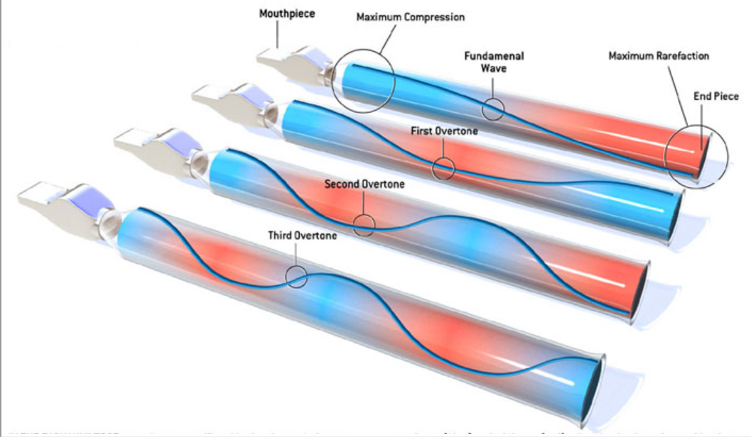
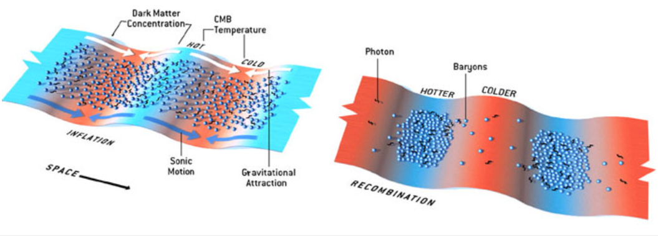
Physics of the Peaks
The spectrum peaks come from those of the metric perturbations.
In the beginning of the early universe, all particles (photons, electrons, etc) coupled together and formed a single gas (plasma).
As in air, a small disturbance in gas density would have propagated as a sound wave (Cosmic Acoustics).
In recombination stage, photons decoupled from the plasma.
The coupling between matters and metric forms a set of overtones of sound wave, where the length is the cosmic sound horizon at recombination stage.
Under the action of gravity, the distribution of photons become anisotropic (hotter or colder), which tracks the gravitational potential anisotropy.
Therefore, the peak of CMB spectrum corresponds to the length of overtones (related to the sound horizon).

Slide 32
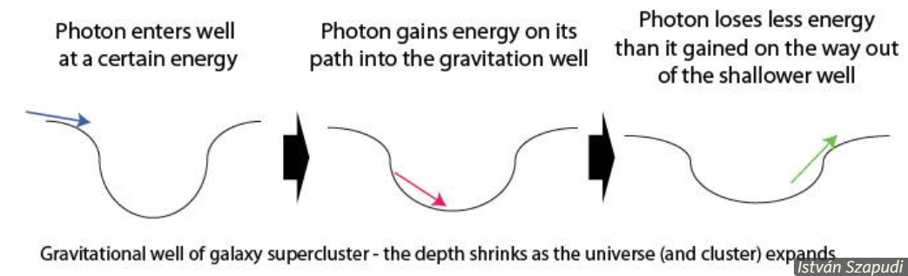
Sachs-Wolfe effect
The Sachs–Wolfe effect, is a property of the CMB, in which photons from the CMB are gravitationally redshifted, causing the CMB spectrum to appear uneven. This effect is the predominant source of fluctuations.
Sachs–Wolfe (SW) effect: It is caused by gravitational redshift occurring at the surface of last scattering. The effect is not constant across the sky due to differences in the matter/energy density at the time of last scattering. It depends only on the state of universe at recombination.
Integrated Sachs–Wolfe (ISW) effect: It is also caused by gravitational redshift, but it occurs between the surface of last scattering and the Earth. It depends on the evolution history after recombination, including the information of ‘dark energy’.

Slide 33
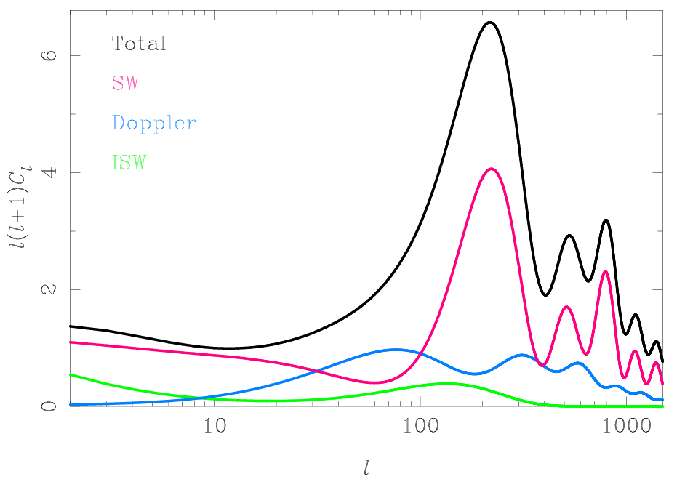
The Doppler term is caused by the moving of electrons, which tends to smooth the gravitational potential well.
Therefore, this effect tends to fill in power between the acoustic peaks.

Slide 34
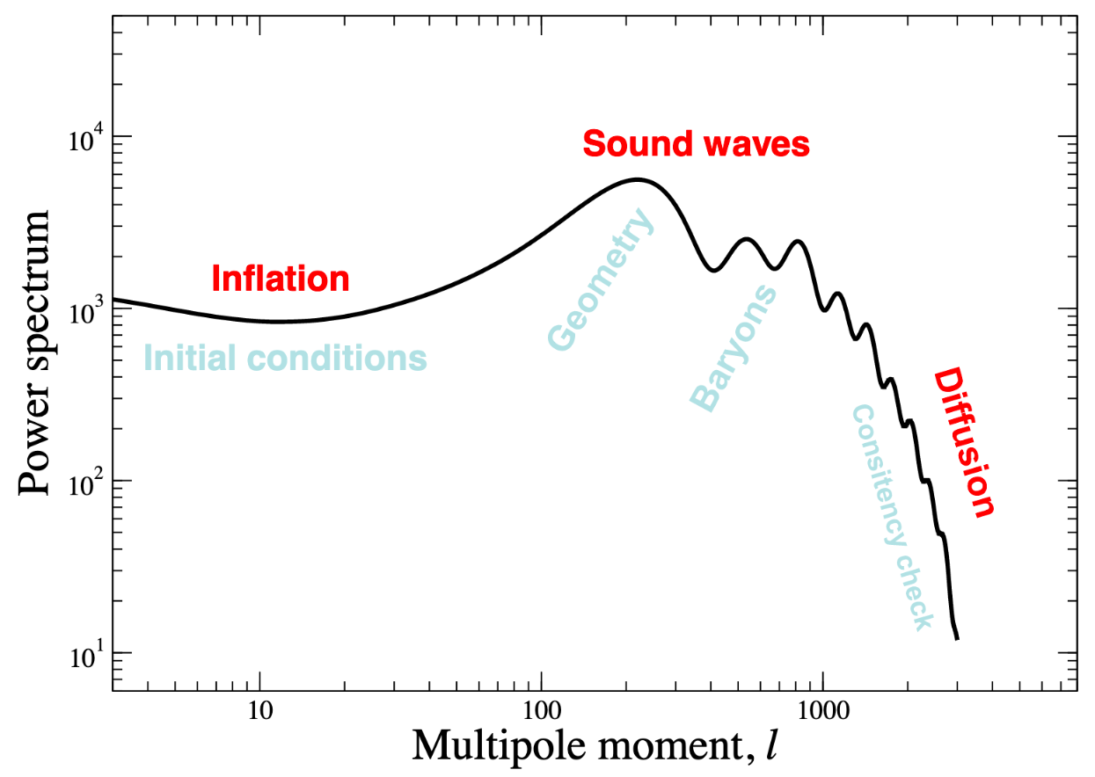
Silk damping (diffusion damping)
During the epoch of recombination, diffusing photons travelled from hot regions of space to cold ones, equalising the temperatures of these regions.
Qualitatively speaking, the smaller scales, the more thorough of the scattering, and the smaller anisotropies.

Slide 35
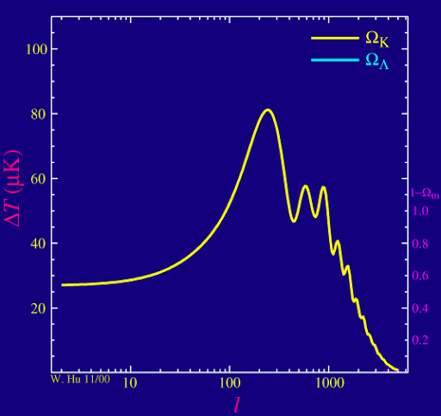

Slide 36
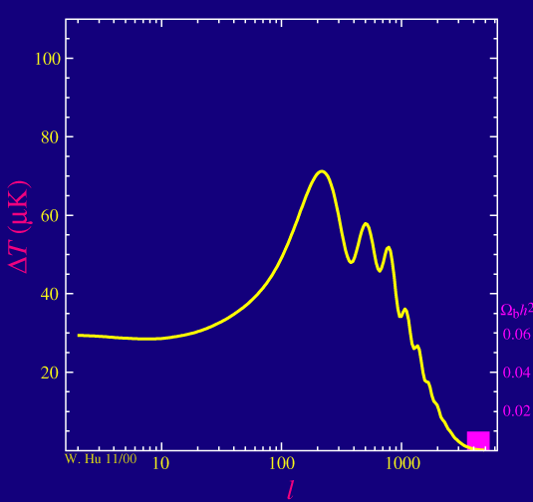

Slide 37
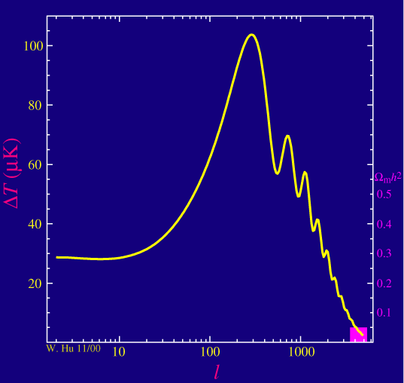

Slide 38
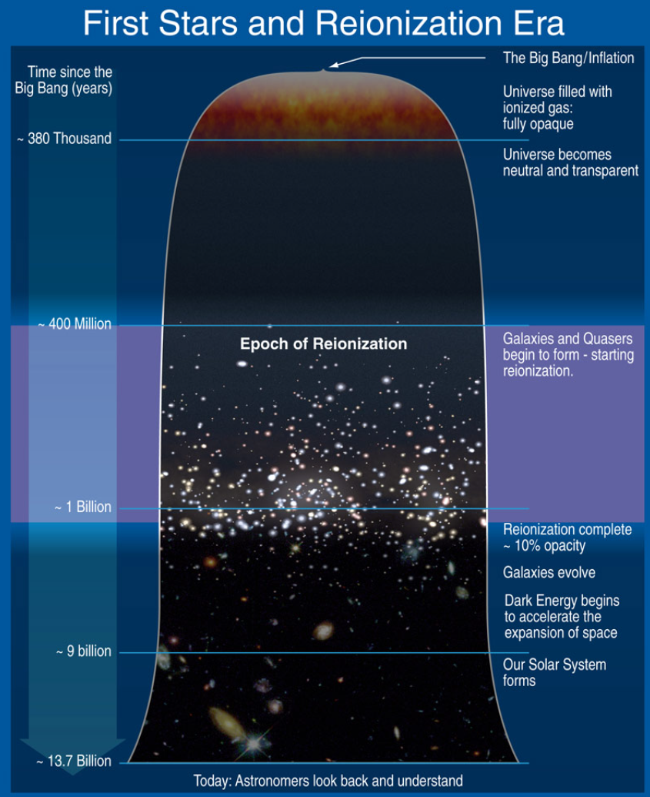
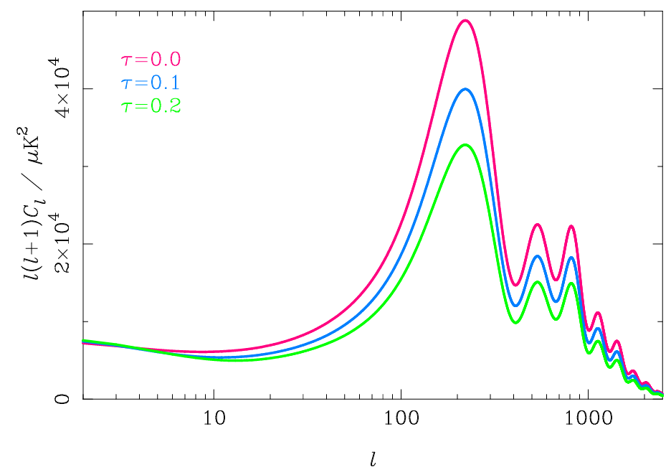

Slide 39
Polarization Anisotropy Spectrum sourced by Scalar Fluctuations
The cosmic microwave background is polarized at the level of a few microkelvin.
The linear polarization can be generated by the Thomson scattering of CMB photons (right).
Two factors are needed: (1) Temperature anisotropies; (2) Free electrons, which can be satisfied only in two stage of the Universe:
@ recombination stage (z~1100),
@ reionization stage (z~10).

Slide 40
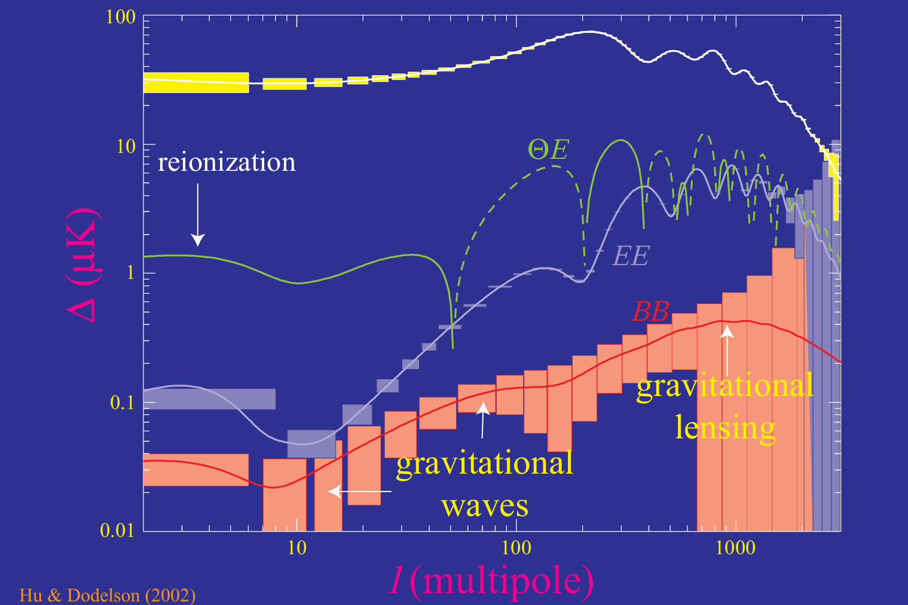

Slide 41
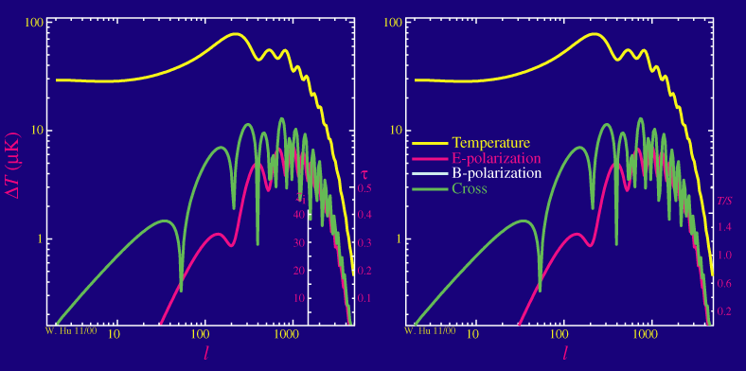

Slide 42
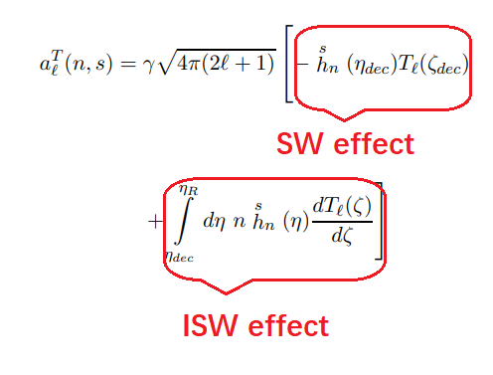
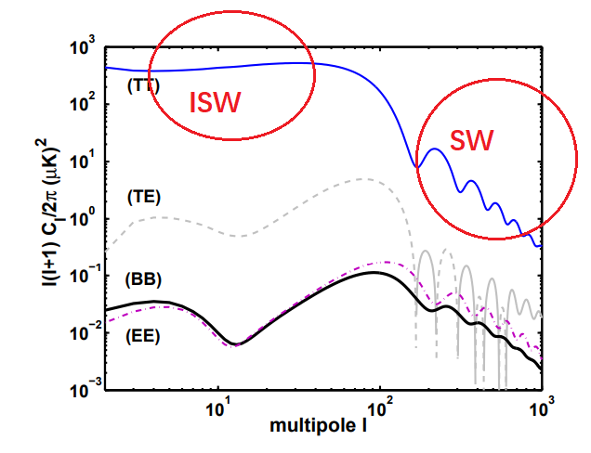
Temperature Anisotropy Spectrum sourced by Primordial Gravitational Waves

Slide 43

Peak scale?
PGW has no coupling with matter, so they evolve independently.
In the recombination epoch, the wave with k=aH (horizon), it begins to damp, and its amplitude is largest.
Its wavelength corresponds to the peak scale of CMB.
Why damping?
Waves with larger k corresponds to small scale (i.e. larger l).
Larger k enters horizon earlier, and damping earlier, and amplitude at recombination smaller. So, larger l, smaller spectrum.

Slide 44

Polarization Anisotropy Spectrum sourced by Primordial Gravitational Waves

Slide 45


Gravitational wave can generate both E-mode and B-mode polarization.
Density perturbation can generate the E-mode polarization, but no B-mode.

Slide 46


Slide 48

Effect of cosmic weak lensing
In addition to the first-order effects as mentioned above, there are several second-order effects (cosmic weak lensing, Sunyaev-Zeldovich effect and so on) which can also slightly affect the CMB power spectra.
Here, we only introduce the cosmic weak lensing effect.

Slide 49


Slide 50


Slide 51


Slide 52


Slide 53


Slide 54
OUTLINE
CMB and cosmology
Statistical properties of CMB
Physics of CMB
Detecting PGWs in CMB
Conclusions

Slide 55

CMB power spectra
Density perturbations
Primordial gravitational waves
r=1
55

Slide 56
Detection in the CMB
Method a: BB channel
But B-polarization is very small. When the noise is large, this channel is useless.
Method b: TT+EE+TE channels
Total TT = TT (dp,+) + TT (gw,+)
Total EE = EE (dp,+) + EE (gw,+)
Total TE = TE (dp,+) + TE (gw,-)
This method is limited by cosmic variance of d.p. When r<0.05, these three channels will be useless.
56

Slide 57


Forecasts for Planck Noise: TT+EE+TE

Slide 58

Focus on the B-mode Polarization

Slide 59
Main Contaminations For B-modes
Instrumental noises
Foreground radiations
E-B mixtures
Various systematics
B-mode from cosmic weak lensing

Slide 60
Main Contaminations For B-modes
Instrumental noises
Foreground radiations
E-B mixtures
Various systematics
B-mode from cosmic weak lensing

Slide 61


Slide 62
Comparison of Different Experiments
62
S/N is determined by two factors:
1) sky survey area 2) noise level.
Planck: full sky but large noise
Ground-based: lower noise but small partial survey
LiteBird, CMBPOL or PICO: lower noise + full sky survey

Slide 63


Slide 64
Main Contaminations for B-modes
Instrumental noises
Foreground radiations
E-B mixtures
Various systematics
B-mode from cosmic weak lensing

Slide 65

Foreground Radiations

Slide 66


Slide 67
Main Contaminations For B-modes
Instrumental noises
Foreground radiations
E-B mixtures
Various systematics
B-mode from cosmic weak lensing

Slide 68

E-B mixture due to incomplete sky Surveys
SZ (Smith-Zaldarriaga) method, ZB (Zhao-Baskaran) method, etc were developed.

Slide 69
Main Contaminations For B-modes
Instrumental noises
Foreground radiations
E-B mixtures
Various systematics
B-mode from cosmic weak lensing

Slide 70


Slide 71


Slide 72
Main Contaminations For B-modes
Instrumental noises
Foreground radiations
E-B mixtures
Various systematics
B-mode from cosmic weak lensing

Slide 74

Delensing

Slide 75



The upper limit on r tightens to r<0.036 at 95% C.L.
BICEP/Keck Collaboration,
PRL 127, 151301 (2011)
75

Slide 76


Slide 77


Slide 78




Forecast for the PGW detection for AliCPT-1 ------ Ghosh et al., JCAP 10, 063 (2022)
78

Slide 79



Fourth Generation (Precise Measurement): Planned CMBPOL (COrE, LiteBird, PICO, etc) experiment ------ Zhao, JCAP 1103, 007 (2011)
79

Slide 80




Ideal CMB experiment
Cosmic lensing generates the E-B mixtures, and forms a nearly white B-mode spectrum.
For the ideal experiment, where only the reduced cosmic lensing contamination is considered.
Detection limit:
80

Slide 81
OUTLINE
CMB and cosmology
Statistical properties of CMB
Physics of CMB
Detecting PGWs in CMB
Conclusions

Slide 82
Conclusions
CMB with a prefect black-body spectrum, is the smoking-gun evidence of hot big-bang cosmology model.
In the leading order, the CMB anisotropy linearly depends on the primordial perturbations, which satisfies the Gaussian distribution, and confirmed by observations.
CMB temperature and polarization anisotropies encode fruitful cosmological information, which becomes one of the most important probes for modern cosmology.
CMB B-mode polarization is the smoking-gun evidence of PGWs. In the near future, it is possible to be detected if r>0.001, but also challenged by various contaminations.

Slide 83



Slide 84


Slide 85


Slide 86


Slide 87


Slide 88



Estimate S/N for gravitational waves
For a given CMB experiment, the S/N for GWs can be estimated by
where， is BB spectrum caused by GWs, which depends on r; is the uncertainty, which can be estimated by
sky-cut factor
angle rotation
inst. noises
weak lensing
foregrounds
various systematics
2025/7/4
88
88

Slide 89

Testing inflationary consistency relation
------ Zhao & Huang, CQG 28, 235003 (2011)
89

