Slide 1
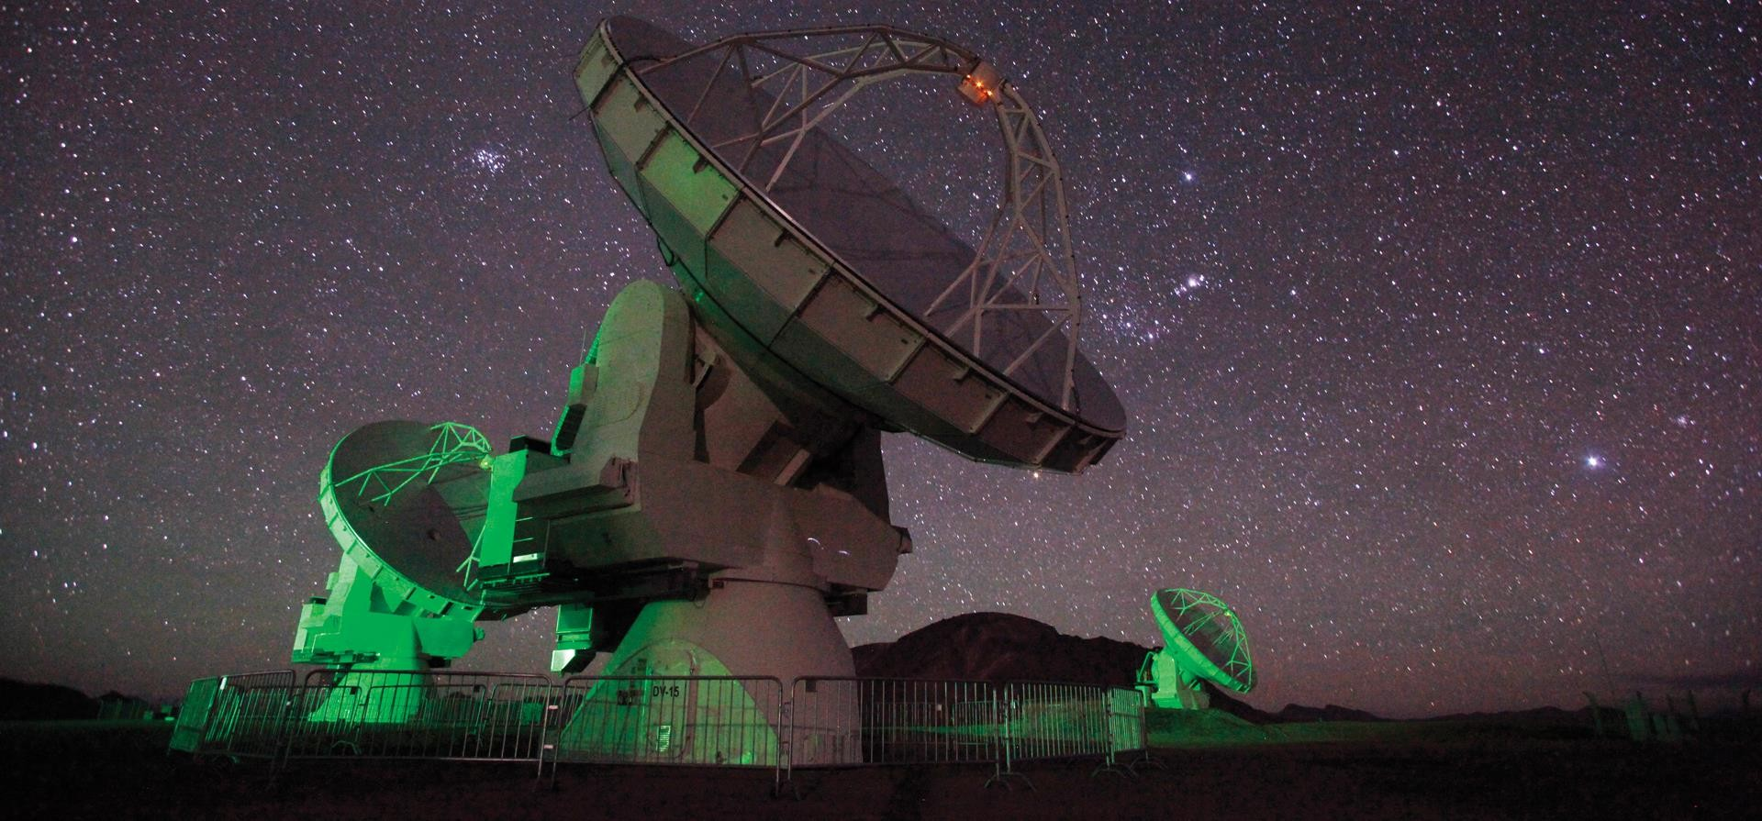
Introduction to Radio Astronomy

Slide 2
Learning Objectives
By the end of this talk, participants should be to:
Define the unit of Jansky [Jy]
Summarize common emission mechanisms in Radio Astronomy
Recall the basics of an interferometer (for future lectures)
Discuss the difference between six types of temperature typically encountered in Radio Astronomy

Slide 3
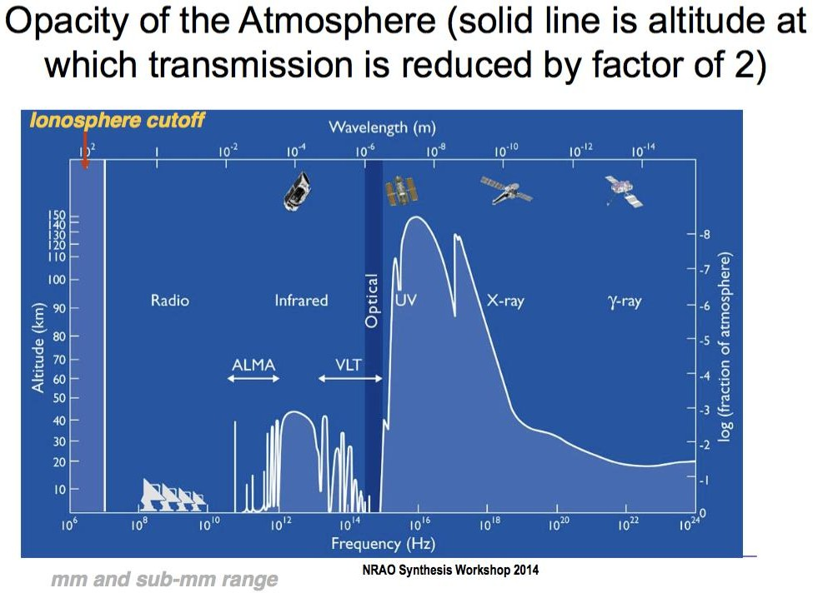
The Radio Window
Other than optical / near IR, radio offers the only opportunity for ground based astronomy.
The atmosphere still matters for some observing

Slide 4
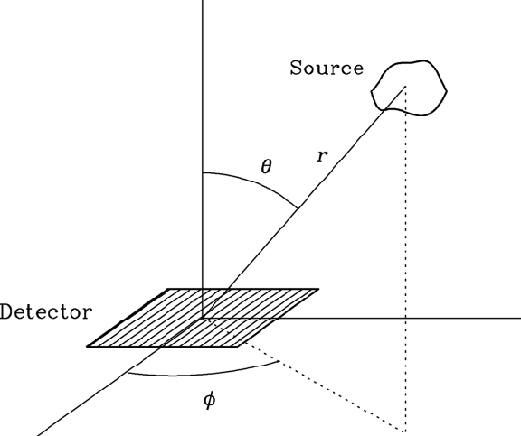
Tricky Units Note! Specific intensity =
Units
Jansky
1Jy = 10⁻²⁶ W m⁻² Hz⁻¹
1Jy = 10⁻²³erg s⁻¹cm⁻²Hz⁻¹
Jy Jy
𝐼_{𝑣} =
or
beam sr
Flux density =
𝑆_{𝑣} = ∫ 𝐼_{𝑣}𝑑Ω = 𝐽𝑦
Common unit of Radio Astronomy
Fundamental unit of flux density
Specific Intensity vs. Flux density vs. Flux
𝑊
_{𝑚}2
Flux = 𝑆 = ∫ 𝑆 𝑑𝜈 =
𝑣
5/15/2024
Dominic Ludovici | 20th Synthesis Imaging Workshop
5

Slide 5
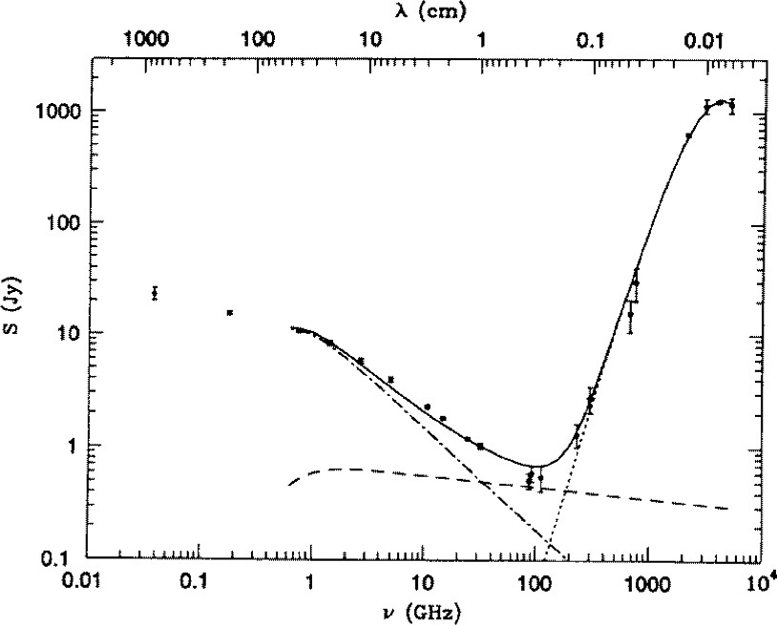
Emission at Radio Wavelengths
Emission Mechanisms
M82
Bremsstrahlung Thermal Dust Synchrotron Spectral Lines
Dust
Synchrotron
Bremsstrahlung

Slide 6
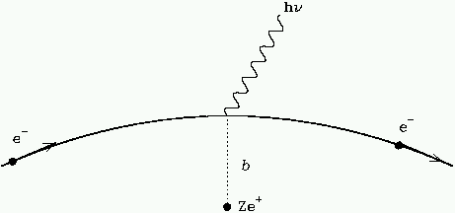
Emission at Radio Wavelengths
Emission Mechanisms
Free-free emission (both particles are free)
Braking emission
– acceleration of the electron
Thermal emission from ionized gas (e.g., HII regions)
Optically thin
Good for estimating density and temperature of ionized gas
Bremsstrahlung Thermal Dust Synchrotron Spectral Lines

Slide 7
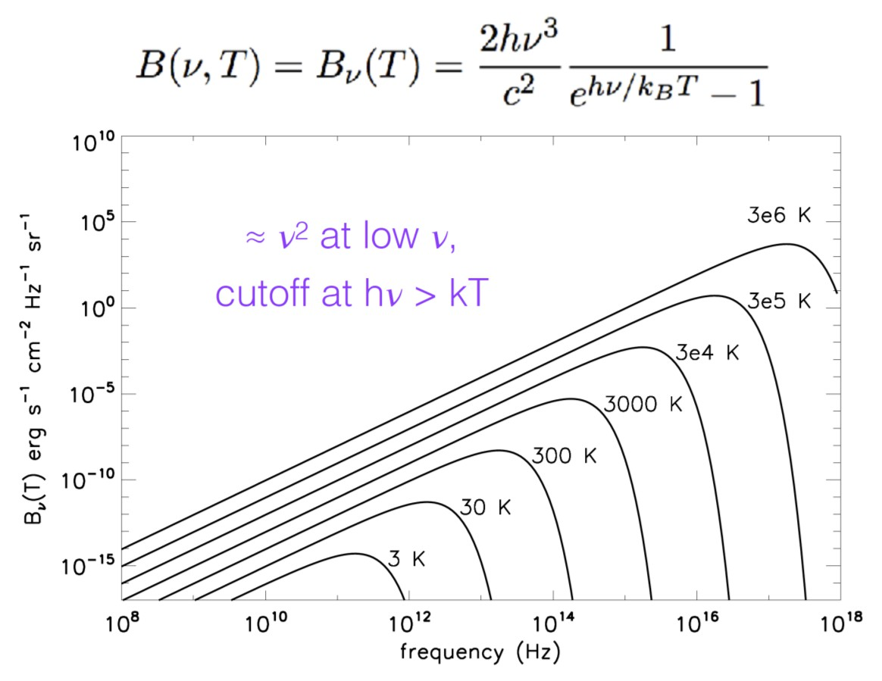
Emission at Radio Wavelengths
Emission Mechanisms
Thermal radiation
Follows a blackbody spectrum
In the Rayleigh-Jeans Limit in Radio
Bremsstrahlung Thermal Dust Synchrotron Spectral Lines

Slide 8
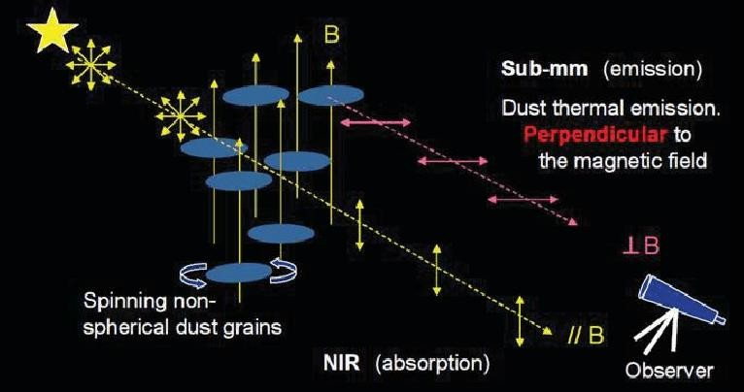
Emission at Radio Wavelengths
Emission Mechanisms
Thermal radiation
Follows a blackbody spectrum
In the Rayleigh-Jeans Limit in Radio
Dust Polarization due to grain alignment
Bremsstrahlung Thermal Dust Synchrotron Spectral Lines

Slide 9
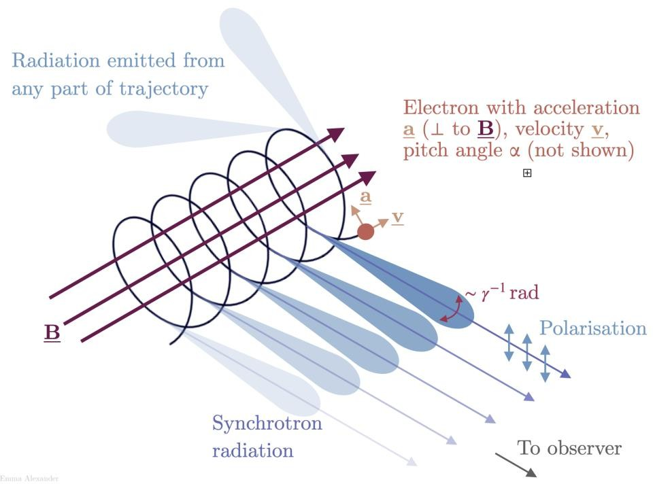
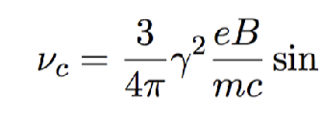
Emission at Radio Wavelengths
Emission Mechanisms
Relativistic electrons spiraling around a magnetic field
Polarized Emission / Relativistic Beaming
Non-thermal emission
Sources: Active Galactic Nuclei, Pulsars, Supernova Remnants
Bremsstrahlung Thermal Dust Synchrotron Spectral Lines

Slide 10
Identifying Emission at Radio Wavelengths
Emission Mechanisms
M82
Bremsstrahlung Thermal Dust Synchrotron Spectral Lines
Dust
Synchrotron
Bremsstrahlung

Slide 11
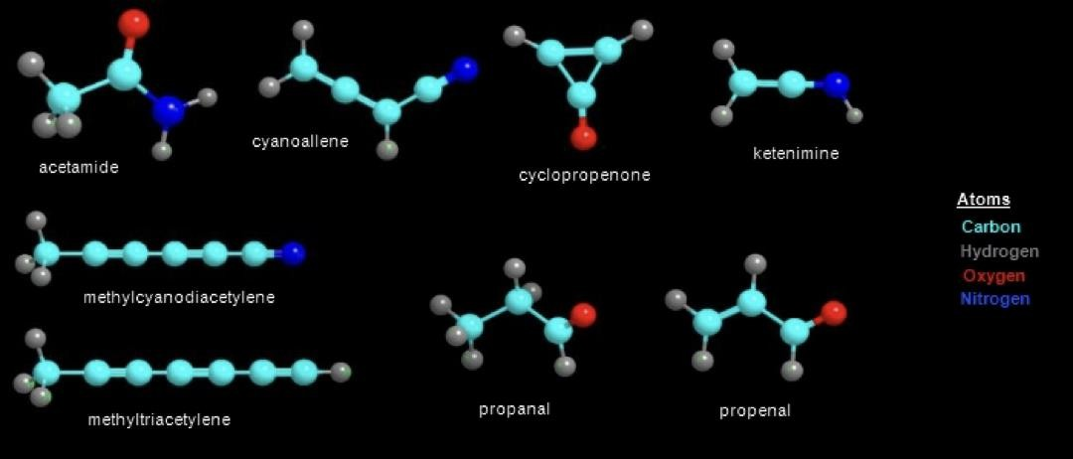
Emission at Radio Wavelengths
Emission Mechanisms
Molecular Gas
2+ atom molecules (CO, HCN, NH3, etc)
Rotational states in radio
Molecules can form on the surfaces of dust grains or in the gas phase
https://splatalogue.online/
Bremsstrahlung Thermal Dust Synchrotron Spectral Lines

Slide 12
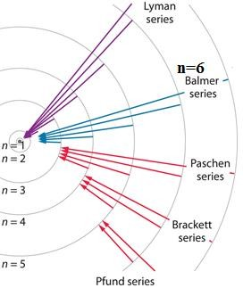
Emission at Radio Wavelengths
Emission Mechanisms
Ionized Gas
Radio recombination lines
Like Balmer and Lyman series
Higher ‘n’ transitions (~20+)
Bremsstrahlung Thermal Dust Synchrotron Spectral Lines
Cascade of the electron down to the ground state
Can use multiple transitions together to boost SNR
– E.g., H64a+H63a

Slide 13
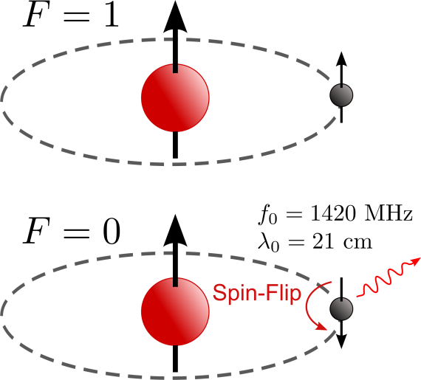
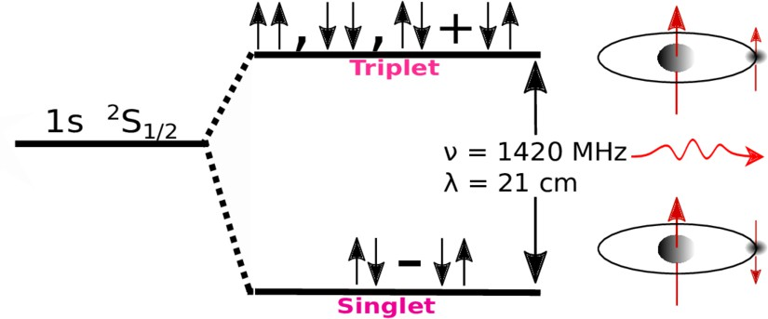
Emission at Radio Wavelengths
Emission Mechanisms
Neutral Hydrogen (HI)
21 cm spin flip of the electron
Rest frequency is 1420 MHz
– L band; observable with the VLA and GBT
Detected in both emission and absorption
Commonly observed in galactic and extragalactic studies
Bremsstrahlung Thermal Dust Synchrotron Spectral Lines

Slide 14
Temperatures
An object’s physical temperature causes it to emit Black Body Radiation according to Plank’s Law
Physical Temperature (𝑻) Excitation Temperature (𝑇_{𝐸} ) Brightness Temperature (𝑇_{𝐵} )
2ℎ𝜈³ 1
_{𝑐}2 _{𝑒}ℎ𝑣/𝑘_{𝐵}𝑇
𝐵_{𝑣} 𝑇 =
− 1
Often times in the Radio, we can use the Rayleigh-Jeans
approximation, the low frequency limit of Plank’s Law.
2𝜈²𝑘_{𝐵}𝑇
𝐵_{𝑣} 𝑇 =
_{𝑐}2

Slide 15
Temperatures
Excitation temperature describes the relative populations of two energy levels in a collection of atoms/molecules/ions
Physical Temperature (𝑇) Excitation Temperature (𝑻_{𝑬}) Brightness Temperature (𝑇_{𝐵} )
𝑛₂ 𝑔₂
=
𝑒
−ℎ𝑣 /𝐾𝑇
0
𝑒𝑥
𝑛₁ 𝑔₁
𝑇_{𝑒𝑥} may or may not be equal to T depending on if the gas is in local thermodynamic equilibrium.

Slide 16
Temperatures
2𝜈²
≃ 𝑘_{𝐵}𝑇
_{𝑐}2
𝐵_{𝑣} 𝑇
Physical Temperature (𝑇) Excitation Temperature (𝑇_{𝐸} ) Brightness Temperature (𝑻_{𝑩})
When ℎ𝜈 ≪ 𝑘_{𝐵}𝑇 (Rayleigh Jean’s Approximation)
We define 𝑇_{𝐵} as a scaled version of the specific intensity (Jy/beam)
_{𝜈}2
𝐼_{𝑣} = 2 _{𝑐2} 𝑘_{𝐵}𝑇_{𝐵}
In thermal regime for low optical depth, 𝑇_{𝐵} < 𝑇
For non-thermal, there is no connection to 𝑇.

Slide 17
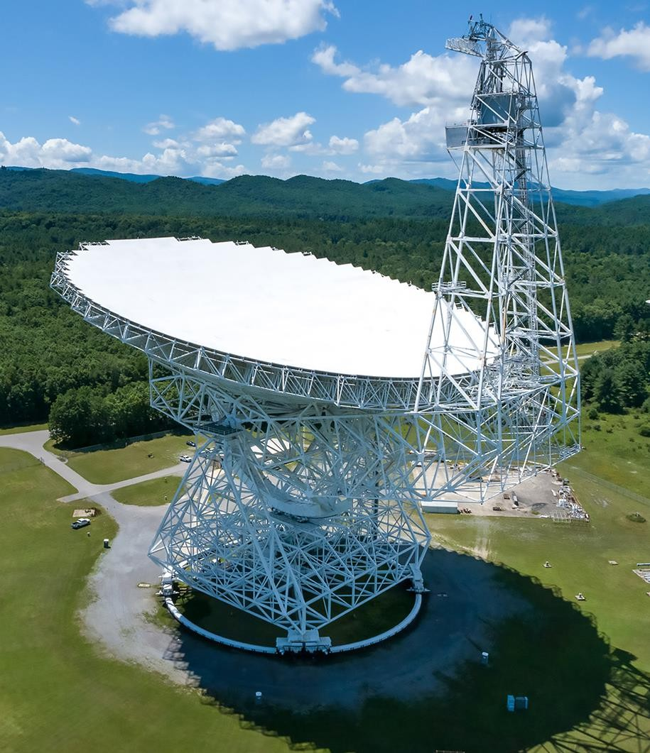
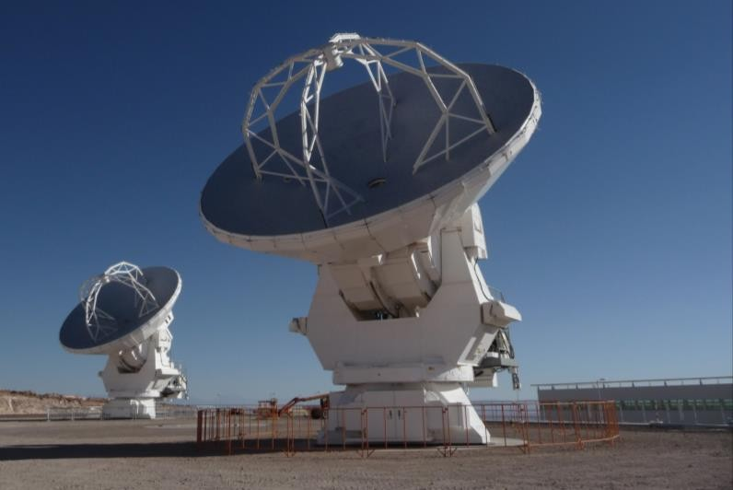
Single Dish telescopes consist of a single antenna
Examples: GBT, ALMA (Total Power), Parks, APEX
Beam size dependent on dish size.
Types of Radio Telescopes
Single Dish
Interferometers
𝜃 ≈ 1.2 ^{𝜆}
𝐷
GBO Single Dish School Also Offered

Slide 18
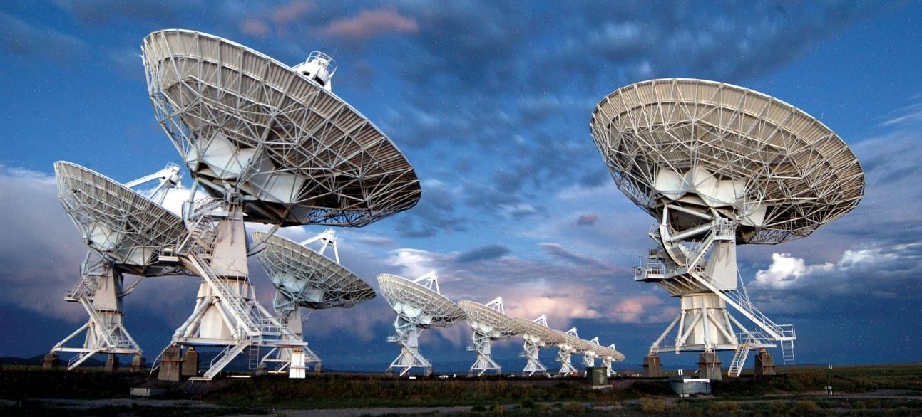
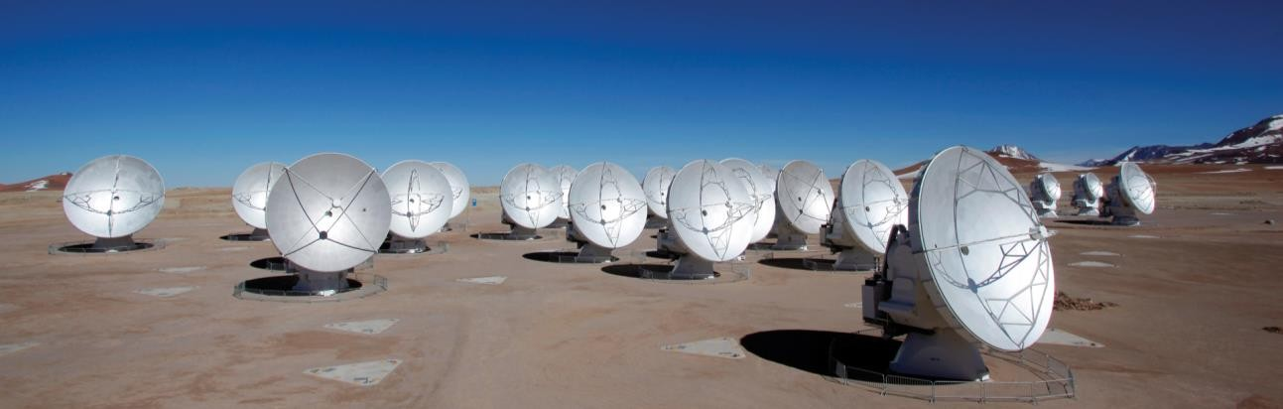
Multiple Antennas work together to increase resolution of the
telescope
VLA, ALMA, NOEMA, ATCA, VLBA
Types of Radio Telescopes
Single Dish
Interferometers

Slide 19
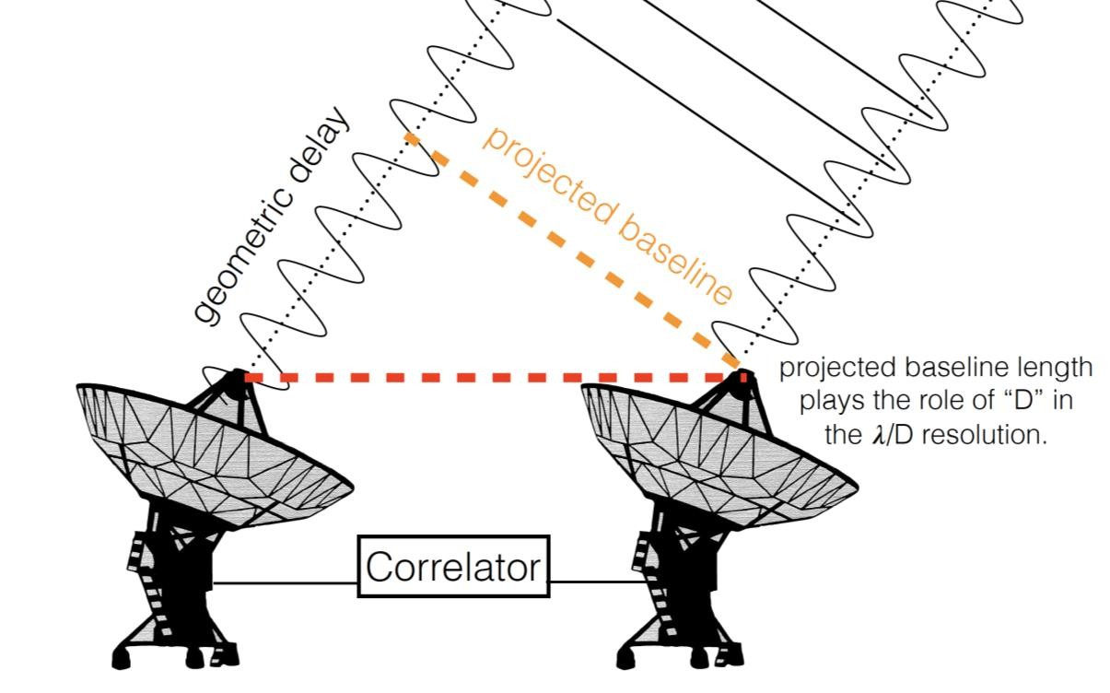
Multiple Antennas work together to increase resolution of the
telescope
VLA, ALMA, NOEMA, ATCA, VLBA
Primary Beam vs. Synthesized Beam
Types of Radio Telescopes
Primary beam is determined by dish size
Synthesized beam is determined by telescope separation
Single Dish
Interferometers
Lisa Young 16th SIW

Slide 20
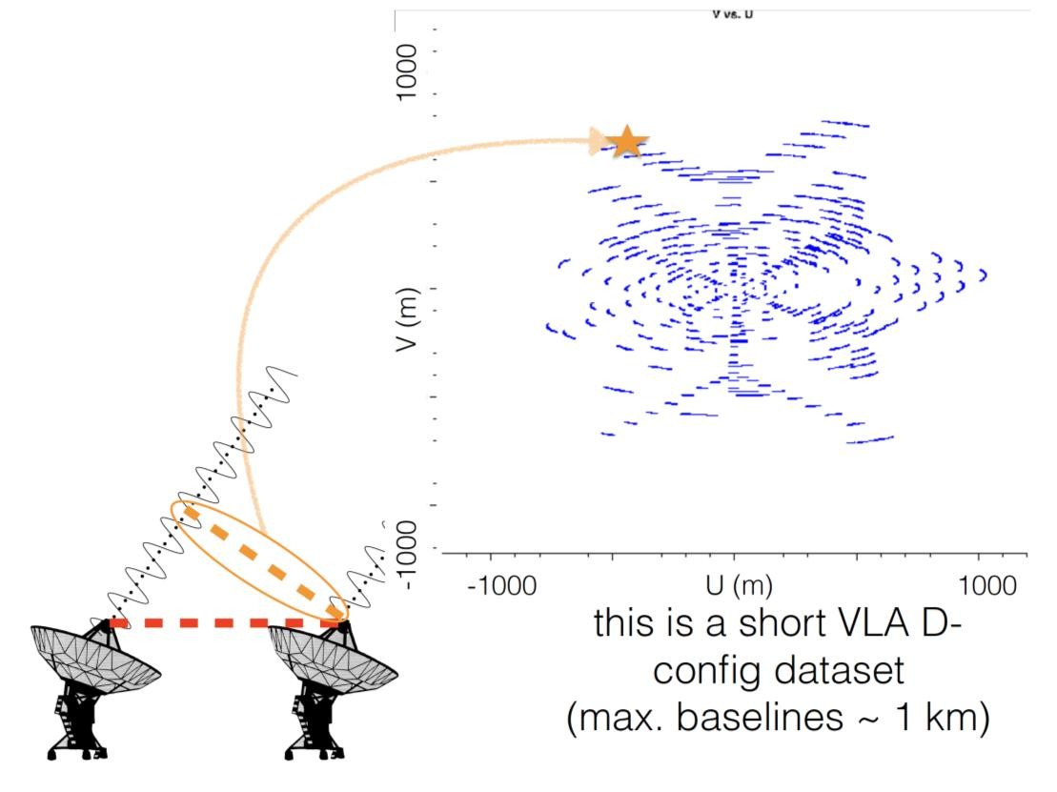
Multiple Antennas work together to increase resolution of the
telescope
VLA, ALMA, NOEMA, ATCA, VLBA
Primary Beam vs. Synthesized Beam
Types of Radio Telescopes
Primary beam is determined by dish size
Synthesized beam is determined by telescope separation
Single Dish
Interferometers
Lisa Young 16th SIW

Slide 21
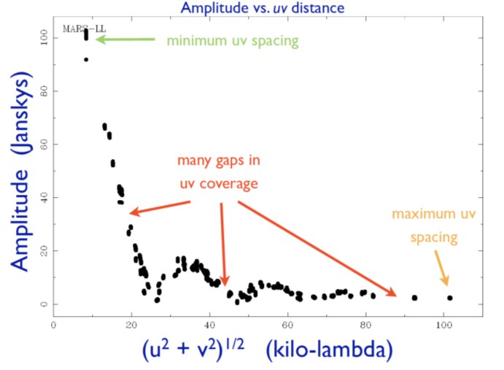
Multiple Antennas work together to increase resolution of the
telescope
VLA, ALMA, NOEMA, ATCA, VLBA
Primary Beam vs. Synthesized Beam
Types of Radio Telescopes
Primary beam is determined by dish size
Synthesized beam is determined by telescope separation
Single Dish
Interferometers
Lisa Young 16th SIW

Slide 22
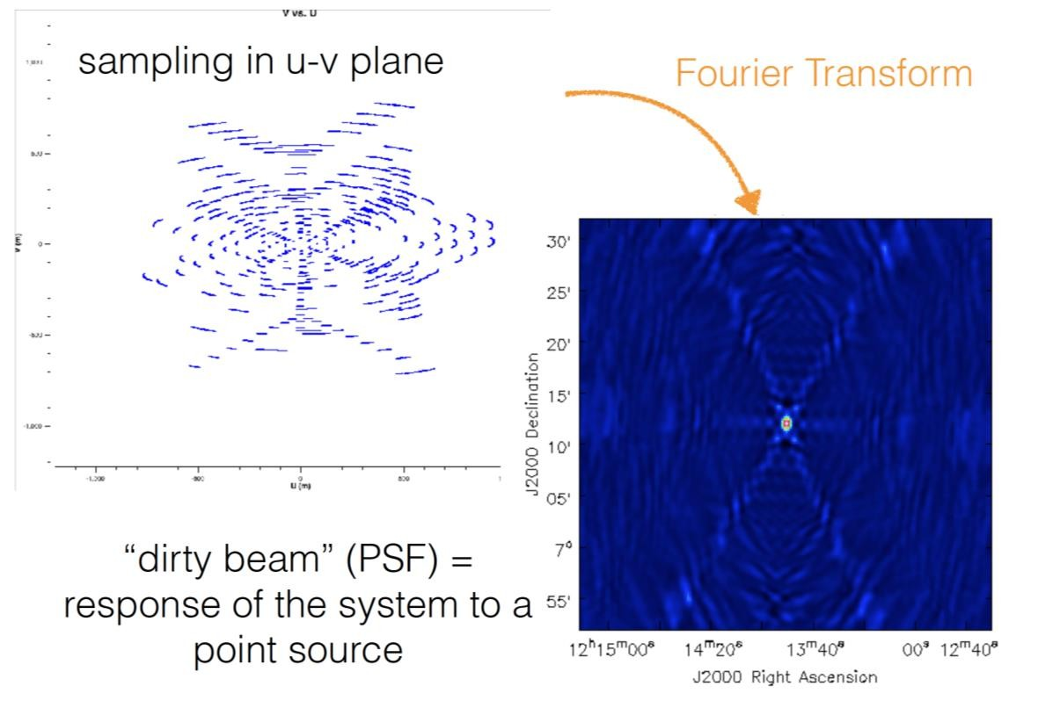
Multiple Antennas work together to increase resolution of the
telescope
VLA, ALMA, NOEMA, ATCA, VLBA
Primary Beam vs. Synthesized Beam
Types of Radio Telescopes
Primary beam is determined by dish size
Synthesized beam is determined by telescope separation
Single Dish
Interferometers
Lisa Young
16th SIW

Slide 23
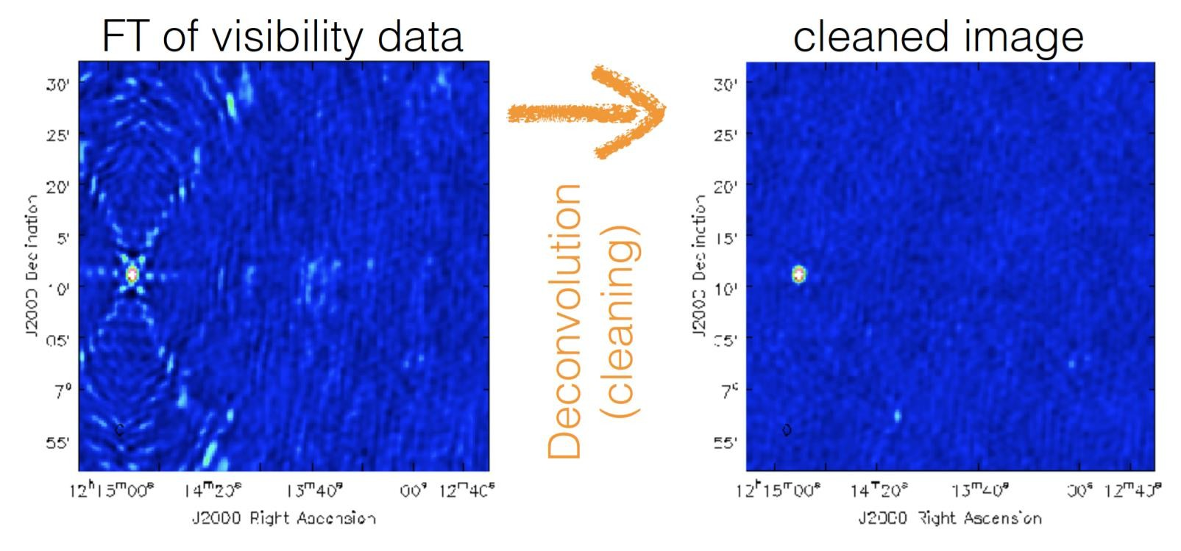
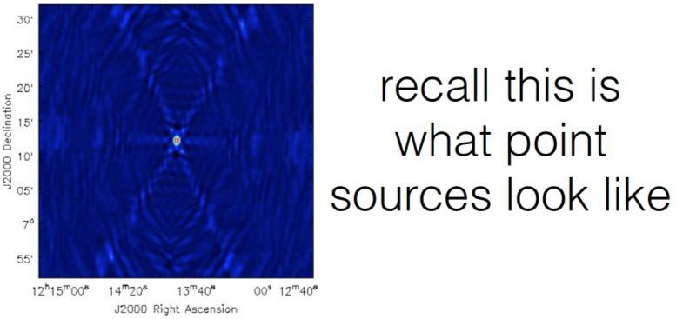
Multiple Antennas work together to increase resolution of the
telescope
VLA, ALMA, NOEMA, ATCA, VLBA
Primary Beam vs. Synthesized Beam
Types of Radio Telescopes
Primary beam is determined by dish size
Synthesized beam is determined by telescope separation
Single Dish
Interferometers
Lisa Young
16th SIW

Slide 24
Don’t worry, you will be going into a lot more depth on these topics
throughout the rest of the workshop!

Slide 25
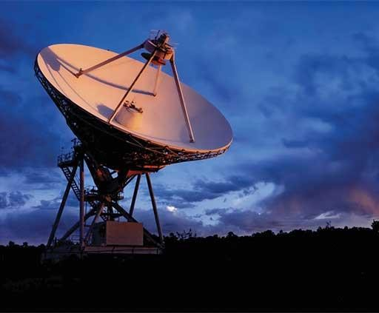
More Temperatures
In addition to the temperatures that are related to the source, there are also instrumental temperatures.
VLBA Antenna

Slide 26
Temperatures
𝑇_{𝐴} is the power delivered by an equivalent thermal resistor at the input of the receiver. This is how single dish telescopes often report their sensitivities.
Physical Temperature (𝑇) Excitation Temperature (𝑇_{𝐸} ) Brightness Temperature (𝑇_{𝐵} )
So 𝑇_{𝐴} is a measure of how bright your source is & how it couples to your
telescope beam. 𝑇_{𝐴} < 𝑇_{𝐵} because of the telescope efficiency
Antenna Temperature can be converted to a point source flux density using
Antenna Temperature 𝑻_{𝑨}
Receiver Temperature (𝑇_{𝑅})
𝐴 𝑆 Ω
𝑇 =
𝑒 𝝂
𝑠
𝐴
= 𝑇
𝐵
System Temperature 𝑇
2𝑘_{𝐵} Ω_{𝐴}
𝑠𝑦𝑠
Where Ω_{𝑠} is the solid angle of the source and Ω_{𝐴} is the beam solid angle

Slide 27
Even without any signal, a receiver will generate noise which can again be modeled as a resistor of temperature 𝑇_{𝑅} which is connected to a noiseless receiver. To make 𝑇_{𝑅} as low as possible, receivers are often cryogenically cooled.
Temperatures
Physical Temperature (𝑇) Excitation Temperature (𝑇_{𝐸} ) Brightness Temperature (𝑇_{𝐵} )
However, radiometers are not just matched resistors, so Tr may be either lower or higher than the physical temperature of the radiometer itself.
Antenna Temperature 𝑇_{𝐴}
Receiver Temperature (𝑻_{𝑹})
System Temperature
^{𝑇}𝑠𝑦𝑠

Slide 28
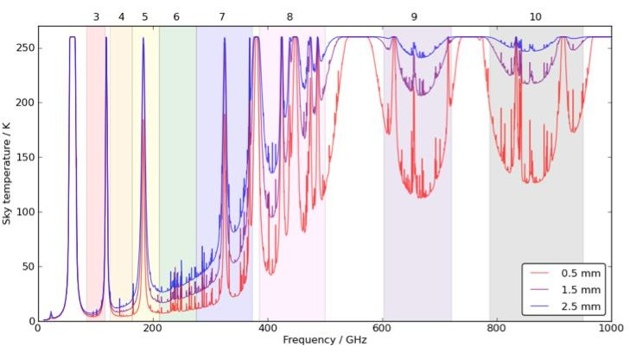
Temperatures
𝑇_{𝑠𝑦𝑠} quantifies the noise that will be contributed to your measurement by emission from the receiver, dish, atmosphere, etc.
At high frequencies 𝑇_{𝑠𝑦𝑠} is strongly weather-dependent
Physical Temperature (𝑇) Excitation Temperature (𝑇_{𝐸} ) Brightness Temperature (𝑇_{𝐵} )
Antenna Temperature 𝑇_{𝐴}
Receiver Temperature (𝑇_{𝑅})
System Temperature
^{𝑻}𝒔𝒚𝒔

Slide 29
Temperatures
System temperature is particularly important because:
^{𝑇}𝑠𝑦𝑠
Δ𝑇_{𝑟𝑚𝑠} =
Physical Temperature (𝑇) Excitation Temperature (𝑇_{𝐸} ) Brightness Temperature (𝑇_{𝐵} )
Δ𝜈 𝜏
The rms of your measurement scales with 𝑇_{𝑠𝑦𝑠}. Increasing the bandwidth (𝛥𝜈) and integration time (𝜏) helps lower the rms.
Antenna Temperature 𝑇_{𝐴}
Receiver Temperature (𝑇_{𝑅})
System Temperature
^{𝑻}𝒔𝒚𝒔

Slide 30
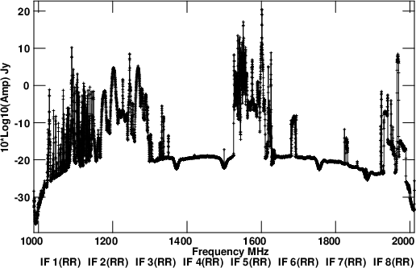
Radio Frequency Interference
Interference in radio astronomy observations due to terrestrial sources (e.g., short-wave radio, telecommunications, radar, thunderstorms, et. cetera)
We have to share the spectrum.
November 2023 RFI sweep at the VLA L Band (1-2 GHz)

Slide 31
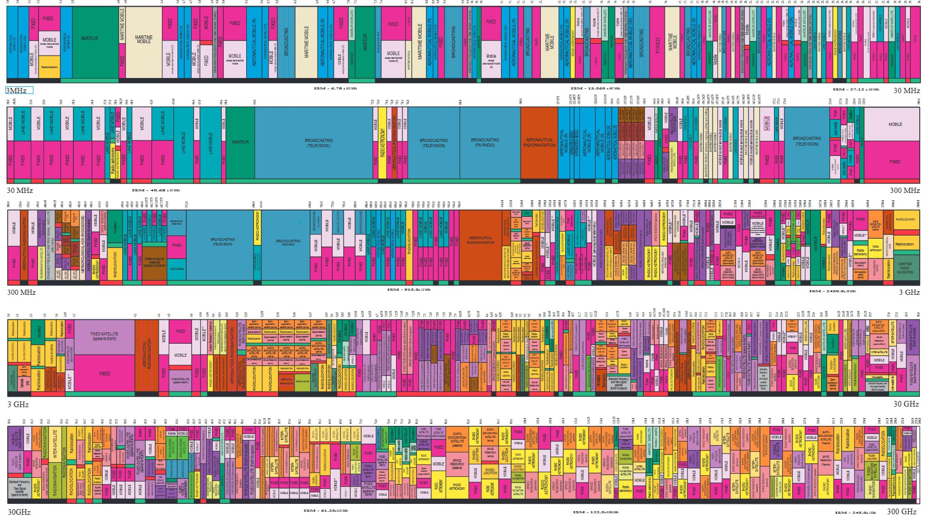

32

Slide 32
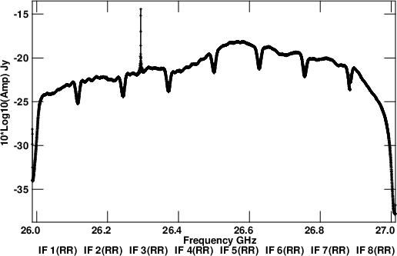
L Band compared to Ka band.

Slide 33
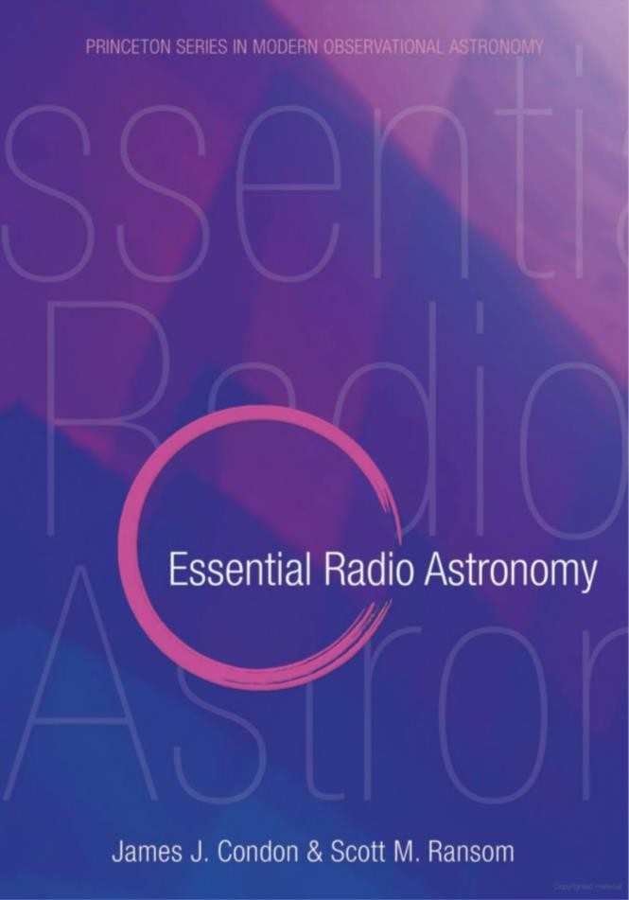
Additional Resources
Helpful books:
Radiative Processes in Astrophysics
  Rybicki & Lightman
Essential Radio Astronomy
  Condon & Ransom
Online version of the Essential Radio Astronomy textbook can be found here:
https://science.nrao.edu/opportunities/courses/era/

