Slide 1

RM synthesis
in practice
Wenhui Jing (荆文慧）| Yunnan University (云南大学)
2025.07.07 | Email: wh.jing@outlook.com

Slide 2
Outline & Goals
Tutorial: polarization_tutorial
fits_cube: Stokes I, Q, U
spectrum_1d
src: tutorial.ipynb
Tools:
RM-Tools (pip install RM-Tools)
visualization software:
carta, ds9, kvis...
Dataset
ASKAP
FAST
Goals
Understand the basic workflow of RM synthesis
How to use RM-tools on both 1D and 3D datasets.
https://cartavis.org/

Slide 3
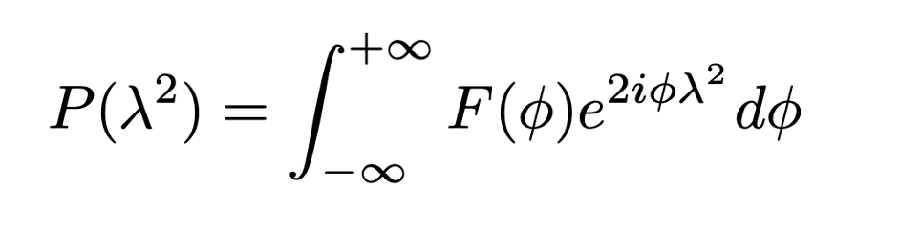
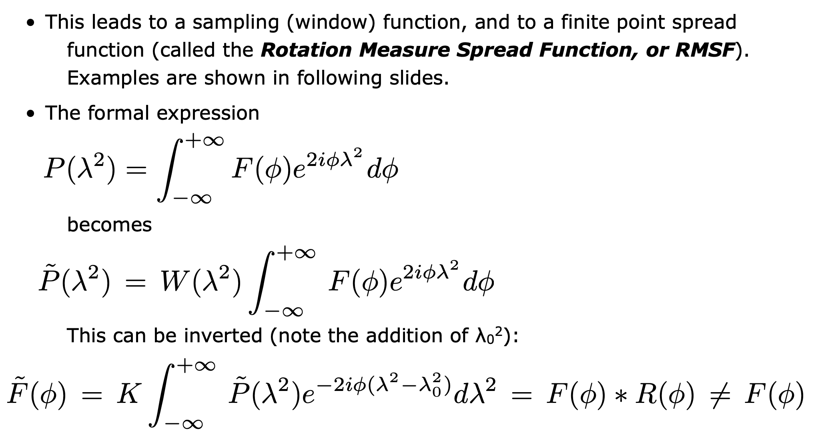

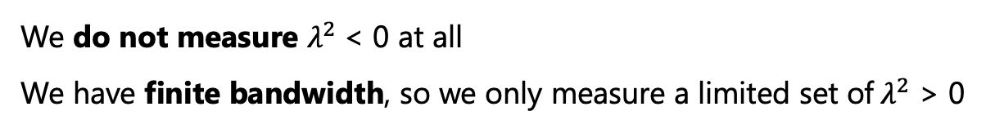
RM synthesis: from theory to practice
Slide from Heald
In theory:
In real observation:
We do not measure $λ^{2}$< 0 at all
We have finite bandwidth, so we only measure a limited set of${ λ}^{2}$ > 0
W(${ λ}^{2}$ ) window function
Inverse Transform (with $λ^{2}$shift):
RMSF

Slide 4
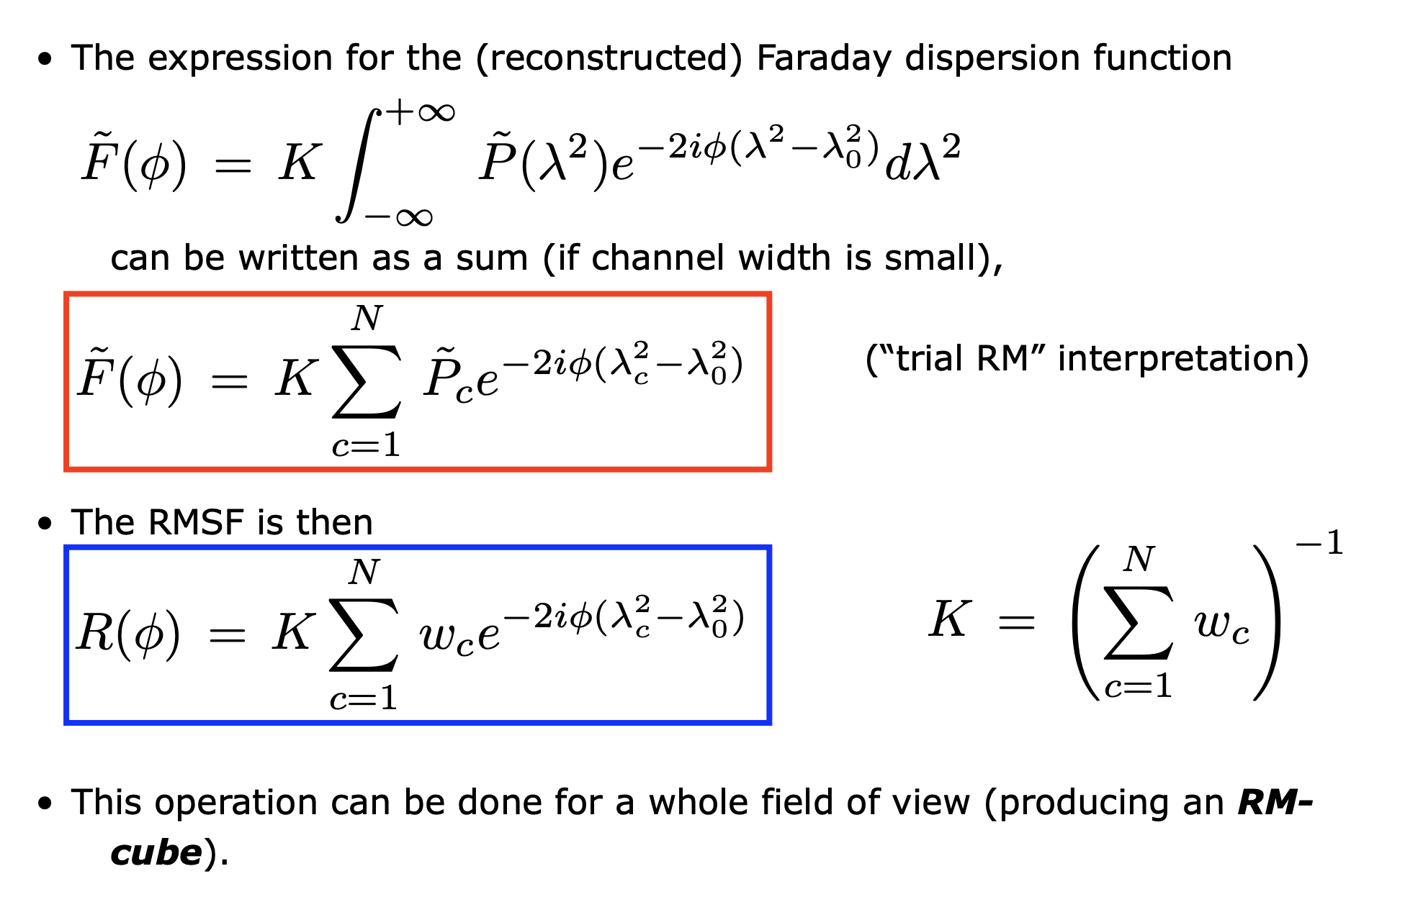
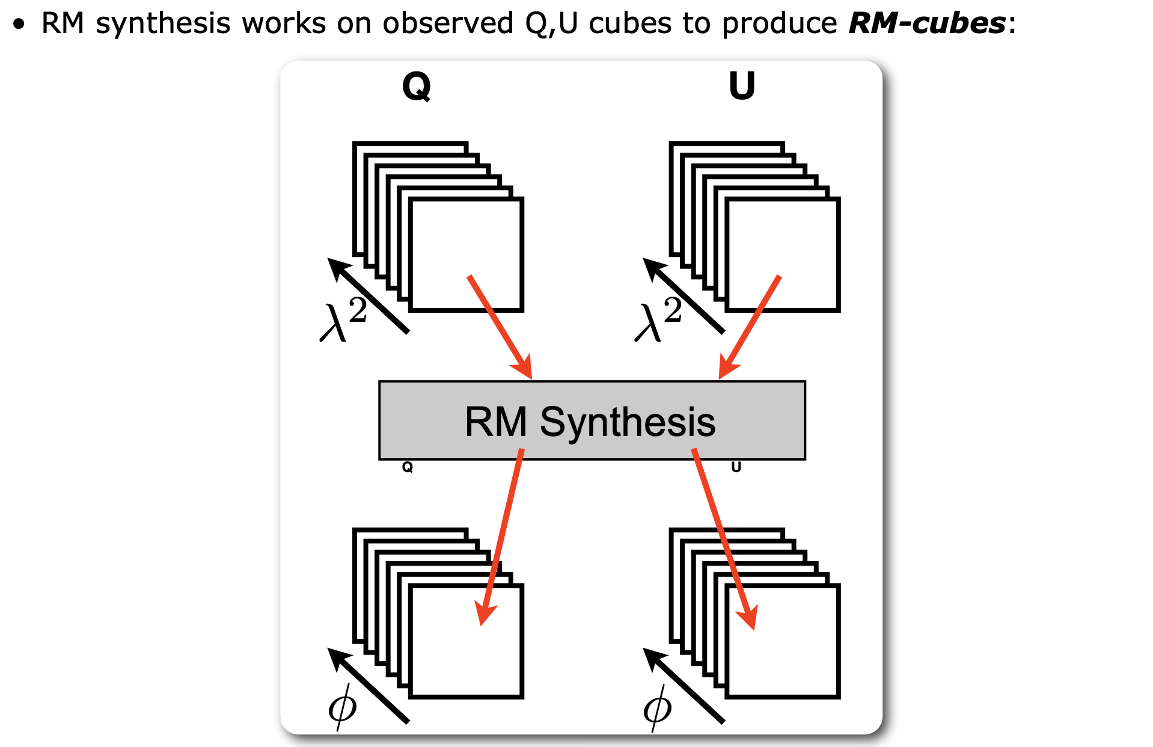
RM synthesis: from theory to practice
Slide from Heald

Slide 5
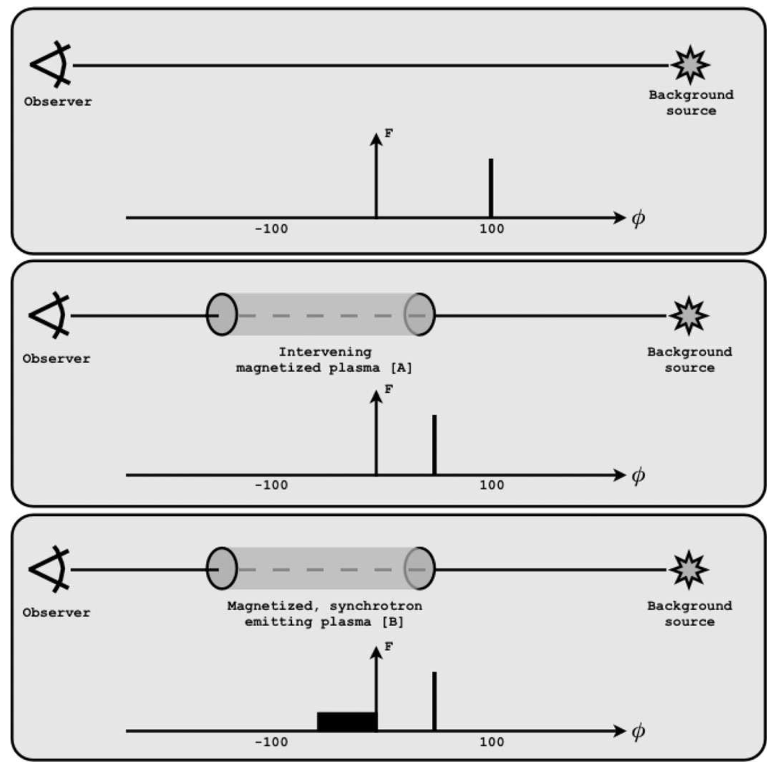
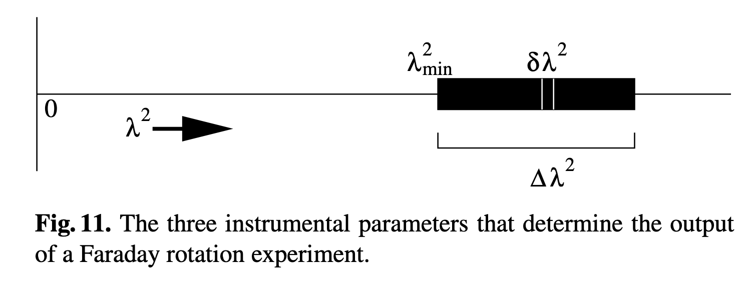
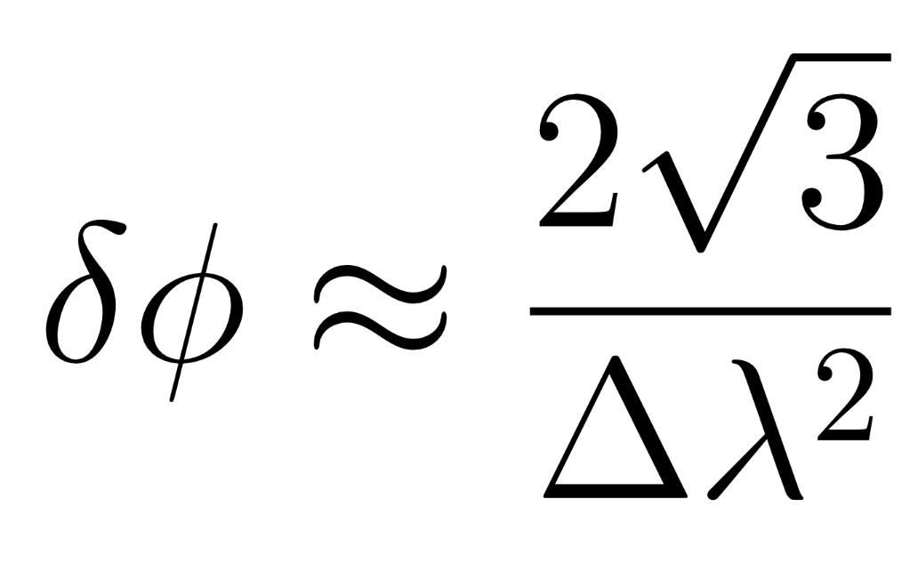
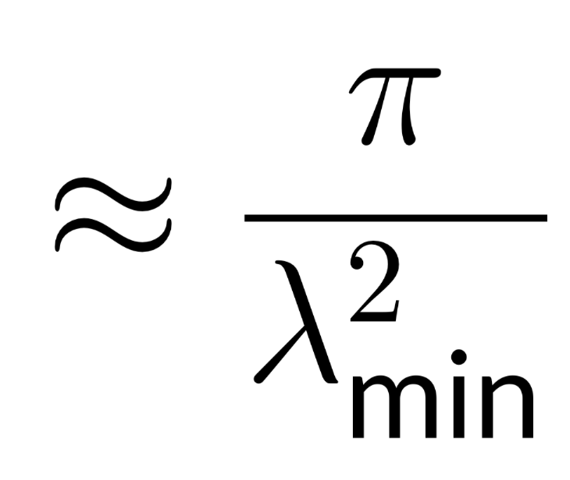
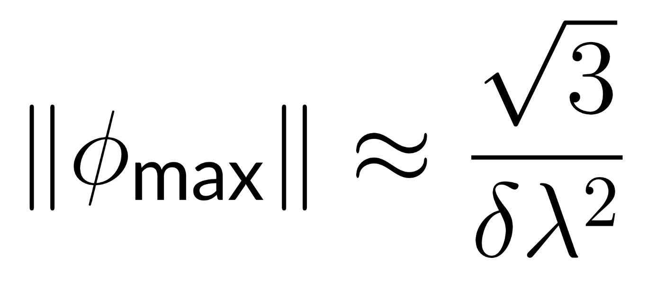

General experiment layout
RM = -50 rad $m^{−2}$
Brentjens & de Bruyn (2005)
FWHM of RMSF
Maximum RM scale
Maximum accessible RM
50
Heald 2009

Slide 6
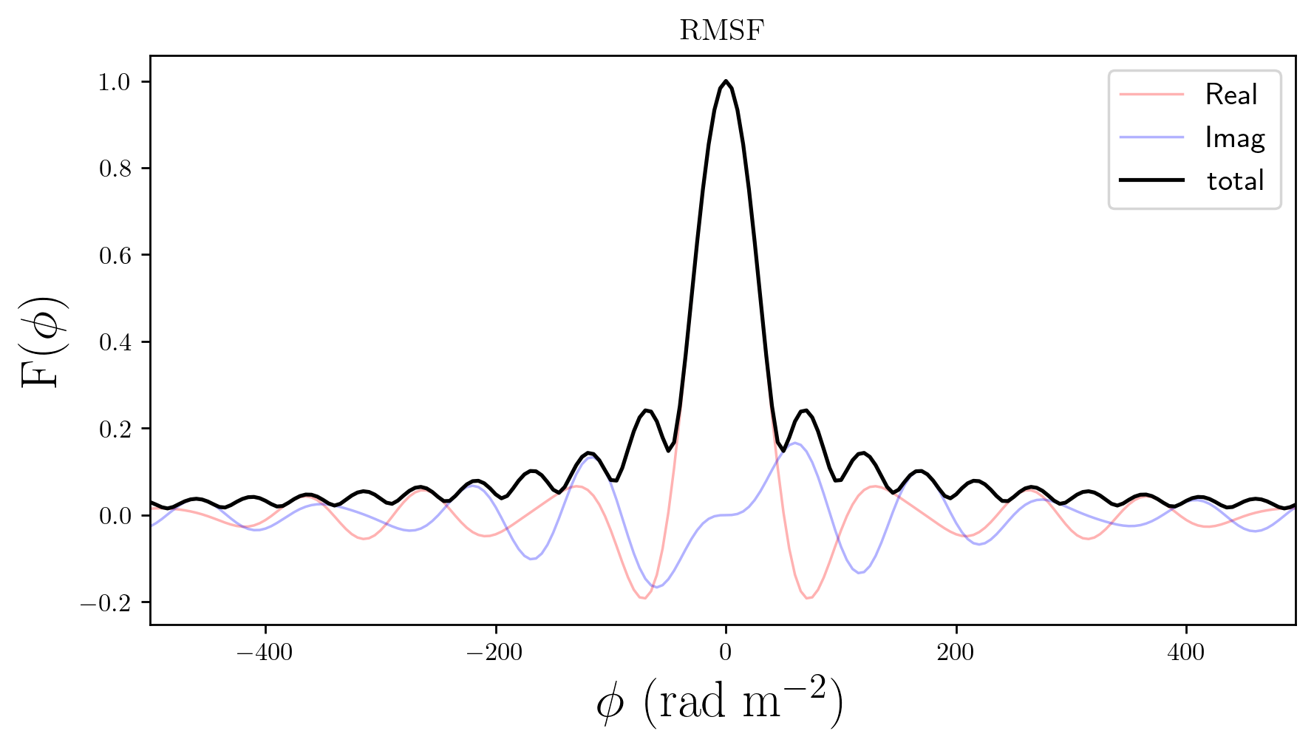
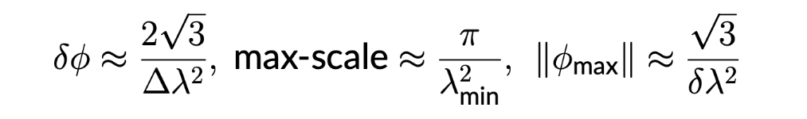
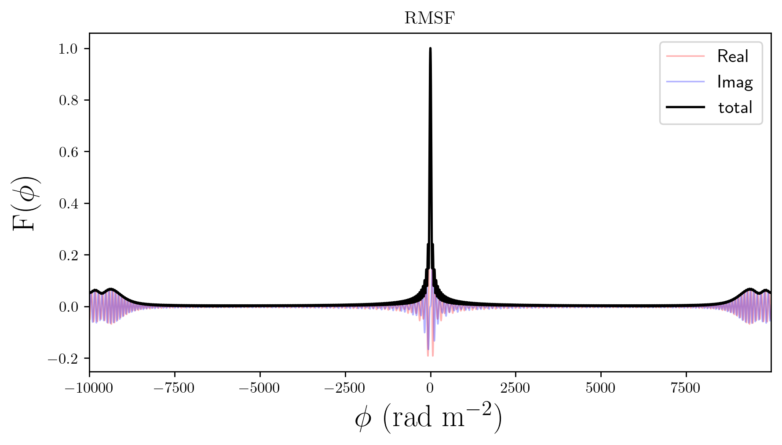
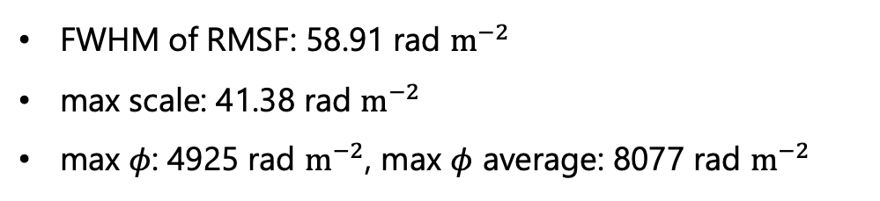
For example
Reference: https://github.com/csobey/simRMsynth
ASKAP-low:
799.5-1087.5 MHz
channel width：1 MHz * 288
FWHM of RMSF: 58.91 rad $m^{−2}$
max scale: 41.38 rad $m^{−2}$
max 𝜙: 4925 rad $m^{−2}$, max $φ$ average: 8077 rad $m^{−2}$

Slide 7
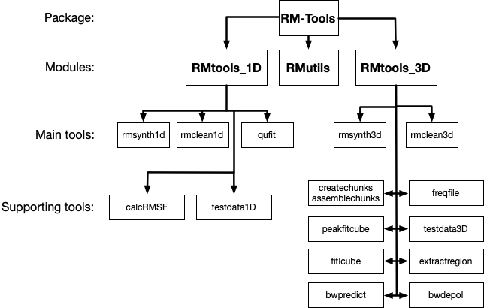
RM-Tools
RM-Tools: https://github.com/CIRADA-Tools/RM-Tools
Purcell et al 2020
Heald’s slide
RM-Tools wiki

Slide 8
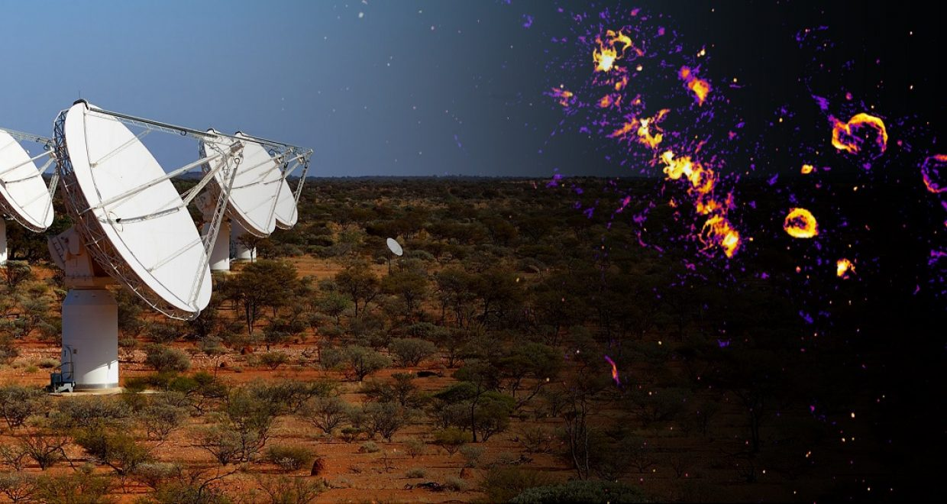
Australia's SKA Pathfinder (ASKAP) telescope
Joint sky survey:
EMU (continuum) & POSSUM (polarization)
Duration: ~10 hours
Sensitivity: 30 μJy/beam
credit: CSIRO

Slide 9
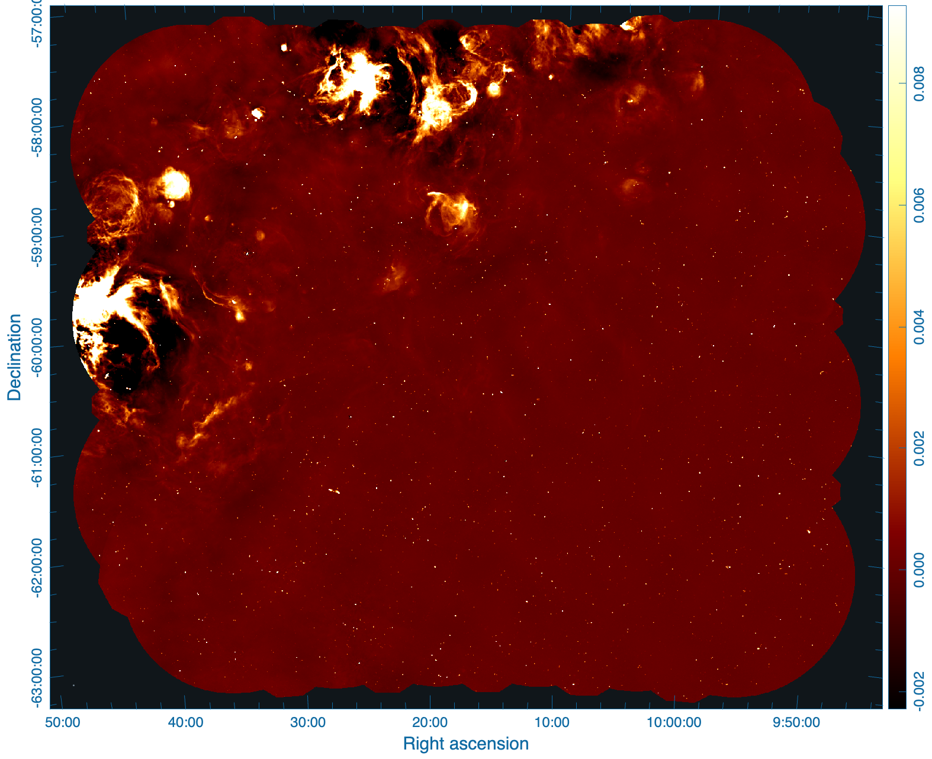
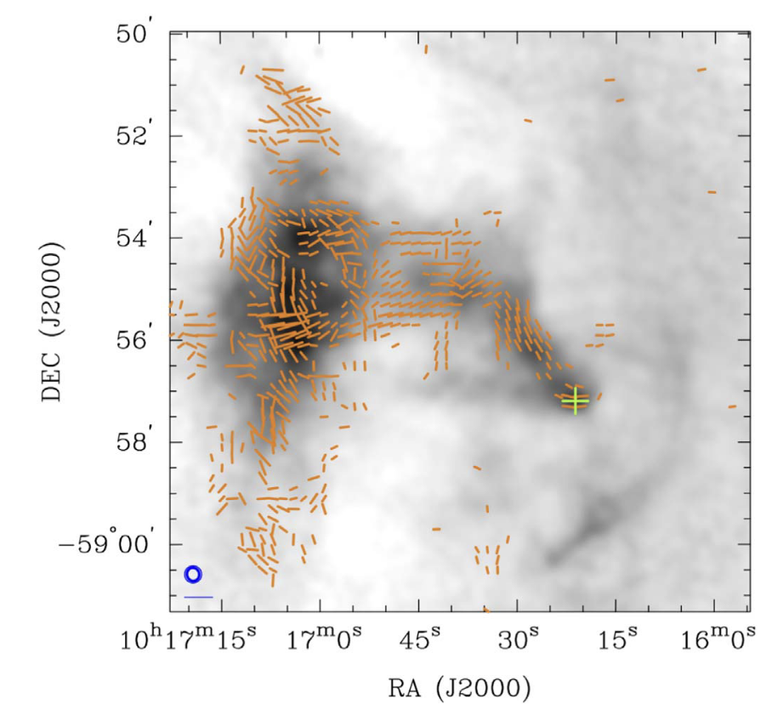
Observe information about PWN ”Goose”
Pulsar wind nebula (PWN) Goose
pulsar: PSR J1016–5857
Size: ~10 arcmin
We need the Stokes Q and U cubes.
POSSUM has made those products for the public!
ASAKP @943 MHz
Date: 2022-12-28
SBID: 46953
ATCA 6cm (~5 GHz) total intensity map of Goose overlay with polarization angle.

Slide 10
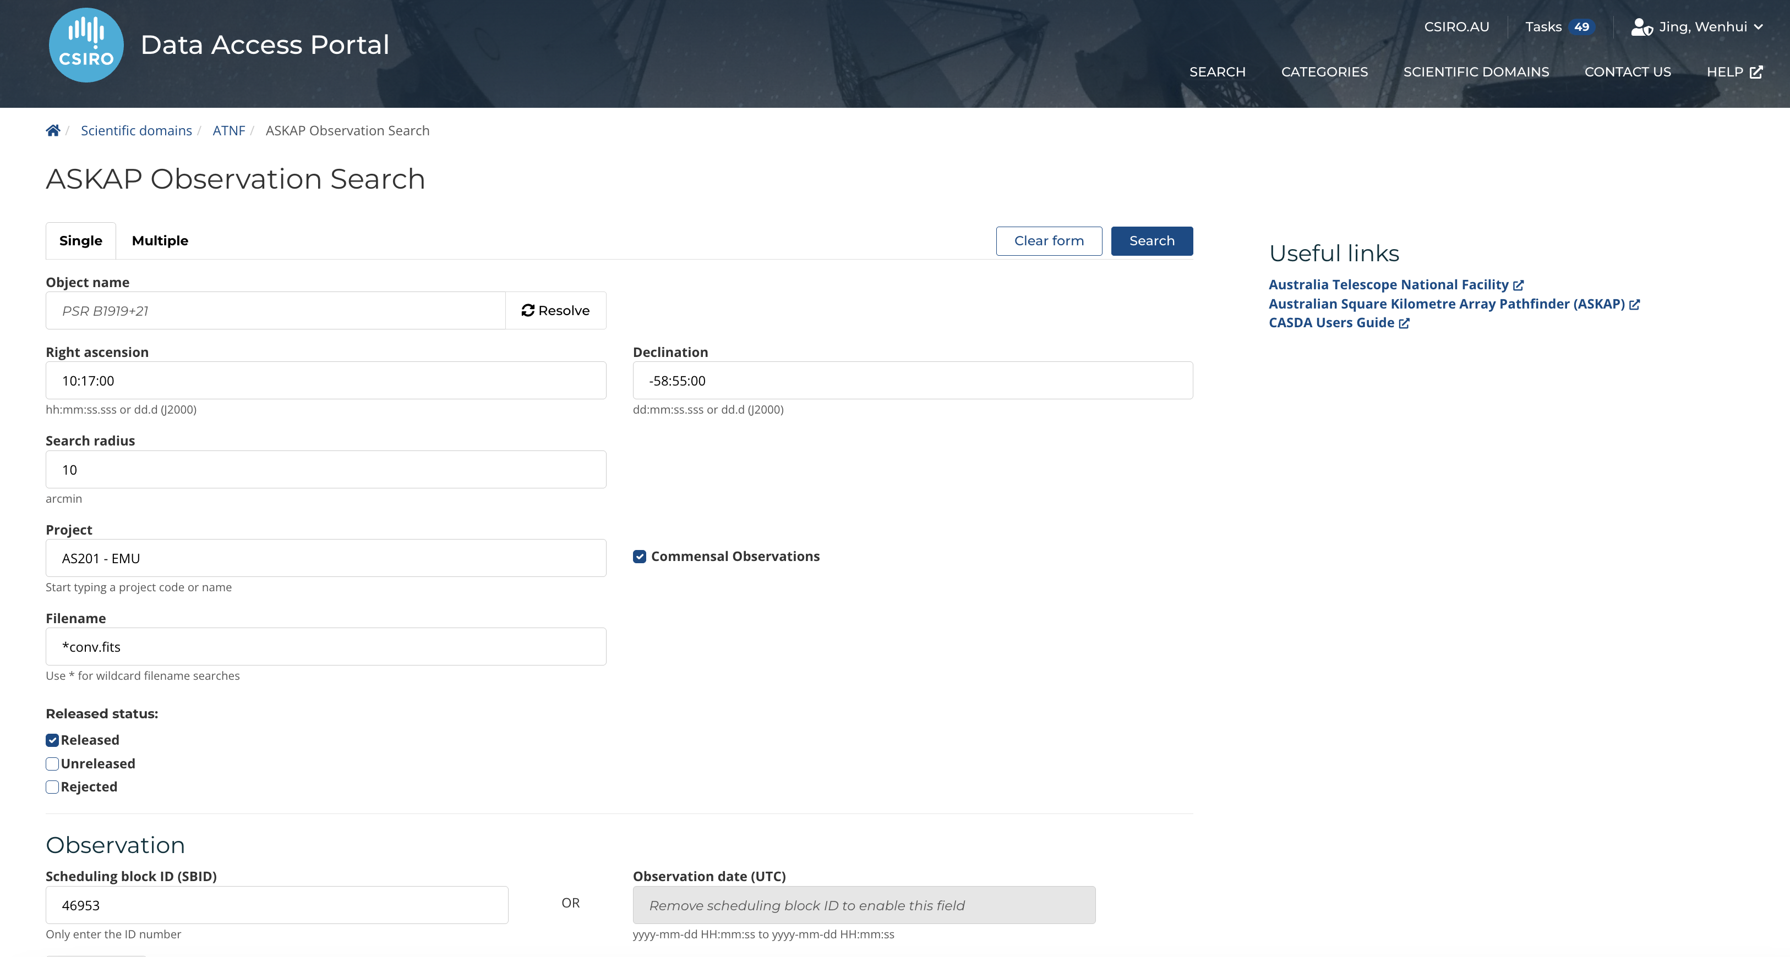
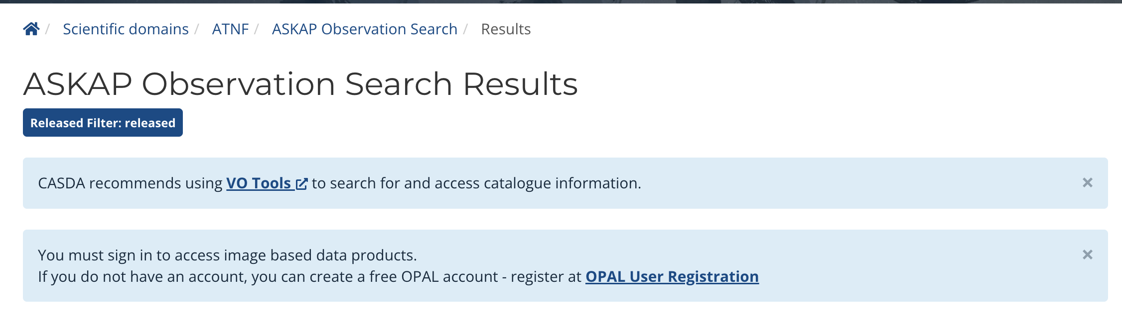
Obtain the Q & U cube
CASDA: https://data.csiro.au/domain/casdaObservation
AS203 - POSSUM
Please create an account!

Slide 11
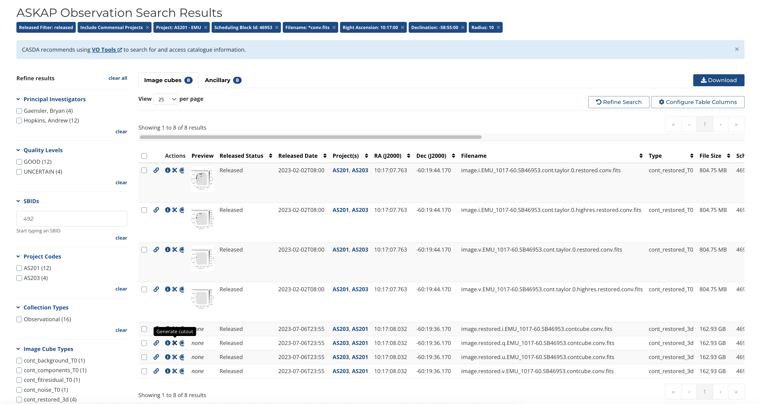

Slide 12
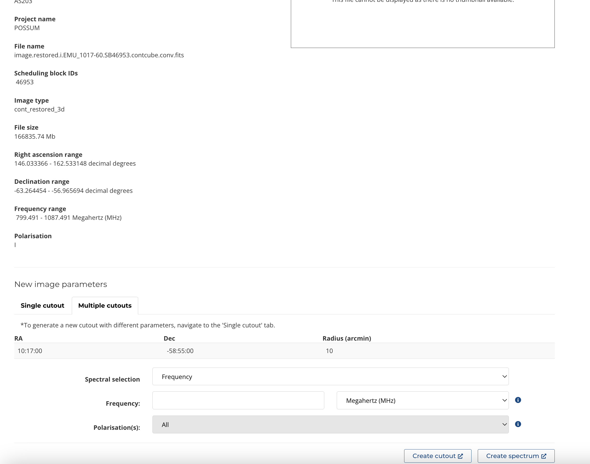

Slide 13
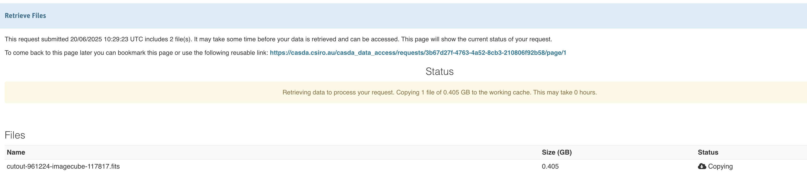
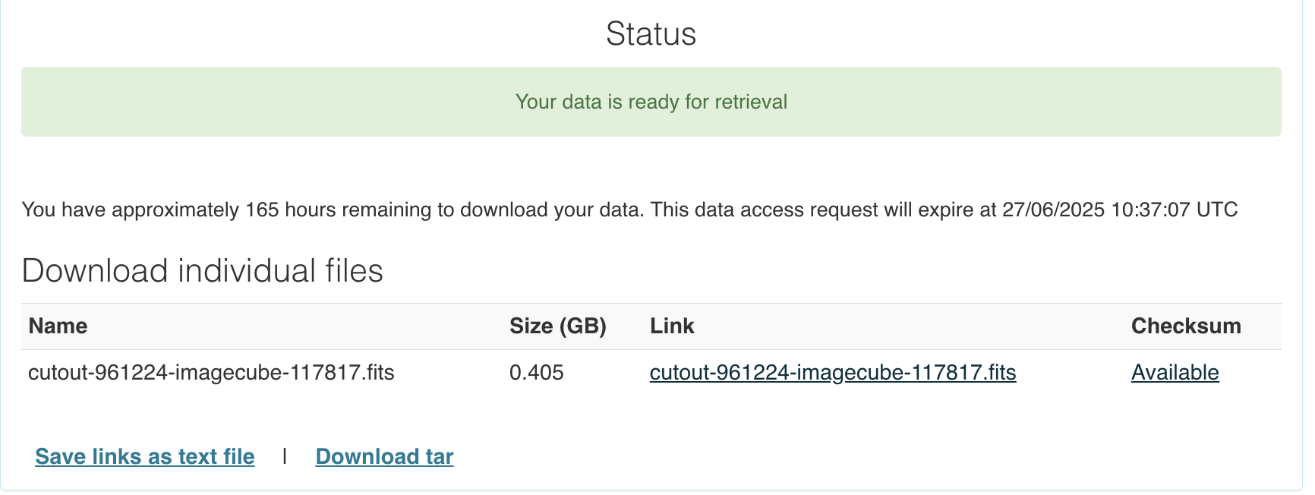

Slide 14
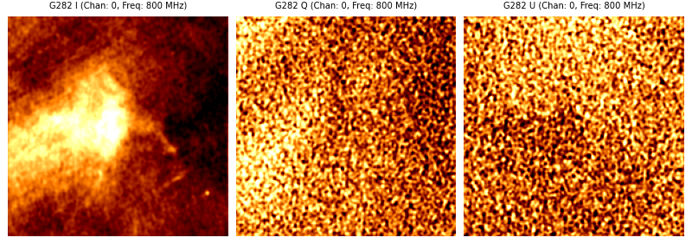
Before running RM-Tools
Must: Convolve them to the same resolution. (Tool: RACS-tools, only for ASKAP)
Optional: Regird
In this tutorial: Resolution: 20 arcsec, Pixel size: 6 arcsec.

Slide 15
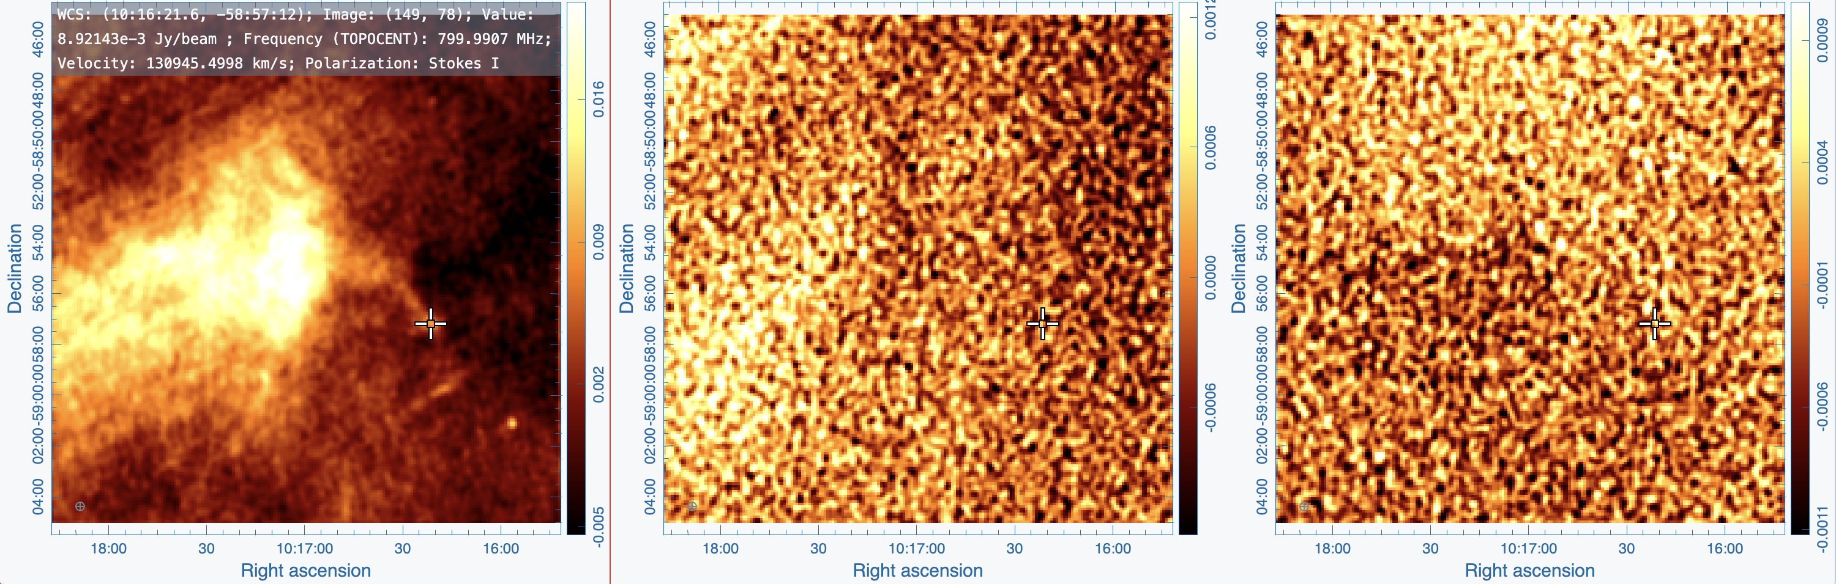
1d analysis: extract the pixel spectrum toward pulsar
Find the position, extract the Stokes Q and U data.
Wrote to a data file as columns: G282_1d_149-78.dat
[freq, Q, U, Q_error, U_error] (We take error as 3e-5 Jy/beam here)
Stokes I
Stokes Q
Stokes U

Slide 16
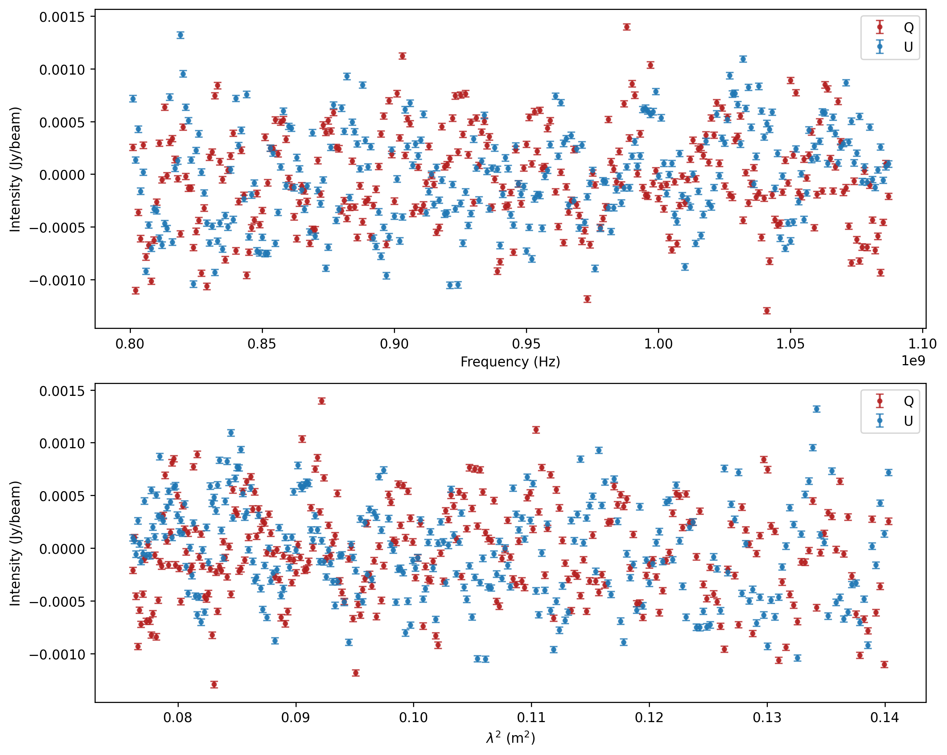
Check the dataset
Frequency
$$λ^{2}$$

Slide 17
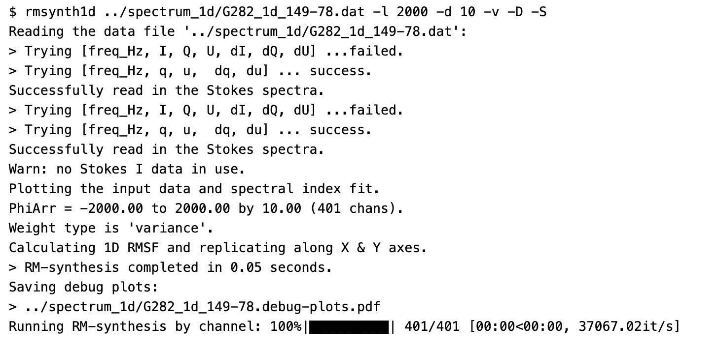

Run rmsynth1d
Find the peaks from -2000 to 2000 rad $m^{−2}$ , with a step of 10 rad $m^{−2}$
-l the $φ$max we searched in
do not higher than the max$φ$ (8080)
-d d$φ$, the steps of $φ$
1/3 FWHM of RMSF will be enough
-S save the plot
–D show the debug plot

Slide 18
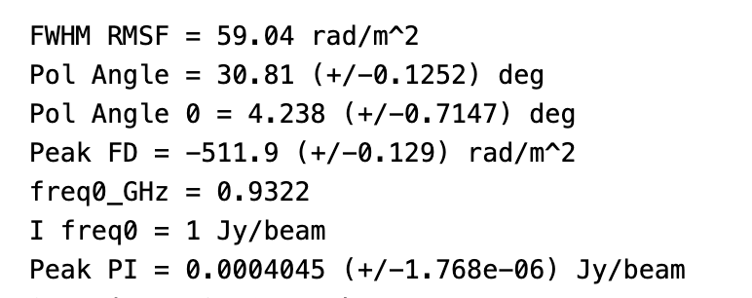
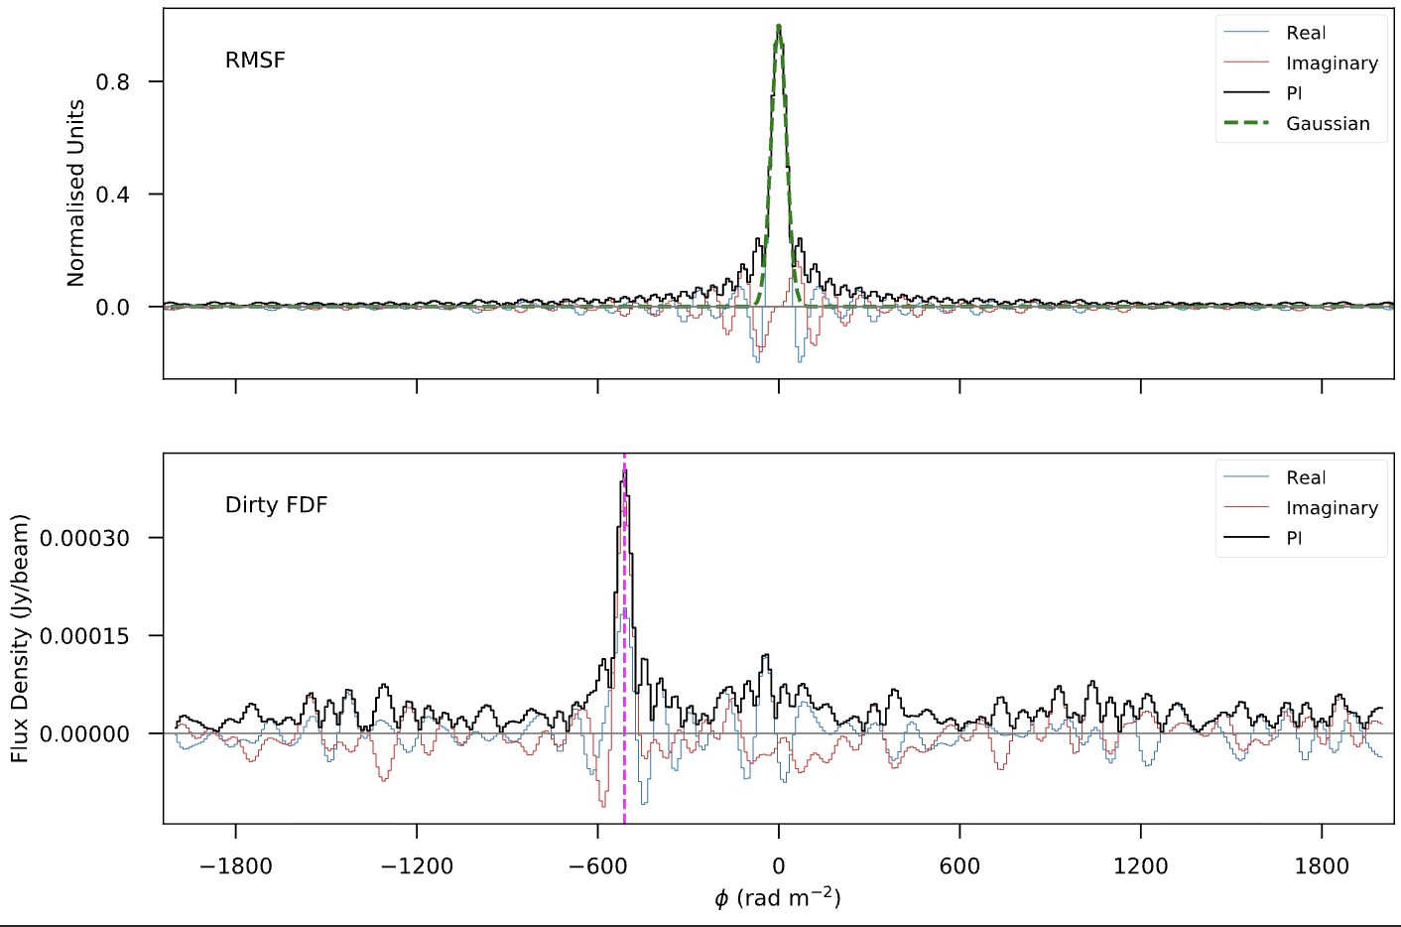
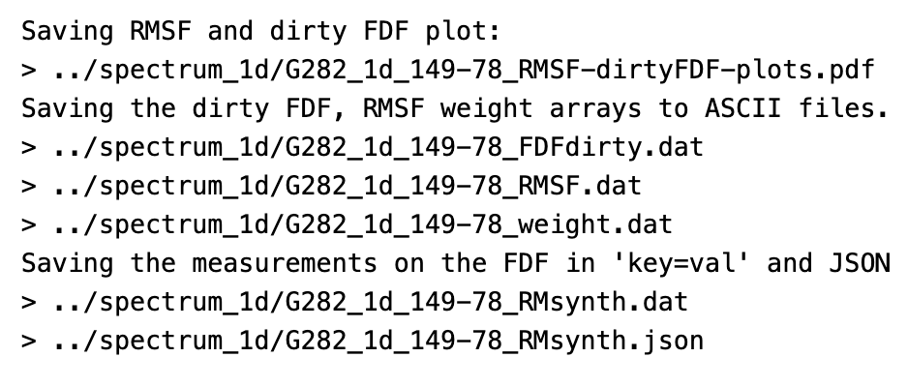
rmsynth1d results

Slide 19
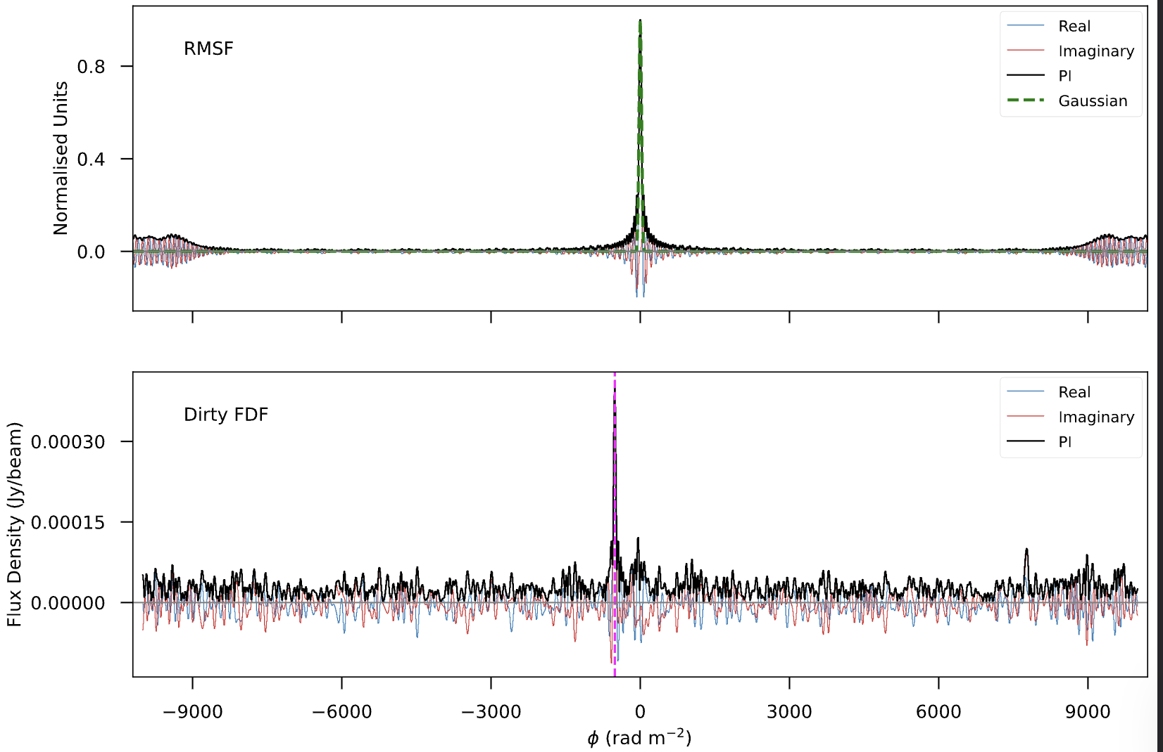
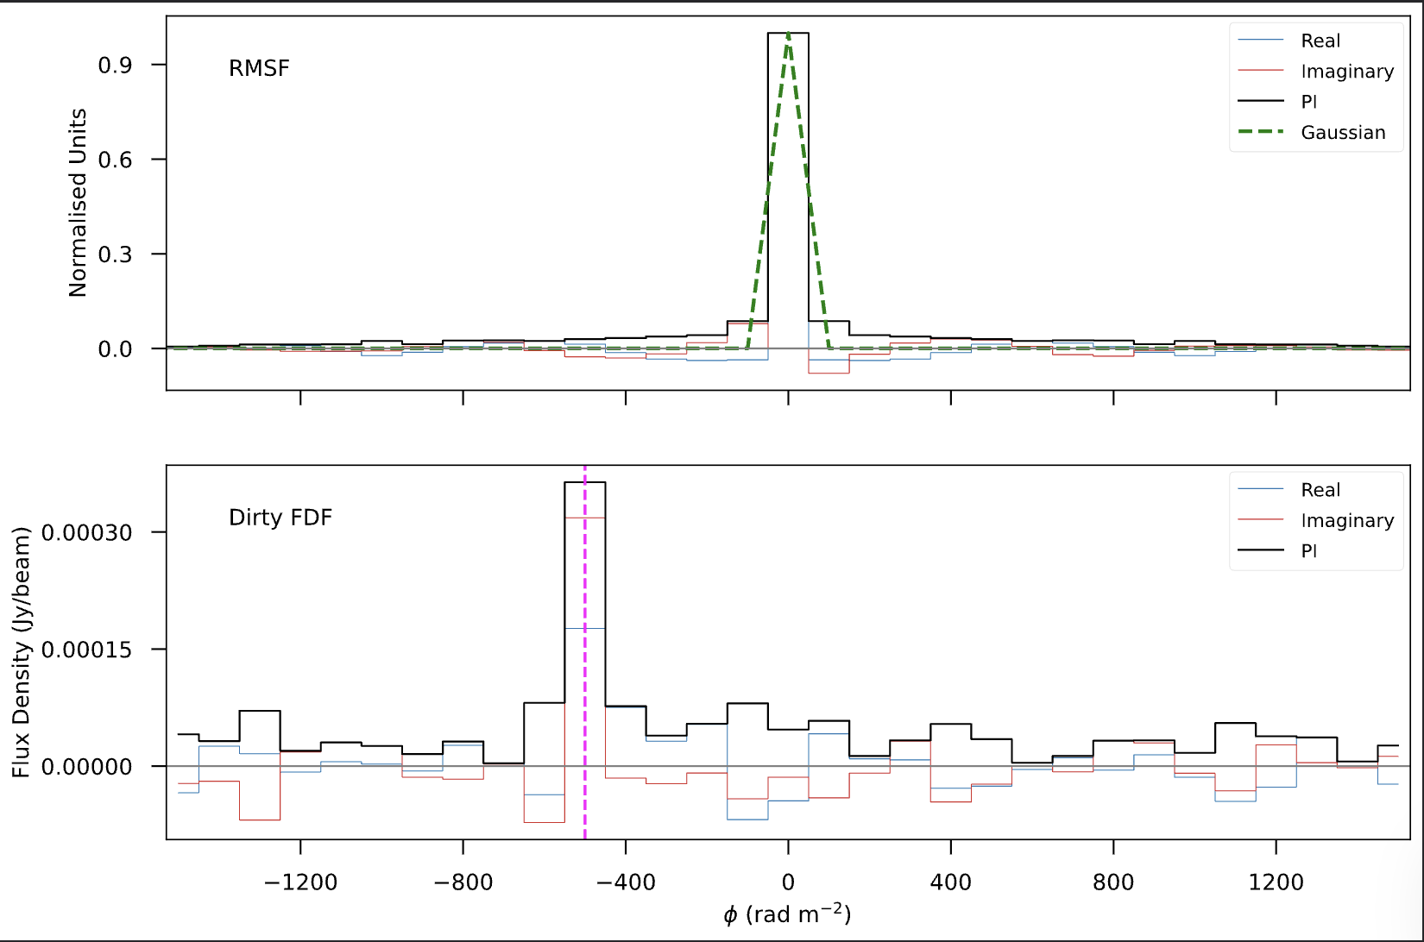

Slide 20
Now let run RM synthesis on each pixel!

Slide 21
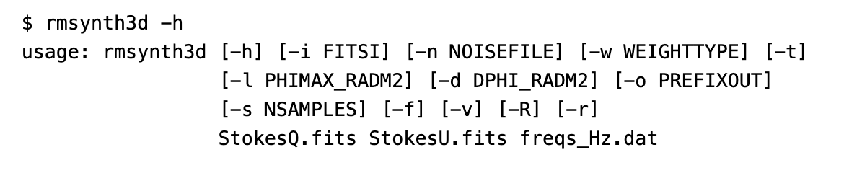
RM synthesis 3d
It requires the Stokes Q and U cubes and a file that contains the frequency array.
Extracted frequencies
Note:
It works well with ASKAP datacube from CASDA.
You may need to wrote you own scripts for other dataset.

Slide 22
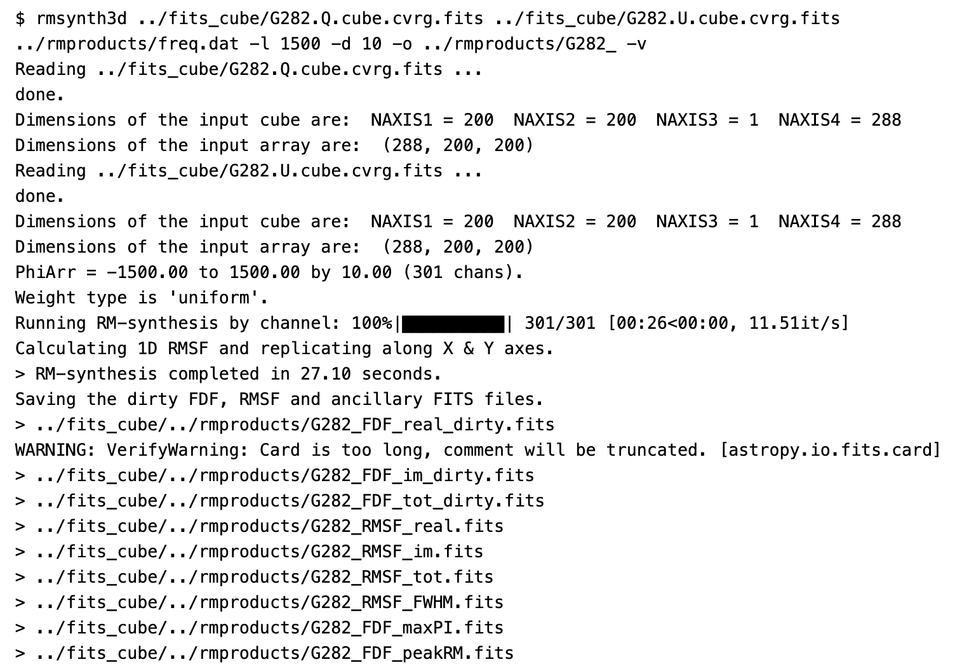
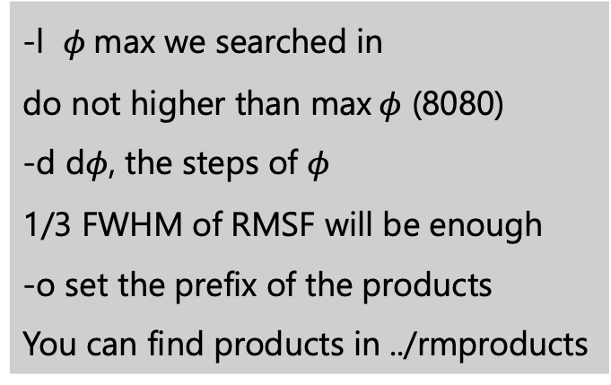
RUN rmsynth3d
-l $φ$max we searched in
do not higher than max$φ$ (8080)
-d d$φ$, the steps of $φ$
1/3 FWHM of RMSF will be enough
-o set the prefix of the products
You can find products in ../rmproducts

Slide 23
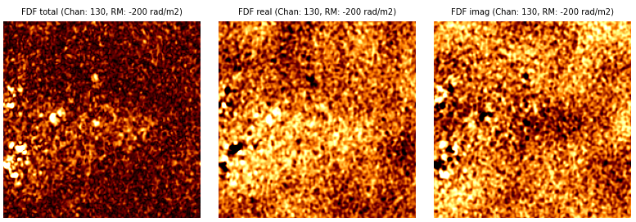
FDF cube (RM range: -200 ~ +200 rad $m^{−2}$ )

Slide 24
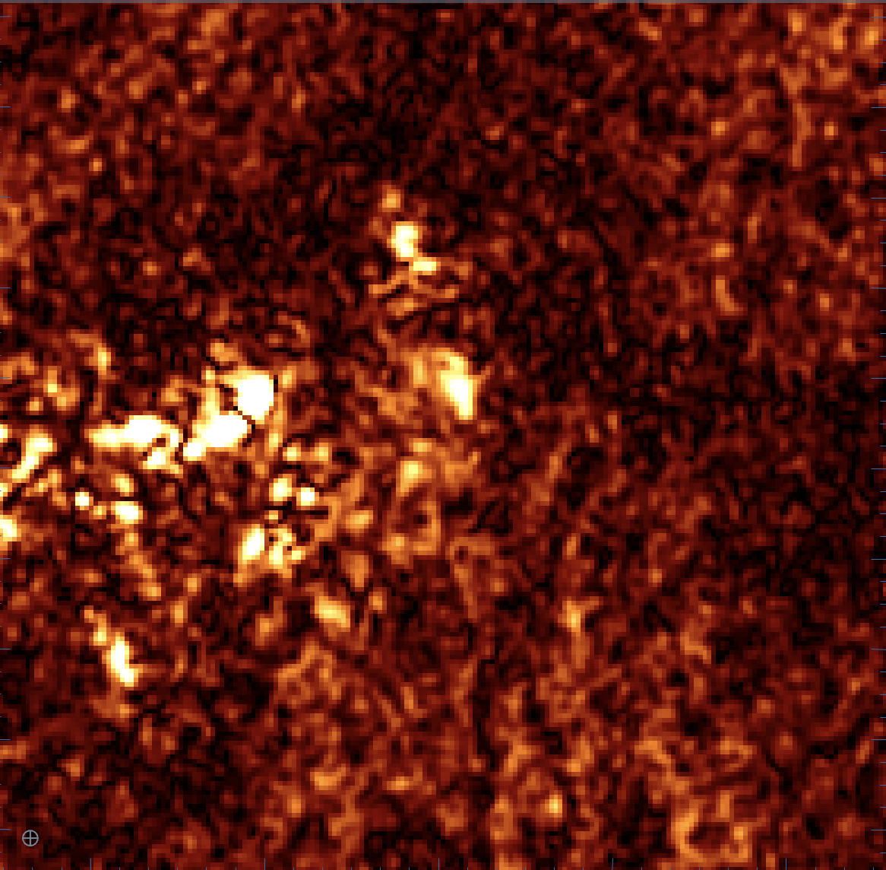
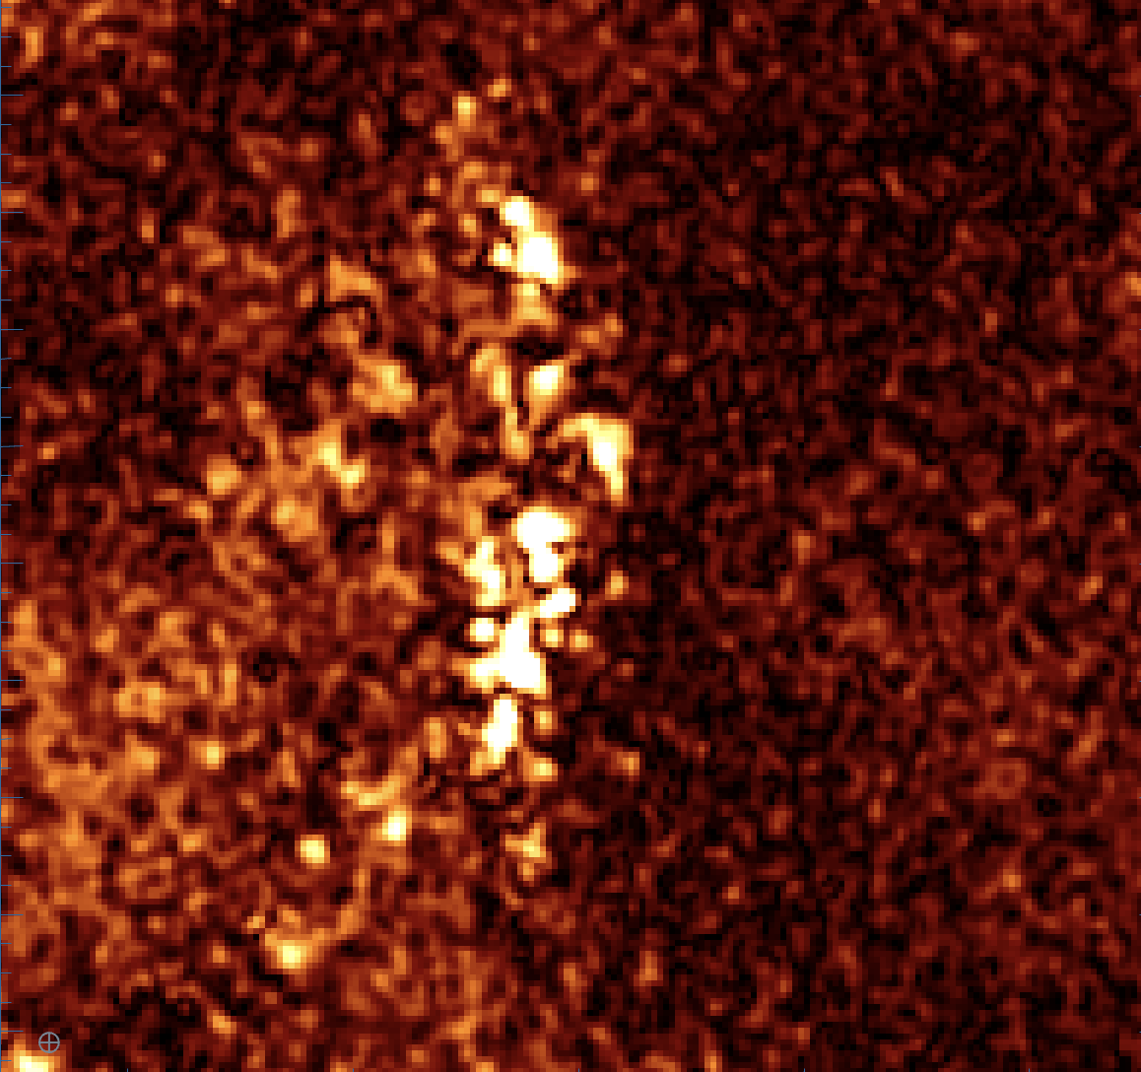
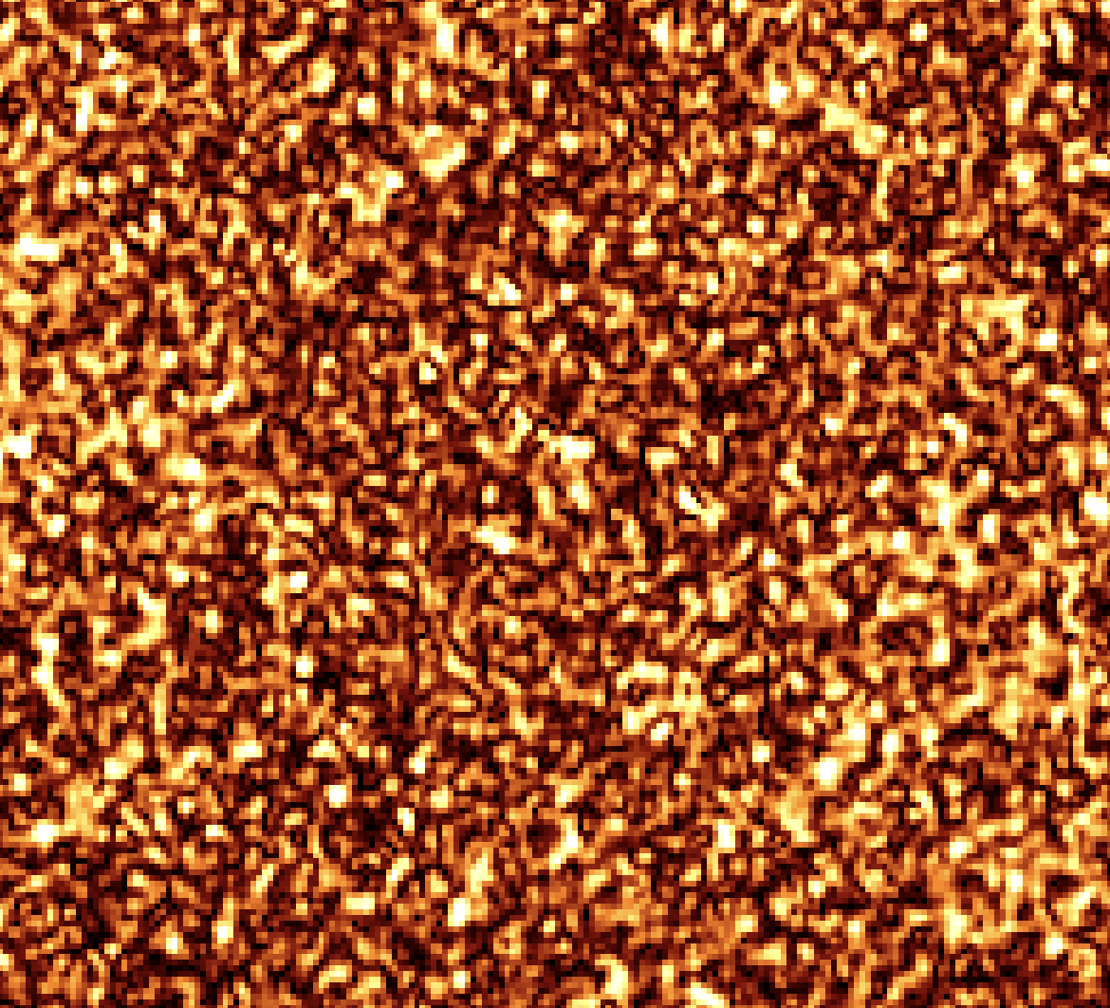



*FDF_tot_dirty.fits
RM= -30 rad $m^{−2}$
RM= 10 rad $m^{−2}$
RM= 1000 rad $m^{−2}$

Slide 25
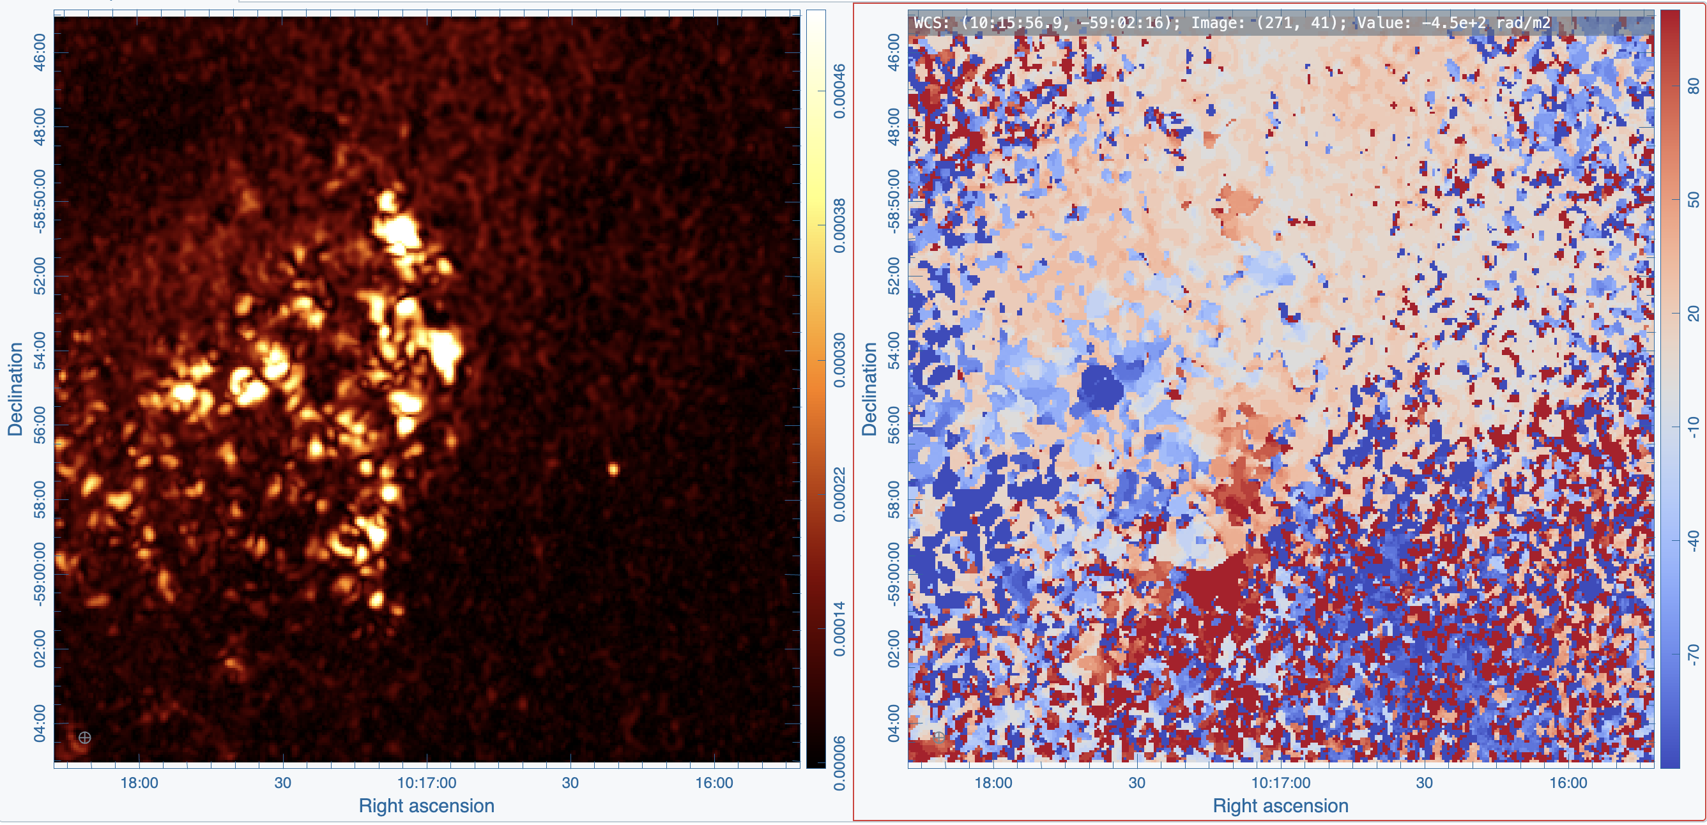
*FDF_maxPI.fits *FDF_peakRM.fits

Slide 26
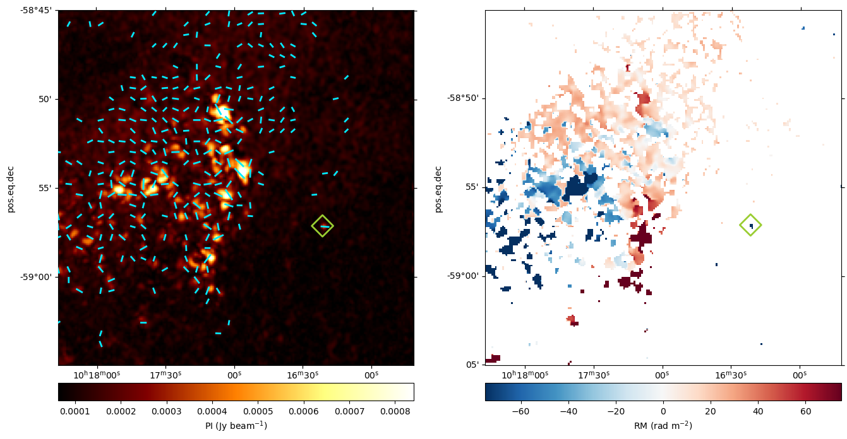
rmtools_peakfitcube
Fitted map.
Error map,
Polarization angle (PA),
Signal-to-noise ratio
>>>
ATCA 6cm (~5 GHz) total intensity map of Goose overlay with PA.
max PI overlay with PA. @943MHz peal RM map

Slide 27
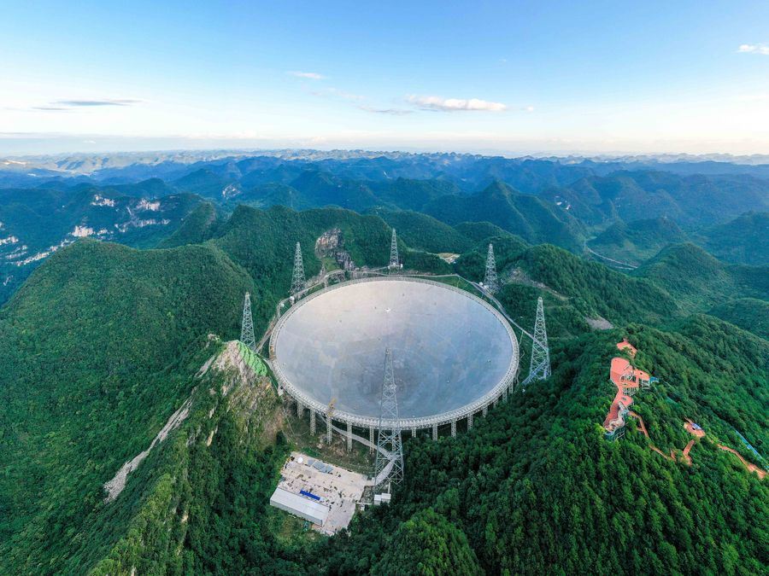
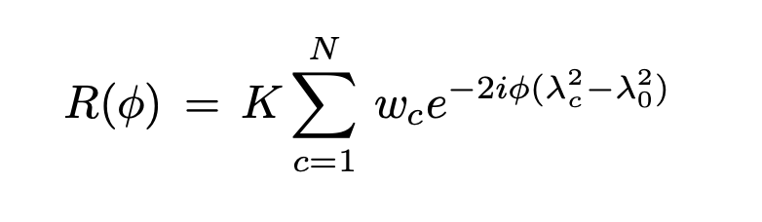
Five-hundred-meter Aperture Spherical radio Telescope (FAST)
Q: Can we run the same procedure on FAST dataset?
Credit: Xinhua/Ou Dongqu

Slide 28
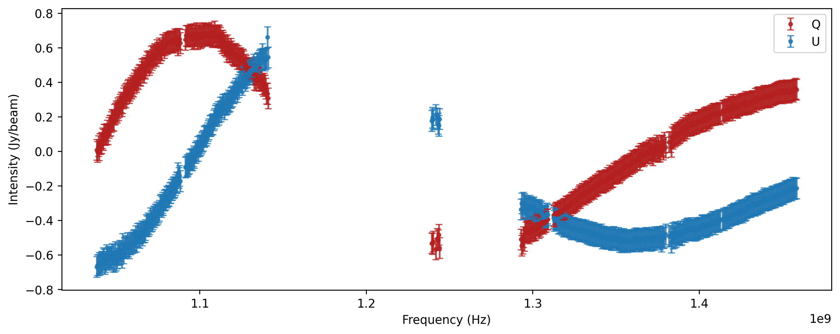
FAST: the gap between two frequency band
ASKAP low: 799.5 – 1087.5 MHz => *continuous coverage
FAST: backend 1 - 1.5 GHz, but 1.15 -1.3 GHz is contaminated by RFI [spectrum_1d/G182_1d_239-58.dat]

Slide 29
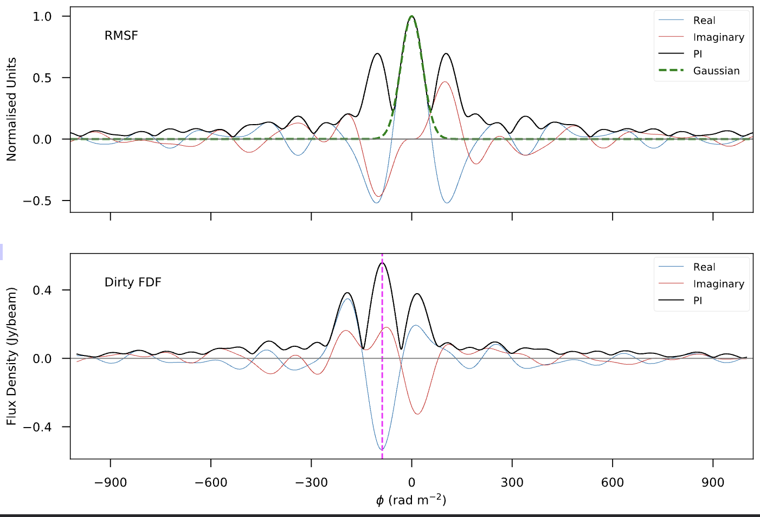
Run RM synthesis 1d
UV coverage => PSF
λ coverage => RMSF
Clean =>RM clean

Slide 30
RM clean (Heald 2009)
In realistic cases: where multiple RM components are present, the RMSF sidelobes can overlap and distort the signal.
Technique (just like CLEAN in interferometric imaging):
Find the peak in the reconstructed Faraday dispersion function
Subtract a scaled version of the RMSF, centered at that location
Store a delta-function component at that location
Repeat this process => niter
Stop when the residuals are below the noise (or a threshold).
Restore the final result:
all stored delta-function components * restoring RMSF (Gaussian) + residual

Slide 31
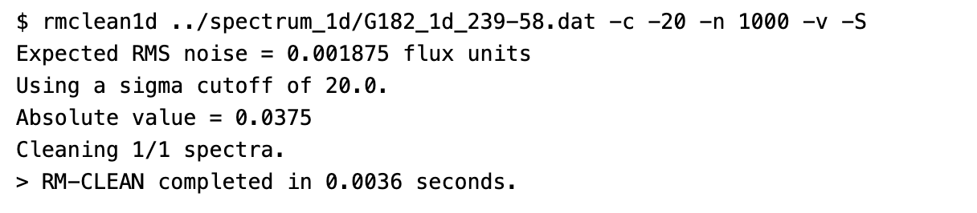
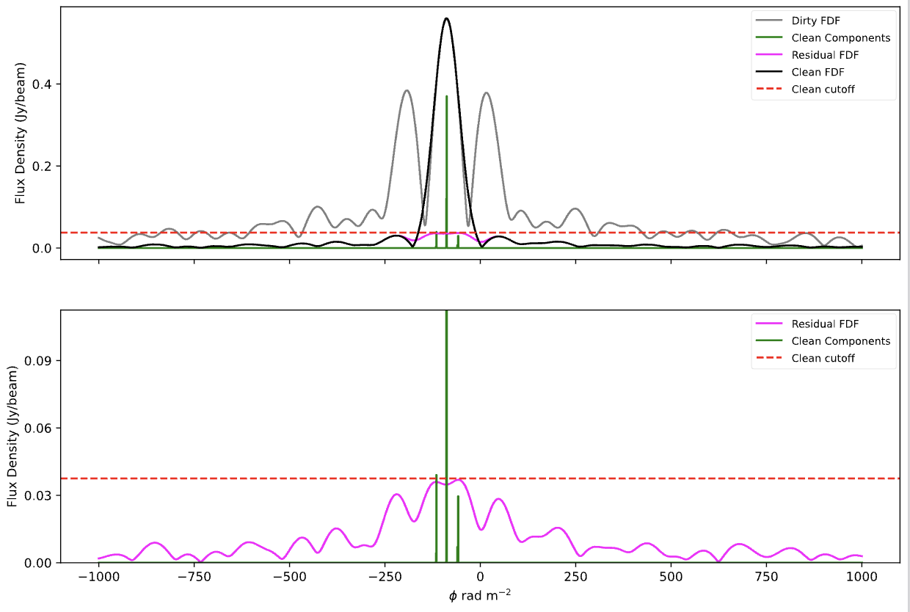
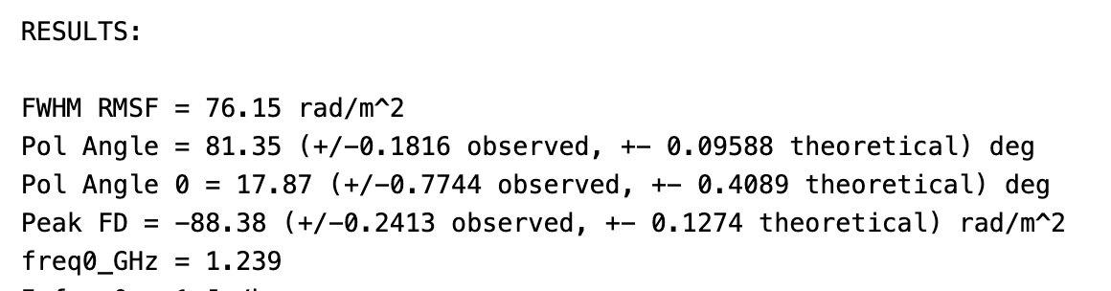

Run RM clean 1d

Slide 32


More examples
Vanderwoude et al 2024

Slide 33
In more complex cases...
Data cube is too large
Regrid & Chunk (e.g, with RM-Tools)
Stokes I spectrum is too steep
Including the Stokes I data for analysis
Complex FDF spectra/foreground
Deal with foreground RM and multiple components
Missing flux problem
Combine single-dish + interferometer data to recover missing scales

Slide 34
Take away
Understand key RM synthesis concepts:
RMSF, FWHM, Max accessible RM, Max RM scale
Learn how to perform RM CLEAN
Know how to:
Load and view ASKAP polarization data
Run RM-Tools
RM synthesis 1D & 3D
RM CLEAN
peakfitcube
Many thanks & Have fun!
If you have any further question, welcome to contact me for more discussions!
wh.jing@outlook.com

