Slide 1
单天线和干涉联合探测下的星系HI分布和运动
王菁 北京大学
Jwang_astro@pku.edu.cn

Slide 2
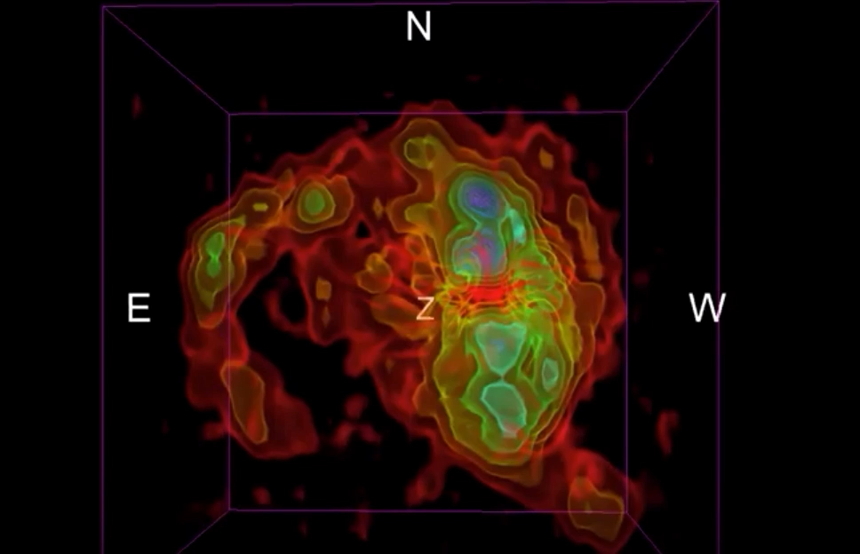
HI分布在尺度和柱密度上的动态范围极大
成图比想象的困难

Slide 3
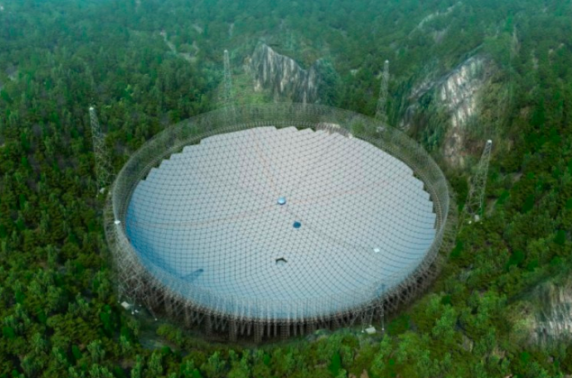
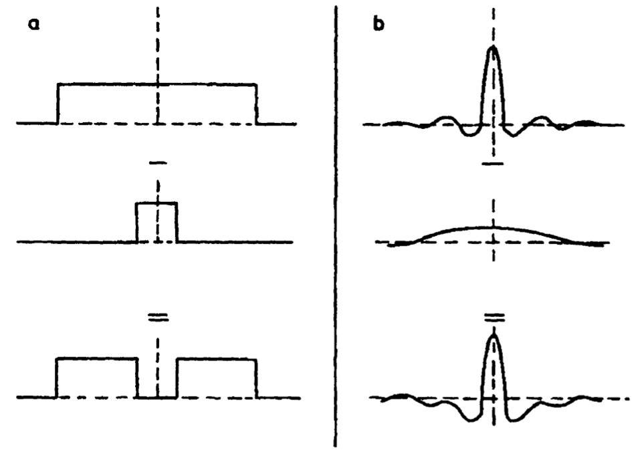
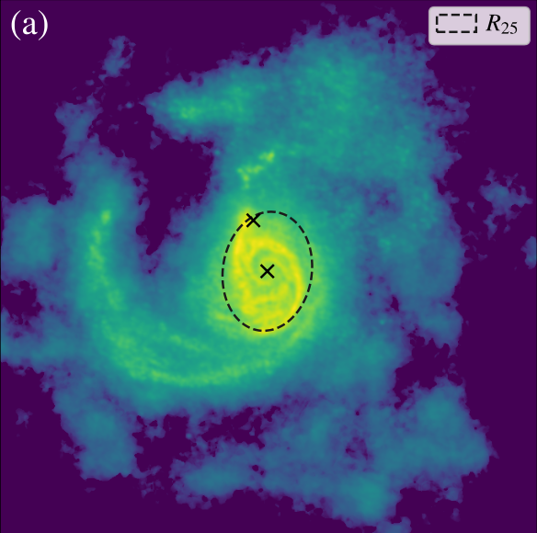
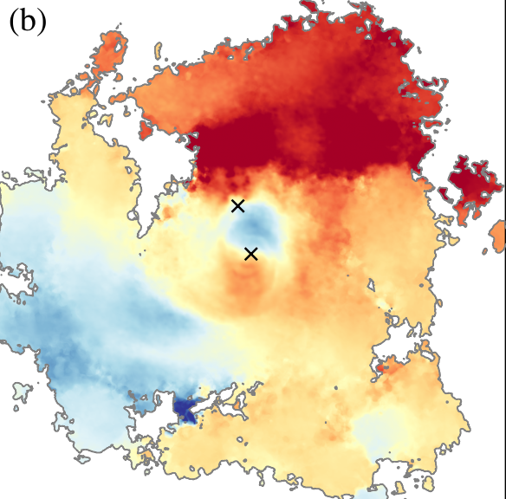
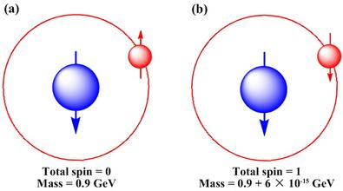
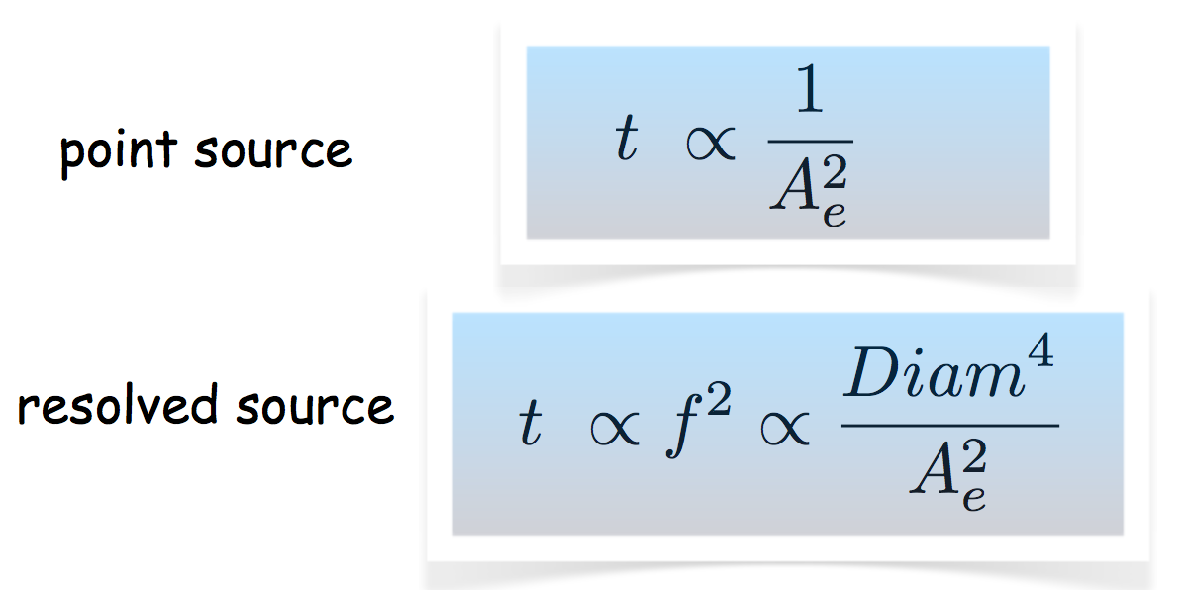
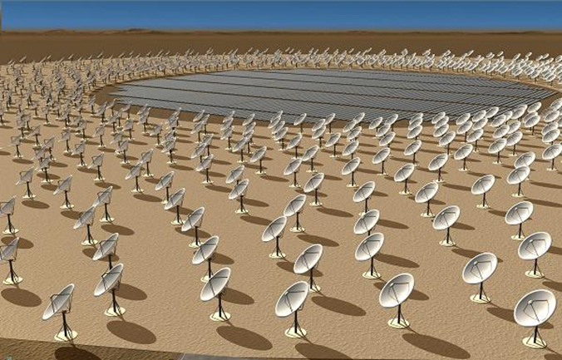
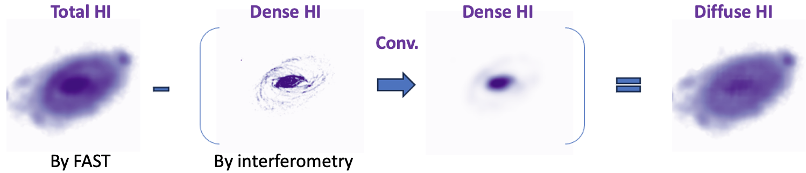
Traditional way of mapping HI in the ISM via interferometric or single-dish observation
The missing flux problem of INT
Baseline sampling
PSF shape
Spatial resolution 3.2’ (7 kpc)
10^{17.7} cm⁻² in 5h
Idealized
missed
reality
Resolution~1.22λ/D
Short-spacing, missing extended structure, negative bowl, etc.
Spatial resolution 5’’ (0.2 kpc)
10²⁰ cm⁻² in 12h

Slide 4
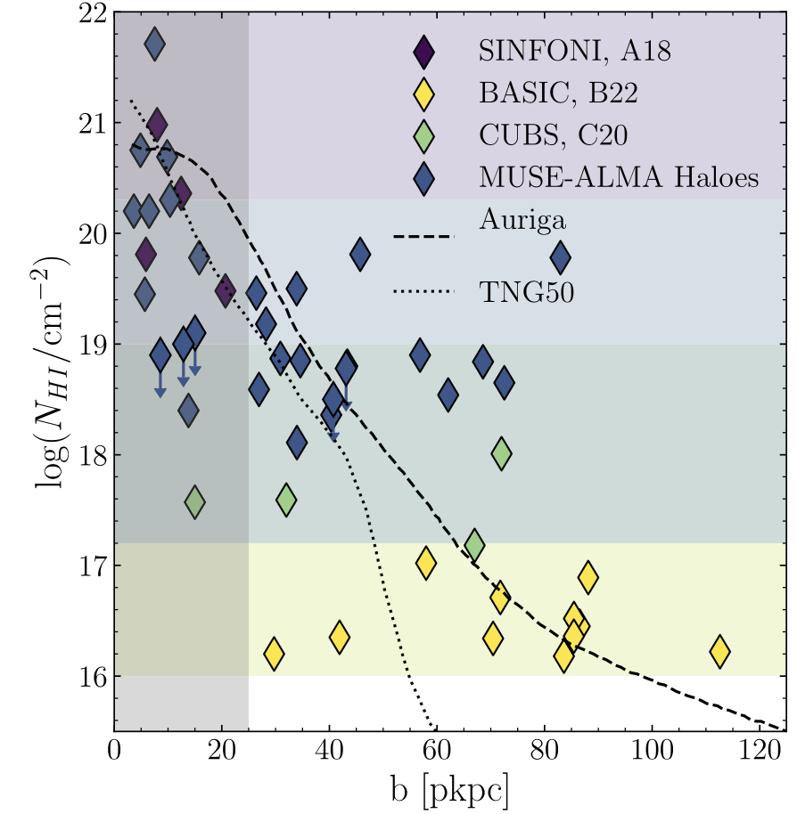
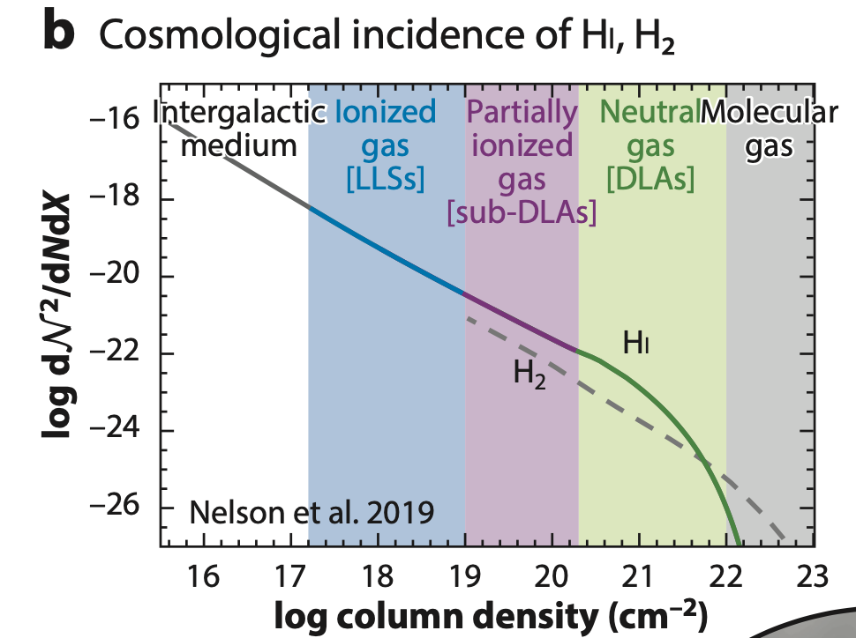
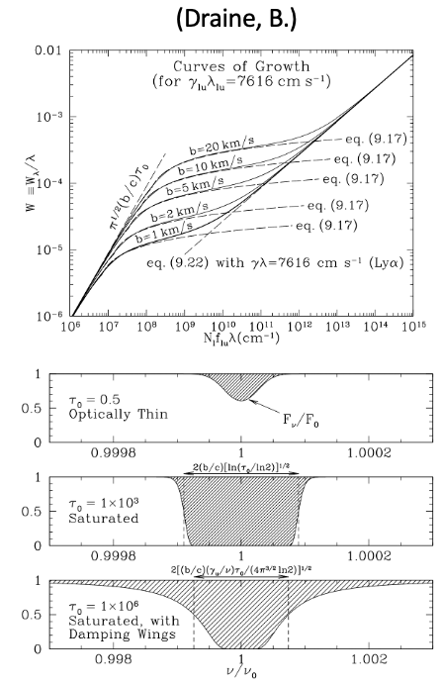
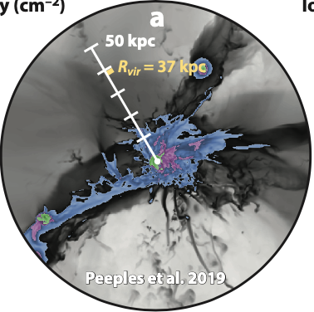
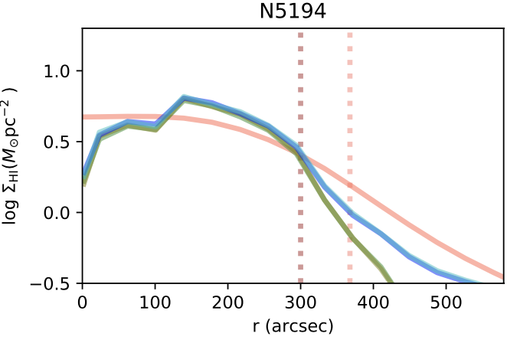
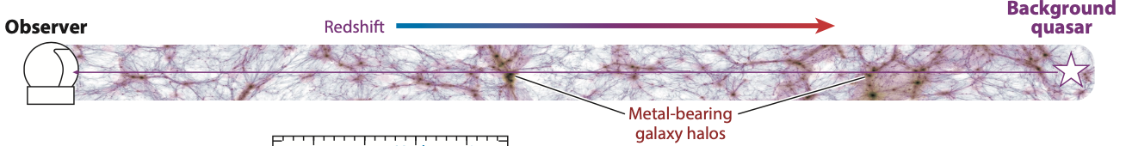
Traditional way of detecting HI in the CGM via UV absorption toward QSOs
2. A particular problematic range for absorption
(Peroux+20)
1. Struggle of collecting incidence samplings
(Weng+23)
Incidence sampling on QSOs
FAST
FAST+int
Int
3. N_{HI} range that can be mapped with FAST+int

Slide 5
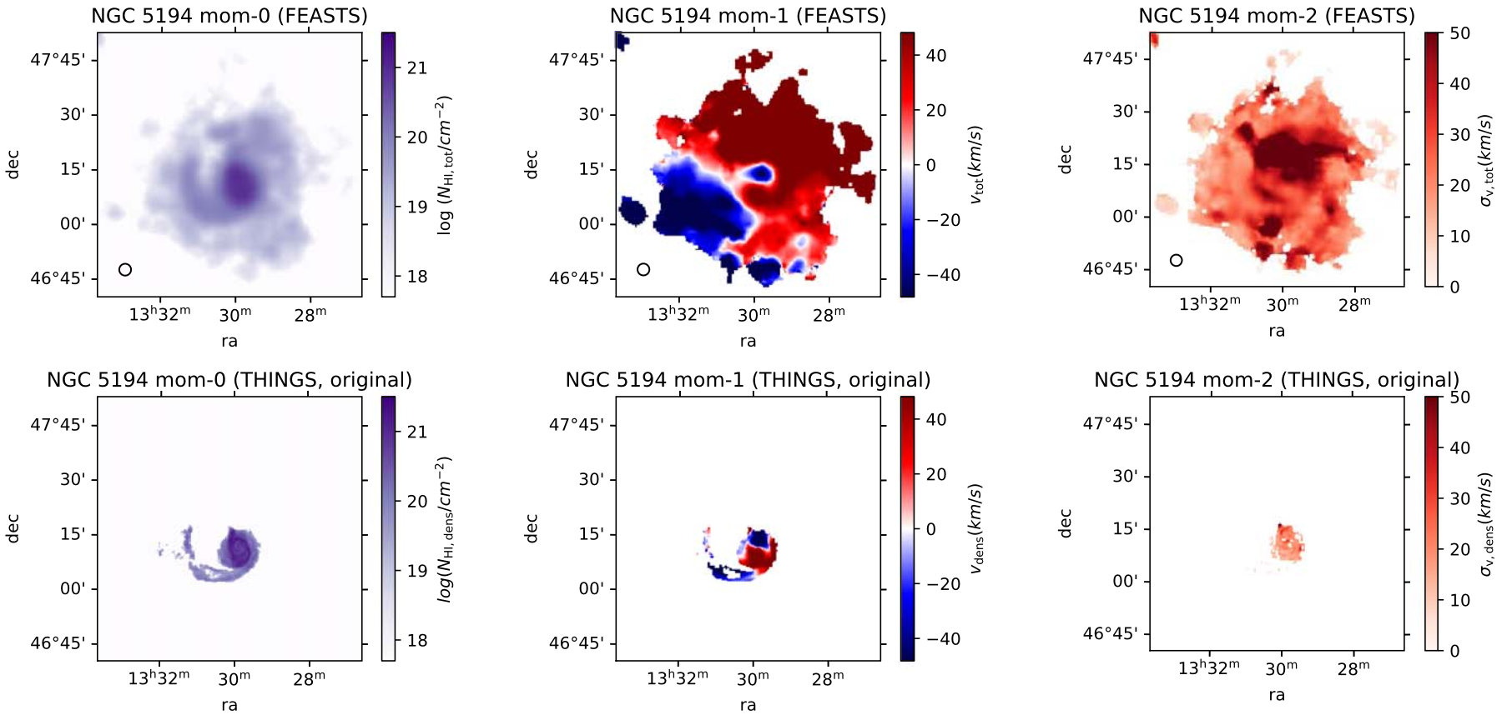
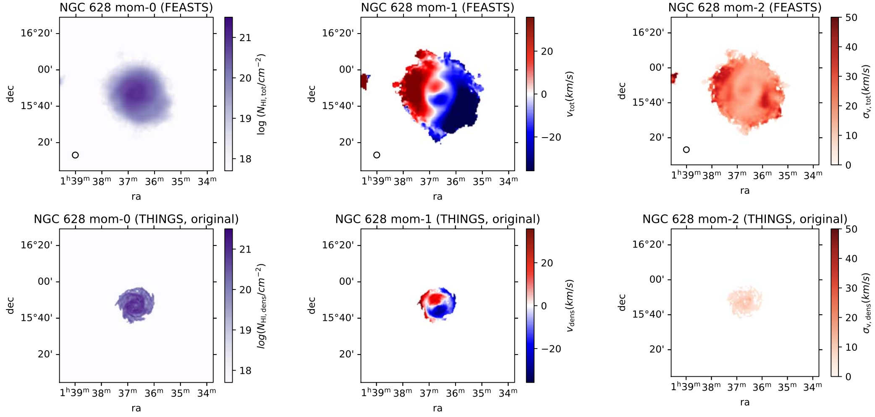

Slide 6
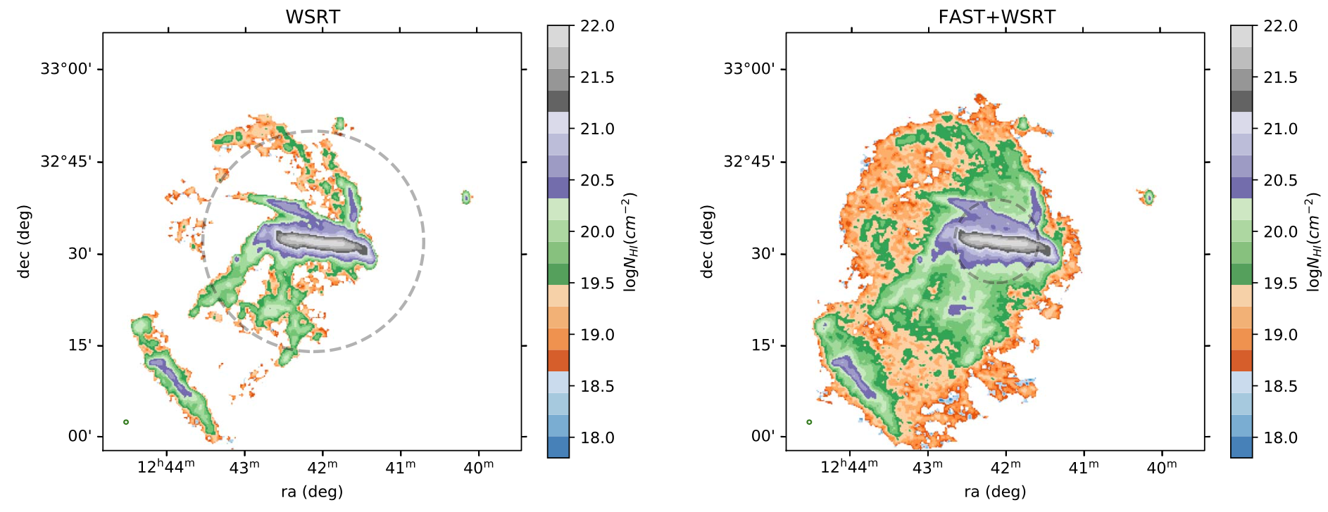
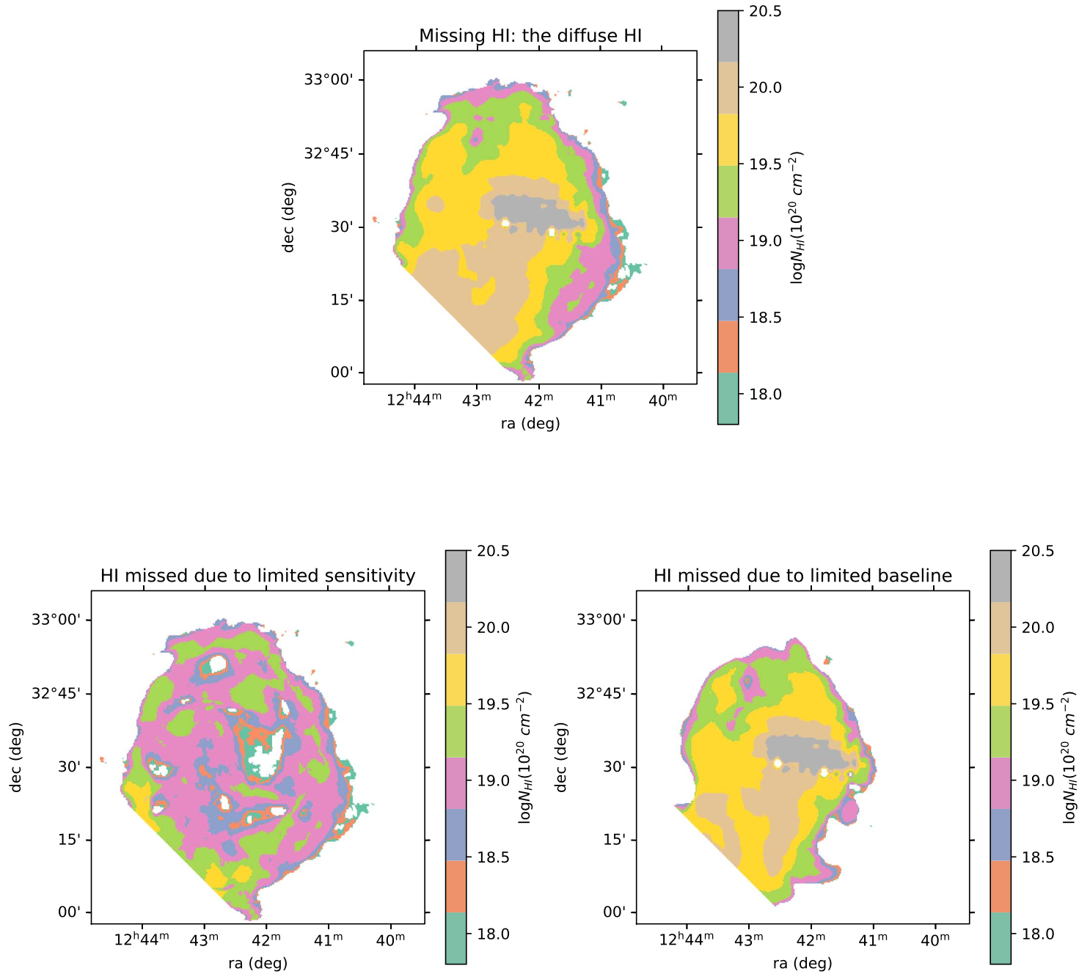
A close look into the HI around NGC 4631
FEASTS+HALOGAS full HI
FEASTS-HALOGAS reveals that the diffuse HI is by missed HALOGAS not because of low NHI, but because of large-scale nature.
45% diffuse HI in the system, 75% diffuse HI in the CGM, missed by HALOGAS.
90% of diffuse HI missed by HALOGAS is due to short spacing, this HI has sky scale > 12’ or 30 kpc
Notes:
How does this low column HI survive? In what status does it exist?
We look closely into the galaxy N4631.
The total and full HI image captures significantly more HI than the previous halogas observation.
Most of the diffuse HI is missed due to short-spacing of HALOGAS observation, because it has large spatial scales, with characteristic scalesabove 30 kpc.

Slide 7
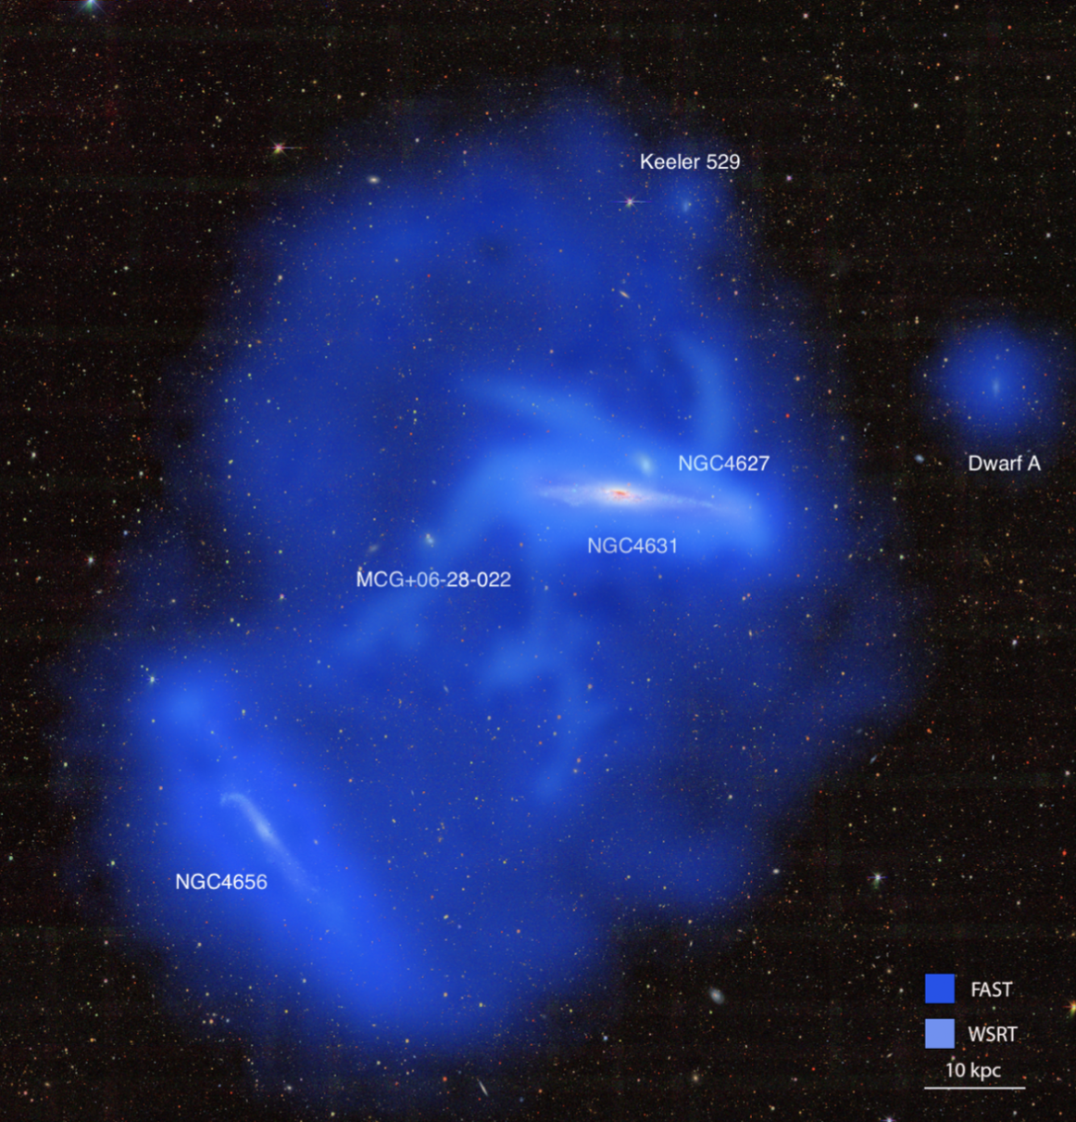
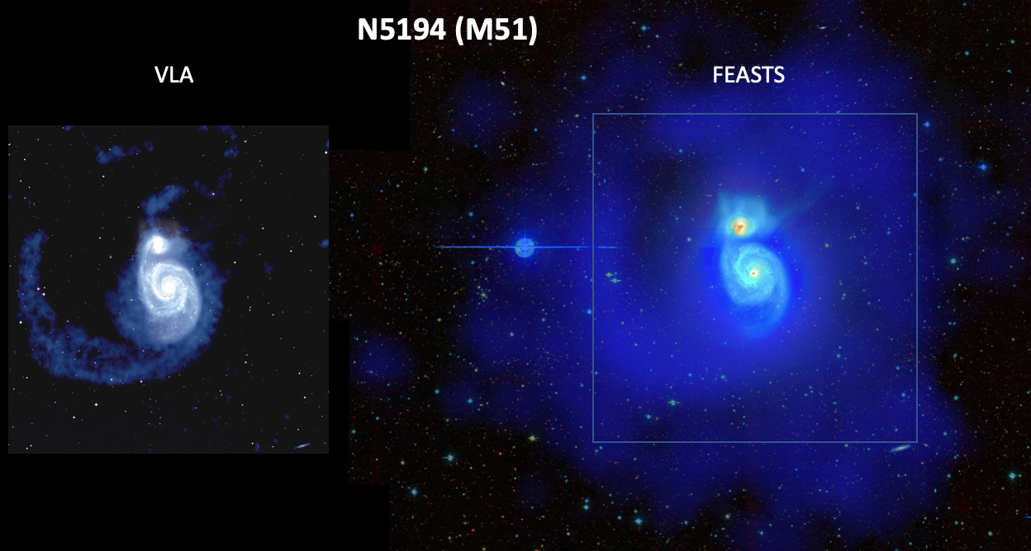
These two images from FEASTS are highlighted in many different talks in the past IAU.GA in August
Wang+23, Lin+ 25

Slide 8

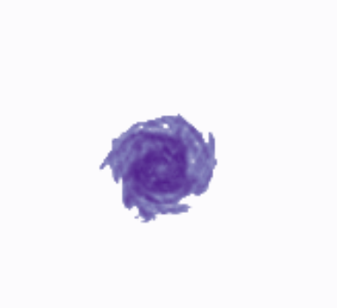


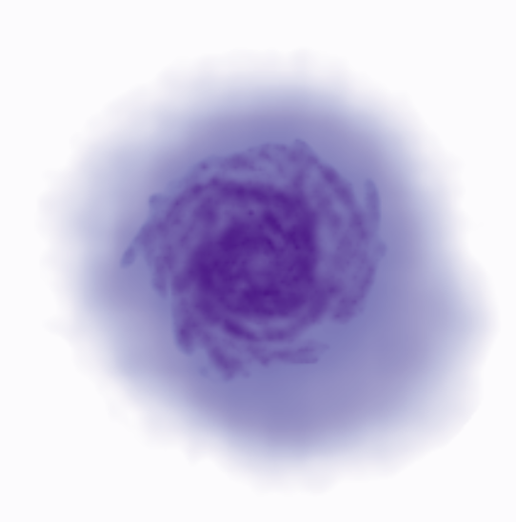
FAST+interferometry data combination
A loose but convenient way of viewing it:
Total HI
Smoothed dense HI
Diffuse HI
FAST beam
Diffuse HI
Dense HI
Full HI
The full HI has the resolution of interferometry and sensitivity of ~FEASTS
Notes:
When I talk about combining the two types of data, I do not mean showing contours of the images in the same plot.
Here is a loose but convenient way of viewing the data combination.
With FAST, we obtain the total , subtracting the convolved int data, we obtain the diffuse HI
The diffuse HI is so extended and so featureless, that a FAST image and a SKA image should have no significant differencees.
The diffuse HI plus the dense HI, produces the full HI

Slide 9
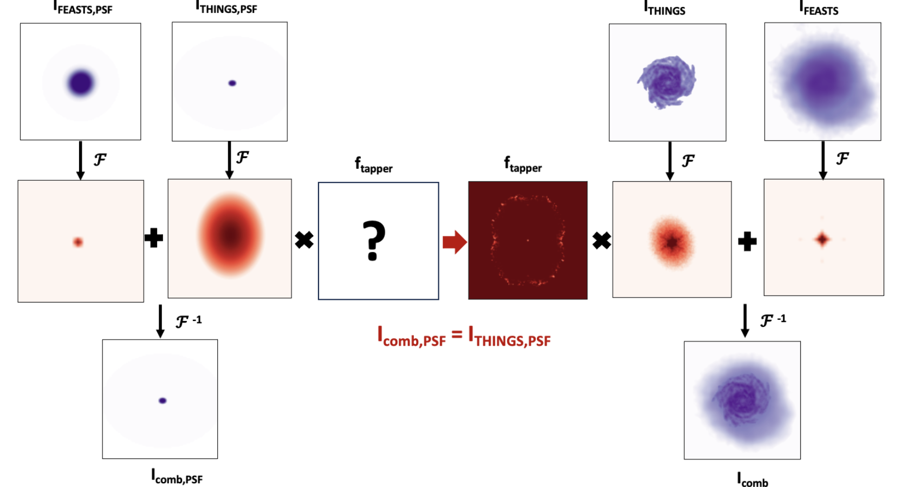
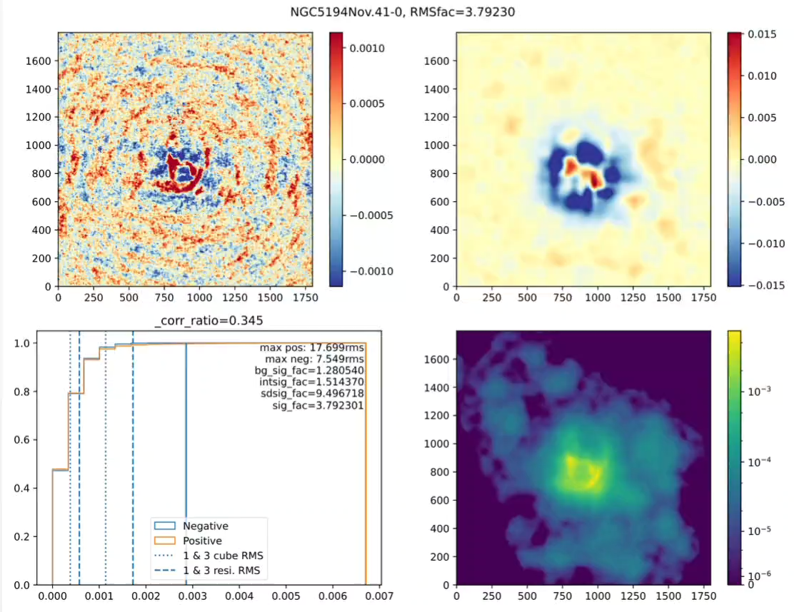
Combining FEASTS and interferometry to obtain full HI
Linear combination: optimized for NHI deviation
Joint deconvolution: optimized for extracting kinematics
resi
resi
Procedure and flow chart modified based on Stanimirovic (2002).
Wang+2024b
Lin+2025
model
Notes:
In really, and in practice, we combine them in the fourier space , or jointly deconvovle them.

Slide 10
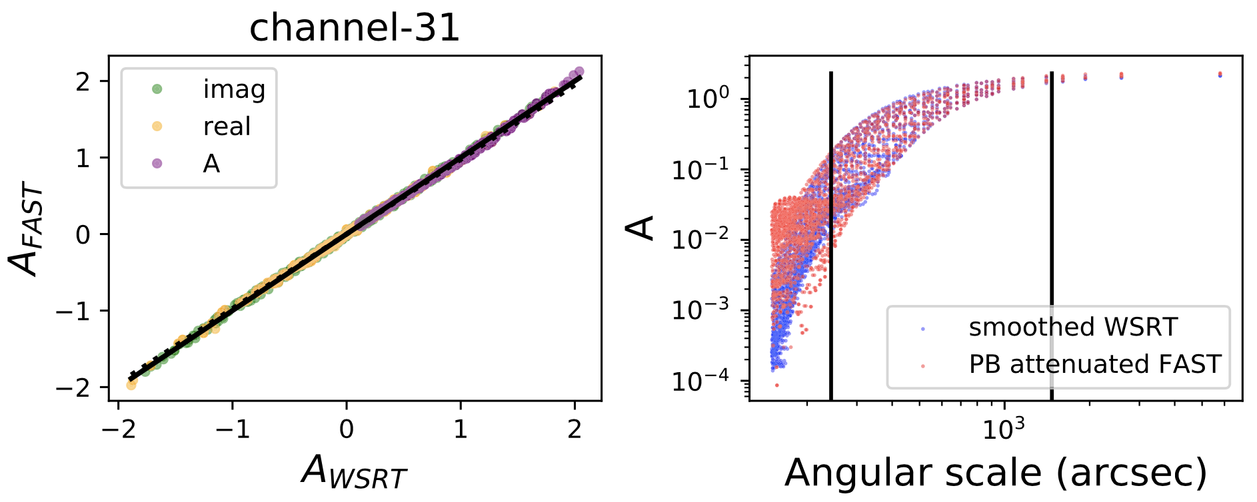
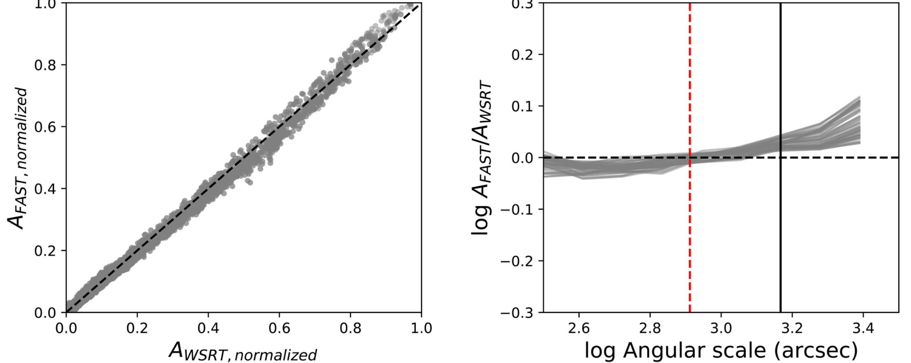
Flux cross-cralibration before combining FEASTS and int data
Wang+23, 24
Notes:
For example, using mock tests, we find the best way to do flux cross calibration should be different when dealing with interferometry data having high and low signal to noise ratios.

Slide 11
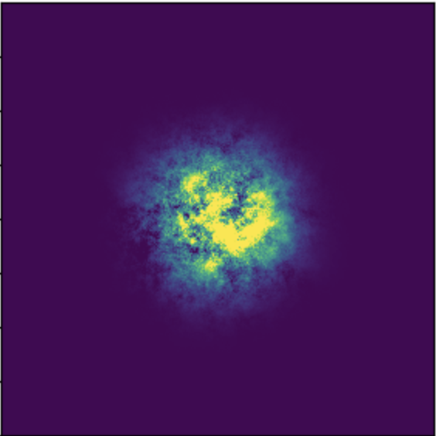
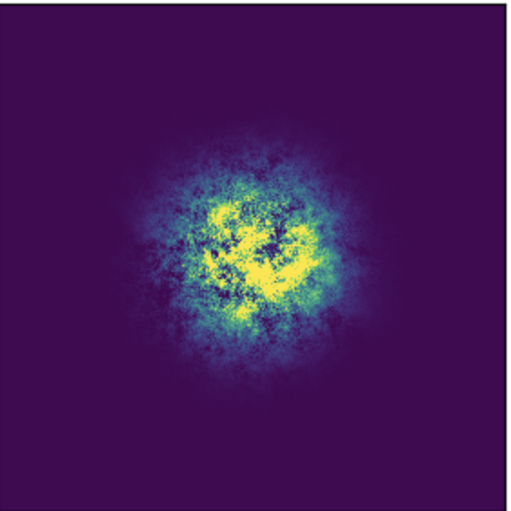
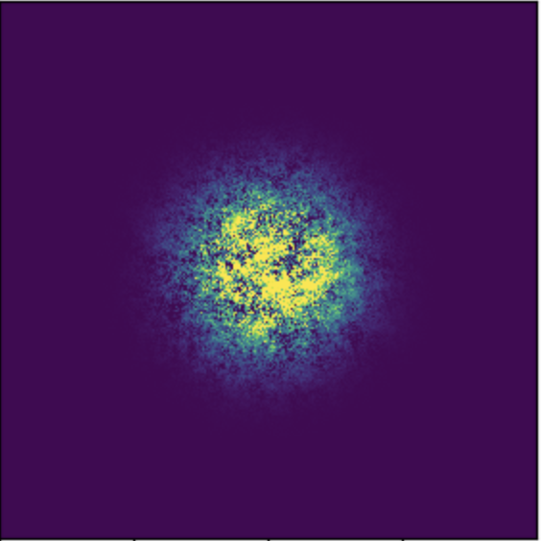
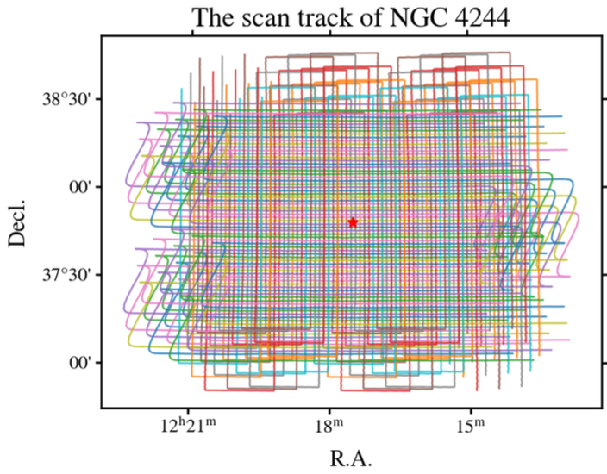
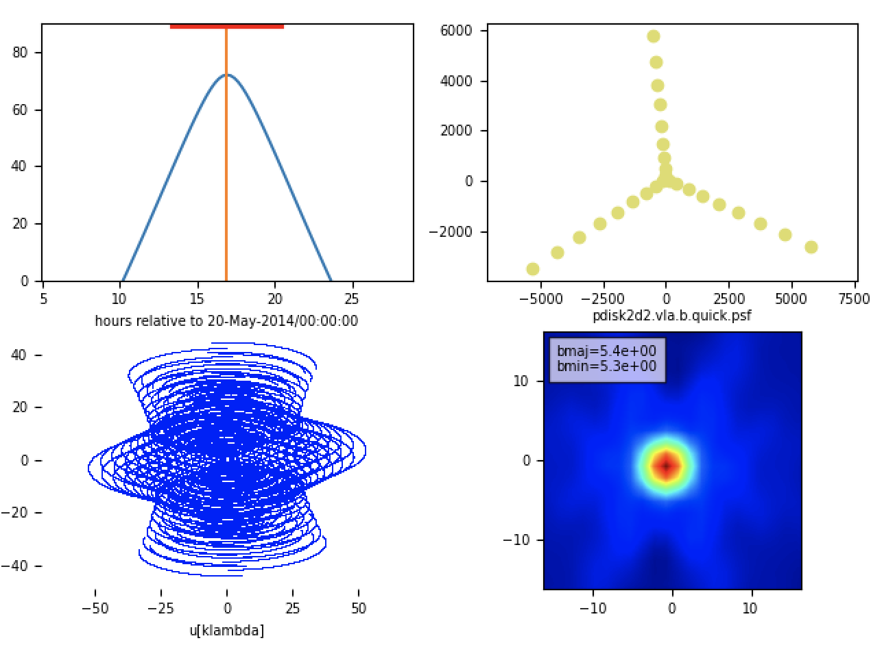
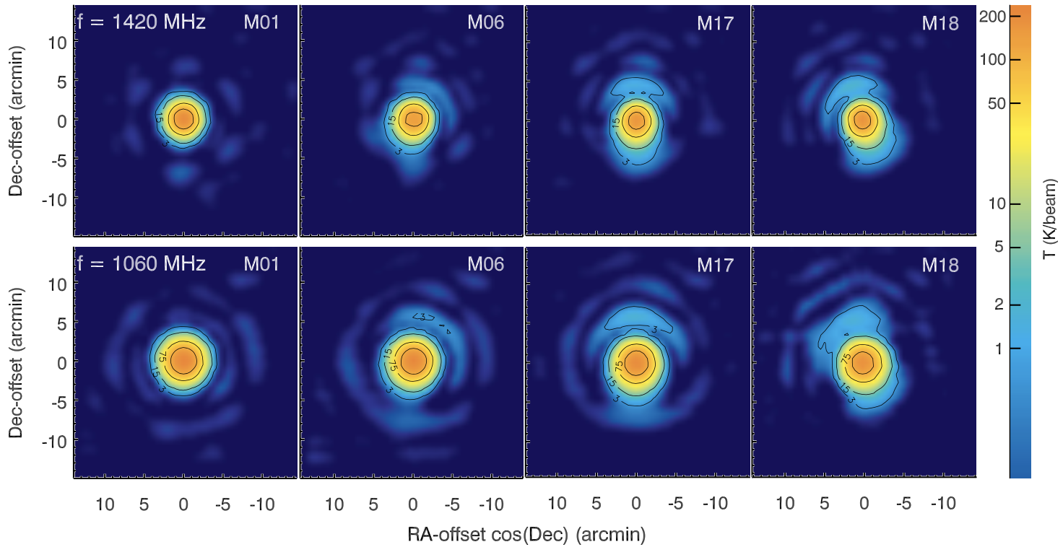
FAST and interferometry mock observations
Example of mock HI disks with decreasing power spectral slopes
Int observing simulator:
CASA.SIMOBSERVE
A FAST observing simulator
+
Wang+24a,b
Yang+ 2025
Notes:
We do not just make pretty images and plots, but also conduct mock tests to optimize procedures and estimate errors

Slide 12
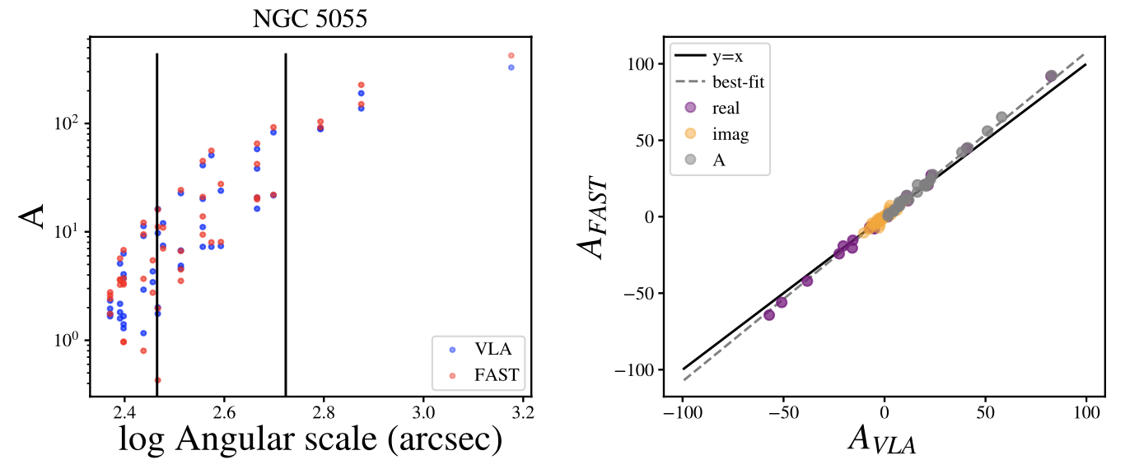
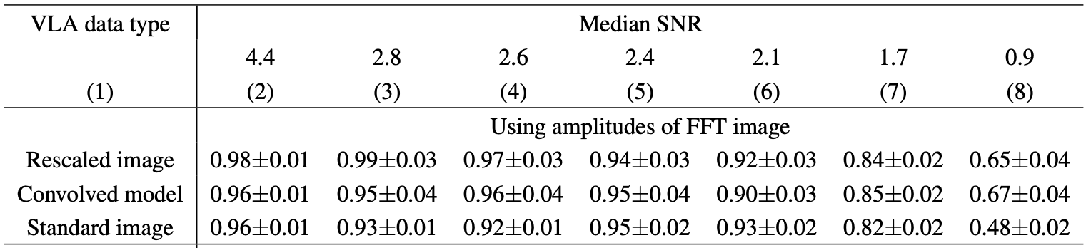
Different types of interferometric data cubes
Standard image/cube: (synthesized beam) convolved model+ clean residual
Rescaled image: convolved model+ clean residual * (clean beam area)/(dirty beam area) (e.g. Walter +08)
Convolved model: convolved model

Slide 13
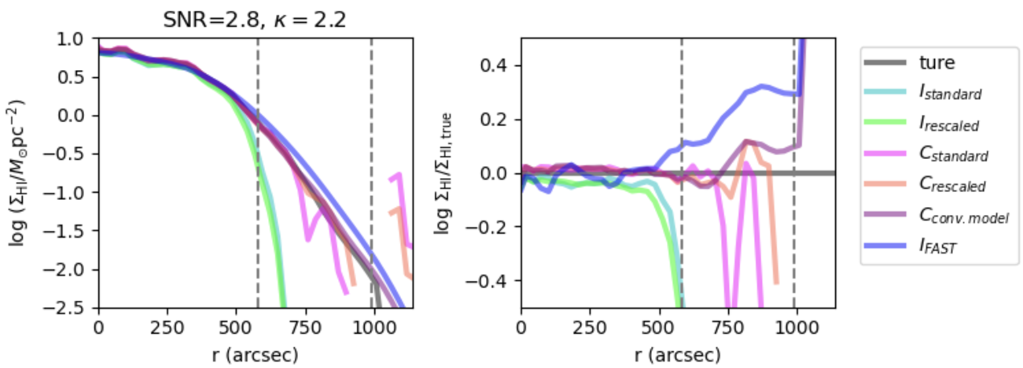
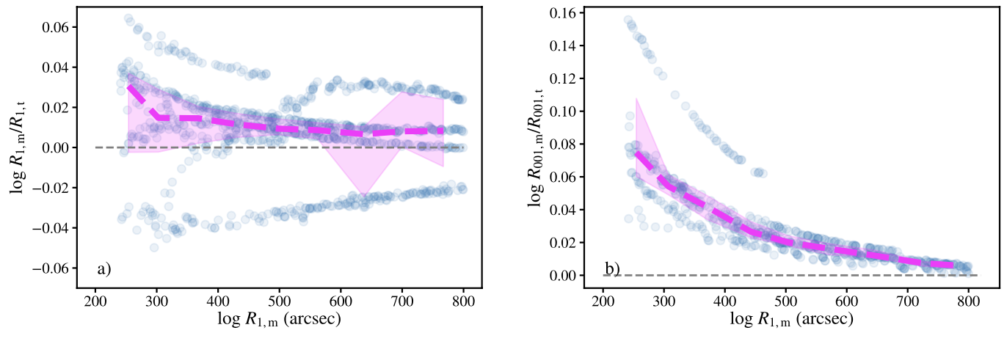
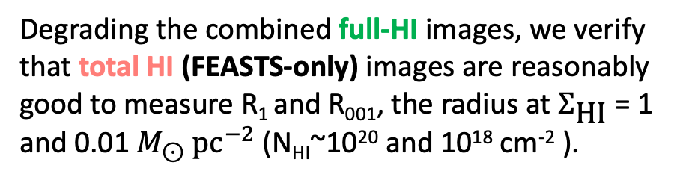
Mock tests to find the best way of analysis, and estimate accuracy of measurements
Convolved model (without clean residual) of interferometry data is preferred when obtaining images of the full HI (linearly combined) or the diffuse HI.
Degrading the combined full-HI images, we verify that total HI (FEASTS-only) images are reasonably good to measure R₁ and R₀₀₁, the radius at $Σ_{\text{HI}}$ = 1 and 0.01 $M_{⊙} {\text{pc}}^{−2}$ (N_{HI}~10²⁰ and 10¹⁸ cm⁻² ).
Wang+ submitted
Notes:
Another example, we find the best way to linearly combine in the fourier space is to use convovled model of interferometry data without adding the clean residuals. The purple curve in the plot.
After we obtain reliably full HI images through combination, we degrade them to estimate measurement errors on FEASTS-only images. We verify that we can safely derive the HI disk sizes at surface density level of 1 and 0.01 Msun pc-2

Slide 14
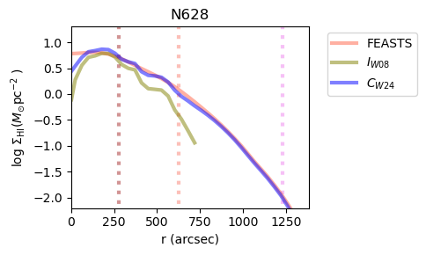
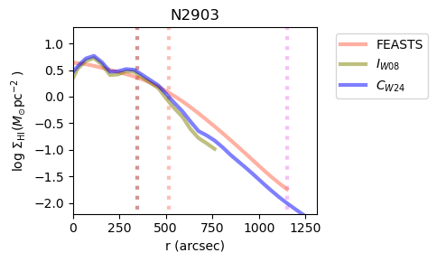
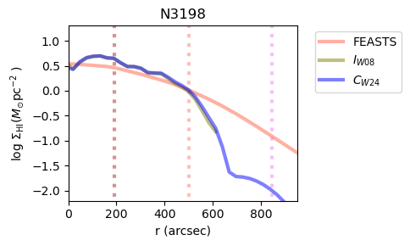
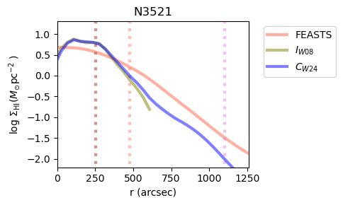
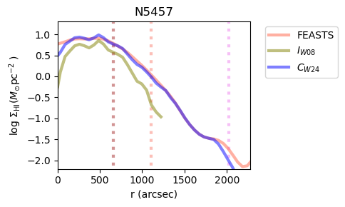
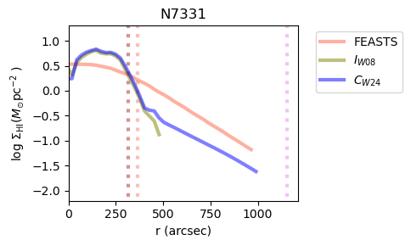
Examples of HI profiles from combined images
Total HI (FAST)
Full HI
(FAST+int.)
Dense HI
(Int.)
Wang+24b
Notes:
And HI radial profiles from them in comparison to FEASTS only and interferoemtry only profiles.
The full HI profile inherite the structrual details of interferometry data, but extends much further.

Slide 15
Some scientific results

Slide 16
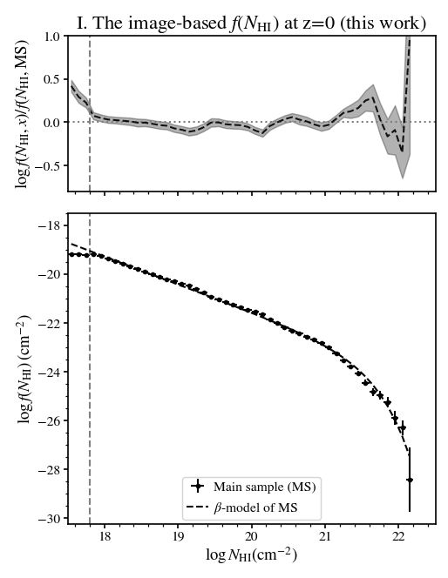
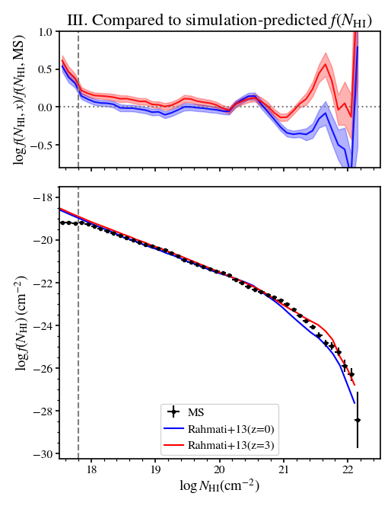
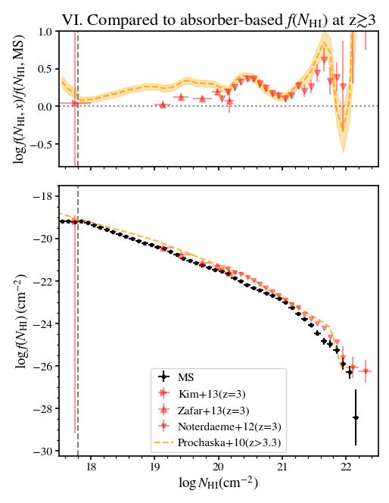
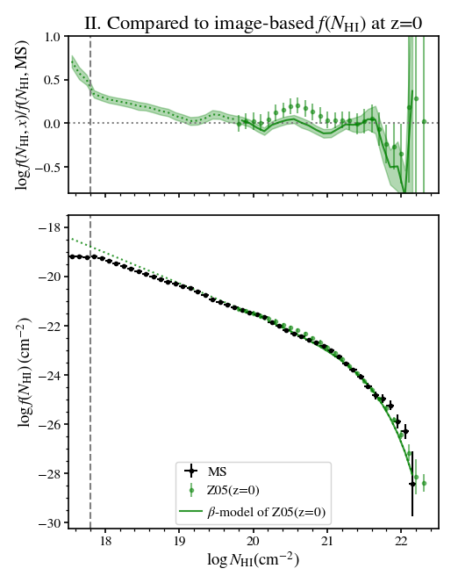

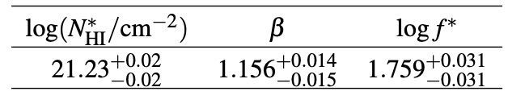
The column density distribution function f(N_{HI}) for N_{HI}>10^{17.7} cm⁻² at z=0
(JW+ 26)
(combines 40 FEASTS full HI+ 30 MHONGOOSE galaxies)
Directly observing deep is necessary.
The only simulation predicting f(N_{HI}) at z=0 also predicts lack of evolution since z=3
There is hint of mild and decreasing evolution since z=3 in observation

Slide 17
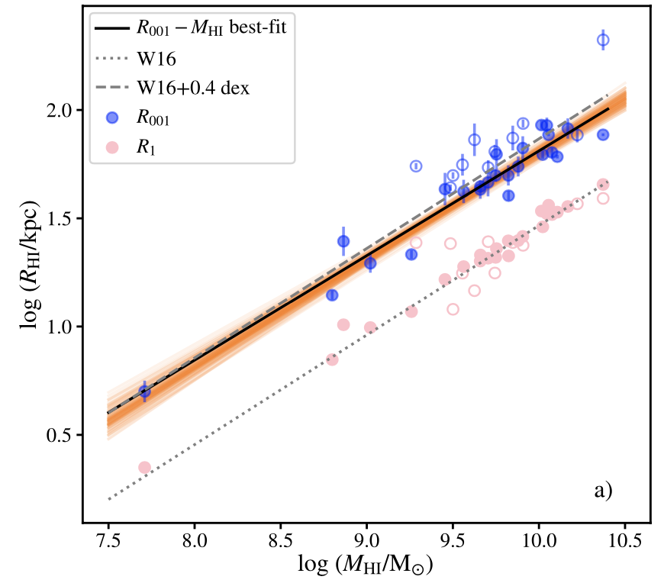

The size-mass relations
Face-on view (JW+25)
Edge-on view (Yang,Wang+25)
deprojected
projected
R₀₀₁~ 2.5 R₁ (area 6 times larger), both R-M_{HI} relations have slope~0.5.
Similar size-mass relation seen in the y direction.
Whatever physical processes that set the M_{HI} also set the R₀₀₁, and erase their fingerprints.
R₀₀₁: 0.01 Msun/pc²
～10¹⁸ cm⁻²
(JW+25)
R₁: 1 Msun/pc²
～10²⁰ cm⁻²
(JW+16)

Slide 18





FEASTS vs. TNG50: discrepancies @ $\text{∼}{10}^{18} {\text{cm}}^{−2}$
Lin, JW+26
Size $R_{HI,001}$
Thickness $z_{18}$
Notes:
Their two other size measurements do not fit with observations.
HI radius @ 0.01; HI vertical extension out to 1e18.
Compare with observational relations mentioned by Jing & Dong, many TNG galaxies have a more extended & thicker HI structures than in observations.

Slide 19



HI distribution (b, N_{HI})
Probabilities of locating N_{HI} within b around galaxies
absorbers
Contour: 21-cm imaging of this study.
+/x: absorbers at z<0.5.
b (kpc)
The isophotal c/a<~0.5
The scatter in absorber strength partly reflects projection effect of a disk
Challenges in associating LLSs to galaxies.
LLSs more tracing large-scale environment.

Slide 20




Significant diffuse HI on outer disks and significantly changed KS law in HI dominated regime
Lagos, … JW+26
Significantly changed SFL in HI dominated regions
JW+24b

Slide 21

Hint for cooling role of diffuse HI
Constant volume density => constant cooling rate,
Decreasing thickness with increasing r => due to compression of the CGM, possible reason to survive UVB ionization and keep cool and neutral.
Notes:
The volume density of HI in these ten galaxies tend to be constant because h~ N
The thickness of this HI decreases toward large r instead of flaring up, because of

Slide 22

The diffuse HI survives the UVB and thermal environment around NGC4631
Diffuse HI survives thermal evaporation and induces cooling flows because of high velocity dispersion.
Diffuse HI serves as shielding layer for the dense HI, and interface of interaction with the hot gas in the CGM.
Critcal NHI to survive thermal evaporation
Notes:
Because this high sigma puffs up the HI, the large thickness makes most of the diffuse HI safely survives thermal conduction.
We can see a rough border of most HI lying above the critical line.
If we change to the total HI, the boder is much less clear.
It suggests the role of diffuse HI

Slide 23


A close look into the HI around M51: turbulent-mixing-cooling
The first successful application of MEM based joint deconvolution of HI image outside the Local Group.
The first observational ensemble measure of turbulent mixing cooling characteristics.
Lin+ submitted
Notes:
We look closely into one galaxy, M51, and find this relation
Xuchen is goingt to talk ..

Slide 24
The column density distribution function f(N_{HI}) for N_{HI}>10^{17.7} cm⁻² at z=0
(JW+ 26)
(combines 40 FEASTS full HI+ 30 MHONGOOSE galaxies)
Directly observing deep is necessary.
The only simulation predicting f(N_{HI}) at z=0 also predicts lack of evolution since z=3
There is hint of mild and decreasing evolution since z=3 in observation

Slide 25



FEASTS: FAST Extended Atlas for Selected Targets Survey
https://github.com/FEASTS/LVgal/wiki
Sample size: 55 galaxies
Selection: f_{HI}>50 Jy km/s, 42 have f_{HI}>100 Jy km/s
Spatial resolution: 3.24’ (5-10 kpc)
Velocity resolution: 1.65 km/s
3-$σ$ N_{HI} limit: $5×{10}^{17}$ cm⁻²
  Typical interferometry : 5 $×{10}^{19}$ cm⁻²
Interferometry data:
(published FEASTS studies)
THINGS (VLA)
HALOGAS (WSRT)
VLA archive
(in progress)
WALLABY (ASKAP)
MeerKAT

