Slide 1


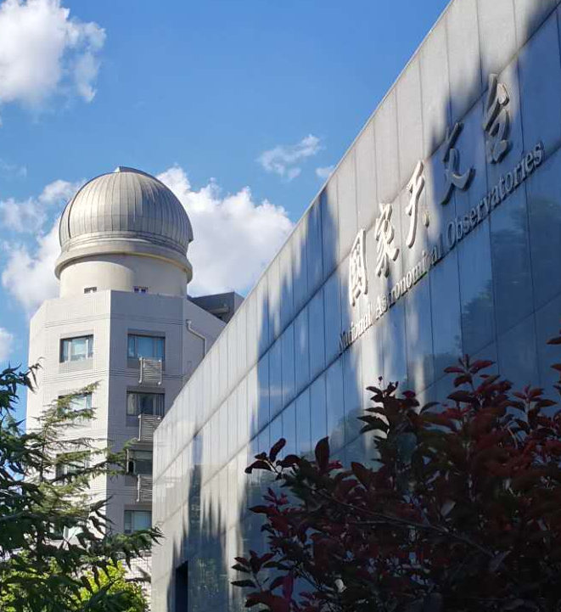

射电干涉阵列数据质量控制、Flagging 与定标
—— SKA暑期学校
左世凡
sfzuo@bao.ac.cn
2026年8月

Slide 2

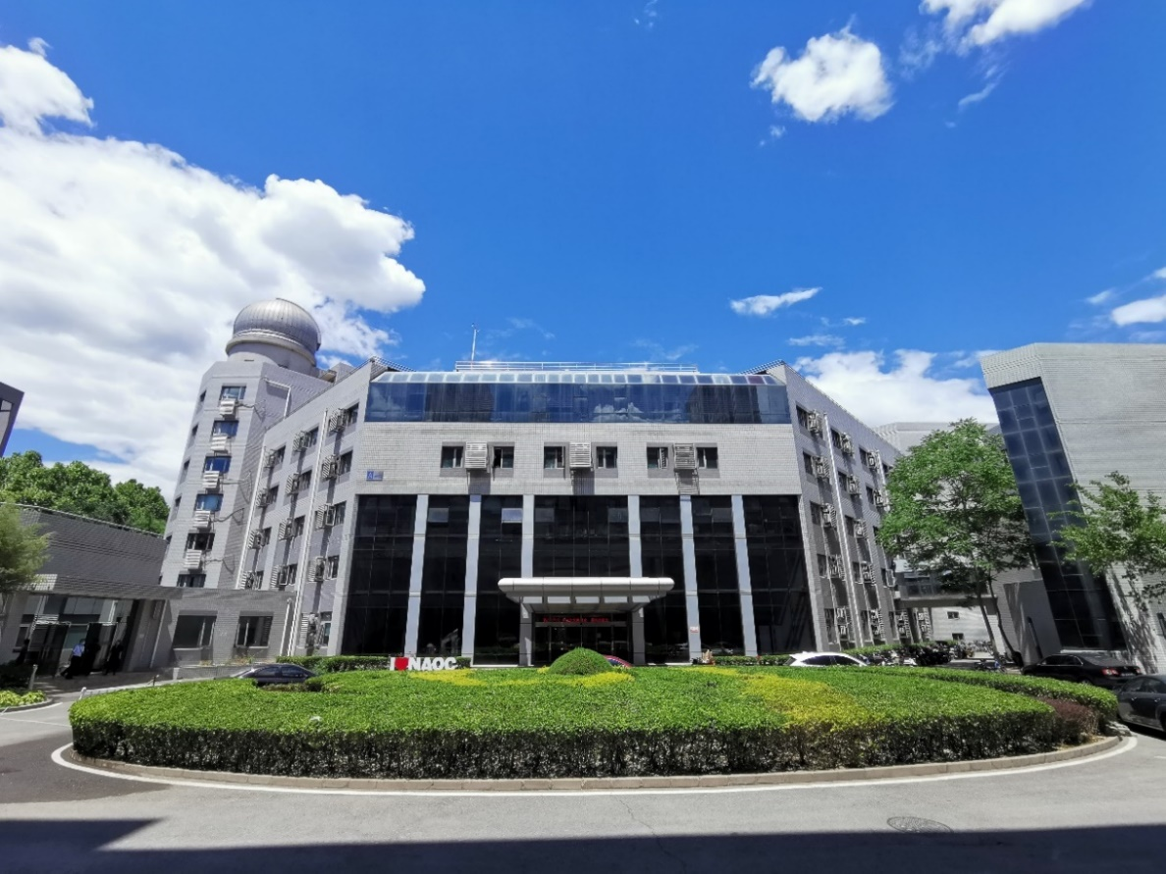
主 要 内 容
一、Introduction
二、RFI
三、Calibration
四、Coupling Effects
五、 Ionosphere
六、Tools

Slide 3
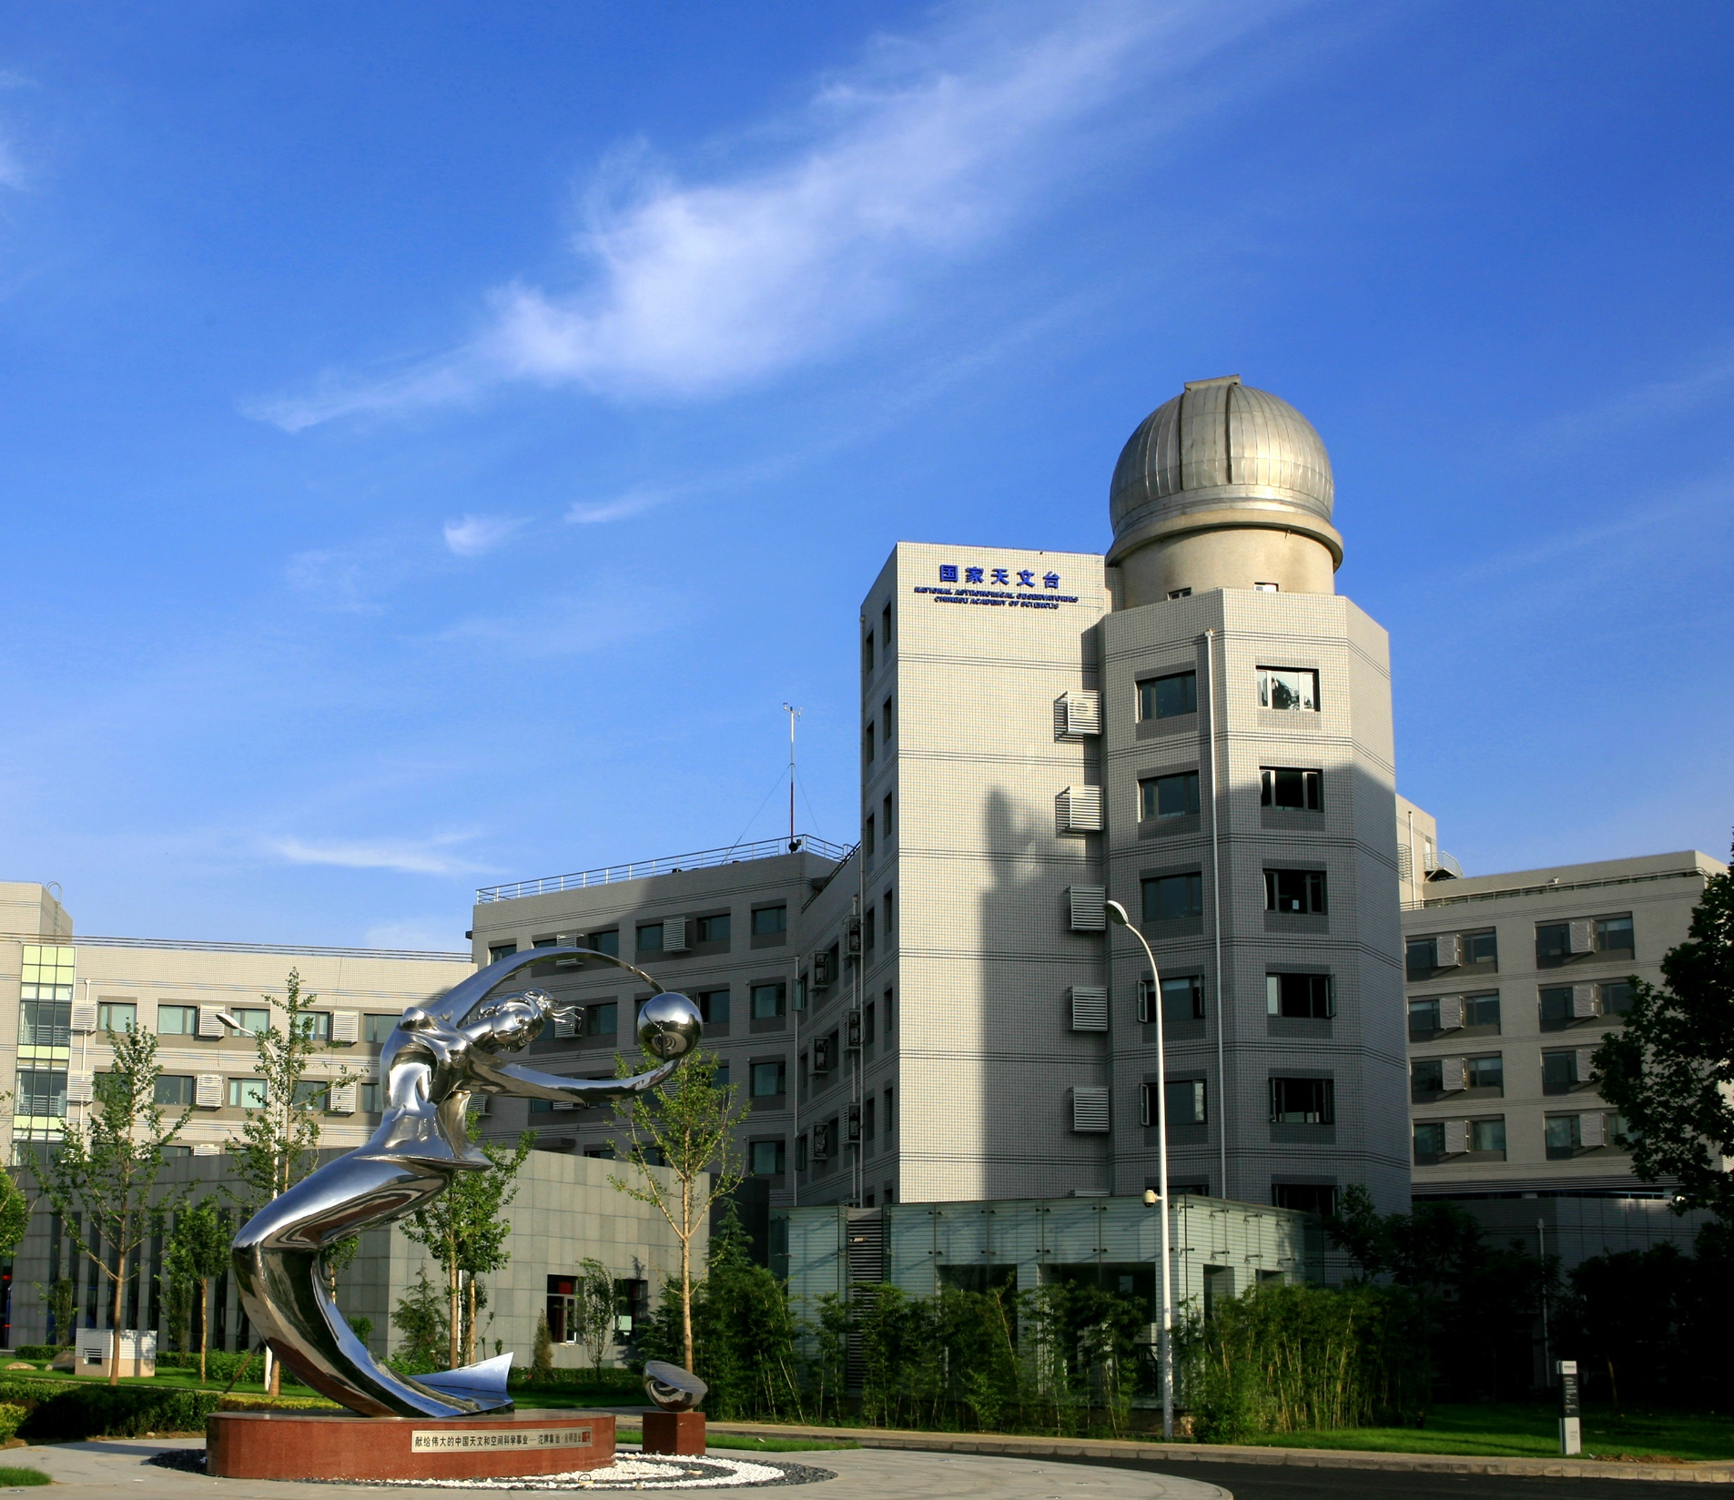

Introduction

Slide 4
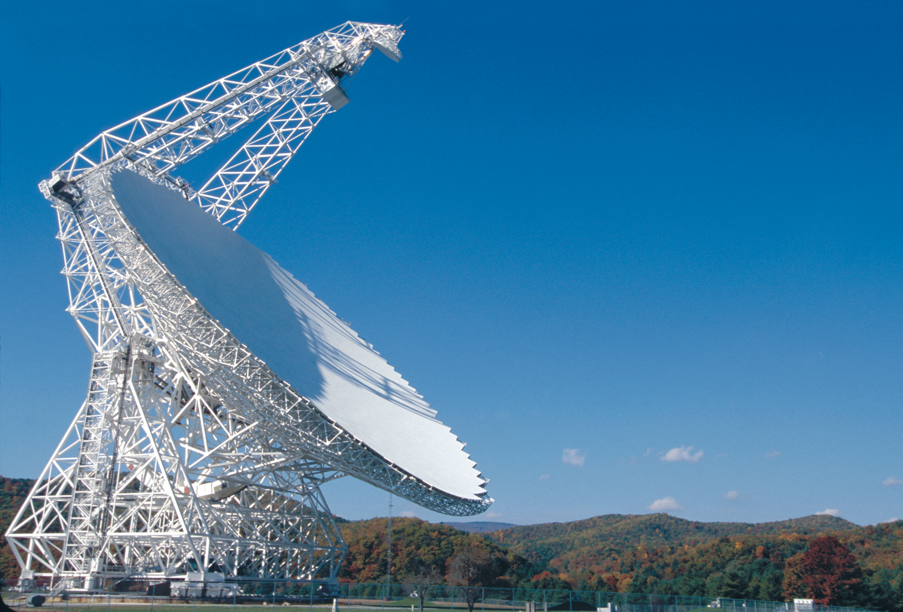
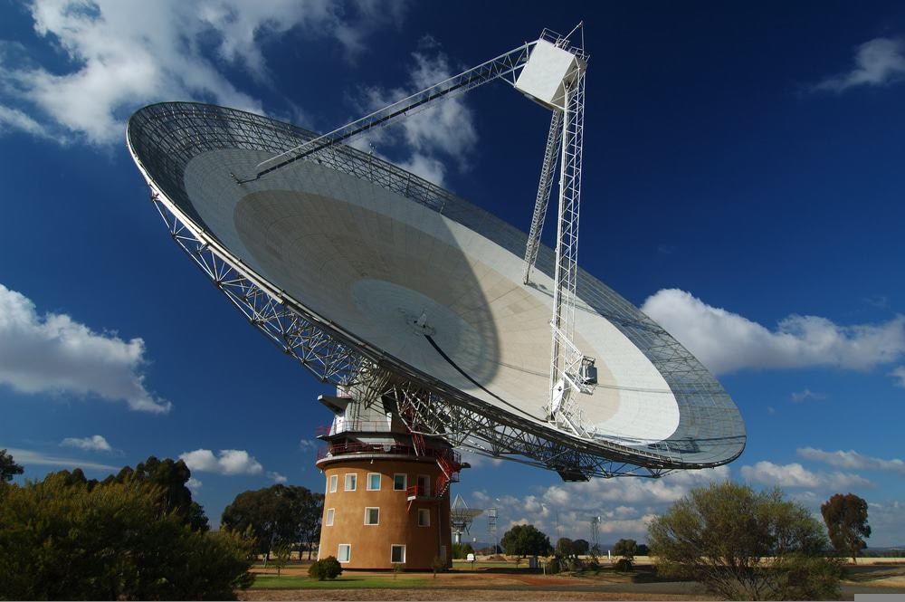
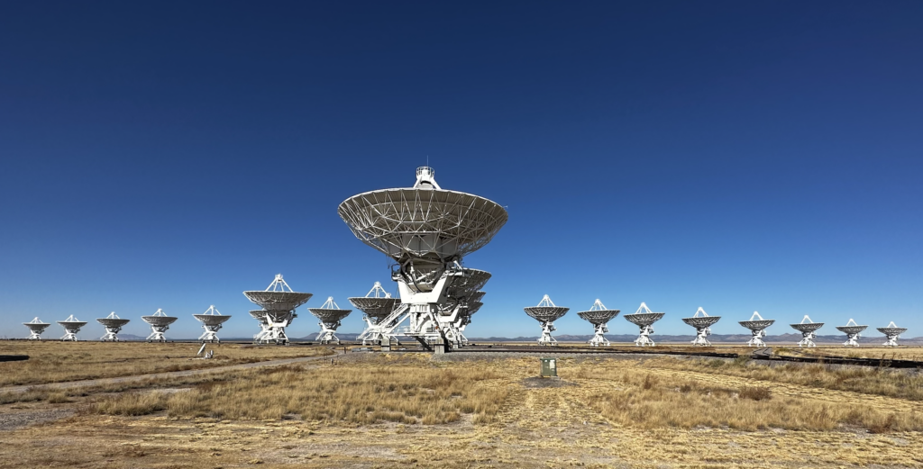
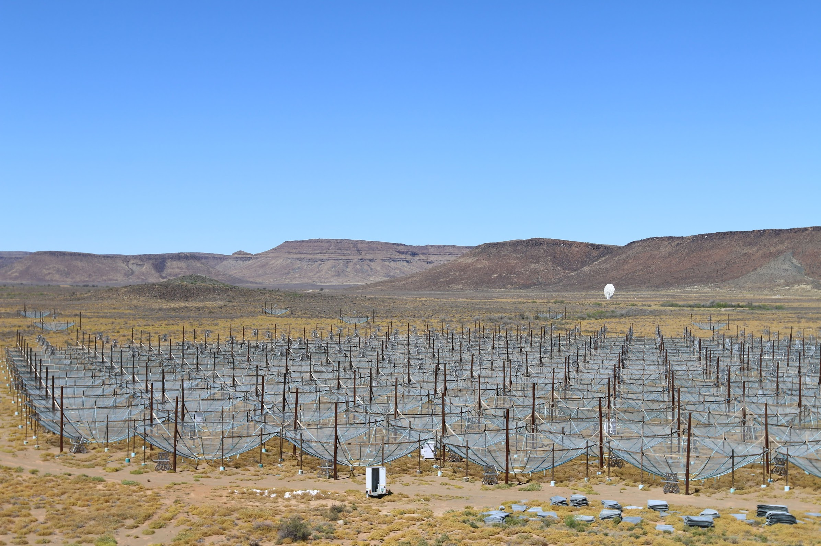
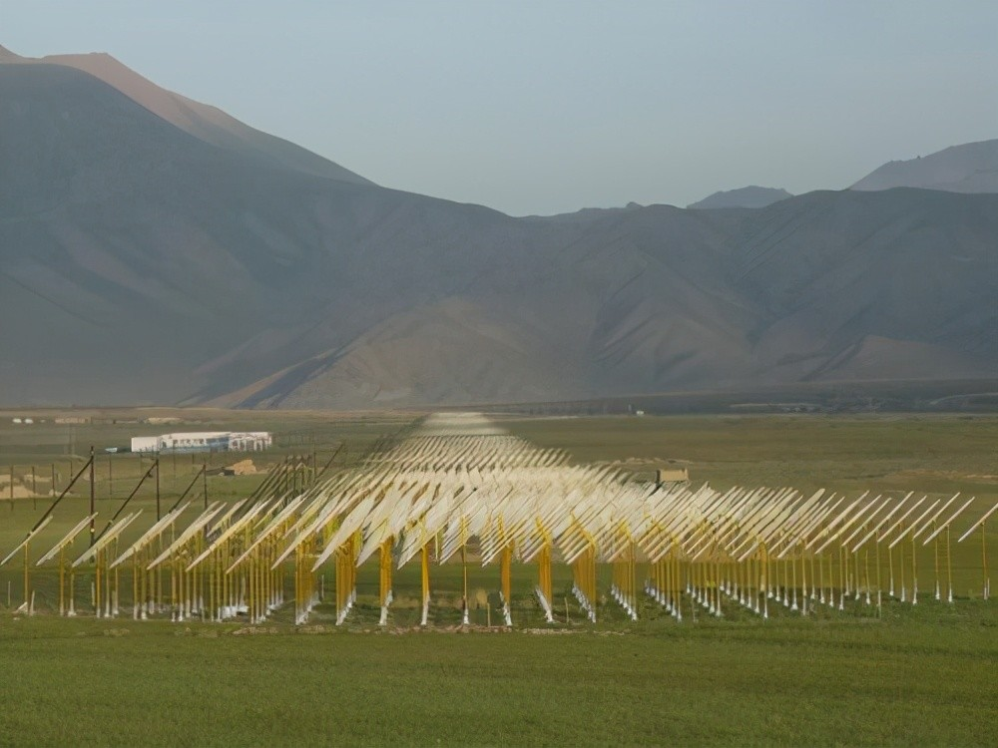
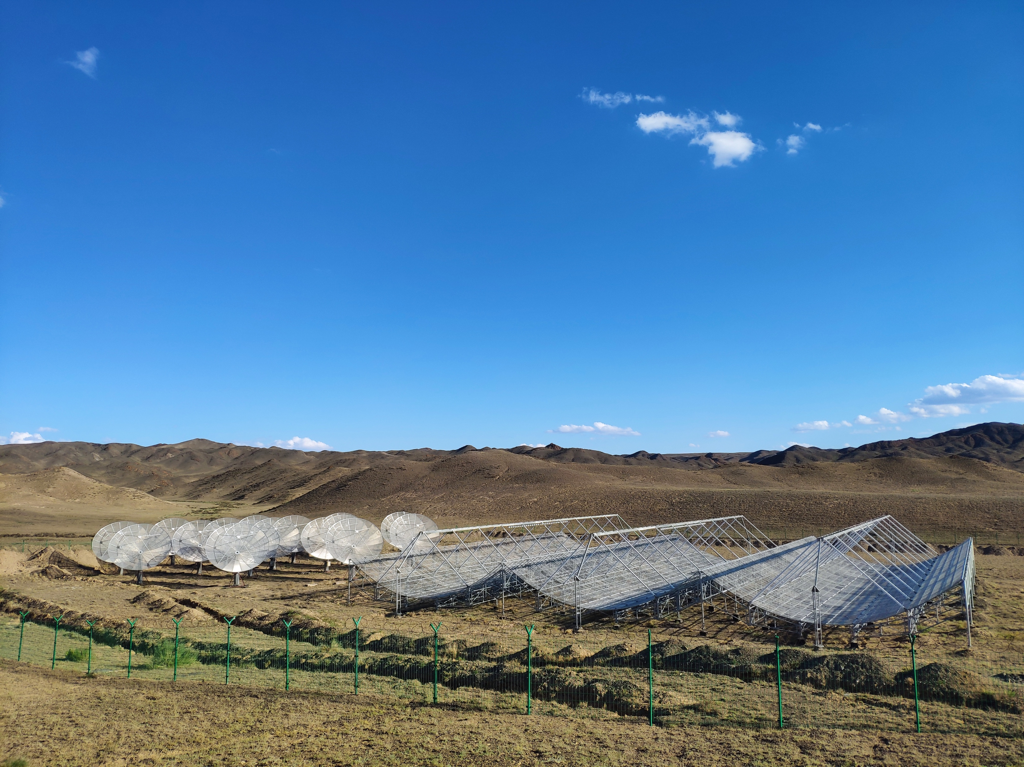
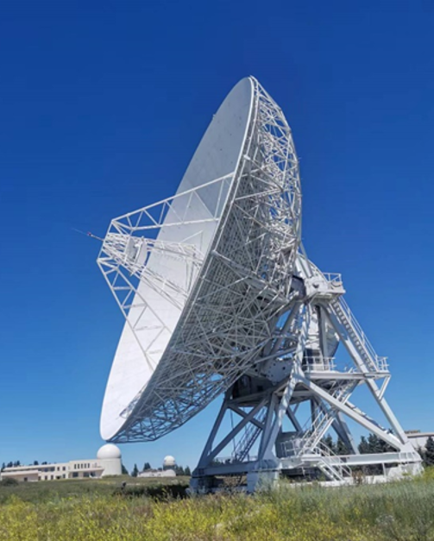
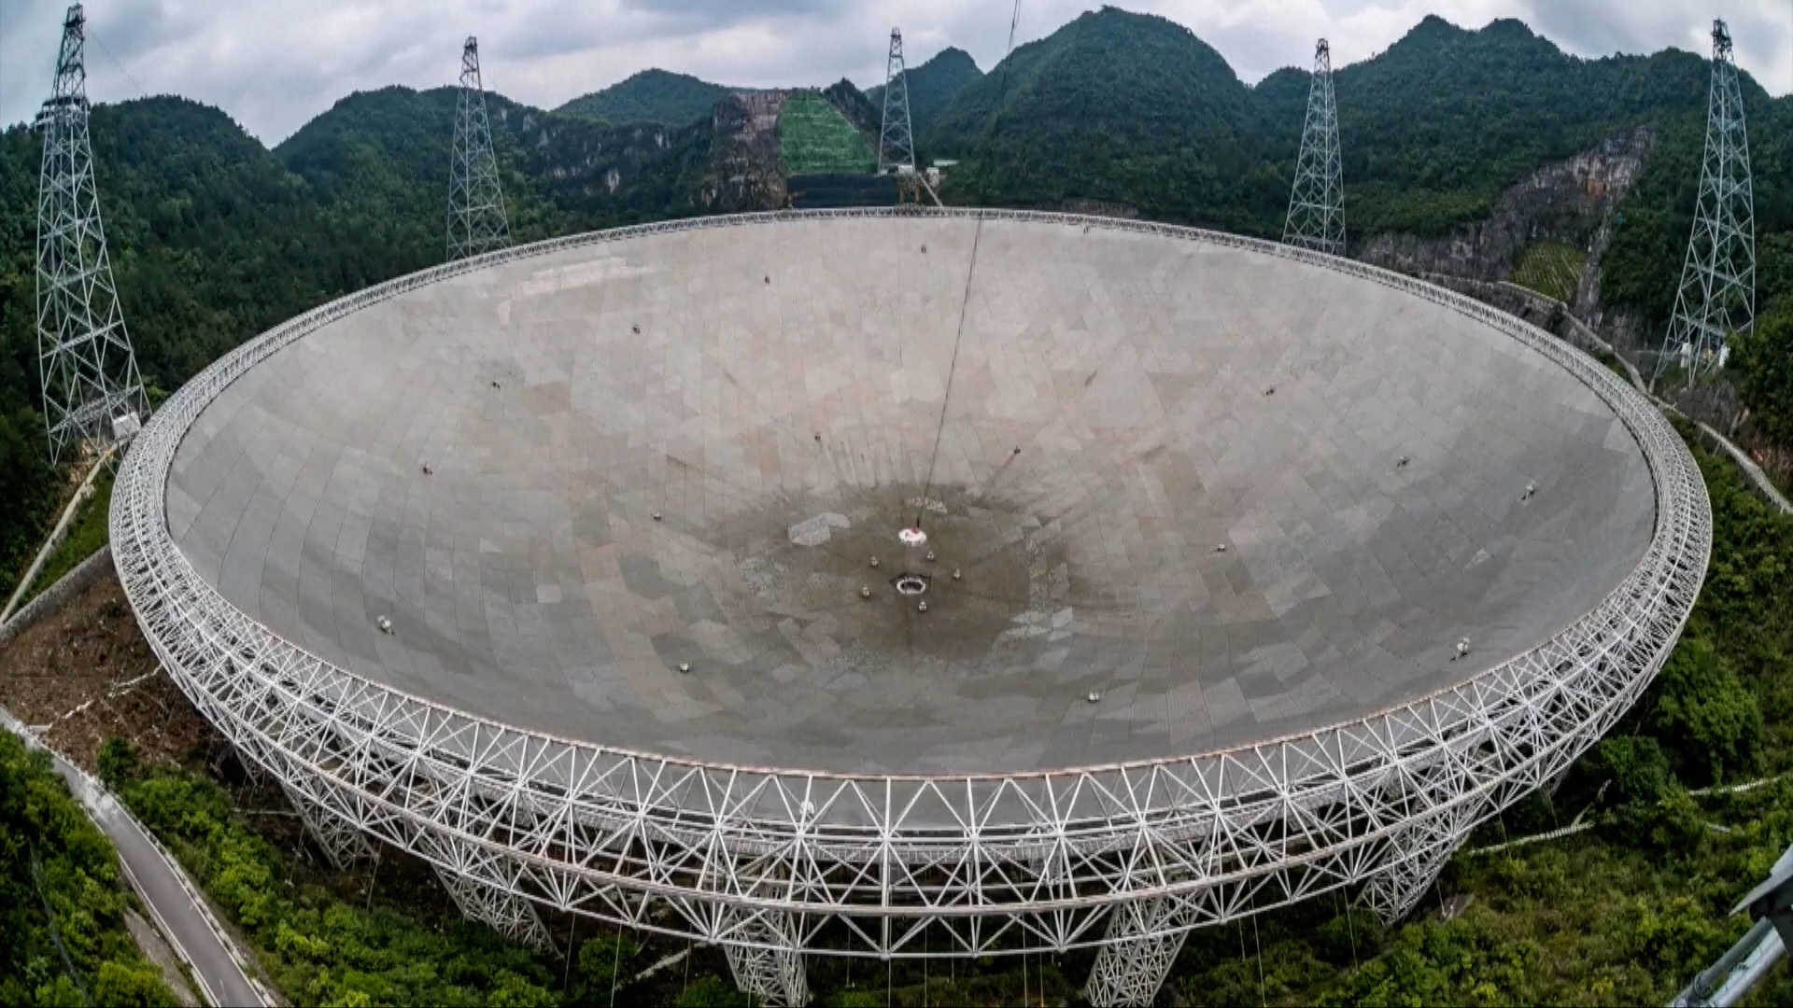
Single Antenna vs Interferometer Array
Two different types of radio observational methods
Single antenna Radio interferometer array
GBT (110m) Parkes (64m)
VLA HERA
21CMA Tianlai
Xinjiang Nansh (26m) Guizhou Fast (500m)

Slide 5
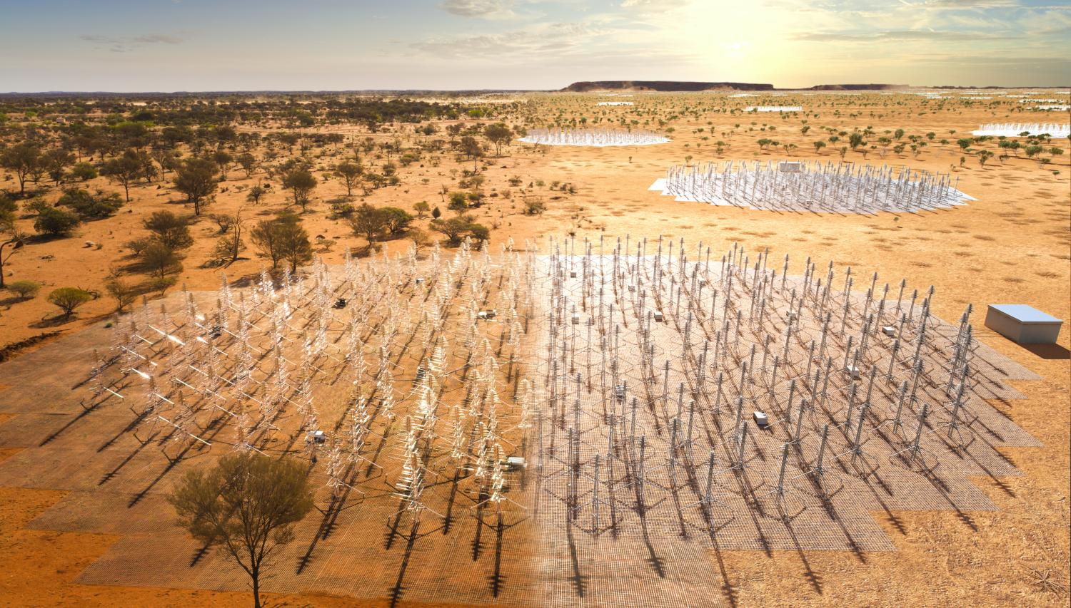
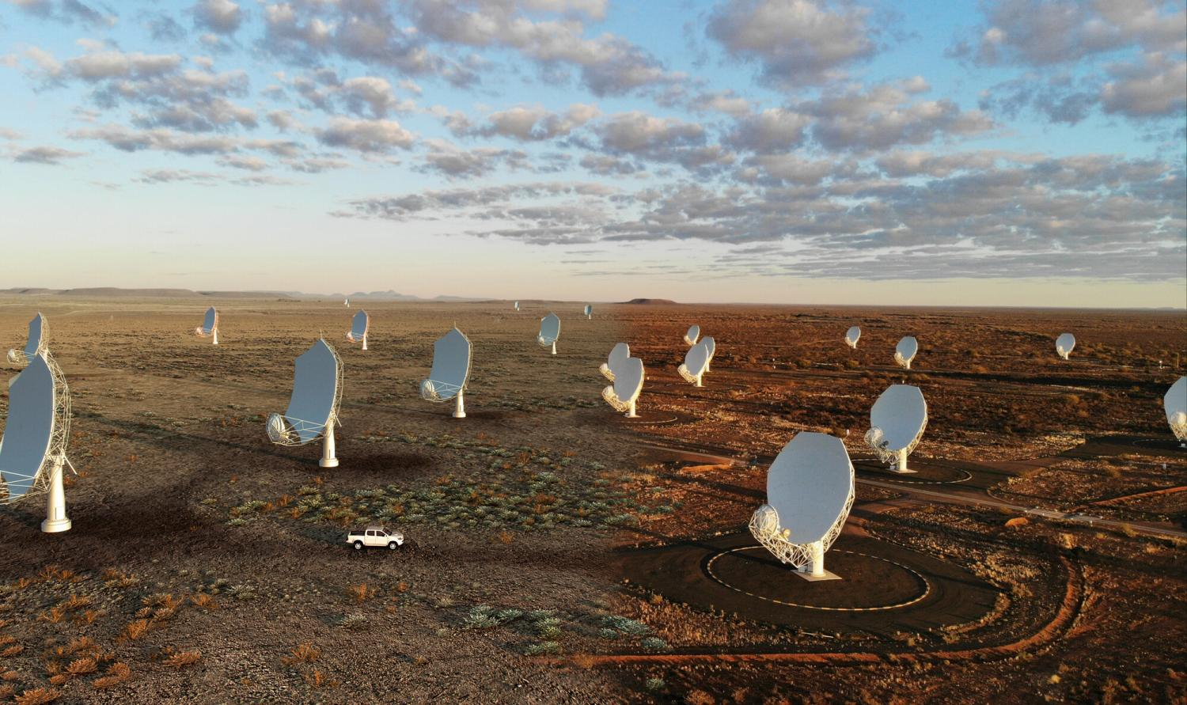
SKA
SKA-Low SKA-Mid

Slide 6
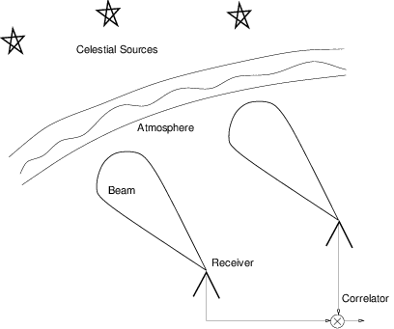
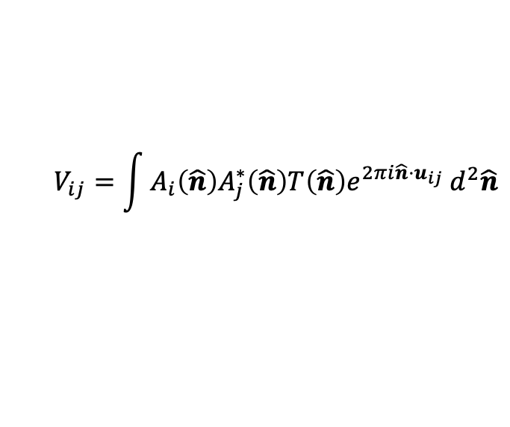
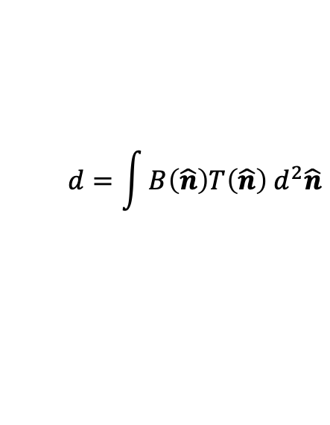
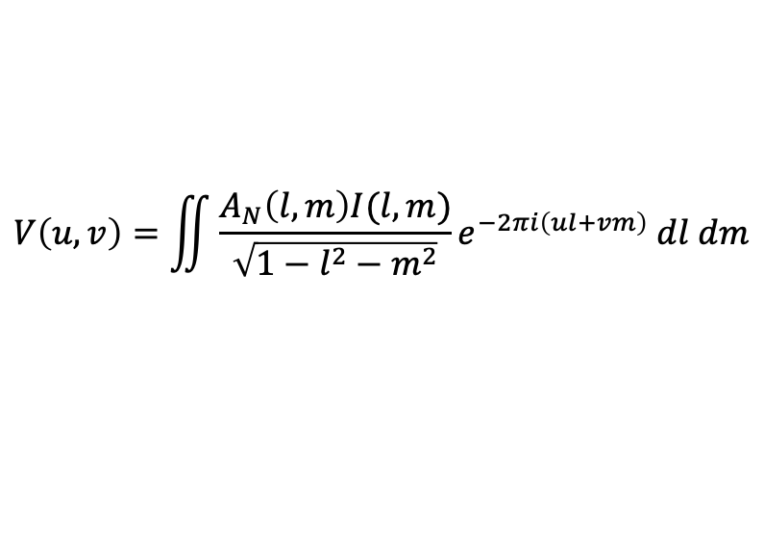
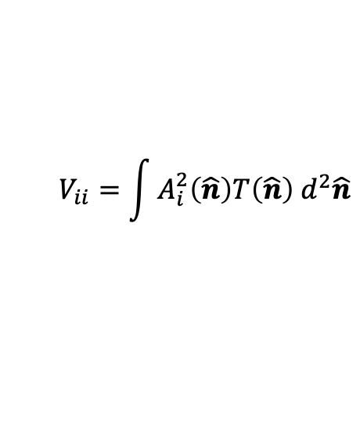
Measurements
The observed data of a single antenna is called time-ordered data (TOD)
$$d=\int{B\left(\hat{n}\right)T\left(\hat{n}\right) d^{2}\hat{n}}$$
The observed data of an interferometer array is called visibility
$$V_{ij}=\int{A_{i}\left(\hat{n}\right)A_{j}^{∗}\left(\hat{n}\right)T\left(\hat{n}\right)e^{2πi\hat{n}⋅u_{ij}} d^{2}\hat{n}}$$
In the case of planar approximation
$$V\left(u, v\right)=\iint{\frac{A_{N}\left(l, m\right)I(l, m)}{\sqrt{1−l^{2}−m^{2}}}e^{−2πi\left(ul+vm\right)} dl dm}$$
For auto-correlation
$$V_{ii}=\int{A_{i}^{2}\left(\hat{n}\right)T\left(\hat{n}\right) d^{2}\hat{n}}$$

Slide 7
RFI

Slide 8
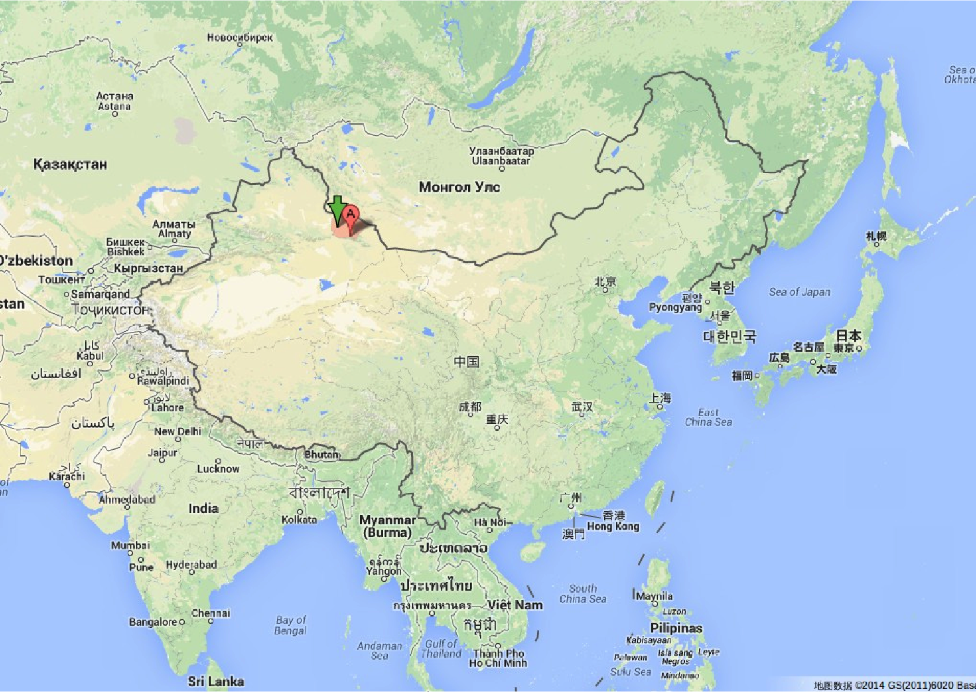
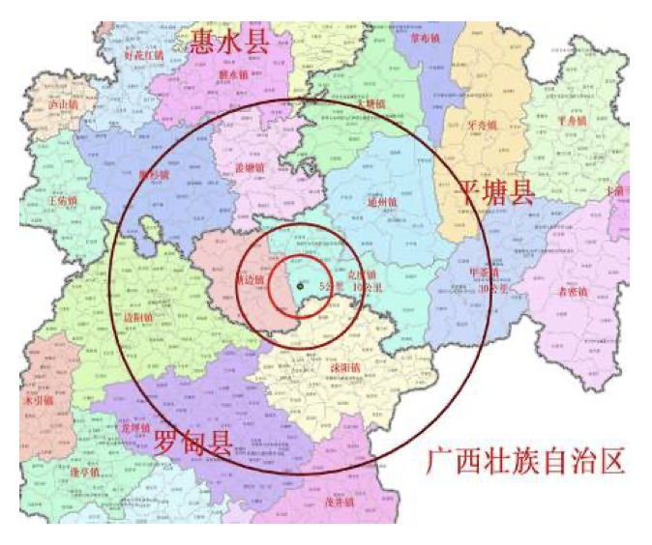
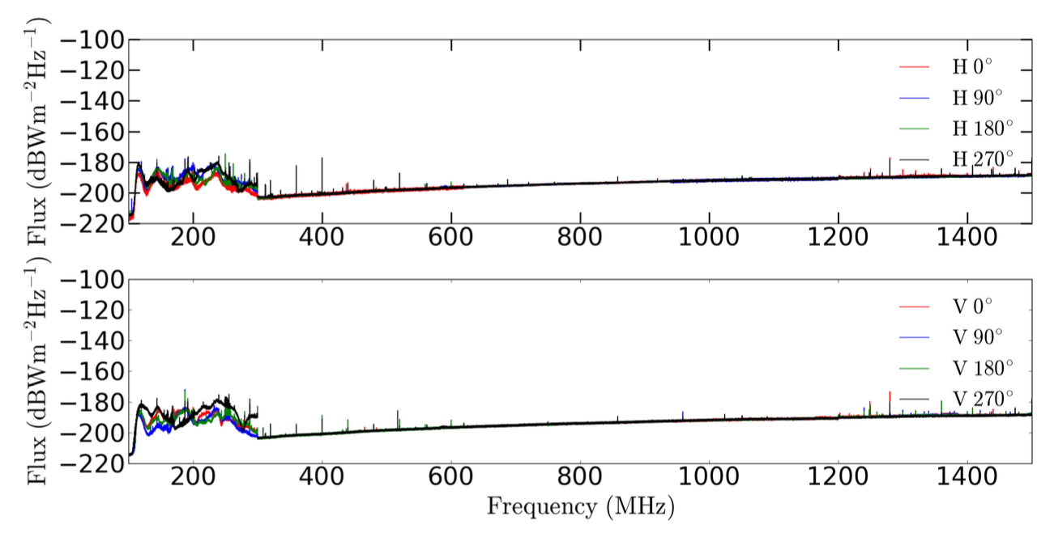
Site
Radio observations are affected by man-made radio transmitters, which can be several orders of magnitude stronger than the weak celestial signals of interest. This kind of interference, which seriously disturbs radio observations, is called radio-frequency interference (RFI).
天籁站址（新疆巴里坤县大红柳峡乡大红柳村） 天籁站址电磁环境测量 FAST电磁宁静区

Slide 9
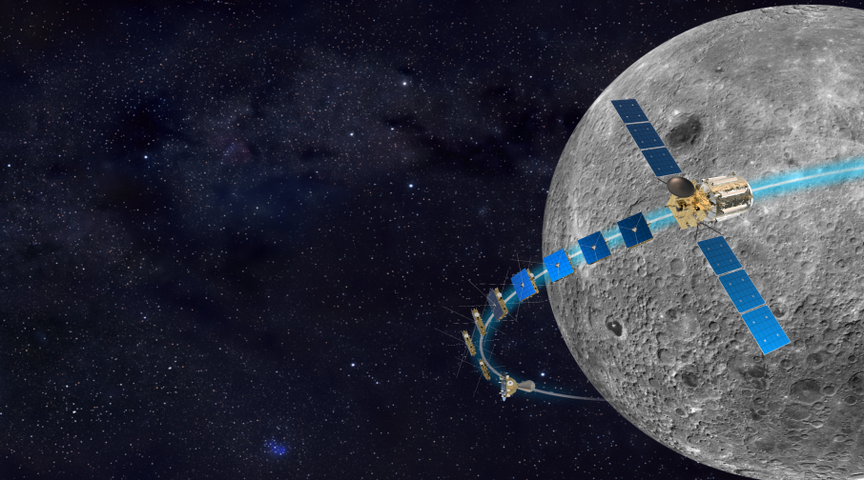
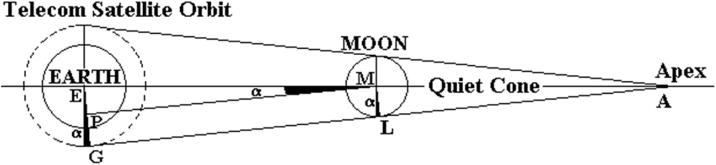
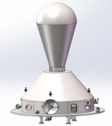
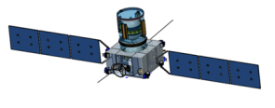
Farside of the Moon
鸿蒙计划: Discovering Sky at the Longest wavelength
1× 高频子星: 30-120 MHz
频谱测量
1 × 母星
通信、数传
8 × 低频子星: 0.1-30 MHz
干涉测量
龙江2号: 月球可有效遮挡来自地球的干扰

Slide 10
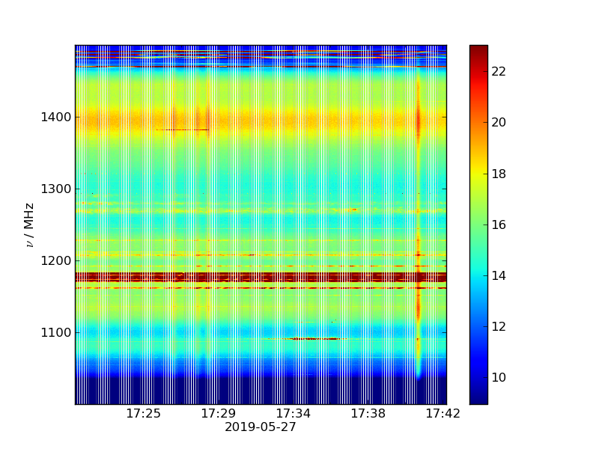
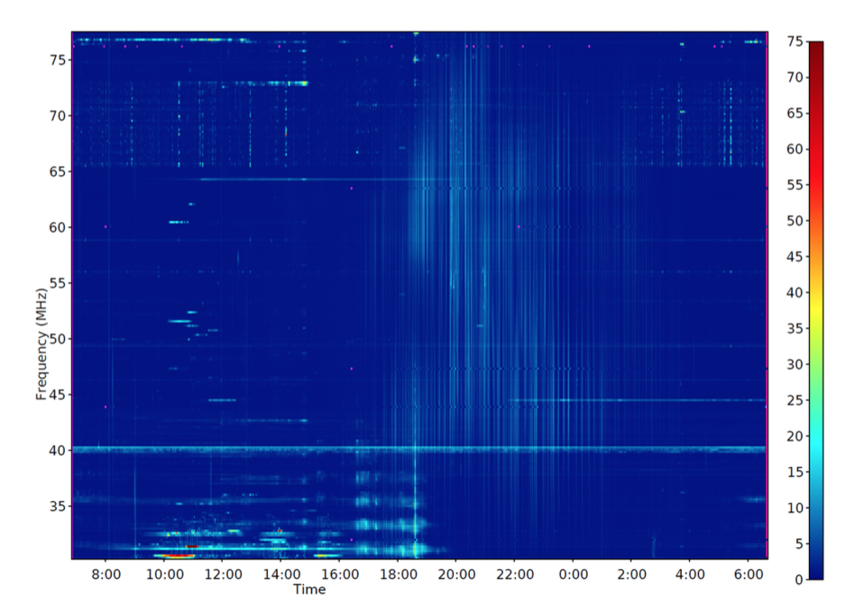
RFI Examples
LOFAR RFI
FAST RFI

Slide 11
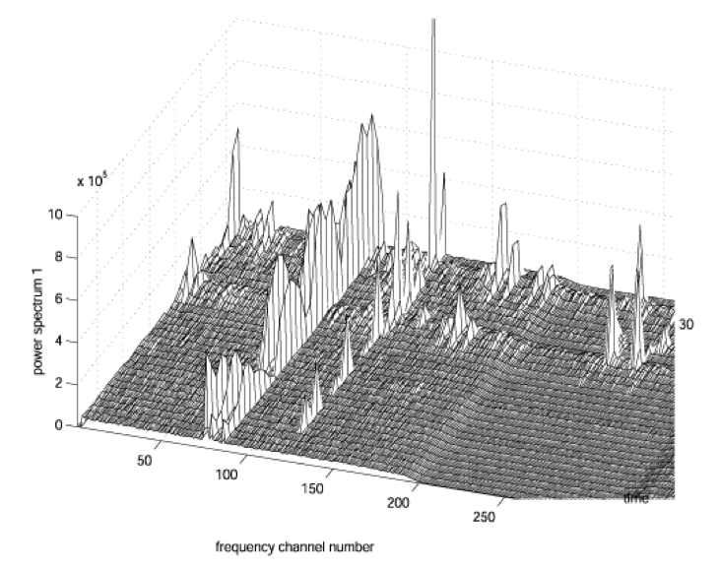
RFI
Threshold-based method

Slide 12
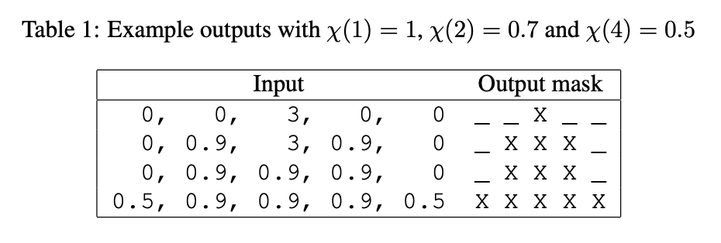
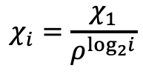


SumThreshold Method
SumThreshold method
Define a set containing the number of samples that will be combined in each flag direction
A single SumThreshold iteration
Slide a window over the data, with size equal to the sub-sequence size M to be tested in this iteration.
Maintain the sum and the number of unflagged samples in the window. In particular, when moving the window one sample to the right:
  If the sample to the right was not flagged in previous iterations, add it to the sum and increase the counter.
  If the sample to the left was not flagged in previous iterations, subtracted it from the sum and decrease the counter.
For each window position, the average can be calculated by dividing the sum with the counter. If this average exceeds the threshold χ, flag all samples in the window.
$$M=\{1, 2, 4, 8, 16, 32, 64, …\}$$
The set of thresholds for the different number of combinations M.
$$χ_{i}=\frac{χ_{1}}{ρ^{\log_{2}i}}$$
$$ρ=1.5$$

Slide 13
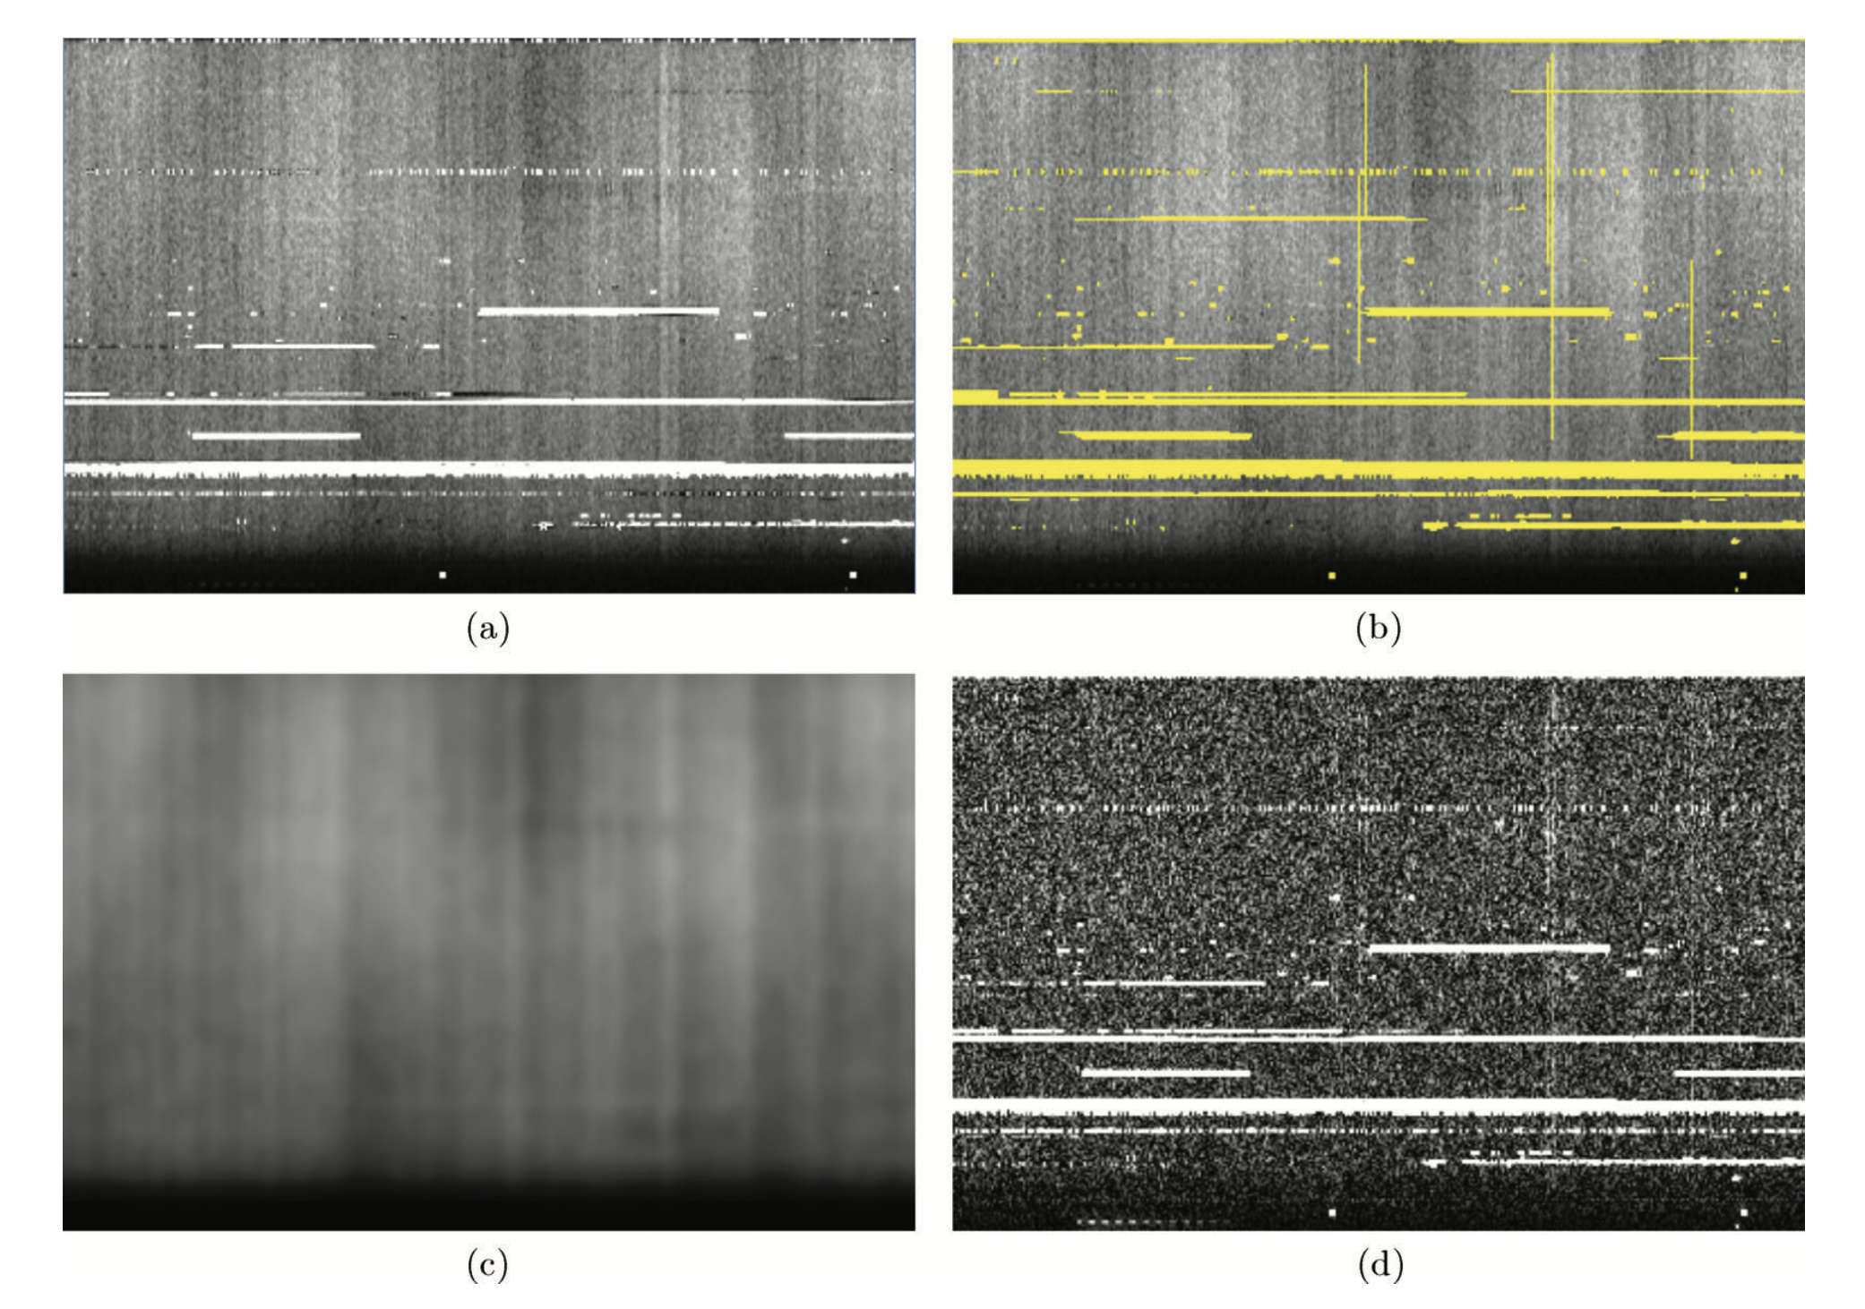
SumThreshold Method
SumThreshold method example

Slide 14
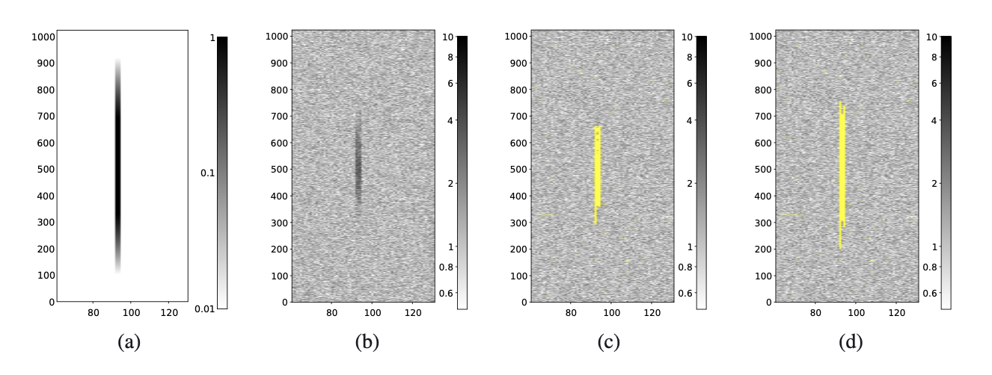
SIR Method
Scale-Invariant Rank operator (SIR)
The operator considers a sample to be contaminated with RFI when the sample is in a subsequence of mostly flagged samples. To be more precise, it will flag a subsequence when more than (1−η)N of its samples are flagged, with N the number of samples in the subsequence and η a constant, 0 ≤ η ≤ 1.
SumThreshod SIR

Slide 15
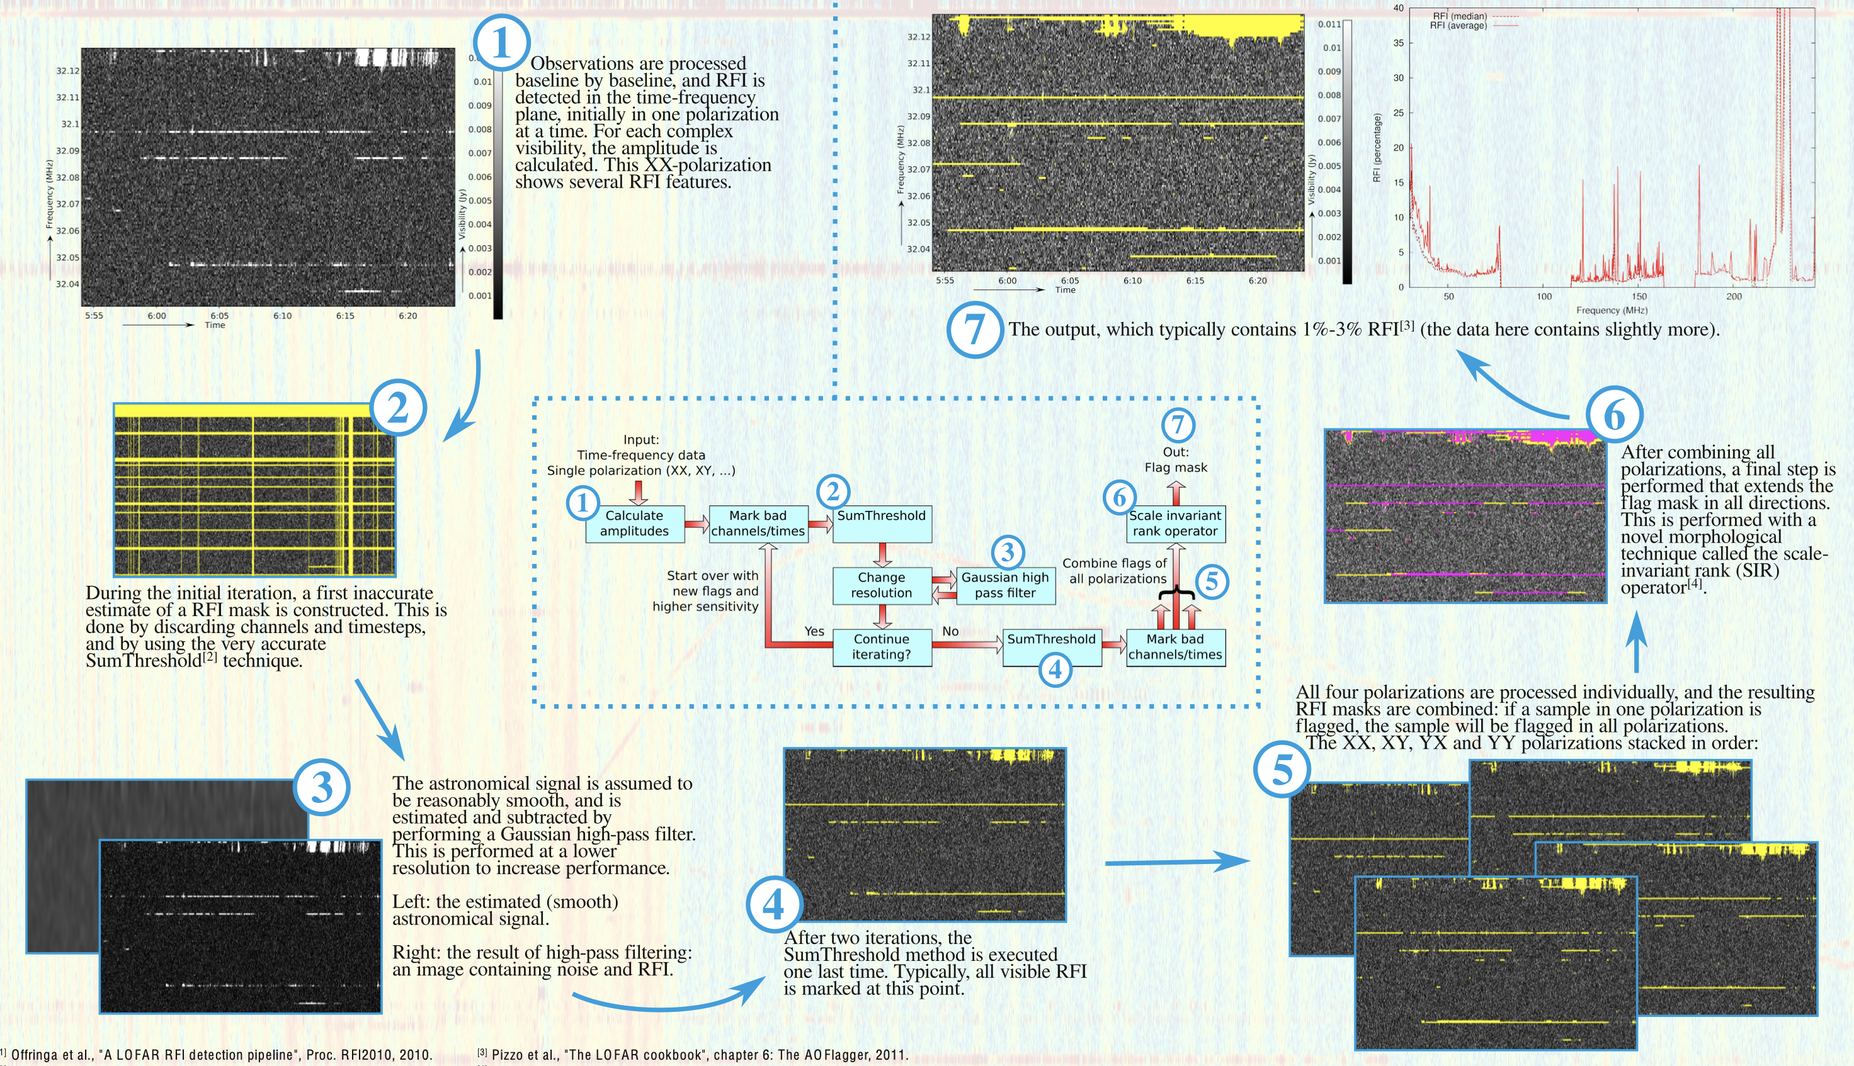
Example RFI Detetion Pipeline
The LOFAR interference detection pipeline

Slide 16
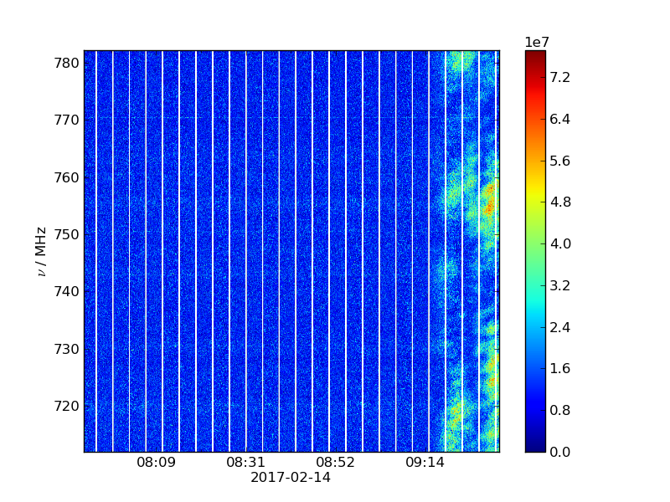
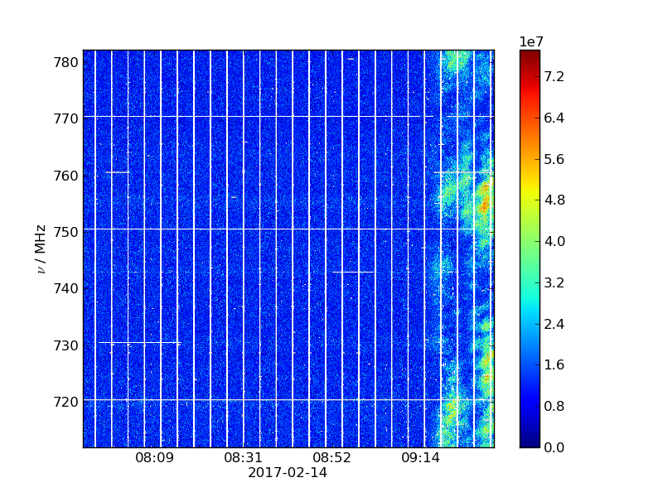

Tianlai Example
Tianlai RFI example
Observational data SumThreshold SIR

Slide 17
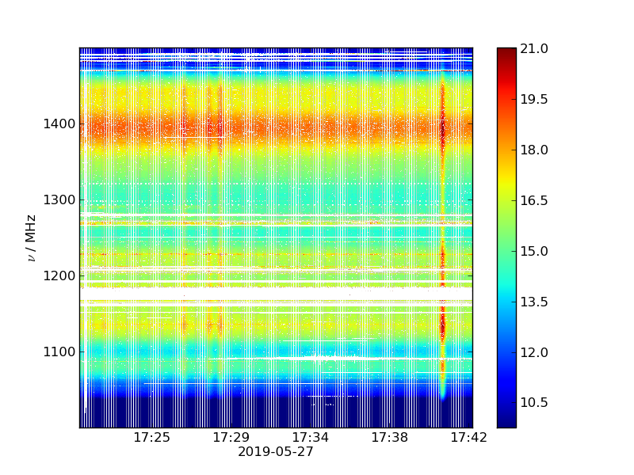
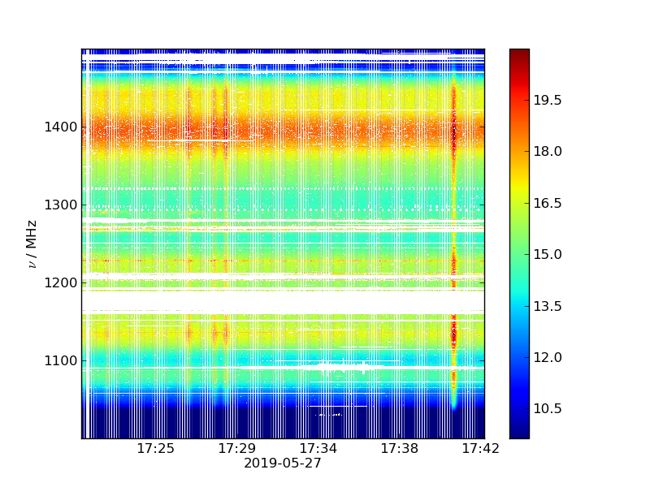
Fast Example
FAST RFI example
Observational data SumThreshold SIR

Slide 18
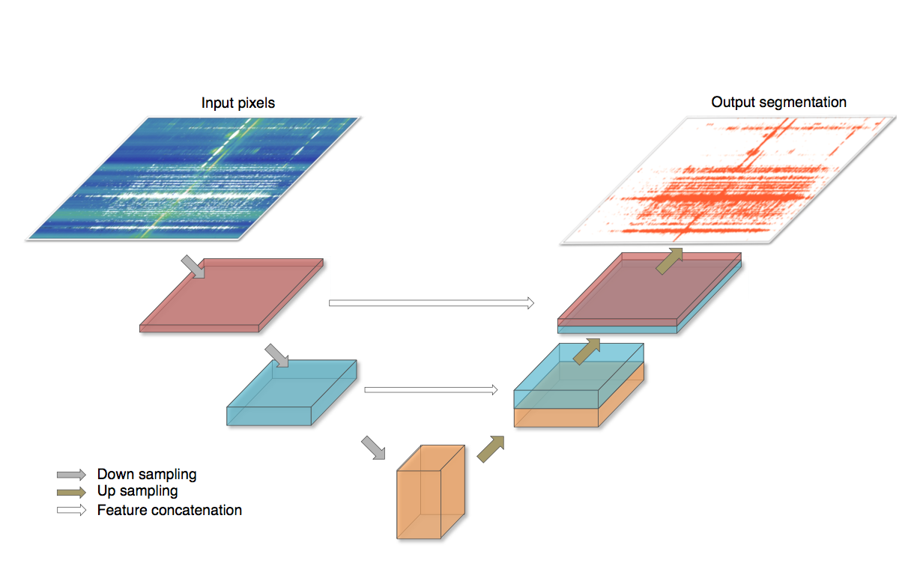
Neural Network Method
U-net arXiv:1609.09077

Slide 19
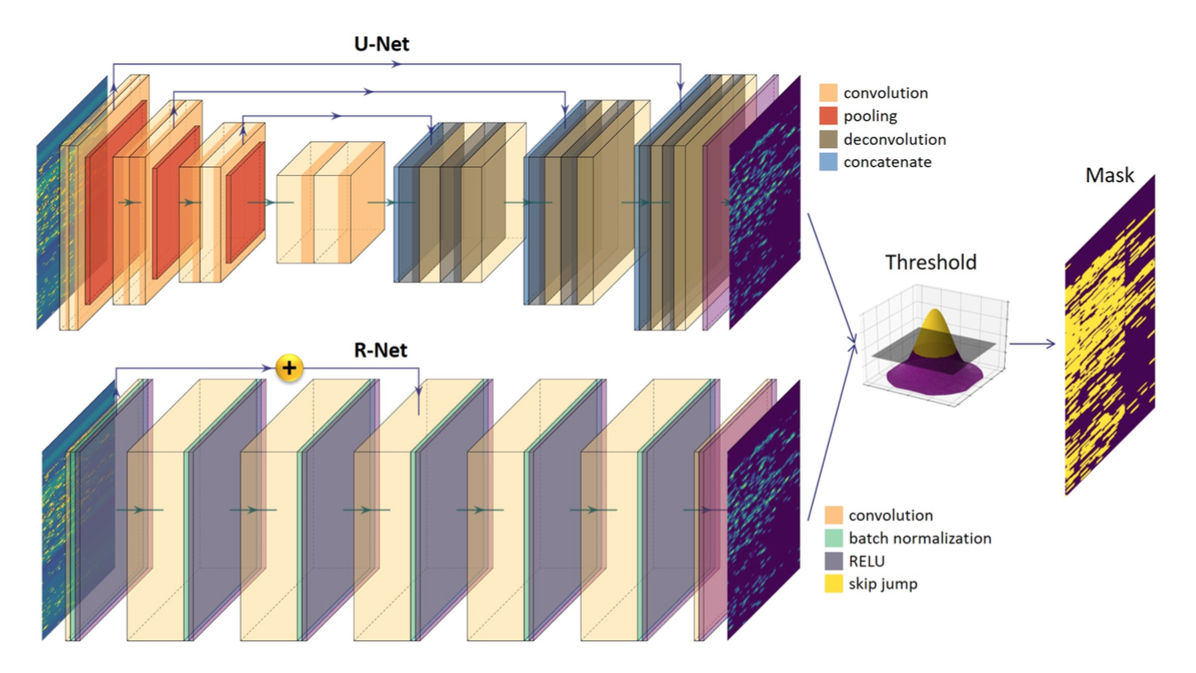
Neural Network Method
R-Net arXiv:2005.08992

Slide 20
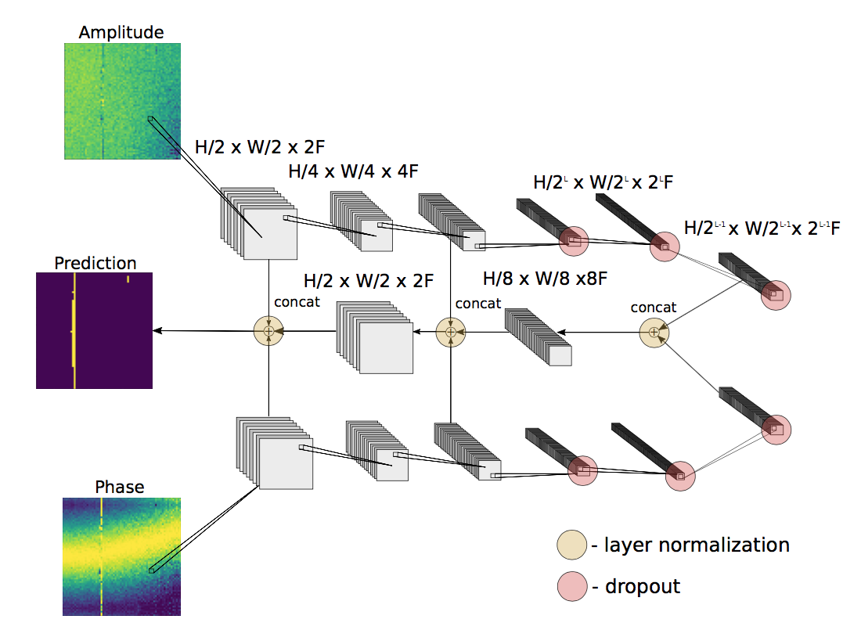
Neural Network Method
Amplitude-phase DFCN arXiv:1902.08244

Slide 21
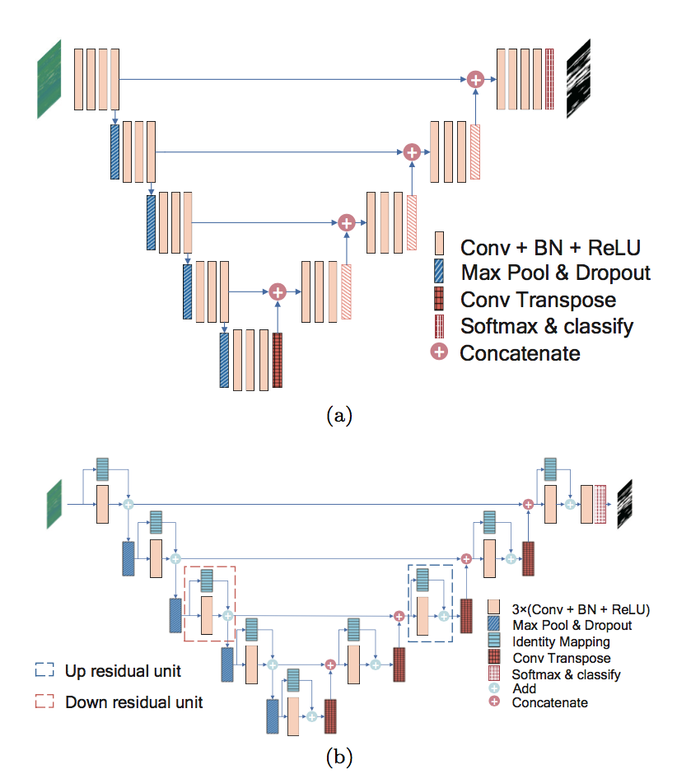
Neural Network Method
RFI-Net arXiv:2001.06669

Slide 22
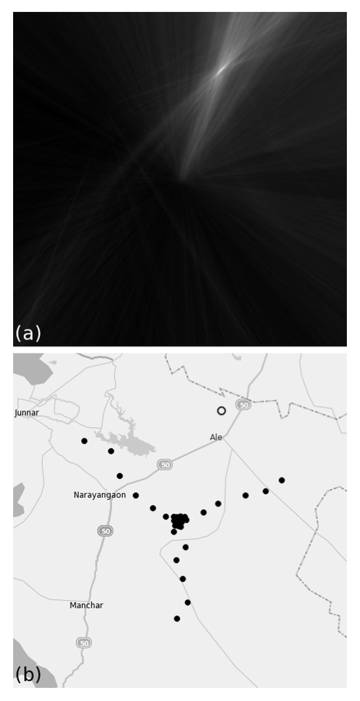
RFI Source Idendification
While some RFIs can be removed in the data analysis, this risks
removing sky signal as well.
Ideally, one would prevent RFIs from occurring at all by identifying and correcting the physical sources.
An interferometer GMRT is able to make images of the near-field, and create maps of bright RFI sources near the array itself.
Candidate sources detected by a single baseline appear as a hyperbola of equal light arrival time in near-field images of a single SVD mode. When a source is detected by many baselines, the corresponding hyperbolas intersect at a single point in the image.

Slide 23
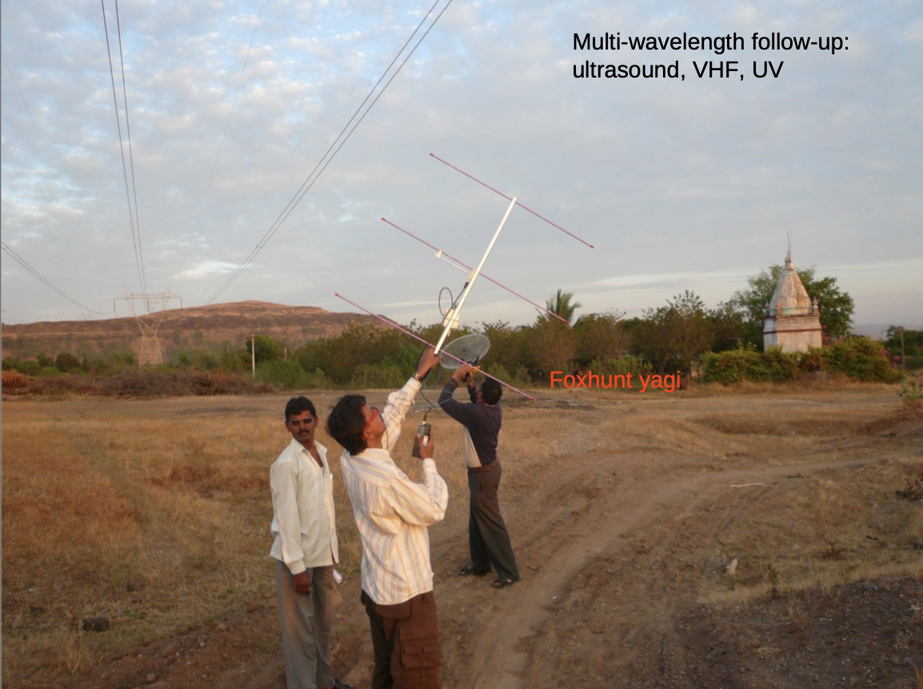
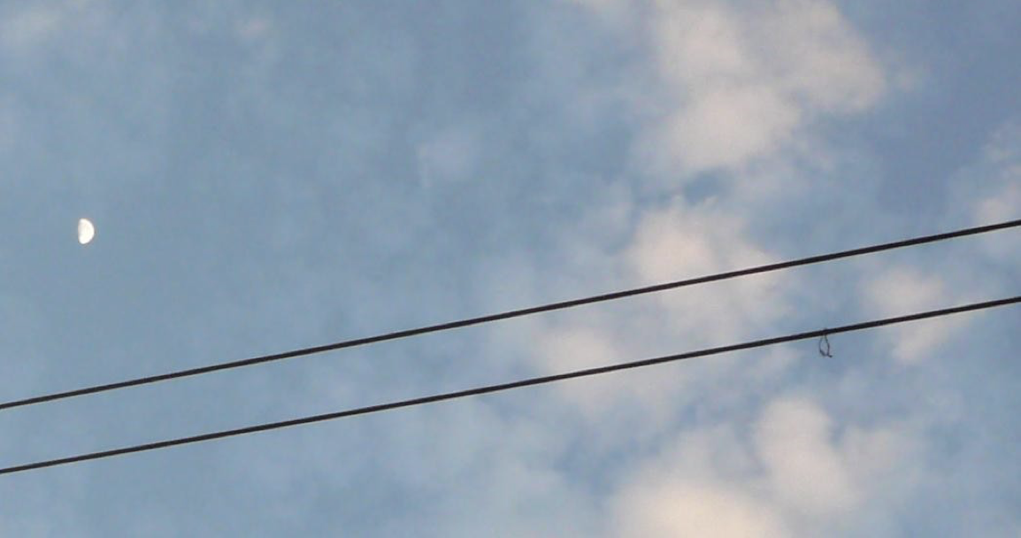
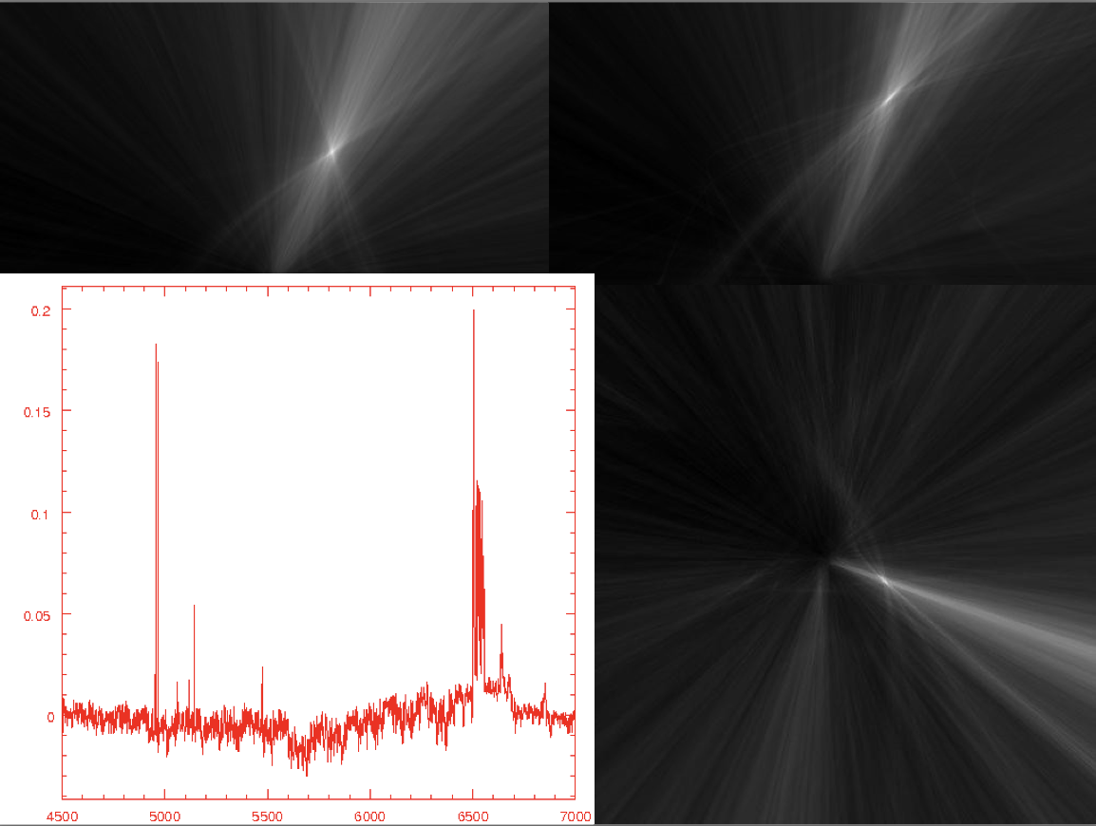
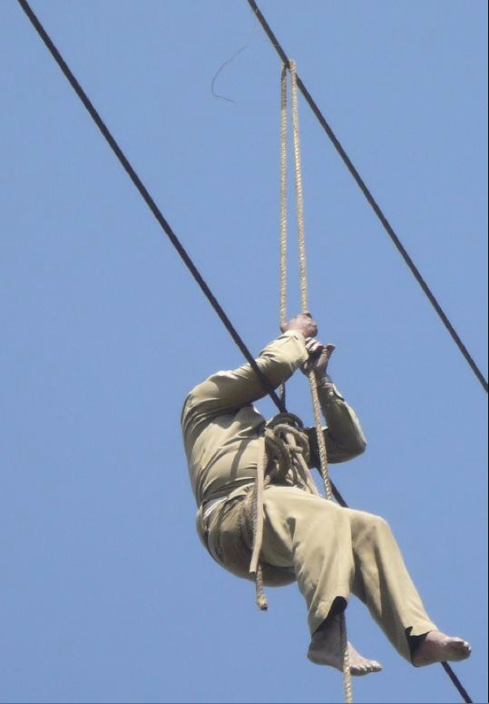
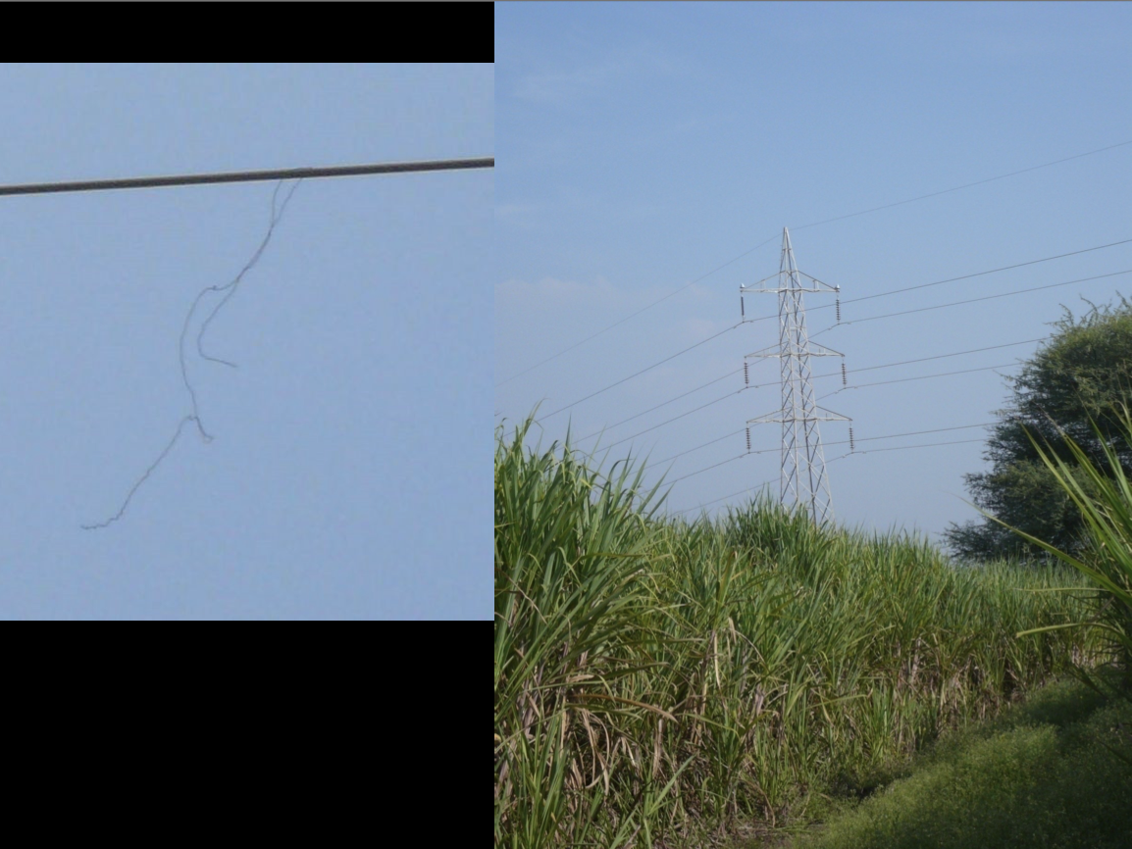
Physical Removal
GMRT example

Slide 24
Calibration

Slide 25
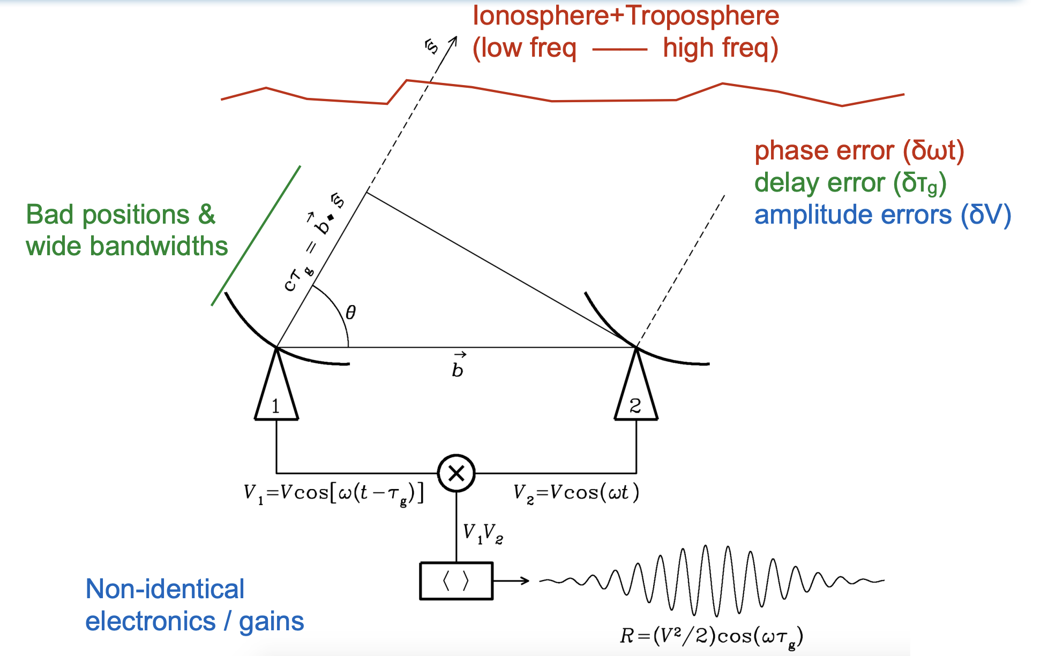
Calibration
What is calibration?
The purpose of calibration is to remove, insofar as possible, the effects of instrumental and atmospheric factors in the measurements. Such factors depend largely on the individual antennas or antenna pairs and their associated electronics, so correction must be applied to the visibility data before they are combined into an image.

Slide 26
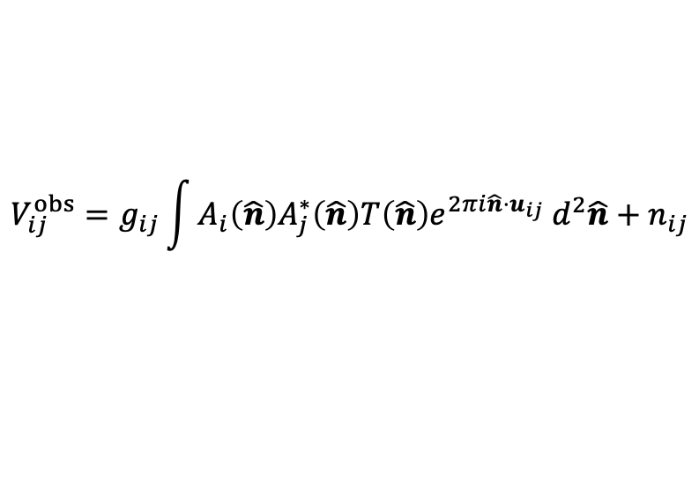
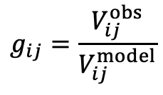

Calibration with a Sky Model
Use sky model
$$V_{ij}^{obs}=g_{ij}\int{A_{i}\left(\hat{n}\right)A_{j}^{∗}\left(\hat{n}\right)T\left(\hat{n}\right)e^{2πi\hat{n}⋅u_{ij}} d^{2}\hat{n}}+n_{ij}$$
The complex gain factor $g_{ij}$ is the function of the antenna pair $(i, j)$ and, as a result of unwanted effects, may vary with time.
$$V_{ij}^{obs}=g_{ij}V_{ij}^{model}$$
$$g_{ij}=\frac{V_{ij}^{obs}}{V_{ij}^{model}}$$

Slide 27


Calibration with a Calibrator
Use calibrator
Data taken on unresolved calibration sources (calibrator) are particularly useful here, since the response to such a source is predictable and should vary only slowly and smoothly with time.
To observe the calibration source, it is usually placed at the phase center of its field. Then assuming that the calibrator is unresolved, the phase is a direct measure of the instrumental phase.
For an unresolved calibrator, the measured response is
$V_{ij}^{C}=g_{ij}S_{c }$,
where the subscript $c$ indicates a calibrator, and $S_{c}$ is the flux density of the calibrator.
$$V_{ij}^{cal}=\frac{V_{ij}^{obs}}{g_{ij}}=\frac{V_{ij}^{obs}}{V_{ij}^{C}} S_{c}$$

Slide 28

Calibrators
The desirable characteristics of a calibration source are the following.
Flux density. The calibrator should be strong, so that a good signal-to-noise ratio is obtained in a short time.
Angular width. The calibrator should, if possible, be unresolved so that precise details of its visibility are not required.
Position. The position of the calibrator should be close to that of the target source.
Some commonly used calibrators: Cassiopeia A (Cas A), Cygnus A (Cyg A), Virgo A (Vir A), 3C 48, 3C 147, 3C 286, …

Slide 29

Gain
The measured gains for antenna pairs can be used to determine gain factors for the individual antennas.
$$g_{ij}=g_{i}g_{j}^{∗}$$
Using the individual antenna gain factors rather than the baseline gain factors reduces the calibration data to be stored and helps in monitoring the performance of individual antennas. Also, with this technique, some of the spacings can be omitted from the calibration observation so long as each of the antennas is included

Slide 30




Eigenvector-based Calibration
Eigenvector-based calibration method
Using the individual antenna gain factors, for an unresolved calibrator, the measured response is
$$V_{ij}^{C}=g_{ij}S_{c }=g_{i}g_{j}^{∗}S_{c}$$
Now if we arrange the observed visibilities into a matrix, we have
$V=S_{c}gg^{†}$
$$Vg=S_{c}gg^{†}g=S_{c}{\text{|}g\text{|}}^{2}g$$
This is in the form of
$$Mx=λx$$

Slide 31


Eigenvalue and Eigenvecor
Eigenvalues and Eigenvectors
Let $M$ be an $n×n$ square matrix with complex entries. Then, $λ$ is an eigenvalue of $M$ if there is a non-zero vector $x$ such that
$$Mx=λx$$
This implies $\left(M−λI\right)x=0$, which also means the determinant of $M−λI$ is zero. Since the determinant is a degree $n$ polynomial in $λ$, this show that any $M$ has $n$ real or complex eigenvalues.
A complex-valued matrix $M$ is said to be Hermitian if for all $i, j$, we have $M_{ij}=M_{ji}^{∗}$. If the entries are all real numbers, this reduces to the definition of symmetric matrix.
If $M$ is Hermitian, all its eigenvalues are real.

Slide 32



Example
Eigenvector-based calibration --- Tianlai example
$V=S_{c}gg^{†}$
Before calibration After calibratiion
$Re\left(V\right)$ $Im(V)$ $Re\left(V\right)$ $Im(V)$

Slide 33



SVD
The Singular Value Decomposition of a matrix is usually refered to as the SVD.
$$M={UΣV}^{T}$$
where $U$ is orthogonal, $Σ$ is diagonal, $V$ is orthogonal.
In the SVD, $M$ can be any matrix. If $M$ is symmetric positive definite its eigenvectors are orthogonal and we can write $M=QΛQ^{T}$. This is a special case of a SVD, with $U=V=Q$. For more general $M$, the SVD requires two different matries $U$ and $V$.
Another way of written the SVD is
$$M=\sum_{i}{σ_{i}u_{i}v_{i}^{T}}$$
where $σ_{i}$ is a singular value, $u_{i}$ and $v_{i}$ are the corresponding left and right singular vectors.

Slide 34


SVD-based Calibration
SVD-based calibration method
The observed data (Time-ordered data, TOD) $V\left(t, ν\right)$, is the system gain multiplied with the combination of the input signal and noise
$$V\left(t, ν\right)=g\left(t, ν\right)\left[T\left(t, ν\right)+n\left(t, ν\right)\right]$$
$g\left(t, ν\right)$ is the system gain, we assume it can be decomposed into a time-dependent component and a frequency-dependent component
$$g\left(t, ν\right)=g_{t}\left(t\right)g_{ν}(ν)$$
where $g_{ν}(ν)$ is the bandpass gain factor and $g_{t}\left(t\right)$ is the temporal drift factor of the gain.
$g_{ν}(ν)$ and $g_{t}\left(t\right)$ can be calibrated using the noise diode,
$$V_{ND on}\left(t, ν\right)−V_{ND off}\left(t, ν\right)=g_{t}\left(t\right)g_{ν}(ν)[T_{ND}\left(ν\right)+n\left(t, ν\right)]$$

Slide 35






Example
FAST Calibration with SVD

Slide 36


Example
SVD-based calibration --- FAST example
Gain Temporal Variations and Bandpass
20210305 feed 01

Slide 37






Redundant Baseline Calibration
Consider the measured visibility
$$V_{ij}=\int{A_{i}\left(\hat{n}\right)A_{j}^{∗}\left(\hat{n}\right)T\left(\hat{n}\right)e^{2πi\hat{n}⋅u_{ij}} d^{2}\hat{n}}$$
$$u_{ij}=u_{i}−u_{j}=(r_{i}−r_{j})/λ$$
If $A_{i}\left(\hat{n}\right)=A_{j}\left(\hat{n}\right)=A\left(\hat{n}\right)$, for baselines that have the same $r_{i}−r_{j}$ (redundant baselines) the measured visibilities should be the same.
$$V_{ij}^{obs}\left(t, ν\right)=g_{i}\left(t, ν\right)g_{j}^{∗}\left(t, ν\right)V_{ij}^{true}\left(t, ν\right)+n_{ij}(t, ν)$$
Fundamentally, redundant-baseline calibration is a process for finding a solution to a system of equations of the form
$$V_{ij}^{obs}=g_{i}g_{j}^{∗}V_{i−j}$$
that minimizes $χ^{2}$ defined as
$$χ^{2}≡\sum_{i<j}{\frac{{|V_{ij}^{obs}−g_{i}g_{j}^{∗}V_{i−j}|}^{2}}{σ^2}}$$

Slide 38


Redundant Baselines
Example of redundant arrays
Tianlai cylinder array
Hydrogen Epoch of Reionization Array (HERA)

Slide 39

Degeneracies
There will always be a few terms that we cannot solve for with redundant-baseline calibration.
Redundant-baseline calibration is not the end of the story.
The power of redundant calibration is that it vastly reduces the number of degrees of freedom in the calibration problem, yielding precise relative calibration and reducing the complexity of any future absolute calibration referenced to the sky.

Slide 40


Example
Redundant calibration example --- Tianlai cylinder array
Before calibration After calibration

Slide 41






Closure Relationships
Closure effects are relationships between visibility values for baselines that form a closed figure, for example, a triangle or quadrilateral with the antennas at the vertices.
Phase closure relation
$$V_{ij}^{obs}=g_{i}g_{j}^{∗}V_{ij}^{true}$$
$$V_{ij}^{obs}=|V_{ij}^{obs}|e^{iφ_{ij}^{obs}}$$
$$g_{i}=\left|g_{i}\right|e^{iφ_{i}}$$
$$V_{ij}^{true}=|V_{ij}^{true}|e^{iφ_{ij}^{true}}$$
$V_{ij}^{obs}⋅V_{jk}^{obs}⋅V_{ki}^{obs}={\left|g_{i}\right|}^{2}$ ${\left|g_{j}\right|}^{2}$ ${\left|g_{k}\right|}^{2}V_{ij}^{true}⋅V_{jk}^{true}⋅V_{ki}^{true}$
$$φ_{ij}^{obs}+φ_{jk}^{obs}+φ_{ki}^{obs}=φ_{ij}^{true}+φ_{jk}^{true}+φ_{ki}^{true}$$
The antenna gain terms, $g_{i}$ and so on, contain the effects of the atmospheric paths to the antennas as well as instrumental effects, and since these terms do not appear, it is evident that the combination of the three correlator output phases constitutes an observable quantity that depends only on the phase of the true visibility.

Slide 42



Closure Relationships
Amplitude closure relation
$$V_{ij}^{obs}=g_{i}g_{j}^{∗}V_{ij}^{true}$$
$$\frac{|V_{ij}^{obs}||V_{kl}^{obs}|}{|V_{ik}^{obs}||V_{jl}^{obs}|}=\frac{|g_{i}||g_{j}||g_{k}||g_{l}|}{|g_{i}||g_{k}||g_{j}||g_{l}|}\frac{|V_{ij}^{true}||V_{kl}^{true}|}{|V_{ik}^{true}||V_{jl}^{true}|}=\frac{|V_{ij}^{true}||V_{kl}^{true}|}{|V_{ik}^{true}||V_{jl}^{true}|}$$

Slide 43



Closure Relationships
Closure Relationships
If we have $n_{a}$ antennas, the number of indepent phase closure relationships is
$$\frac{1}{2}(n_{a}−1)(n_{a}−2)$$
The number of independent amplitude closure relationships for $n_{a}$ antennas is
$$\frac{1}{2}n_{a}(n_{a}−3)$$
The number of baselines for $n_{a}$ antennas without auto-correlations is
$$\frac{1}{2}n_{a}(n_{a}−1)$$

Slide 44



Synthesis Imaging
$$V\left(u, v\right)=\iint{\frac{A_{N}\left(l, m\right)I(l, m)}{\sqrt{1−l^{2}−m^{2}}}e^{−2πi\left(ul+vm\right)} dl dm}$$
$$\frac{A_{N}\left(l, m\right)I(l, m)}{\sqrt{1−l^{2}−m^{2}}}=\iint{V\left(u, v\right) e^{2πi\left(ul+vm\right)} du dv}$$

Slide 45

Deconvolution with CLEAN
CLEAN algorithm framework

Slide 46


Self-Calibration
In self-calibration, the complex antenna gains are regarded as free parameters to be explicitly derived together with the intensity.
The procedure in self-calibration is to use a least-mean-squares method to minimize the square of the modulus of the difference between the observed visibilities, $V_{ij}^{obs}$, and the corresponding values for the derived model, $V_{ij}^{model}$. The expression that is minimized is
$$\sum_{time}{\sum_{i<j}{w_{ij}{|V_{ij}^{obs}−g_{i}g_{j}^{∗}V_{ij}^{model}|}^{2}}}$$
where the weighting coefficient $w_{ij}$ is usually chosen to be inversely proportional to the variance of $V_{ij}^{obs}$.

Slide 47



Self-Calibration
Previous expression can be written
$$\sum_{time}{\sum_{i<j}{w_{ij}{|V_{ij}^{model}|}^{2}{|X_{ij}−g_{i}g_{j}^{∗}|}^{2}}}$$
where
$$X_{ij}=\frac{V_{ij}^{obs}}{V_{ij}^{model}}$$
If the model is accurate, the ratio $X_{ij}$ of the uncalibrated observed visibility to the visibility predicted by the model is independent of $u$ and $v$ but proportional to the antenna gains. Thus, the values of $X_{ij}$ simulate the response to a calibrator and enable the gains to be determined. However, since the initial model is only approximate, the desired result must be approached by iteration.

Slide 48

Self-Calibration
Self-calibration steps
Make an initial image.
Compute the $X_{ij}$ factors for each visibility integration period within the observation.
Determine the antenna gain factors for each integration period.
Use the gains to calibrate the observed visibility values and make an image.
Use CLEAN and select components to provide positivity and confinement of the image; Cornwell (1982) recommends omitting all features for which $|I(l, m)|$ is less than that for the most negative feature.
Test for convergence and return to step 2 as necessary.

Slide 49
Direction-dependent Calibration
Direction-independent effects include the gains of the signal paths from the outputs of the antennas to the correlator.
Direction-dependent effects include the direction of propagation of the signals, the primary beams of the antennas, polarization effects that vary with the alignment of the polarization of the source relative to that of the antennas, and also the effects of the ionosphere and troposphere.
It is necessary to take account of all these various effects to calculate accurately the visibility values corresponding to the source model.

Slide 50


Direction-dependent Calibration
Radio interferometer measurement equation (RIME)
How to:
Break the large FOV into a number of pieces
Correct complex gains for the particular patch of the sky.

Slide 51

Direction-dependent Calibration
Example: The LOFAR Two-metre Sky Survey (Shimwell et al. 2019)

Slide 52









Polarization Calibration
Pick an orthonormal xyz coordinate system, with z along the direction of propagation (i.e. from antenna to source).
where J is a 2 ×2 complex matrix known as the Jones matrix.

Slide 53
Coupling Effects

Slide 54




Reflection and Cross Coupling
$ε11$: Signal chain reflction;
$ε12$: Cross coupling
Schematic digram of Tianlai reflactor and analog signal chain.

Slide 55






Coupling Effects Modelding -- Reflection
The cross-correlation visibility, V₁₂, between antenna 1 and 2, written as
The presence of a reflection can be encapsulated as
Cross-correlation:
Auto-correlation:

Slide 56


Coupling Effects Modelding – Cross Coupling
Two critical insights about the behavior of the cross coupling terms:
1) their time variability is slow, thus occupying low-fringe rate.
2) they have a time-stable phase determined solely by the phase of the coupling coefficient.

Slide 57



Reflection vs. Cross Coupling
Reflection
Cross-coupling
Reflections can be removed via standard (direction-
independent) antenna based calibration.
Cross coupling cannot be factorized into antenna based gains, because $ε12$-like terms, which are baseline-dependent
Removal of cross coupling terms in the data must therefore be done on a per-baseline basis.
Reflections can be removed via standard (direction-
independent) antenna based calibration.

Slide 58







Delay Transform and Fringe-rate
The visibility for a single baseline:
The Fourier transform of the visibility from one baseline along the frequency axis yields the delay transform:
To sort our time-variable visibilities into different fringe-rates f, we take the Fourier transform of our visibility over a short interval of time centered at time t to get

Slide 59

Delay Transform and Fringe-rate Example
Left: Visibility in time and frequency space. Center: Visibility in time and delay space. Right: Visibility in fringe -rate and delay space.

Slide 60



Reflection Parameters Estimation
Approach for estimating the reflection parameters from the data takes the following steps:
1. Zero-pad the auto-correlation in frequency space and apply a windowing function before Fourier transforming to delay space to minimize sidelobe power.
2. Fit for the peak of the reflection bump in $|\tilde{V}|$ via quadratic interpolation of its nearest neighbors.
3. The estimated reflection delay, $τ$ , is equal to $τ_{peak}$.
4. The estimated reflection amplitude, $A$, is the ratio
$\left|\tilde{V}\left(τ=τ_{peak}\right)\right|/\left|\tilde{V}\left(τ=0\right)\right|$.
5. Set all modes of $\tilde{V}$ to zero except the modes nearest $τ_{peak}$ and Fourier transform back to frequency space to get $V_{filt}$.
6. The estimated reflection phase, $φ$, is found by minimizing
${\left|V_{filt}−Ae^{2πiντ+iφ}\right|}^{2}$ while varying $φ$ from $0−2π$.
7. Setup a non-linear optimization that perturbs the initial reflection parameter estimates, applies the calibration and transforms to Fourier space until the residual near the original reflection bump is minimized or a stopping threshold is reached.

Slide 61




Cross-coupling Removal Method
Use Singular Value Decomposition (SVD) to decompose the matrix ${\tilde{V}}_{12}$ as
1. Fourier transform the visibility waterfall to delay space.
2. Apply a rectangular band-stop window across delay to down-weight foregrounds at low delays.
3. Decompose the visibility via SVD.
4. Choose the first $N$ modes to describe the systematic and truncate the rest.
5. Take the outer product of the remaining $T$ and $D$ modes to form $N$ data-shaped templates.
6. Multiply each template with their corresponding singular value in $S$ and sum them to generate the full time and delay-dependent systematic model.
7. Fourier transform the systematic model from delay space back to frequency space and subtract it from the data.

Slide 62
Ionosphere

Slide 63


Ionoshpere
Three distinct ionized media, or plasmas, affect the propagation of radio signals passing through them: the Earth’s ionosphere; the interplanetary medium, also known as the solar wind; and the interstellar medium of our Galaxy. The effects of scattering in other galaxies or in the media between galaxies are not usually important.
The ionization of the upper atmosphere is caused by the ultraviolet radiation from the Sun.

Slide 64


Ionoshpere
Maximum likely values of ionospheric effects at 100 MHz for a zenith angle of 60$°$
Most of these effects scale as $ν^{−2}$, and they can be minimized by observing at higher frequencies.

Slide 65
Ionoshpere
The excess ionospheric path length must be calibrated as accurately as possible in experiments involving precise determination of source positions or baselines.
Three approaches are possible.
In the first approach, models of the ionosphere can be constructed that depend on parameters such as geomagnetic latitude, solar time, season, and solar activity. Two such models are the International Reference Ionosphere (IRI) (Bilitza 1997) and the Parametrized Ionosphere Model (PIM) (Daniell et al. 1995).

Slide 66

Ionoshpere Models
Contemporarily, the prevalent ionospheric empirical and semi-empirical models include IRI (International Reference Ionosphere), CRI (China Reference Ionosphere), NeQuick model, and Klobuchar model. Among them, IRI is regarded as the most effective ionospheric empirical model used extensively at present; CRI incorporates China’s observation data of ionosphere into the IRI model to make it more suitable for China; NeQuick-G model, being a rapid computation method for electron density, is adopted by the Galileo system.
IRI divides the ionosphere into six regions, including upper region, layer F2, layer F1, middle region, peak region, bottom region in layer E, and layer D.

Slide 67



Ionoshpere
In the second approach, estimates of the total electron content (TEC) can be obtained from measurements of the dual-frequency transmissions from the Global Positioning System (GPS) (Ho et al. 1997; Mannucci et al. 1998). GPS has replaced the more traditional methods such as ionosondes, Faraday rotation of satellite signals,and incoherent backscatter radar (Evans 1969). The usefulness of GPS for phase correction of array data has been tested at the VLA (Erickson et al. 2001). Four GPS receivers were installed, one at the array center, and one at the end of each arm. The GPS receiver measured the TEC along lines of sight to the GPS satellite. When compared with interferometric phases at 330 MHz, the GPS system was effective in predicting wavefront slopes from large-scale structures (> 1;000km) in the ionosphere. GPS methods have also been used in the calibration of VLBI observations (e.g., Ros et al. 2000).
When a radio wave signal travels along the zenith direction, the electron content on this path is called as Vertical Total Electron Content (VTEC).

Slide 68
Ionoshpere
Small- and Large-Scale Irregularities
The small-scale irregularities in the electron density distribution introduce random changes in the wavefront of a passing electromagnetic wave. As a consequence,fluctuations in fringe amplitude and phase can be readily observed with an interferometer at frequencies below a few hundred megahertz. In the early days of radio astronomy, signals from Cygnus A and other compact sources were observed to fluctuate on timescales of 0.1–1 min.
The predominant scale sizes in the ionization irregularities were found to be a few kilometers or less. The timescale of the fluctuations indicates that ionospheric wind speeds are in the range of 50–300 m s⁻¹.
Measurements with the GPS can be very useful in monitoring ionospheric fluctuations [e.g., Ho et al. (1996), Pi et al. (1997)].

Slide 69
Ionoshpere
Large-scale variations in the electron density integrated along the line of sight are caused by traveling ionospheric disturbances (TIDs). TIDs, which are manifestations of acoustic-gravity waves in the upper atmosphere, are quasi-periodic, large-scale perturbations in electron density.
There are many potential sources of TIDs, including auroral heating, severe weather fronts, earthquakes, and volcanic eruptions. Medium-scale TIDs have scale lengths of 100–200 km and timescales of 10–20 min and cause a variation in TEC of 0.5–5%. Such TIDs are present for a substantial fraction of the time.
Large-scale TIDs, which are relatively uncommon, have scale lengths of 1000 km and timescales of hours and can cause variations in TEC of up to 8%.

Slide 70

Ionoshpere
In the third approach, the differential path length effects can be virtually eliminated for unresolved sources by making astronomical observations simultaneously at two widely separated frequencies, 1 and 2. If the interferometer phases are 1 and 2 at the two frequencies, then the quantity
$$φ_{c}=φ_{2}−\left(\frac{ν_{1}}{v_{2}}\right)φ_{1}$$
will preserve source position information and be substantially free of ionospheric delay effects. This technique will correct for the effects of all plasmas along the line of sight, not only the ionosphere. A small residual error remains because of higher-order frequency terms in the index of refraction and because the rays at the two frequencies traverse slightly different paths through the ionosphere.

Slide 71
Tools

Slide 72

Tools
aoflagger
The AOFlagger software can find and remove radio-frequency interference (RFI) in radio astronomical observations. The Lua language is used for writing flexible flagging strategies.
The software consists of the flagger library (libaoflagger) that can be integrated into observatory pipelines by using the Application Programming Interface (API). It also provides several programs to execute the flagger on measurement sets, tweak strategies and visualize results. Tools are provided that can for example plot time-frequency diagrams and power spectra, both interactively or from scripts. The two main programs are aoflagger and rfigui. Furthermore, aoqplot can be used to visualize plots (interactively or scripted). The API is available as for programs written in C++ and Python.

Slide 73

Tools
CASA
CASA, the Common Astronomy Software Applications package, is the primary data processing software for the Atacama Large Millimeter/submillimeter Array (ALMA) and NSF's Karl G. Jansky Very Large Array (VLA), and is frequently used also for other radio telescopes. The CASA software can process data from both single-dish and aperture-synthesis telescopes, and one of its core functionalities is to support the data reduction and imaging pipelines for ALMA, VLA and the VLA Sky Survey (VLASS).

Slide 74

Tools
wsclean
WSClean stands for “w-stacking clean”. W-stacking is an alternative to the w-projection algorithm, in which the uv-samples are not convolved with a w-term correcting kernel before the FFT, but are instead corrected with a multiplication after the FFT.

Slide 75


Thanks!

